Slide 1
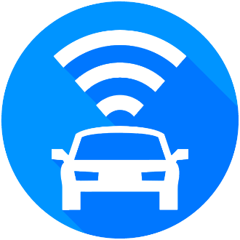
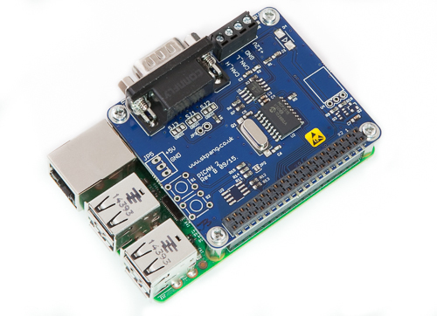
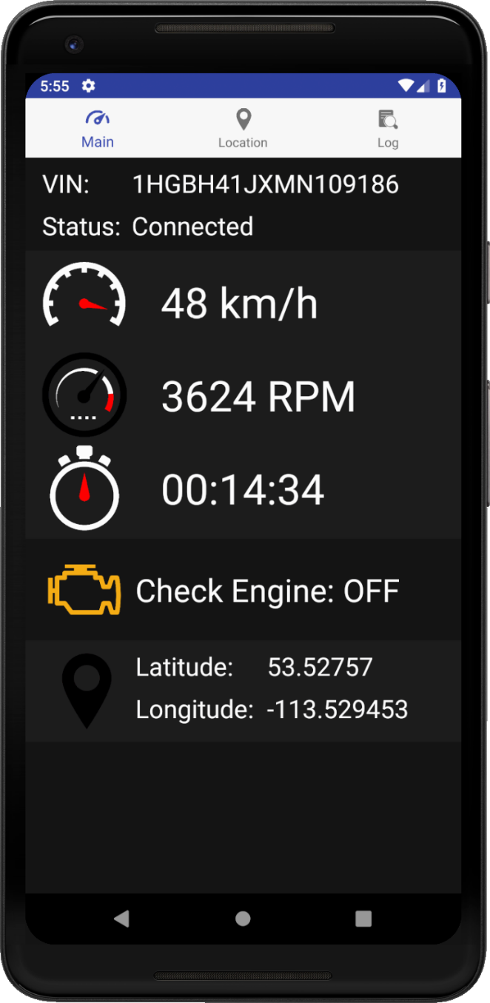
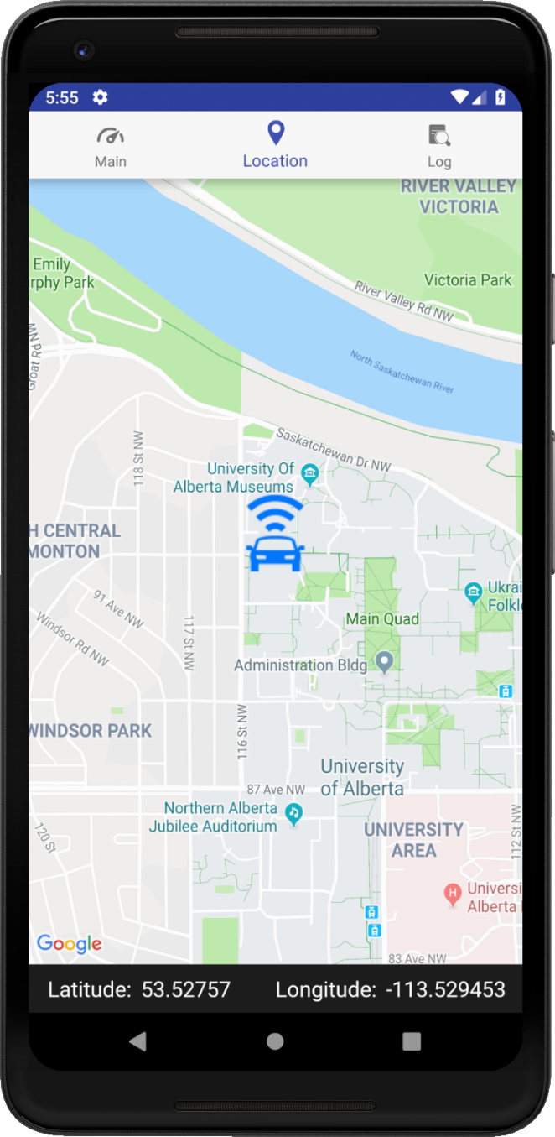
ECE 492 Capstone Design Project
Smart Automatic Vehicle Locator
Design Group Members | Client | Technical Advisor | Year
Nicholas Hoskins, Riley Dixon, Adrian Schuldhaus | Latium Fleet Management | Dr. Edmond Lou | 2018-19
Project Objective
For a company which manages a large fleet of vehicles, tracking each vehicle and the maintenance of each vehicle is a challenge. The Smart Automatic Vehicle Locator (SmartAVL) is a system that begins to solve this challenge. Some qualities that can be read from the vehicle and reported back to the user include:
RPM
Current Speed
Is the Check Engine Indicator on?
These results are then forwarded to an Android app in a user friendly format.
Android App Overview
The Android App has three main activities to present to the user.
The first activity is an overview of the vehicle and selected data to display to the user. The data shown can be modified by changing what the Raspberry Pi looks for from the CAN messaging service.
Secondly, there is a map activity that allows the user to see where the vehicle is in real-time. This data is pulled from the Adafruit GPS that is connected to the Raspberry Pi which is refreshed every second.
Lastly, there is an activity to see a log of data sent to the Android App.
Pi in enclosure goes here
Exposed Pi goes here with individual components shown
Raspberry Pi Overview
The core of SmartAVL is a Raspberry Pi that is connected to the OBD2 port of a vehicle and reads CAN messages from the vehicle’s ECU. The Raspberry Pi was selected for its flexibility for adding hardware components, the ability to run Linux based operating system on it, as well as its wide support for both hardware and software from the Raspberry Pi community. <Need photo of Pi in enclosure and out of enclosure. GPS can come later before print. Include arrows to point out various hardware components.> <Below image is a placeholder.>
Expansion Goals
Add a cellular transceiver to the Pi to facilitate communication over an LTE network, instead of Bluetooth.
Create a web server where data is sent to on the cloud. The Android app would then pull data from the cloud instead of the Raspberry Pi directly.
Our workflow, in final project describe the step here on how the Pi gets data
Insert a GPS graphic here for final poster
Acknowledgements
Our group would like to thank our Latium Fleet Management for sponsoring this project. Additionally, we would like to thank Dr. Edmond Lou, Raza Bhatti, Keith Mills, Raju Macgupalli, and Rick McGregor for their support and technical expertise lent to us throughout the development of the project.
Our workflow, in final project describe the step here on how th pi sends the app data
References
Please scan the QR code to view the GitHub repo our project is hosted on: github.com/aschuldhaus/SmartAVL
Left: An overview of the vehicle’s current status.
Right: The vehicle’s current location.
Department of Electrical & Computer Engineering
Notes:
For colour ideas, University Visual Identity Guidelines can be found here: http://www.toolkit.ualberta.ca/VisualIdentityGuidelines.aspx
1

