Slide 1
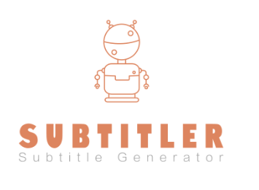




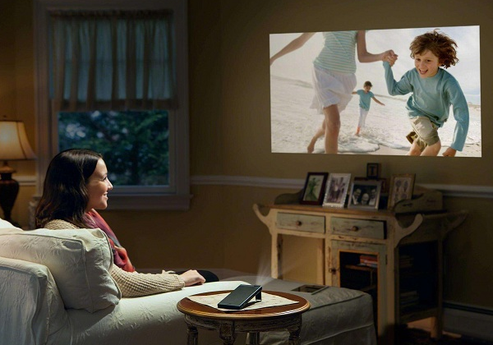






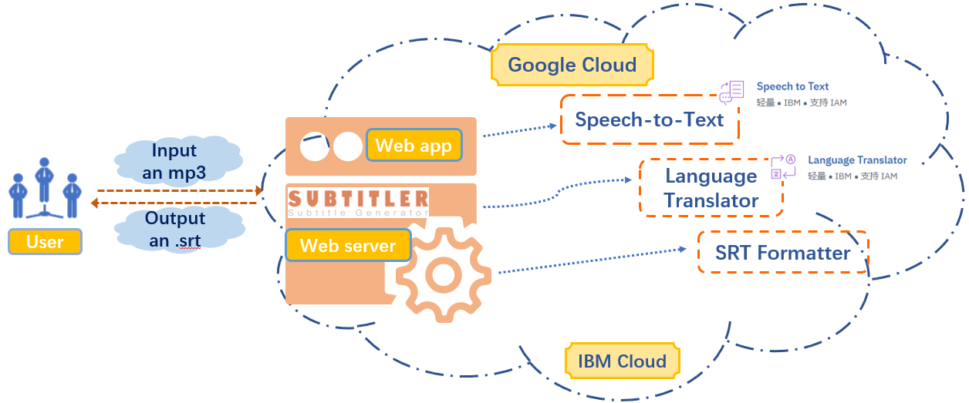

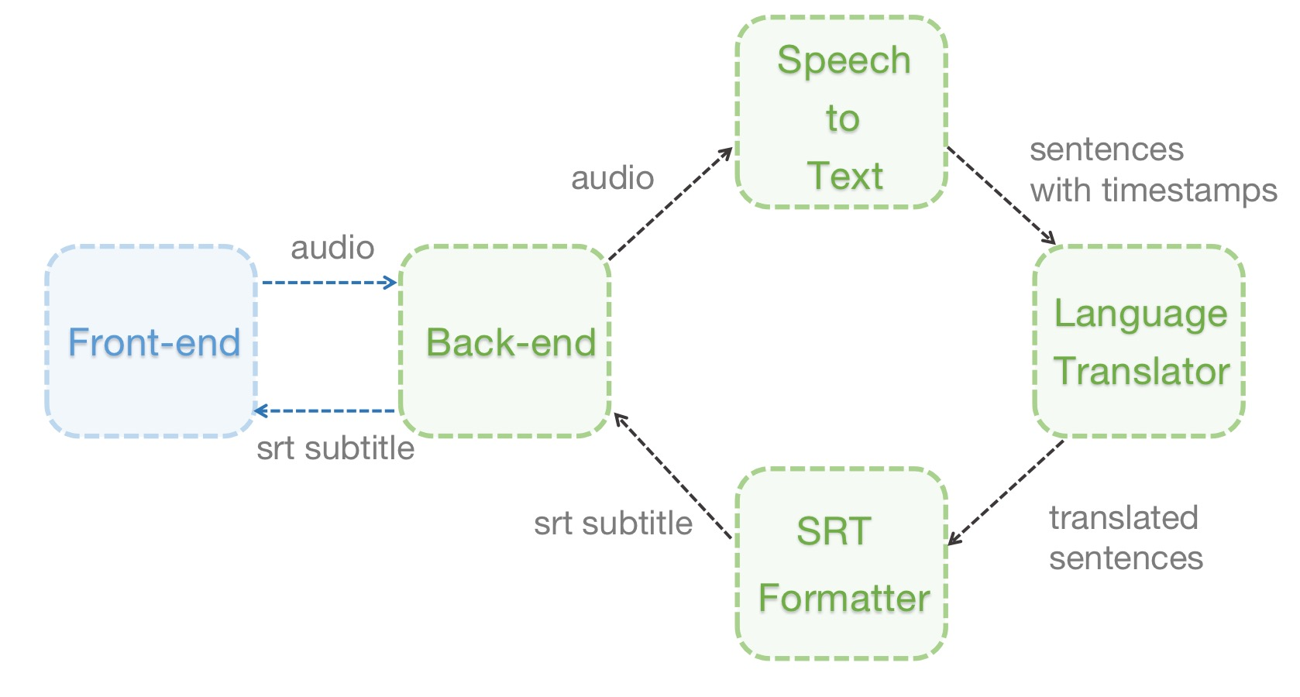
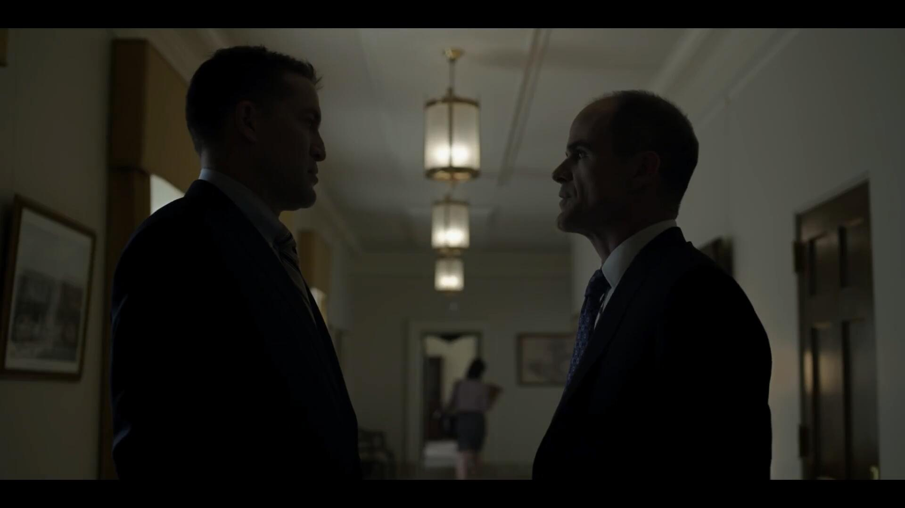
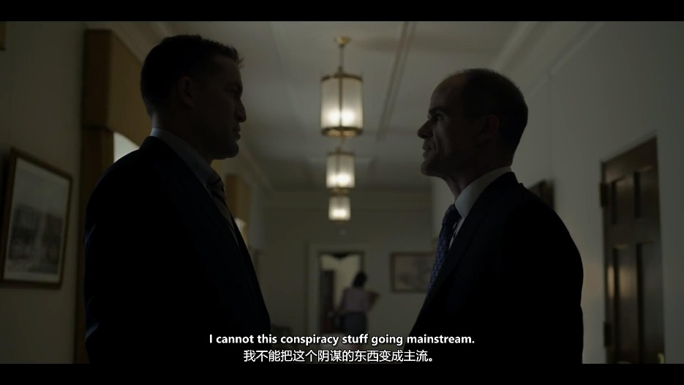


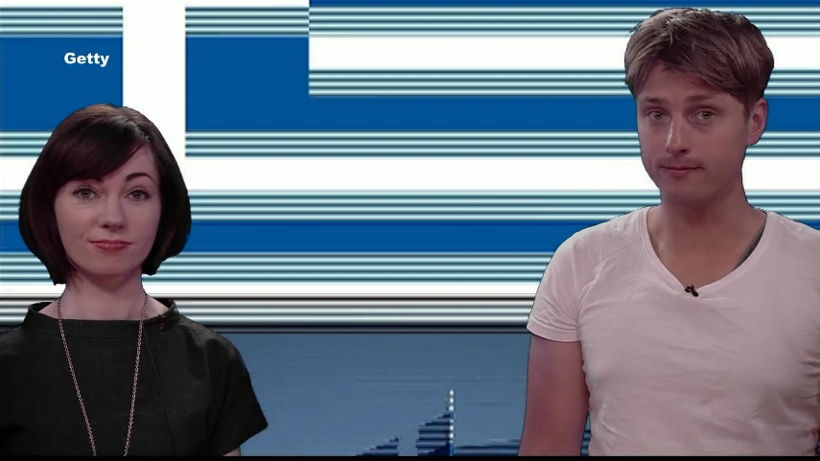
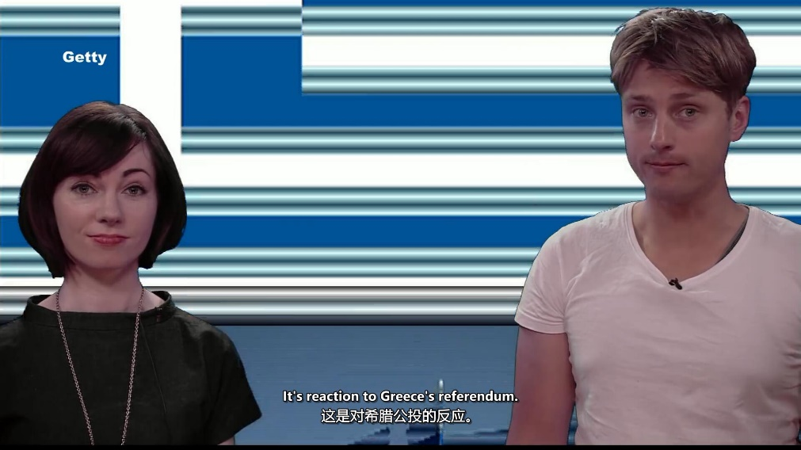






Subtitler
SWS3004 Team CLUSTER2 No.
Intelligent Subtitle Generation
WEN RUILIN
LU SHENYUAN
TANG LIJUAN
BAI WENQI
Motivation
Objective
Foreign Movies, Documentaries or TV Series Usually Do Not Contain Subtitles By Default.
Automatic Subtitle Generation for Movies without Subtitle.
Difficult for People Living in Non-English Environment to Understand.
Utilize IBM Cloud API to Separate Words Into Sentences.
Make Life Easier!
Automatically Generate the Translation for the Subtitle.
As long as you want to watch it, Subtitler can do it.
Approach
Implementation
Architecture
Example one: Movie
Upload
Original MP3
Speech Recognition
Subtitle generation
Translation
Example two: News
Upload
Whether it’s a documentary, real-time news or Hollywood blockbuster, we can provide users with the most rigorous and reliable subtitles based on speech recognition. While providing reliable subtitles, we can provide appropriate language based on the user’s language selection.
Original MP3
Intelligent
Speech Recognition
Subtitle generation
Generate Subtitles with JUST ONE CLICK, users do not need to master cumbersome operations
Translation
Convenient
Conclusions
Limitations
Lessons
The time to return subtitles will increase due to the length of incoming MP3.
There are some deviations in the translation accuracy of professional vocabulary.
1.Cloud Foundry
2.Web Application
3.Use Bluemix as Pass Platform to build Web App

