Slide 1


Presented by: Rima Dutta
Predictive Modeling for Loan Default Risk in a Financial Institutions

Slide 2

PROBLEM STATEMENT
Loan defaults lead to financial losses and operational inefficiencies.
Traditional credit assessments lack accuracy due to subjective evaluations.
Objective:
Develop a machine learning model to predict applicants as "Default" or "Non-Default."
Identify key predictors (e.g., credit history, income).
Optimize risk assessment processes for lenders.

Slide 3
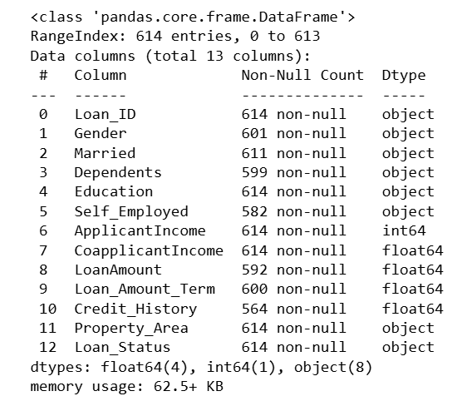
DATA DESCRIPTION
Dataset: Loan Prediction Problem Dataset
(Source: Kaggle)
Size: 614 rows, 13 columns.
Target Variable: Loan_Status (Binary: Y/N).
Key Variables:
Categorical: Gender, Married, Property_Area, Education, Self_Employed, Loan_Status.
Numerical: ApplicantIncome, LoanAmount,Credit_History, Loan_Amount_Term.
Missing Values: Present in Gender, Married, Dependents, LoanAmount, Loan_Amount_Term, Credit_History.

Slide 4
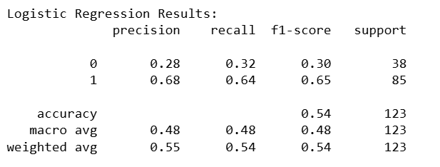
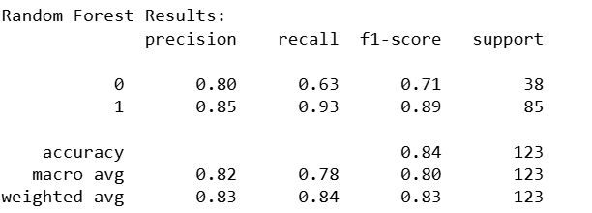
Methodology used in the analysis
Feature Engineering:Created TotalIncome (ApplicantIncome + CoapplicantIncome).
Approach: Binary classification using:
Logistic Regression
Random Forest (Ensemble method for improved accuracy).
Model Selection:
Random Forest outperformed Logistic Regression (Higher accuracy and robustness).

Slide 5
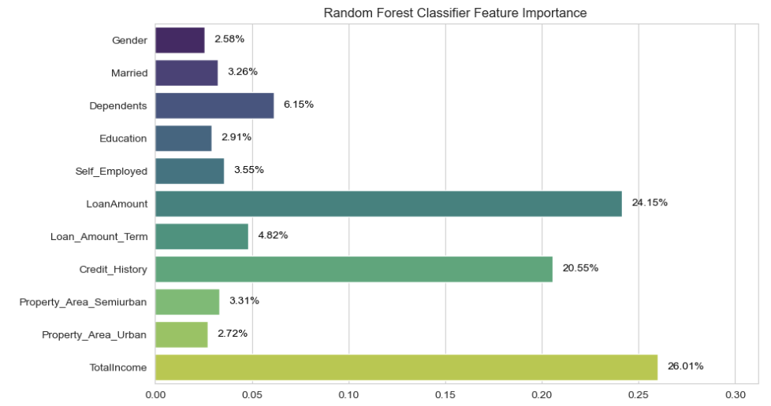
OUTCOME -Top Predictors
Model Performance: Random Forest achieved higher accuracy .
Dominant Predictors:
TotalIncome (26.01%): The most influential factor, indicating that household income (applicant + co-applicant) is the strongest driver of loan approval decisions.
LoanAmount (24.15%): Large loan amounts are strongly associated with higher risk.
Credit_History (20.55%): Creditworthiness remains pivotal, though slightly less influential than income and loan size.
Negligible Features:
Demographics: Gender (2.58%), Married (3.26%), Education (2.91%), and Self_Employed (3.55%) have minimal impact.

Slide 6
BUSINESS IMPLICATION
01. Prioritize Total Household Income
03. Strengthen Credit History Checks
Action : Promote joint applications to enhance TotalIncome visibility and simplify income verification via digital tools like bank APIs and tax records.
Action : Lowers default rates by filtering out high-risk borrowers.
Impact : Automate real-time credit score validation via APIs and reject applicants with poor credit history (Credit_History=0) or offer secured loan options.
Impact : Reduces defaults by focusing on applicants with stable repayment capacity.
02. Risk-Based Pricing for Large Loans
04. Simplify Application Process
Action : Impose higher interest rates or collateral for high LoanAmount requests and enforce stricter eligibility criteria, such as debt-to-income ratio checks, for loans above a threshold.
Action : Eliminate non-predictive fields like Gender, Married, and Education, focusing on key factors: TotalIncome, LoanAmount, and Credit_History.
Impact : Mitigates risk for large loans while maintaining profitability.
Impact : Enhances decision-making efficiency by prioritizing essential financial factors over non-predictive attributes.
Impact : Minimize defaults, streamline approvals, and enhance stakeholder trust.

Slide 7

Thank you very much!

