Slide 1

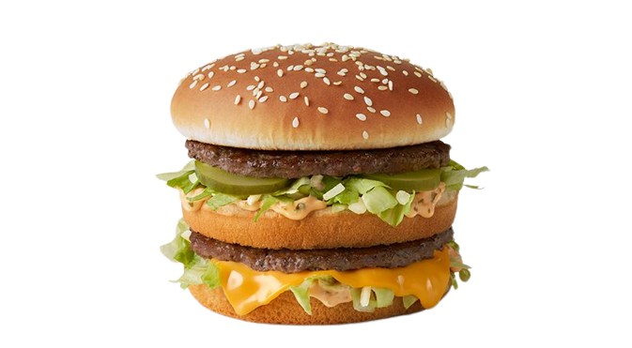
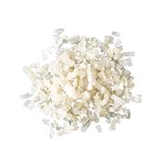
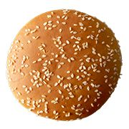
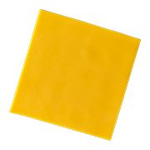
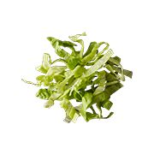
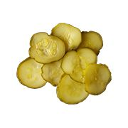
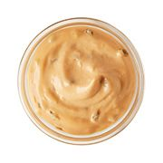
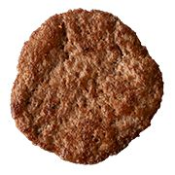
Big Mac®

Slide 2
Big Mac Sauce
Big Mac
Bun
Pasteurized Process
American Cheese
Shredded
Lettuce
100% Beef Patty
Pickle Slices
Onions
Big Mac®

Slide 3

Big Mac®
590 Cal.
Ever wondered what's on a Big Mac®?
The McDonald's Big Mac® is a 100% beef burger with a taste like no other. The mouthwatering perfection starts with two 100% pure all beef patties and Big Mac® sauce sandwiched between a sesame seed bun.
It’s topped off with pickles, crisp shredded lettuce, finely chopped onion, and a slice of American cheese. It contains no artificial flavors, preservatives, or added colors from artificial sources. Our pickle contains an artificial preservative, so skip it if you like.

