Slide 1



Circular Linked List Session No.: Course Name: Advanced Data Structures and Algorithms Course Code: R1UC531B Instructor Name: Duration: 50 mins Date of Conduction of Class:

Slide 2



[1-mins]
What is the Difference between an array and a Linked List?

Slide 3
Learning Outcomes
[2-mins]
By the end of this session, You will be able to:
Define a Circular Linked List
Wrtie a program to implement a CLL

Slide 4
Session Outline
Types of List
Limitations of Singly Linked List
Need of a Circular Linked List

Slide 5

Activity (Think – Pair – Share)
[1-mins]
Given a singly linked list. Think of the algo to insert an element at the end of linked list.
Think – pair and share with groups.

Slide 6
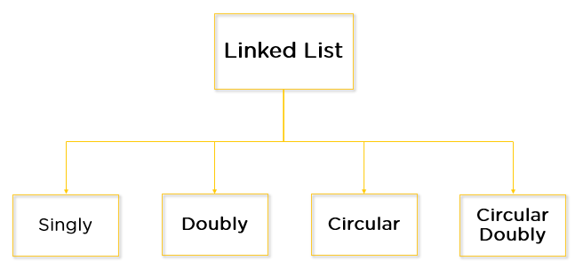
Types

Slide 7
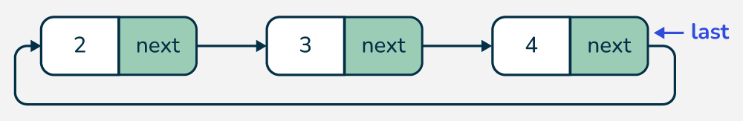
Creating a Circular Linked List
Note:
A LastPointer is maintained at the last node.
There is no head pointer
The last node points to the first node

Slide 8
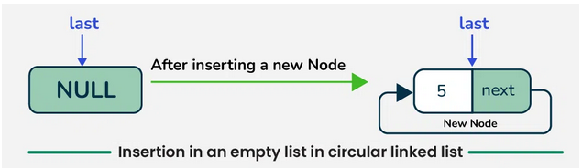
Insertion in a CLL
If there is no node, create a new node and assign last to the new node
if (last == null) {
// Create a new node and make it point to itself
Node newNode = new Node(data);
last = newNode;
last.next = last;
return last;
}

Slide 9
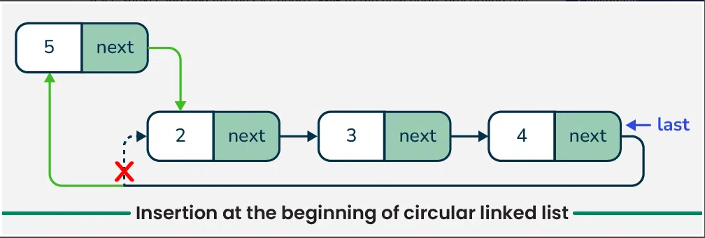
Insert at Beginning
Create a new node and point the last node to the first node.

Slide 10
Insert at Begin – Function
Void insertAtBegin( int data){
Node newNode = new Node(data);
Node curr = last.next;
newNode.next = curr;
last.next = newNode;
return last;
}

Slide 11
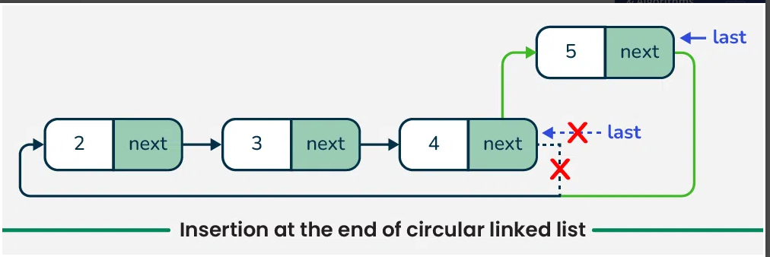
Insert at End
Update Tails next pointer to new node
set the tail to the new node,

Slide 12
Deletion in a CLL
Deletion at Begin
Deletion at End
Deletion in middle

Slide 13
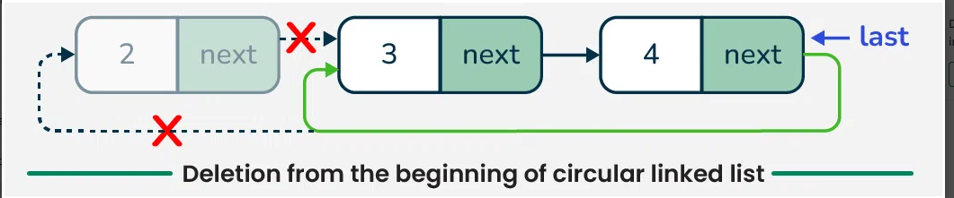
Deletion at Beginning
Check if the list is empty or has only one node. If so, we handle those cases by deleting the node and updating the last pointer.

Slide 14
Deletion at Beginning
We update the last node’s next pointer to skip the head and free the head node, returning the updated last pointer.

Slide 15
Delete at Begin
public static Node deleteFirstNode(Node last) {
Node head = last.next;
if (head == last) {
// If there is only one node in the list
last = null;
} else {
// More than one node in the list
last.next = head.next;
}
return last;
}

Slide 16
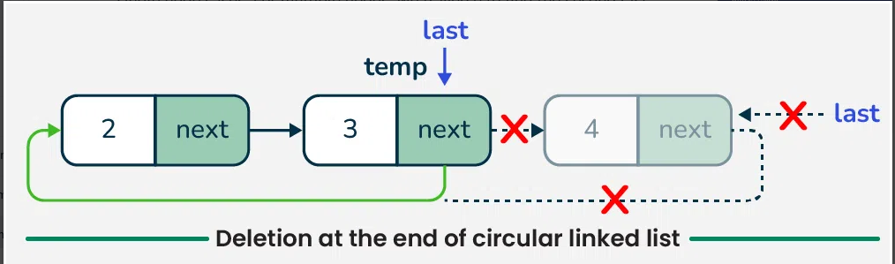
Deletion at End
Traverse to find the second last node, update its next pointer to the head, delete the last node, and return the updated last pointer.

Slide 17
Activity 2 (Pen Paper): Coding Problem
Problem: Find the Maximum and minimum Element in an Array
Task:
Write a program to find the maximum and minimum element in an array of size n.
Questions for Analysis:
1. Time Complexity:
• What is the time complexity of your algorithm in terms of n?
• Can you explain why?
2. Space Complexity:
• What is the space complexity of your algorithm?
• Does your algorithm use any additional memory apart from the input
array?

Slide 18
Delete at End – Function
public static Node deleteLastNode(Node last){
Node head = last.next;
// If there is only one node in the list
if (head == last) {
last = null;
return last;
}
// Traverse the list to find the second last node
Node curr = head;
while (curr.next != last) {
curr = curr.next;
}
// Update the second last node's
next pointer to point to head
curr.next = head;
last = curr;
return last;
}

Slide 19
Summary
Applications of Circular Linked Lists
It is used for time-sharing among different users, typically through a Round-Robin scheduling mechanism.
In multiplayer games, a circular linked list can be used to switch between players. After the last player's turn, the list cycles back to the first player.
Circular linked lists are often used in buffering applications, such as streaming data, where data is continuously produced and consumed.
In media players, circular linked lists can manage playlists, this allowing users to loop through songs continuously.
Browsers use circular linked lists to manage the cache. This allows you to navigate back through your browsing history efficiently by pressing the BACK button.

Slide 20
Discussion on the post session activities
Write and implement the insertion and deletion operation of CLLs

Slide 21
Next Session:
Operations on Linked List – Insertion , Deletion, Traversal

