Slide 1



Hanoi towers. Trade-offs between iteration and recursion. Session No.: 11 Course Name: Data Structures Course Code: R1UC308B Instructor Name: Akhilesh Tripathi Duration: 50 mins Date of Conduction of Class:

Slide 2

Review
Pre-Requisite :
Students must have knowledge Recursion and Iteration in C/C++ programming language.

Slide 3

Pre-Class Assessment
[2-mins]

Slide 4

[1-mins]
Suppose you have three rods and three disks of different sizes stacked on one rod. You must move all the disks to another rod, moving only one disk at a time, and never placing a larger disk on top of a smaller one. How many moves do you think it will take?”

Slide 5
Learning Outcomes
[2-mins]
By the end of this session, You will be able to:
understand the recursive nature of the Tower of Hanoi problem, implement its solution in C using recursion
Analyze and compare the trade-offs between iteration and recursion in problem solving."

Slide 6
Session Outline
Tower of Hanoi problem
Trade-off Between Iteration and Recursion
hands-on activities and reinforce learning through an interactive WooClap and WooFlash tools.

Slide 7

Activity-1 (Think – Pair – Share)
[1-mins]
What is Tower of Hanoi?
What is Recursive solution of TOH?

Slide 8
Concept and Definition for (LO-1)
Tower of Hanoi problem
The Problem Statement
You are given:
Three rods (pegs): usually named Source (A), Auxiliary (B), and Destination (C).
n disks of different sizes, stacked on the source rod in decreasing size (largest at the bottom, smallest at the top).
Objective: Move all the disks from the source rod (A) to the destination rod (C) following these rules:
Only one disk can be moved at a time.
A disk can only be moved if it is the top disk on a rod.
No larger disk can be placed on top of a smaller disk.

Slide 9
Concept and Definition for (LO-1) 3 Disk Simulation
Example: Tower of Hanoi with 3 disks
We want to move all 3 disks from Source → Destination, using Auxiliary.
Steps:
Move disk 1 from Source → Destination
Move disk 2 from Source → Auxiliary
Move disk 1 from Destination → Auxiliary
Move disk 3 from Source → Destination
Move disk 1 from Auxiliary → Source
Move disk 2 from Auxiliary → Destination
Move disk 1 from Source → Destination

Slide 10
Recursive Idea (with Source, Destination, Auxiliary)
To move n disks from Source → Destination using Auxiliary:
Move the top n-1 disks from Source → Auxiliary (using Destination as helper).
Move the remaining largest disk (nth) from Source → Destination.
Move the n-1 disks from Auxiliary → Destination (using Source as helper).

Slide 11
Concept and Definition for (LO-1) Recursive Algorithm
If n > 0 then: a. Recursive Call: Move top n-1 disks from Source → Auxiliary, using Destination as helper. b. Move: Print "Move disk n from Source → Destination". c. Recursive Call: Move top n-1 disks from Auxiliary → Destination, using Source as helper.
If n == 0, do nothing (base case).

Slide 12
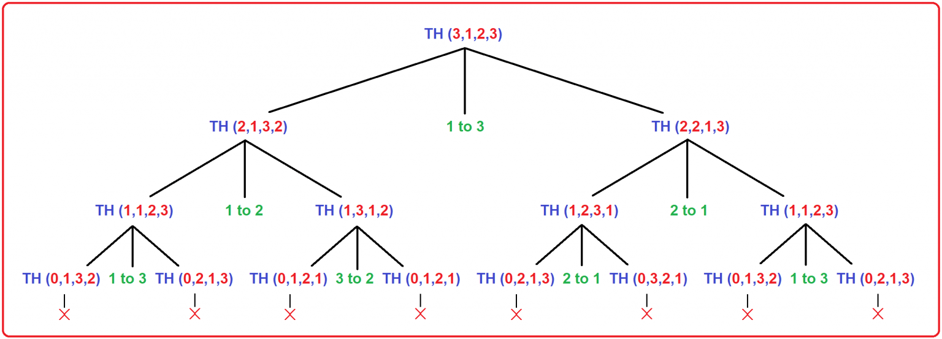
Call trace for 3 Disk:
[5-mins]

Slide 13
C Implementation
#include <stdio.h>
// Recursive function for Tower of Hanoi
void TOH(int n, char Source, char Auxiliary, char Destination) {
if (n > 0) {
// Step 1: Move n-1 disks from Source → Auxiliary
TOH(n - 1, Source, Destination, Auxiliary);
// Step 2: Move the nth (largest) disk from Source → Destination
printf("Move disk %d from %c to %c\n", n, Source, Destination);
// Step 3: Move n-1 disks from Auxiliary → Destination
TOH(n - 1, Auxiliary, Source, Destination);
}
// Base case (n == 0): do nothing
}
[5-mins]
int main() {
int n;
printf("Enter number of disks: ");
scanf("%d", &n);
printf("\nThe sequence of moves in Tower of Hanoi are:\n\n");
TOH(n, 'S', 'A', 'D'); // S = Source, A = Auxiliary, D = Destination
printf("\nTotal moves required = %d\n", (1 << n) - 1); // 2^n - 1
return 0;
}

Slide 14
Time & Space Complexity
For n disks, the recursive solution works as follows:
To move n disks:
Move n-1 disks → recursive call
Move the largest disk → 1 step
Move n-1 disks again → recursive call
This gives the recurrence:
T(n)=2T(n−1)+1T(n)
Solve the recurrence:
T(1)=1
T(2)=2T(1)+1=3
T(3)=2T(2)+1=7
In general:
T(n)=2n−1T(n) = 2^n - 1T(n)=2n−1
So, Time Complexity = O(2^n) (exponential).
Space Complexity
Each recursive call is stored on the function call stack.
Maximum depth of recursion = n (since we reduce disks one by one until 0).
Space Complexity=O(n)

Slide 15
Concept and Definition for (LO-2) Trade-off Between Iteration and Recursion
Memory Usage
Recursion: Uses the call stack to remember previous states. Each recursive call consumes stack memory (function parameters, return address, local variables).Risk: For large input, recursion can cause stack overflow.
Iteration: Uses loops and explicit data structures (like arrays, stacks, or queues if needed). Memory use is predictable and usually smaller.
2. Ease of Understanding
Recursion: Very natural for problems that are inherently recursive (Tower of Hanoi, factorial, Fibonacci, tree traversals). Code is usually shorter and closer to the mathematical definition.
Iteration: Sometimes less intuitive for recursive problems. Code may become longer and harder to follow (e.g., iterative Tower of Hanoi requires bitwise logic or stack simulation).
3. Performance
Recursion: Each recursive call has overhead (function call setup, return address storage, etc.).May be slower in practice.
Iteration: Generally faster, since it avoids repeated function calls and stack operations.

Slide 16
4. Termination & Base Case
Recursion: Requires a base case to stop; otherwise, infinite recursion leads to stack overflow.
Iteration: Requires a loop condition to stop; otherwise, an infinite loop (but does not overflow the call stack).
5. Flexibility
Recursion: Better for problems with divide-and-conquer or self-similar subproblems (e.g., Tower of Hanoi, quicksort, mergesort, binary trees).
Iteration: Better for problems with repeated, sequential steps (e.g., searching, sorting arrays, summing numbers, matrix operations).

Slide 17
Summary Table
Aspect | Recursion | Iteration
Memory | Uses call stack (risk of overflow) | Uses less memory (stack not needed)
Code simplicity | Short, elegant for self-similar problems | Longer, harder for recursive problems
Performance | Slower (function call overhead) | Faster (no function call overhead)
Debugging | Harder (stack traces can be deep) | Easier
Best for | Divide-and-conquer, recursive structures | Repetitive tasks, linear problems

Slide 18

Assessment: WooFlash Quiz

Slide 19
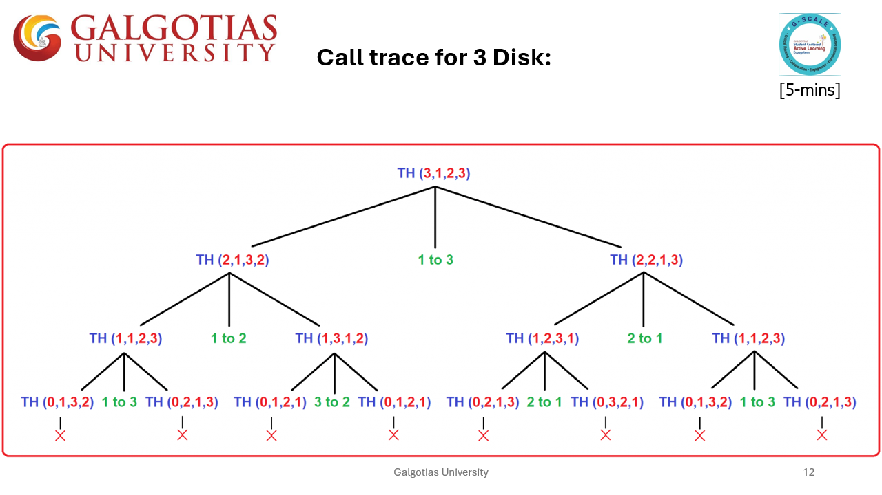
Summary
[1-mins]

Slide 20
[2-mins]
Ensure attainment of LO’s in alignment to the learning activities:
understand the recursive nature of the Tower of Hanoi problem, implement its solution in C using recursion
Analyze and compare the trade-offs between iteration and recursion in problem solving."

Slide 21
[1-min]
Next Session:
Linear search, Binary Search

Slide 22
Review and Reflection from students

