Slide 1



Linear search, Binary Search. Session No.: 12 Course Name: Data Structures Course Code: R1UC308B Instructor Name: Akhilesh Tripathi Duration: 50 mins Date of Conduction of Class:

Slide 2

Review
Pre-Requisite :
Students must have knowledge 1 D Arrays in C/C++ programming language.

Slide 3

Pre-Class Assessment
[2-mins]

Slide 4

[1-mins]
“If you are looking for your friend’s name in an unsorted attendance list of 50 students, how would you search for it?”
“If the same list is sorted alphabetically, can you think of a faster way to find your friend’s name without checking every single entry?”

Slide 5
Learning Outcomes
[2-mins]
By the end of this session, You will be able to:
implement the linear search algorithm and analyze its time and space complexity.
implement the binary search algorithm, analyze its complexity, and compare its efficiency with linear search

Slide 6
Session Outline
Linear Search
Binary search
hands-on activities and reinforce learning through an interactive WooClap and WooFlash tools.

Slide 7

Activity-1 (Think – Pair – Share)
[1-mins]
What is Linear Search?
What is Binary search?

Slide 8
Concept and Definition for (LO-1)
Linear Search (Sequential Search)
Linear Search is the simplest searching algorithm. It checks each element one by one in a list/array until the target element (key) is found or the list ends.
Algorithm
Start from the first element of the list.
Compare the current element with the key (the value we are searching for).
If they match → Element found (return index/position).
If not, move to the next element.
Repeat until:
The element is found
Or the list ends (element not present).

Slide 9
C function Linear Search (Sequential Search)
int linearSearch(int arr[], int n, int key)
{
for (int i = 0; i < n; i++) {
if (arr[i] == key) {
return i; // Return index if key is found
}
}
return -1; // Key not found
}

Slide 10
Linear Search Complexity
For each iteration, we do:
Comparison arr[i] == key
If true → return index (stop).
So, in the worst case, we perform n comparisons.
Only 1 comparison is needed in Best case
for (i = 0; i < n; i++) {
if (arr[i] == key) {
return i;
}
}
return -1;
Best Case: O(1)
Worst Case: O(n)
Average Case: O(n)
Space Complexity: O(1)

Slide 11
Binary Search
Binary Search is an efficient searching algorithm used on sorted arrays or lists. It works by repeatedly dividing the search interval in half until the element is found or the interval becomes empty.
Algorithm
Start with the low (first index) and high (last index).
Find the mid index:
mid=low+high/2​
Compare the key with arr[mid]:
If key == arr[mid] → Found.
If key < arr[mid] → Search in the left half (set high = mid - 1).
If key > arr[mid] → Search in the right half (set low = mid + 1).
Repeat steps 2–3 until:
The element is found, or
low > high (element not present).

Slide 12
Concept and Definition for (LO-1)

Slide 13
Iterative Binary Search in C
// Iterative Binary Search function
int binarySearchIterative(int arr[], int n, int key) {
int low = 0, high = n - 1;
while (low <= high) {
int mid = (low + high) / 2;
if (arr[mid] == key)
return mid; // Key found
else if (key < arr[mid])
high = mid - 1; // Search in left half
else
low = mid + 1; // Search in right half
}
return -1; // Key not found
}

Slide 14
Concept and Definition for (LO-1) Recursive Binary Search in C
/ Recursive Binary Search function
int binarySearchRecursive(int arr[], int low, int high, int key) {
if (low > high)
return -1; // Key not found
int mid = (low + high) / 2;
if (arr[mid] == key)
return mid;
else if (key < arr[mid])
return binarySearchRecursive(arr, low, mid - 1, key);
else
return binarySearchRecursive(arr, mid + 1, high, key);
}

Slide 15
Time and space complexity of Binary Search
[5-mins]
Each step cuts the array size in half.
T(n)=T(n/2)+1 (where +1 is for the comparison with the middle element).
Solve the Recurrence
Expand it step by step:
T(n)=T(n/2​)+1
=T(n/4)+1+1
=T(n/8)+1+1+1 until the array size becomes 1.
That happens after kkk steps where:
n/2^{k}=1⇒k=log_{⁡2}n
T(n) = log_{⁡2}n + 1

Slide 16
Time Complexity
Best Case:
If the middle element is the key → only 1 comparison.
O(1)
Worst Case:
Keep dividing until one element is left → log⁡₂n comparisons.
O(log⁡₂n)
Average Case:
Also about log⁡₂n steps (since each search discards half).
O(log⁡₂n)
Space Complexity
Iterative Binary Search: Uses only a few variables →
O(1)
Recursive Binary Search: Each recursive call adds to call stack. Depth of recursion = log⁡₂n
O(log⁡ n)

Slide 17
Linear Search vs Binary Search
Feature | Linear Search | Binary Search
Input Requirement | Works on unsorted or sorted data | Works only on sorted data
Approach | Sequentially checks each element | Repeatedly divides array into halves (Divide & Conquer)
Best Case Time | O(1) (element at first position) | O(1) (element at middle)
Worst Case Time | O(n) | O(log⁡₂ n)
Average Case Time | O(n) | O(log⁡₂ n)
Space Complexity | O(1) | Iterative: O(1), Recursive: O(log⁡₂ n)
Ease of Implementation | Very simple | Slightly more complex
Use Case | Small or unsorted datasets | Large sorted datasets

Slide 18
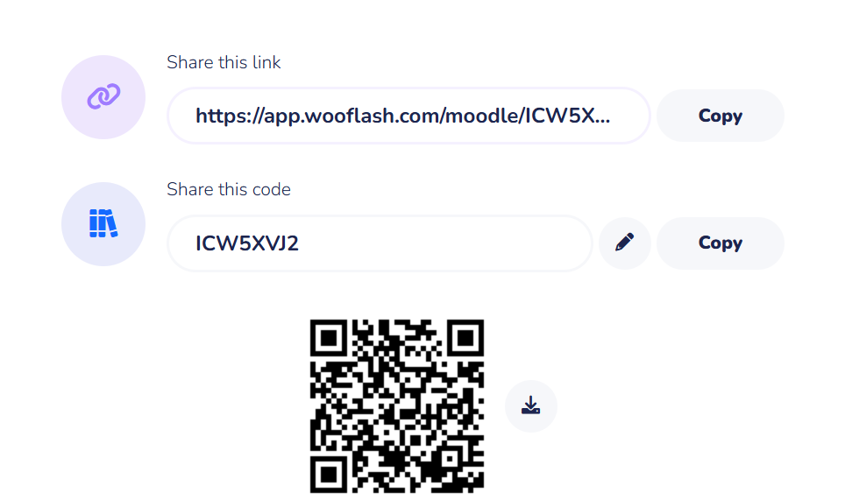
Assessment: WooFlash Quiz

Slide 19
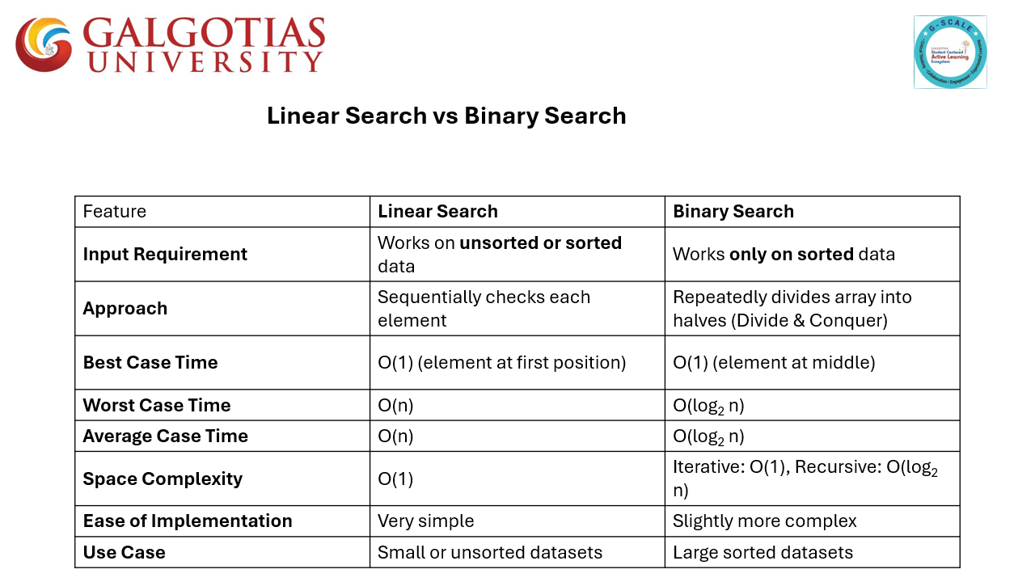
Summary
[1-mins]

Slide 20
Learning Outcomes
[2-mins]
Ensure attainment of LO’s in alignment to the learning activities:
implement the linear search algorithm and analyze its time and space complexity.
implement the binary search algorithm, analyze its complexity, and compare its efficiency with linear search

Slide 21
[1-min]
Next Session: Bubble sort

Slide 22
Review and Reflection from students

