Slide 1



Sorting : Bubble Sort Session No.: 13 Course Name: Data Strucutres Course Code: R1UC308B Instructor Name: Akhilesh Tripathi Duration: 50 mins Date of Conduction of Class:

Slide 2

Review
Review of the key concepts of last session
Linear Search is simple and works on both sorted and unsorted data, but it is inefficient for large datasets due to its O(n) time complexity.
Binary Search is much faster with O(log n) complexity, but it requires the data to be sorted before searching.
One should be able to decide which search algorithm to use depending on the dataset and requirements.

Slide 3

Pre-Class Assessment
[2-mins]

Slide 4
Learning Outcomes
[2-mins]
By the end of this session, You will be able to:
Explain the concept and working of Bubble Sort with the help of examples and dry run.
Analyze the Bubble Sort algorithm, including its time and space complexity.

Slide 5
Session Outline
Introduction to Sorting and its importance in data structures.
Concept and working principle of Bubble Sort with dry run example.
Algorithm and pseudocode.
Time and space complexity analysis of Bubble Sort.
Advantages, limitations, and comparison with other sorting techniques.

Slide 6
Different Sorting Algorithms
Bubble Sort
Selection Sort
Insertion Sort
Merge Sort
Quicksort
Counting Sort
Radix Sort
Bucket Sort
Heap Sort
Shell Sort

Slide 7


Activity-1 (Think – Pair – Share)
[1-mins]
What is the need of Sorting?
Need of Sorting

Slide 8
Concept and Definition for (LO-1)
What is Bubble Sort?
Bubble Sort is a simple comparison-based sorting algorithm.
It repeatedly compares adjacent elements and swaps them if they are in the wrong order.
After each pass, the largest element “bubbles up” to its correct position at the end of the array.
This process continues until the list is completely sorted.

Slide 9
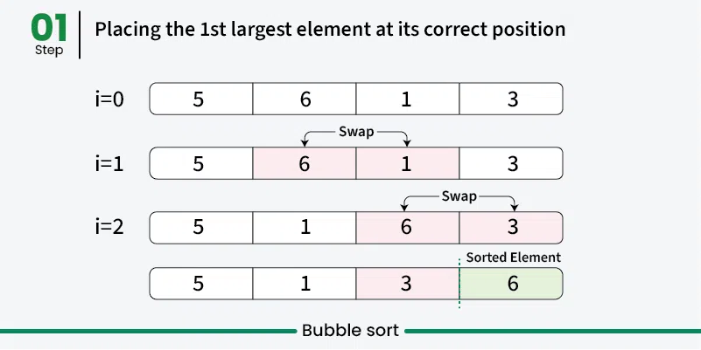
Concept and Definition for (LO-1)

Slide 10
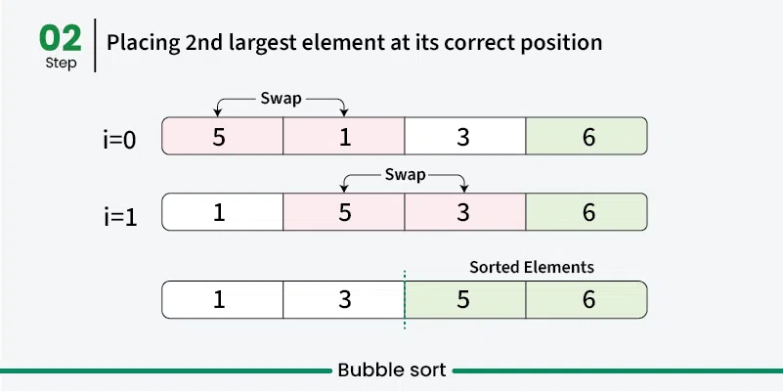
Concept and Definition for (LO-1)

Slide 11
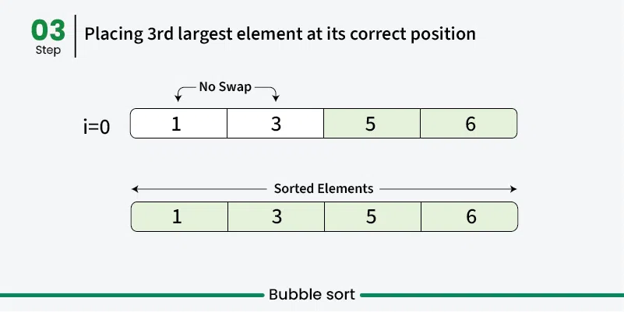
Concept and Definition for (LO-1)

Slide 12
Concept and Definition for (LO-1)

Slide 13
Concept and Definition for (LO-1) Bubble Sort Algorithm
We assume list is an array of n elements. We further assume that swap function swaps the values of the given array elements.
Step 1 − Check if the first element in the input array is greater than the next element in the array.
Step 2 − If it is greater, swap the two elements; otherwise move the pointer forward in the array.
Step 3 − Repeat Step 2 until we reach the end of the array.
Step 4 − Check if the elements are sorted; if not, repeat the same process (Step 1 to Step 3) from the last element of the array to the first.
Step 5 − The final output achieved is the sorted array.

Slide 14
Concept and Definition for (LO-1) Bubble Sort Psuedocode
procedure bubbleSort(arr, n)
for i ← 0 to n-1 do
swapped ← false
for j ← 0 to n-i-2 do
if arr[j] > arr[j+1] then
swap(arr[j], arr[j+1])
swapped ← true
end for
if swapped = false then
break // array is already sorted
end for
end procedure

Slide 15
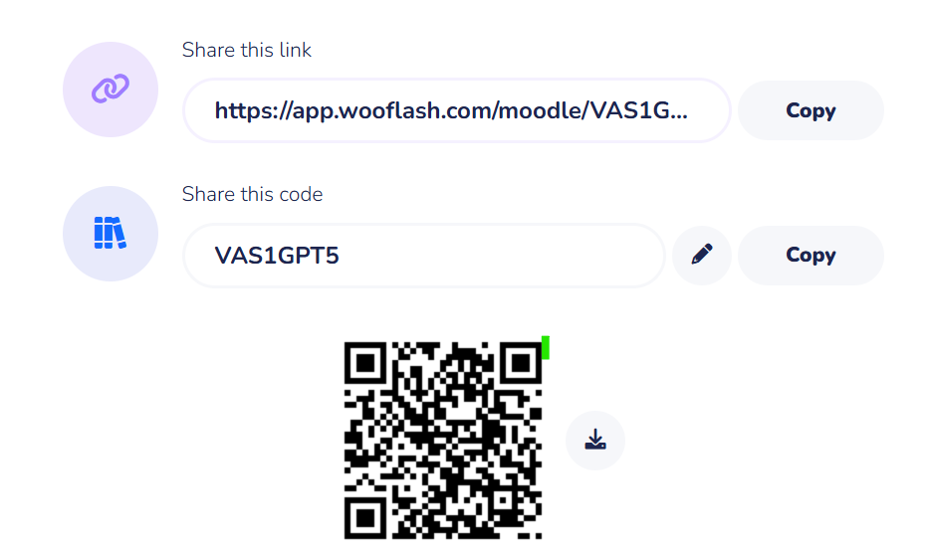
Concept and Definition for (LO-1) Activity -2

Slide 16
Concept and Definition for (LO-1) Classification / Types of Data Structures
Complexity Analysis of Bubble Sort
Best Case (Already Sorted Array):
Only one pass is needed, and no swaps occur.
Time Complexity: O(n)
Reason: We still check all elements once.
Worst Case (Reverse Sorted Array):
Every comparison requires a swap.
Number of comparisons ≈ n(n-1)/2
Time Complexity: O(n²)
Average Case (Random Order):
On average, about half the comparisons will require swaps.
Time Complexity: O(n²)
Space Complexity:
Only a temporary variable is used for swapping.
O(1) auxiliary space (in-place sorting).

Slide 17
Advantages of Bubble Sort:
Bubble sort is easy to understand and implement.
It does not require any additional memory space.
It is a stable sorting algorithm, meaning that elements with the same key value maintain their relative order in the sorted output.
[5-mins]

Slide 18
Disadvantages of Bubble Sort:
Bubble sort has a time complexity of O(n²) which makes it very slow for large data sets.
Bubble sort has almost no or limited real world applications. It is mostly used in academics to teach different ways of sorting.
[5-mins]

Slide 19
Summary
Sorting arranges data in a specific order (ascending/descending).
Bubble Sort works by repeatedly swapping adjacent elements until the array is sorted.
After each pass, the largest element bubbles to its correct position.
Complexity:
Best Case: O(n) (already sorted)
Average/Worst Case: O(n²)
Space: O(1), Stable sorting
Simple and easy to implement, but inefficient for large datasets.
[1-mins]

Slide 20
[2-mins]
Ensure attainment of LO’s in alignment to the learning activities:

Slide 21
[1-min]
Next Session: Insertion Sort, Selection Sort

Slide 22
Review and Reflection from students

