Slide 1



Sorting : Insertion Sort, Selection Sort Session No.:14 Course Name: Data Strucutres Course Code: R1UC308B Instructor Name: Akhilesh Tripathi Duration: 50 mins Date of Conduction of Class:

Slide 2

Review
Review of the key concepts of last session
Sorting arranges data in a specific order (ascending/descending).
Bubble Sort works by repeatedly swapping adjacent elements until the array is sorted.
After each pass, the largest element bubbles to its correct position.

Slide 3

Pre-Class Assessment
[2-mins]

Slide 4
Learning Outcomes
[2-mins]
By the end of this session, You will be able to:
To explain how elements are inserted into their correct positions step by step, and to explain its algorithm, pseudocode, and efficiency analysis.
To explain how the smallest (or largest) element is repeatedly selected and placed in its correct position, and to explain its algorithm, pseudocode, and performance analysis.

Slide 5
Session Outline
Insertion Sort – Concept with playing card analogy, algorithm, pseudocode, example walkthrough, and complexity analysis
Selection Sort – Concept, algorithm, pseudocode, example walkthrough, and complexity analysis
Summary & Q/A

Slide 6
Different Sorting Algorithms
Bubble Sort
Selection Sort
Insertion Sort
Merge Sort
Quicksort
Counting Sort
Radix Sort
Bucket Sort
Heap Sort
Shell Sort

Slide 7
Concept and Definition for (LO-1)
What is Insertion Sort?
Insertion sort is a simple sorting algorithm that works by iteratively inserting each element of an unsorted list into its correct position in a sorted portion of the list. It is like sorting playing cards in your hands. You split the cards into two groups: the sorted cards and the unsorted cards. Then, you pick a card from the unsorted group and put it in the right place in the sorted group.

Slide 8
Concept and Definition for (LO-1)
Insertion Sort Algorithm
Step 1 − If it is the first element, it is already sorted. return 1;
Step 2 − Pick next element
Step 3 − Compare with all elements in the sorted sub-list
Step 4 − Shift all the elements in the sorted sub-list that is greater than the value to be sorted
Step 5 − Insert the value
Step 6 − Repeat until list is sorted

Slide 9
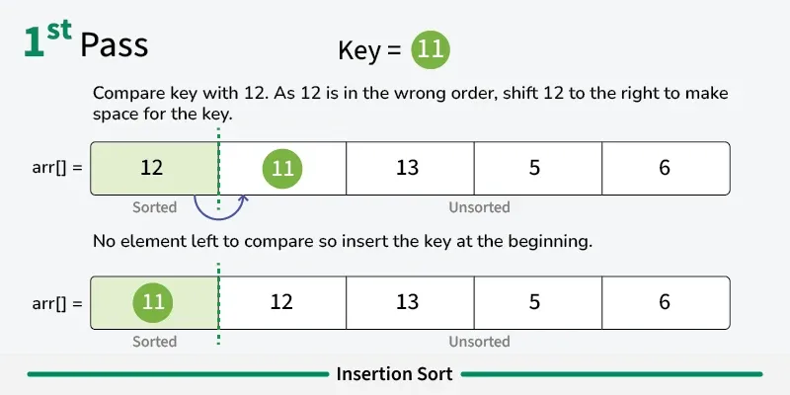
Concept and Definition for (LO-1)

Slide 10
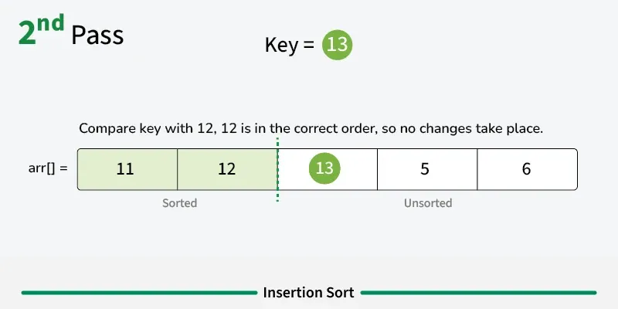
Concept and Definition for (LO-1)

Slide 11
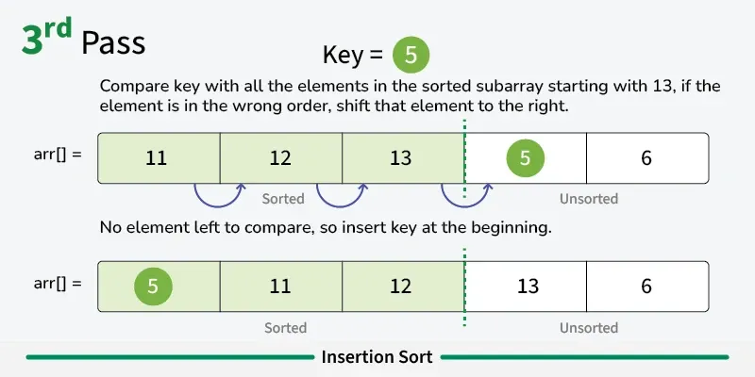
Concept and Definition for (LO-1)

Slide 12
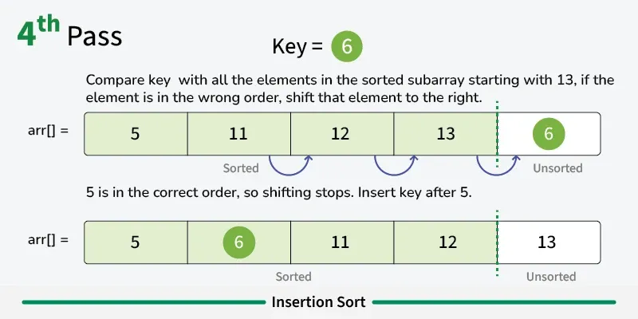
Concept and Definition for (LO-1)

Slide 13
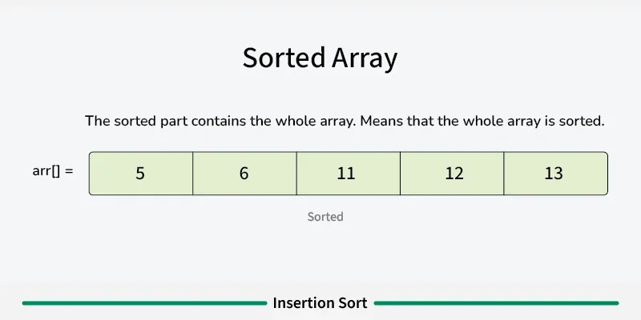
Concept and Definition for (LO-1)

Slide 14

Concept and Definition for (LO-1)
Activity 1: Think-Pair Share Activity

Slide 15
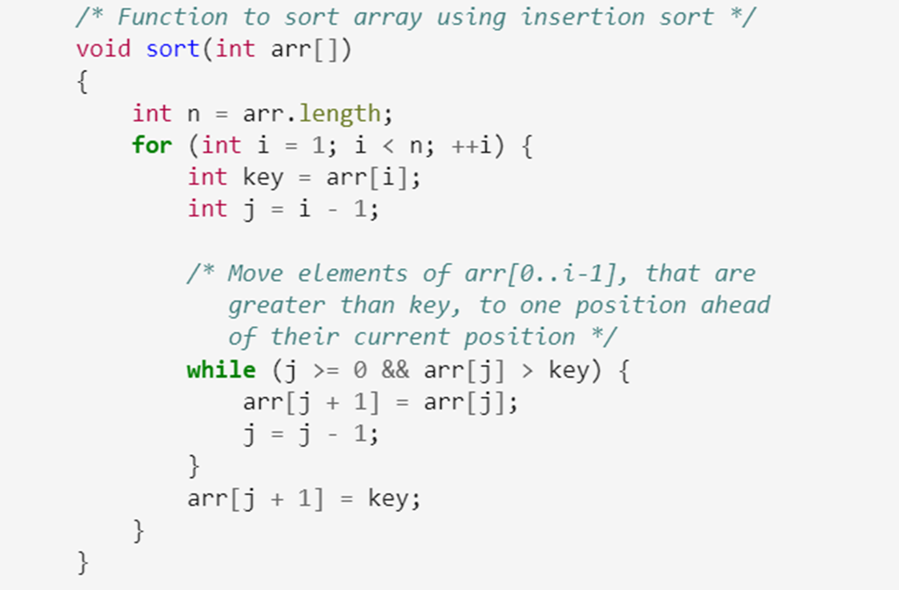
Concept and Definition for (LO-1) Insertion Sort Psuedocode

Slide 16
Concept and Definition for (LO-1) Classification / Types of Data Structures
Complexity Analysis of Insertion Sort
Time Complexity
Best case: O(n), If the list is already sorted, where n is the number of elements in the list.
Average case: O(n²), If the list is randomly ordered
Worst case: O(n²), If the list is in reverse order
Space Complexity
Auxiliary Space: O(1), Insertion sort requires O(1) additional space, making it a space-efficient sorting algorithm.

Slide 17
Concept and Definition for (LO-1) Selection Sort
Selection Sort is a comparison-based sorting algorithm. It sorts an array by repeatedly selecting the smallest (or largest) element from the unsorted portion and swapping it with the first unsorted element. This process continues until the entire array is sorted.

Slide 18
Concept and Definition for (LO-1) Selection Sort
Selection Sort is a comparison-based sorting algorithm. It sorts an array by repeatedly selecting the smallest (or largest) element from the unsorted portion and swapping it with the first unsorted element. This process continues until the entire array is sorted.
First we find the smallest element and swap it with the first element. This way we get the smallest element at its correct position.
Then we find the smallest among remaining elements (or second smallest) and swap it with the second element.
We keep doing this until we get all elements moved to correct position.

Slide 19
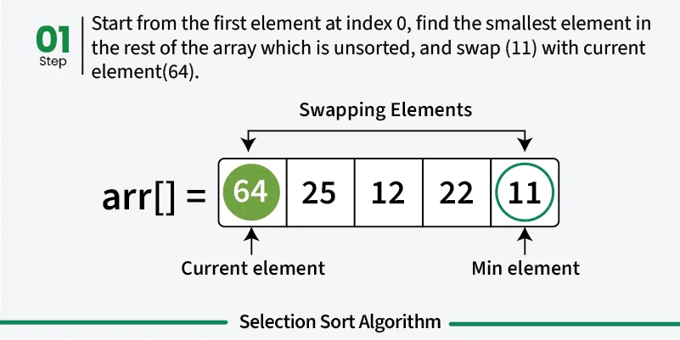
Concept and Definition for (LO-1) Selection Sort

Slide 20
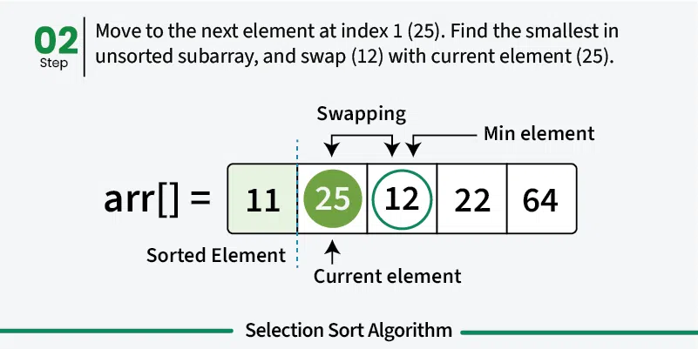
Concept and Definition for (LO-1) Selection Sort

Slide 21
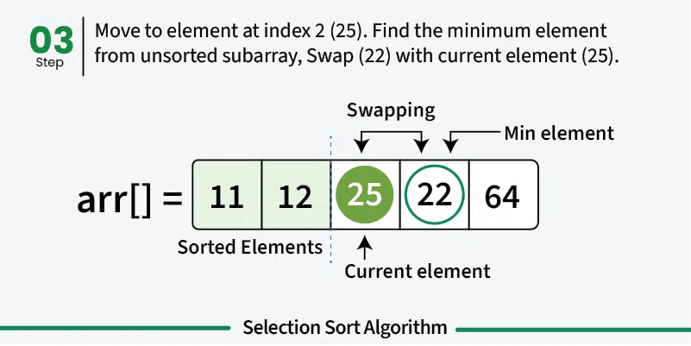
Concept and Definition for (LO-1) Selection Sort

Slide 22
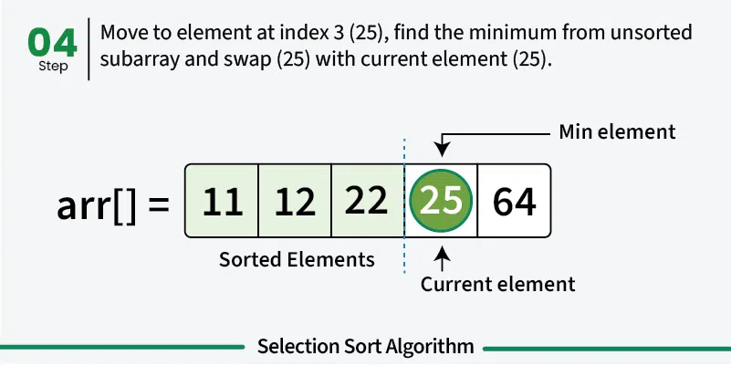
Concept and Definition for (LO-1) Selection Sort

Slide 23
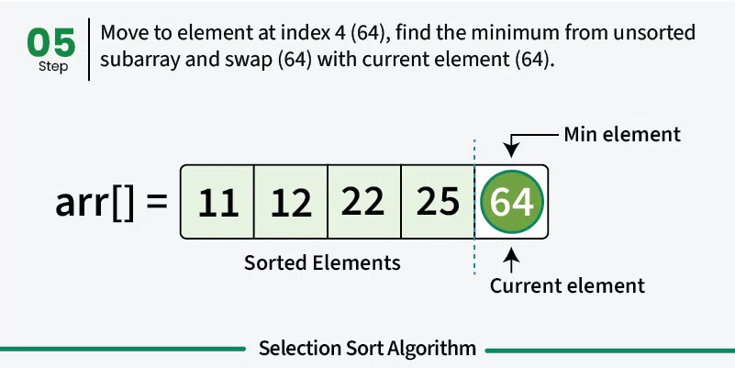
Concept and Definition for (LO-1) Selection Sort

Slide 24
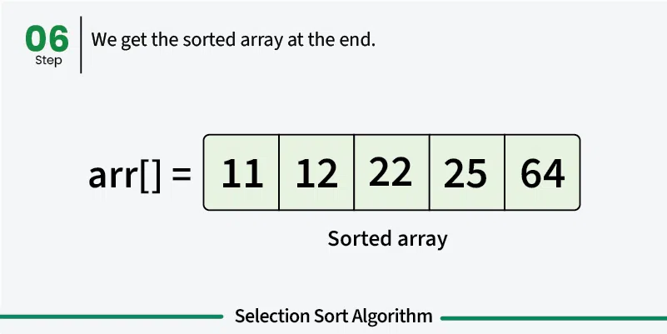
Concept and Definition for (LO-1) Selection Sort

Slide 25
Concept and Definition for (LO-1) Activity

Slide 26
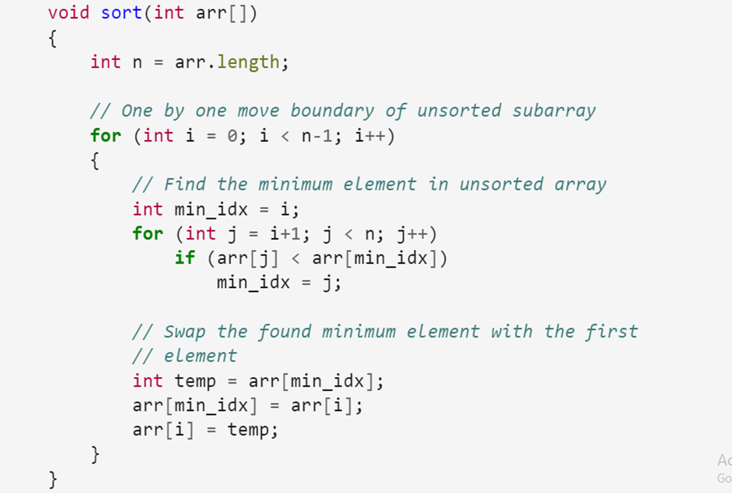
Concept and Definition for (LO-1)

Slide 27
Advantages of Selection Sort
Easy to understand and implement, making it ideal for teaching basic sorting concepts.
Requires only a constant O(1) extra memory space.
It requires less number of swaps (or memory writes) compared to many other standard algorithms.
[5-mins]

Slide 28
Disadvantages of the Selection Sort
Selection sort has a time complexity of O(n^2) makes it slower compared to algorithms like Quick Sort or Merge Sort.
Does not maintain the relative order of equal elements which means it is not stable.
[5-mins]

Slide 29
Complexity Analysis of Selection Sort
Time Complexity: O(n²) ,as there are two nested loops:
One loop to select an element of Array one by one = O(n)
Another loop to compare that element with every other Array element = O(n)
Therefore overall complexity = O(n) * O(n) = O(n*n) = O(n²)
Auxiliary Space: O(1) as the only extra memory used is for temporary variables.
[5-mins]

Slide 30
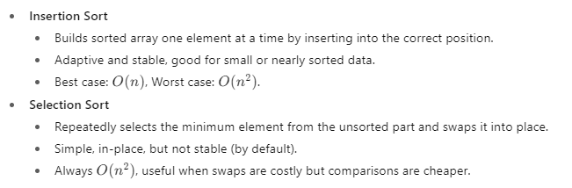
Summary
[1-mins]

Slide 31
[2-mins]
Ensure attainment of LO’s in alignment to the learning activities:
To explain how elements are inserted into their correct positions step by step, and to explain its algorithm, pseudocode, and efficiency analysis.
To explain how the smallest (or largest) element is repeatedly selected and placed in its correct position, and to explain its algorithm, pseudocode, and performance analysis.

Slide 32
[1-min]
Next Session: Quick Sort

Slide 33
Review and Reflection from students

