Slide 1



Sorting : Quick Sort Session No.:15 Course Name: Data Strucutres Course Code: R1UC308B Instructor Name: Akhilesh Tripathi Duration: 50 mins Date of Conduction of Class:

Slide 2

Review
Review of the key concepts of last session
Insertion Sort
Builds sorted array one element at a time by inserting into the correct position.
Adaptive and stable, good for small or nearly sorted data.
Best case: 𝑂(𝑛), Worst case: O(n^2).
Selection Sort
Repeatedly selects the minimum element from the unsorted part and swaps it into place.
Simple, in-place, but not stable (by default).
Always 𝑂(𝑛^2), useful when swaps are costly but comparisons are cheaper.

Slide 3

Pre-Class Assessment
[2-mins]

Slide 4
Learning Outcomes
[2-mins]
By the end of this session, You will be able to:
To explain the divide-and-conquer strategy in Quick Sort and how partitioning is used to recursively sort subarrays.
To analyze the performance of Quick Sort in terms of best, average, and worst-case complexities, and the role of pivot selection in efficiency.

Slide 5
Session Outline
Explain divide-and-conquer strategy and role of pivot.
Present Quick Sort algorithm and pseudocode.
Walk through an example step by step.
Analyze best, average, and worst-case complexities.
Quick summary.

Slide 6
Different Sorting Algorithms
Bubble Sort
Selection Sort
Insertion Sort
Quicksort
Merge Sort
Counting Sort
Radix Sort
Bucket Sort
Heap Sort
Shell Sort

Slide 7
Concept and Definition for (LO-1)
Quick Sort
It is a sorting algorithm based on the Divide and Conquer that picks an element as a pivot and partitions the given array around the picked pivot by placing the pivot in its correct position in the sorted array.

Slide 8
Concept and Definition for (LO-1)
How does QuickSort Algorithm work?
There are mainly three steps in the algorithm.
1. Choose a pivot
2. Partition the array around pivot. After partition, it is ensured that all elements are smaller than all right and we get index of the end point of smaller elements. The left and right may not be sorted individually.
3. Recursively call for the two partitioned left and right subarrays.
4. We stop recursion when there is only one element is left.

Slide 9
Concept and Definition for (LO-1)
Choice of Pivot:
There are many different choices for picking pivots.
Always pick the first (or last) element as a pivot.
Pick a random element as a pivot.
Pick the median element is pivot.

Slide 10
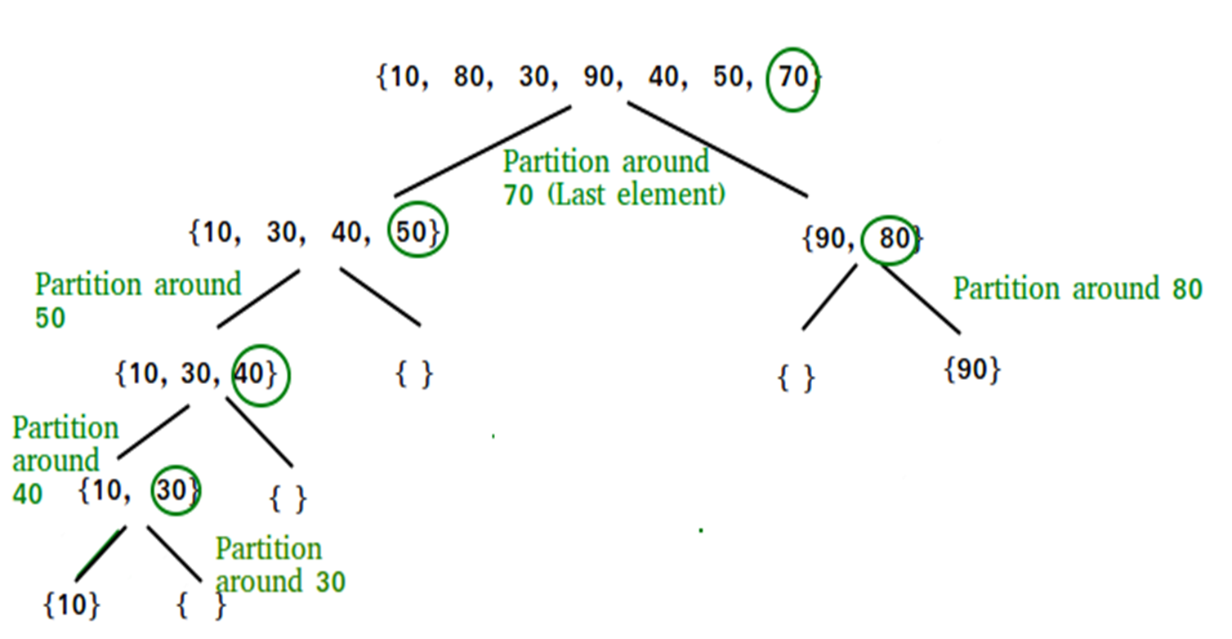
Concept and Definition for (LO-1)
How Quicksort works

Slide 11
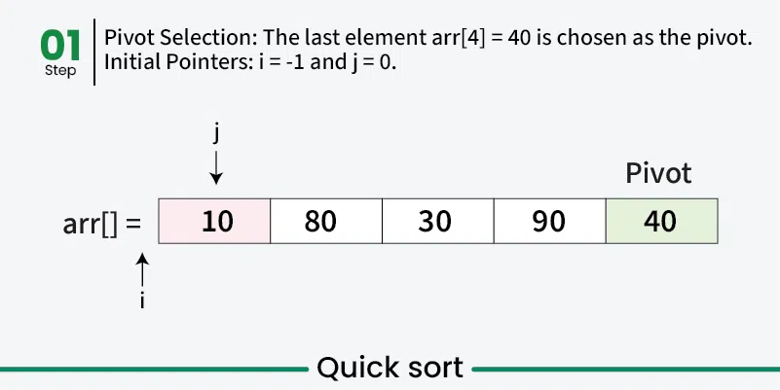
Concept and Definition for (LO-1)
How Quicksort works example

Slide 12
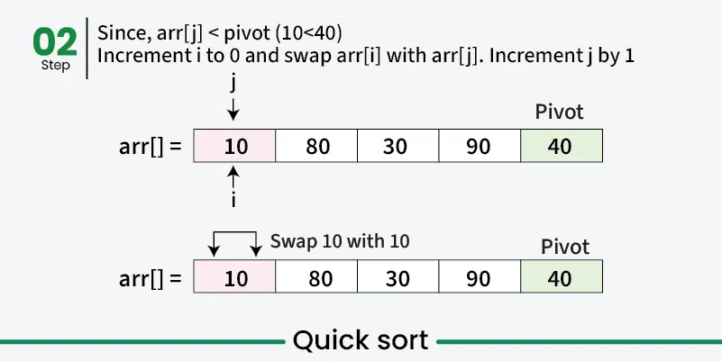
Concept and Definition for (LO-1)
How Quicksort works

Slide 13
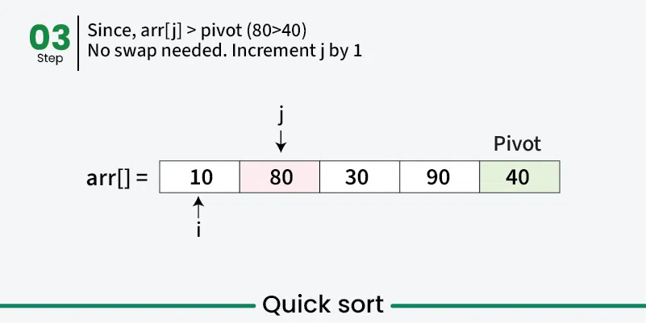
Concept and Definition for (LO-1)
How Quicksort works

Slide 14
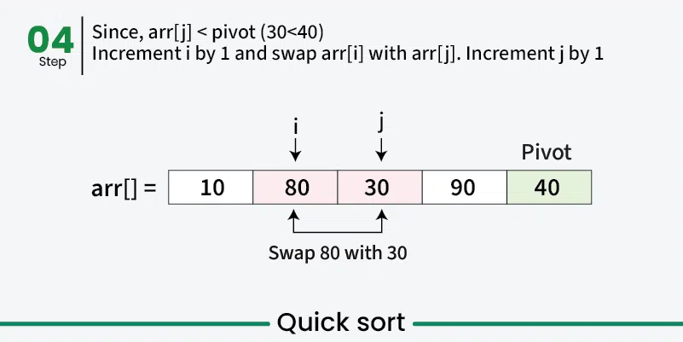
Concept and Definition for (LO-1)
How Quicksort works

Slide 15
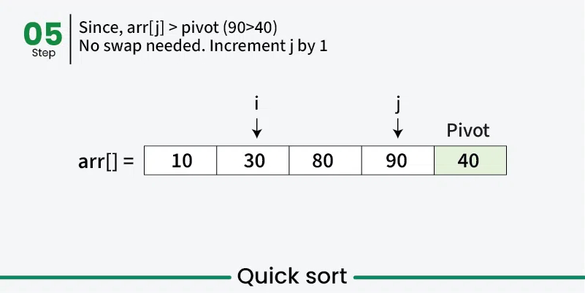
Concept and Definition for (LO-1)
How Quicksort works

Slide 16
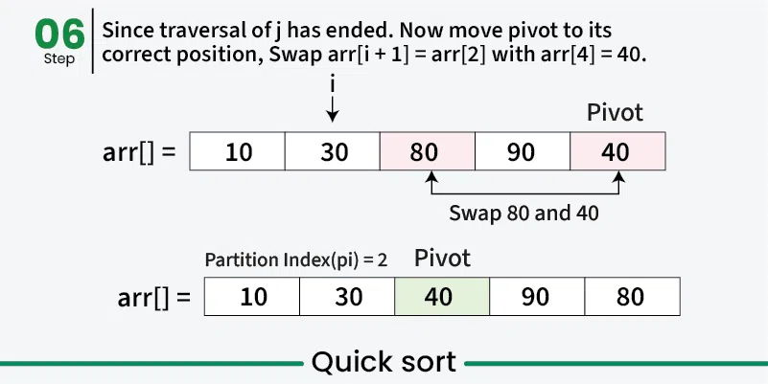
Concept and Definition for (LO-1)
How Quicksort works

Slide 17
Concept and Definition for (LO-1)
Activity 1: Pen-paper Activity
Complete step 6

Slide 18
Concept and Definition for (LO-1)
How Quicksort works

Slide 19

Quick Sort Algorithm
Partition (A, p, r)
{
x ← A[r]
i ← p - 1
for j ← p to r - 1
{
if(A[j] <= x)
{
i ← i + 1
Exchange(A[i], A[j])
}
}
Exchange(A[i + 1], A[r])
return i + 1
}
Quick_Sort(A, p, r)
{
if(p < r)
{
q ← Partition(A, p, r)
Quick_Sort(A, p, q - 1)
Quick_Sort(A, q + 1, r)
}
}
GSCALE full form and date

Slide 20
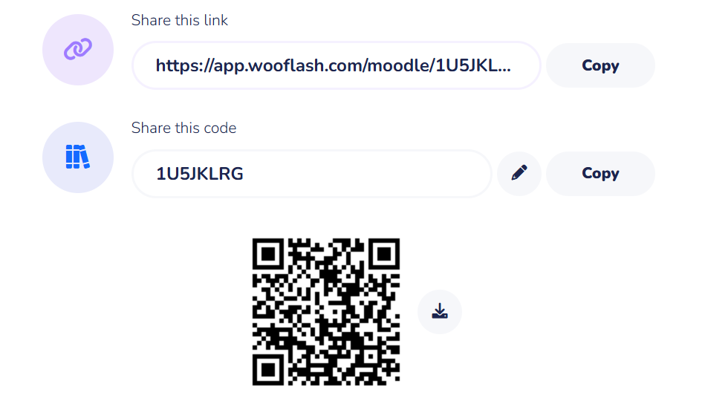
Activity 2
GSCALE full form and date

Slide 21
Concept and Definition for (LO-1)
Time Complexity:
Best Case : Ω (N log (N))
The best-case scenario for quicksort occur when the pivot chosen at the each step divides the array into roughly equal halves.
In this case, the algorithm will make balanced partitions, leading to efficient Sorting.
Average Case: θ ( N log (N))
Quicksort’s average-case performance is usually very good in practice, making it one of the fastest sorting Algorithm.
Worst Case: O(N ^ 2)
The worst-case Scenario for Quicksort occur when the pivot at each step consistently results in highly unbalanced partitions.

Slide 22
Summary
[1-mins]
Quick Sort is a divide-and-conquer sorting algorithm that works by selecting a pivot element, partitioning the array into two subarrays (elements smaller than the pivot and elements greater than the pivot), and then recursively sorting the subarrays. It is efficient with an average and best-case time complexity of O(nlogn), though its worst case is O(n^2) if the pivot is poorly chosen. Quick Sort is an in-place algorithm, generally faster in practice than other sorts, and widely used in real-world applications like system libraries and databases.

Slide 23
[2-mins]
Ensure attainment of LO’s in alignment to the learning activities:
To explain the divide-and-conquer strategy in Quick Sort and how partitioning is used to recursively sort subarrays.
To analyze the performance of Quick Sort in terms of best, average, and worst-case complexities, and the role of pivot selection in efficiency.

Slide 24
[1-min]
Next Session: Merge Sort

Slide 25
Review and Reflection from students

