Slide 1



Merge Sort Session No.: 16 Course Name: Data Structures Course Code: R1UC308B Instructor Name: Akhilesh Tripathi Duration: 50 mins Date of Conduction of Class:

Slide 2

Review
Basic concept of internal and external sorting

Slide 3

Pre-class assessment

Slide 4

[1-mins]
What is the divide and conquer method?

Slide 5
Learning Outcomes
[2-mins]
By the end of this session, You will be able to:
Understand the concept of the divide and conquer strategy used in merge sort.
Explain the working of merge sort with the help of example.

Slide 6
Session Outline
Introduction to Merge sort
How does Merge Sort work
Applications of Merge Sort
Advantages and Disadvantages of Merge Sort

Slide 7

Activity-1 (Think – Pair – Share)
[1-mins]
What is Merge sort, and what are its needs?
Data Structures

Slide 8
Concept and Definition for (LO-1)
What is Merge sort?
Merge sort is a popular sorting algorithm known for its efficiency and stability.
It follows the divide-and-conquer approach.
It works by recursively dividing the input array into two halves, recursively sorting the two halves, and finally merging them back together to obtain the sorted array.

Slide 9
Concept and Definition for (LO-1)
How does Merge Sort work?
step-by-step explanation of how merge sort works:
Divide: Divide the list or array recursively into two halves until it can no more be divided.
Conquer: Each subarray is sorted individually using the merge sort algorithm.
Merge: The sorted subarrays are merged back together in sorted order. The process continues until all elements from both subarrays have been merged.

Slide 10
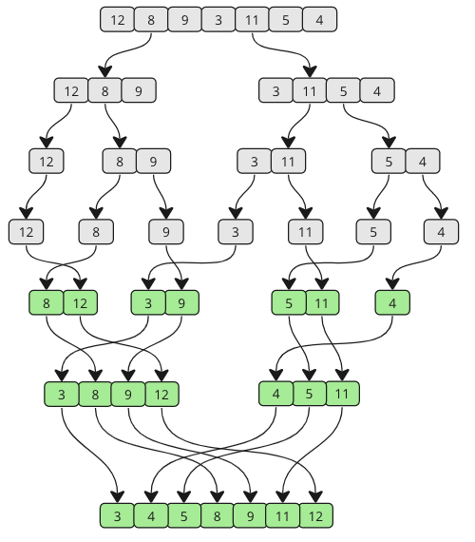
Concept and Definition for (LO-1)
Example

Slide 11
Merge sort Code:
#include <stdio.h>
#include <stdlib.h>
// Merges two subarrays of arr[].
// First subarray is arr[l..m]
// Second subarray is arr[m+1..r]
void merge(int arr[], int l, int m, int r){
int i, j, k;
int n1 = m - l + 1;
int n2 = r - m;
// Create temp arrays
int L[n1], R[n2];
// Copy data to temp arrays L[] and R[]
for (i = 0; i < n1; i++)
L[i] = arr[l + i];
for (j = 0; j < n2; j++)
R[j] = arr[m + 1 + j];
[5-mins]

Slide 12
(Contd…)
i = 0;
j = 0;
k = l;
while (i < n1 && j < n2) {
if (L[i] <= R[j]) {
arr[k] = L[i];
i++;
}
else {
arr[k] = R[j];
j++;
}
k++;
}
[5-mins]

Slide 13
(Contd…)
// Copy the remaining elements of L[],
// if there are any
while (i < n1) {
arr[k] = L[i];
i++;
k++;
}
// Copy the remaining elements of R[],
// if there are any
while (j < n2) {
arr[k] = R[j];
j++;
k++;
}
}
[5-mins]

Slide 14
(Contd…)
// l is for left index and r is right index of the
// sub-array of arr to be sorted
void mergeSort(int arr[], int l, int r){
if (l < r) {
int m = l + (r - l) / 2;
// Sort first and second halves
mergeSort(arr, l, m);
mergeSort(arr, m + 1, r);
merge(arr, l, m, r);
}
}
[5-mins]

Slide 15
(Contd…)
// Driver code
int main(){
int arr[] = {38, 27, 43, 10};
int arr_size = sizeof(arr) / sizeof(arr[0]);
mergeSort(arr, 0, arr_size - 1);
int i;
for (i = 0; i < arr_size; i++)
printf("%d ", arr[i]);
printf("\n");
return 0;
}
[5-mins]

Slide 16
Complexity Analysis of Merge Sort
Time Complexity:
Best Case: O(n log n), when the array is already sorted or nearly sorted.
Average Case: O(n log n), when the array is randomly ordered.
Worst Case: O(n log n), when the array is sorted in reverse order.
Auxiliary Space: O(n), additional space is required for the temporary array used during merging
[5-mins]

Slide 17
Applications of Merge Sort:
Merge sort are used in various fields such as:
External sorting
Inversion counting
[5-mins]

Slide 18
Advantages and Disadvantages of Merge Sort
Advantages
Stability : Merge sort is a stable sorting algorithm, which means it maintains the relative order of equal elements in the input array.
Guaranteed worst-case performance: Merge sort has a worst-case time complexity of O(N logN) , which means it performs well even on large datasets.
Disadvantages
Space complexity: Merge sort requires additional memory to store the merged sub-arrays during the sorting process.

Slide 19

Post Assessment

Slide 20
Summary
[1-mins]
Merge Sort is a sorting algorithm that follows the divide and conquer paradigm.
It efficiently sorts a list by recursively breaking it down into smaller sub-lists until each sub-list contains only one element (which is inherently sorted).
Subsequently, these single-element sub-lists are repeatedly merged back together in a sorted manner to form larger sorted sub-lists, eventually resulting in a single, fully sorted list.

Slide 21
[2-mins]
Ensure attainment of LO’s in alignment to the learning activities:
Understand the concept of the divide and conquer strategy used in merge sort.
Explain the working of merge sort with the help of example.

Slide 22
[1-min]
Next Session:
Introduction to Linked List

Slide 23
Review and Reflection from students
What was the most interesting concept you learn today?
Go to the LMS and fill out the feedback form

