Slide 1



Introduction to Structure and Union, Singly Linked List Session No.: 17 Course Name: Data Structures Course Code: R1UC308B Instructor Name: Akhilesh Tripathi Duration: 50 mins Date of Conduction of Class:

Slide 2

Review
Basic concept of structure, union and dynamic memory allocation.

Slide 3

Pre-class assessment

Slide 4

[1-mins]
What is the structure, union and linked list?

Slide 5
Learning Outcomes
[2-mins]
By the end of this session, You will be able to:
Understand the concept of structures and unions in C
Define singly linked list and basic operation on a singly linked list.

Slide 6
Session Outline
Introduction to Structures and Union
Introduction to linked list and types of linked list
Basic operation on a singly linked list

Slide 7

Activity-1 (Think – Pair – Share)
[1-mins]
What is the difference between an array and a linked list?
Data Structures

Slide 8
Concept and Definition for (LO-1)
What is a structure in C?
A structure in C is a collection of variables, possibly of different types, under a single name.
Each member of the structure is allocated its own memory space, and the size of the structure is the sum of the sizes of all its members.

Slide 9
Concept and Definition for (LO-1)
What is a union in C?
A union in C is similar to a structure, but with a key difference: all members of a union share the same memory location.
This means only one member of the union can store a value at any given time.
The size of a union is determined by the size of its largest member.

Slide 10
Concept and Definition for (LO-1) Difference Between Structure and Union in C
Parameter | Structure | Union
Definition | A structure is a user-defined data type that groups different data types into a single entity. | A union is a user-defined data type that allows storing different data types at the same memory location.
Keyword | The keyword struct is used to define a structure | The keyword union is used to define a union
Size | The size is the sum of the sizes of all members, with padding if necessary. | The size is equal to the size of the largest member, with possible padding.
Memory Allocation | Each member within a structure is allocated unique storage area of location. | Memory allocated is shared by individual members of union.

Slide 11
Concept and Definition for (LO-2)
Introduction to linked list
A Linked List is basically chains of nodes where each node contains information such as data and a pointer to the next node in the chain.
It is a popular data structure with a wide range of real-world applications.
In the linked list there is a head pointer, which points to the first element of the linked list, and if the list is empty then it simply points to null.

Slide 12
Concept and Definition for (LO-2)
Types of linked list
Singly Linked List: Singly linked list is the simplest type of linked list in which every node contains some data and a pointer to the next node of the same data type.
Doubly Linked List: A doubly linked list or a two-way linked list is a more complex type of linked list that contains a pointer to the next as well as the previous node in sequence.
Circular Linked List: A circular linked list is a type of linked list in which the last node's next pointer points back to the first node of the list, creating a circular structure. This design allows for continuous traversal of the list, as there is no null to end the list.

Slide 13
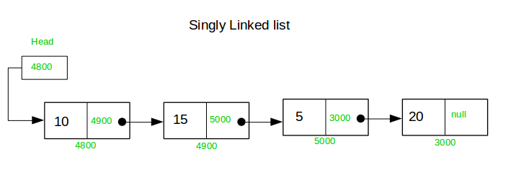
Concept and Definition for (LO-2)
Introduction to Singly linked list (contd…)

Slide 14
Concept and Definition for (LO-2)
Basic Terminologies of Singly Linked List
Head: The Head of a linked list is a pointer to the first node or reference of the first node of linked list. This pointer marks the beginning of the linked list.
Node: Linked List consists of a series of nodes where each node has two parts: data and next pointer.
Data: Data is the part of node which stores the information in the linked list.
Next pointer: Next pointer is the part of the node which points to the next node of the linked list.

Slide 15
Concept and Definition for (LO-2)
Basic operation on a Singly Linked List
Insertion: The insertion operation can be performed in three ways. They are as follows
Inserting at the Beginning of the list
Inserting at the end of the list
Inserting at a specific location in the list
Deletion: The deletion operation can be performed in three ways. They are as follows:
Deleting from the Beginning of the list
Deleting from the End of the list
Deleting a Specific Node

Slide 16
Concept and Definition for (LO-2)
Basic operation on a Singly Linked List (contd…)
Traverse: This process displays the elements of a Single-linked list.
Search: It is a process of determining and retrieving a specific node either from the front, the end or anywhere in the list.

Slide 17

Post-class Assessment

Slide 18
Summary
[1-mins]
There are many advantages of the linked list compared to array, despite the fact that they solve the similar problem to arrays, we have also discussed the advantage, disadvantages, and its application, and we concluded the fact that we can use a linked list if we need the dynamic size of storage and list are good for adding and removing items quickly or for tasks that require sequence but are not suitable for querying or search elements in a large collection of data.

Slide 19
[2-mins]
Ensure attainment of LO’s in alignment to the learning activities:
Understand the concept of structures and unions in C
Define singly linked list and basic operation on a singly linked list.

Slide 20
[1-min]
Next Session:
Single Linked list: Insert & Traversal

Slide 21
Review and Reflection from students
What was the most interesting concept you learn today?
Go to the LMS and fill out the feedback form

