Slide 1



Single Linked List: Insert & Traversal Session No.: 18 Course Name: Data Structures Course Code: R1UC308B Instructor Name: Akhilesh Kumar Tripathi Duration: 50 mins Date of Conduction of Class:

Slide 2

Review
Basic concept of operation on a singly linked list.

Slide 3

Pre-class assessment

Slide 4

[1-mins]
What are the three types of insertion in a linked list?

Slide 5
Learning Outcomes
[2-mins]
By the end of this session, You will be able to:
Describe the structure and components of a singly linked list (nodes, data, pointer).
Define the role of traversal in operations such as searching, deletion, and counting nodes.

Slide 6
Session Outline
Introduction to Operations on singly linked list
Insert operation into singly linked list
Traverse operation on singly linked list

Slide 7

Activity-1 (Think – Pair – Share)
[1-mins]
What is dynamic memory allocation?
Linked List

Slide 8
Concept and Definition for (LO-1)
Insertion in Singly Linked List
Insertion is a fundamental operation in linked lists that involves adding a new node to the list. There are several scenarios for insertion:
Insertion at the Beginning of Singly Linked List
Insertion at the End of Singly Linked List
c) Insertion at a Specific Position of the Singly Linked List

Slide 9
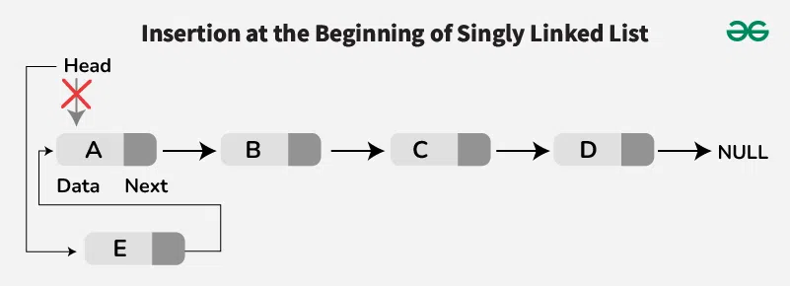
Concept and Definition for (LO-1)
Insertion at the Beginning of a Singly Linked List: To insert a new node at the front, we create a new node and point its next reference to the current head of the linked list. Then, we update the head to be this new node. This operation is efficient because it only requires adjusting a few pointers.

Slide 10
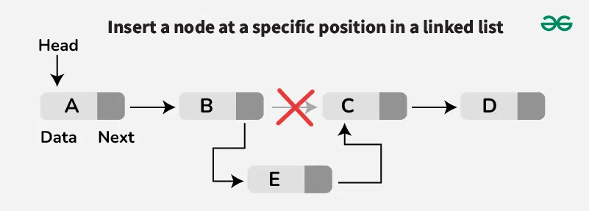
Concept and Definition for (LO-1)
Insertion at the Specific Position of a Singly Linked List: To insert a new node at a specific position, we need to traverse the list to position - 1. If the position is valid, we adjust the pointers similarly such that the next pointer of the new node points to the next of current nod and next pointer of current node points to the new node.

Slide 11
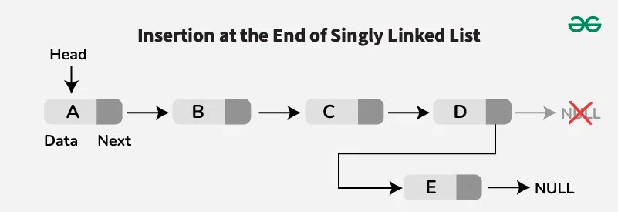
Concept and Definition for (LO-1)
Insertion at the End of a Singly Linked List: Inserting at the end involves traversing the entire list until we reach the last node. We then set the last node's next reference to point to the new node, making the new node the last element in the list.

Slide 12
Concept and Definition for (LO-2)
Traversal of Singly Linked List
Traversal of Singly Linked List is one of the fundamental operations, where we traverse or visit each node of the linked list.

Slide 13

Concept and Definition for (LO-2)
Traversal of Singly Linked List (Example)
Output: 10 -> 20 -> 30 -> 40 -> 50 Explanation: Every element of each node from head node to last node is printed which means we have traversed each node successfully.

Slide 14
Concept and Definition for (LO-2)
Traversal of Singly Linked List (Code)
struct Node {
int data;
struct Node* next;
};
void traverse(struct Node* head) {
struct Node* temp = head;
while (temp != NULL) {
printf("%d ", temp->data); // Process data
temp = temp->next; // Move to next node
}
}

Slide 15

Post-class Assessment

Slide 16
Summary
[1-mins]
Traversal is the process of moving through a linked list starting from the head node and visiting every node until the end (NULL).
Printing elements: Displaying the data stored in each node.
Searching: Locating a specific node based on its data value.

Slide 17
[2-mins]
Ensure attainment of LO’s in alignment to the learning activities:
Describe the structure and components of a singly linked list (nodes, data, pointer).
Define the role of traversal in operations such as searching, deletion, and counting nodes.

Slide 18
[1-min]
Next Session:
Single Linked List: Concept of Deletion

Slide 19
Review and Reflection from students
What was the most interesting concept you learn today?
Go to the LMS and fill out the feedback form

