Slide 1



Single Linked list : Deletion, Searching, Reverse Session No.: 19 Course Name: Data Strucutres Course Code: R1UC308B Instructor Name: Akhilesh Kumar Tripathi Duration: 50 mins Date of Conduction of Class: 2025

Slide 2

Review
Students must have knowledge of Link-list.

Slide 3

Pre-Class Assessment
[2-mins]

Slide 4

[1-mins]
How will you reverse a linked list?

Slide 5
Learning Outcomes
[2-mins]
By the end of this session, You will be able to:
Implement deletion and searching operations in a singly linked list.
Implement reversal operations in a singly linked list.

Slide 6
Session Outline
Search operation on Link-list.
Delete operation performed on Link-list .
Reversal of link list.
Provide hands-on activities and reinforce learning through an interactive WooClap and WooFlash tools.

Slide 7

Activity-1 (Think – Pair – Share)
[1-mins]
What is the difference between array and link list
Data

Slide 8
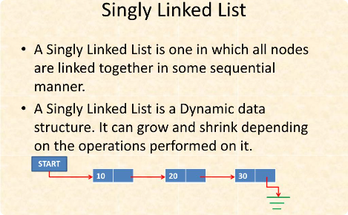
Singly Linked List
A basic linked list where each node has a reference to the next node, forming a unidirectional chain.

Slide 9
Search in Singly Linked List
[5-mins]
int search(struct node *head, int key) {
int position = 1; // Start position from 1
struct node *temp = head;
while (temp != NULL) {
if (temp->data == key) {
return position; // Found → return position
}
temp = temp->link; // Move to next node
position++;
}
return -1; // Not found
}

Slide 10
Delete a node in a singly linked list.
void delete(struct node **head, int num) {
struct node *temp = *head, *pre = NULL;
// Case 1: The head node itself holds the key to be deleted
if (temp != NULL && temp->data == num) {
*head = temp->link; // Move head to next node
free(temp); // Free old head
return;
}
// Case 2: Search for the node to be deleted, keep track of previous node
while (temp != NULL && temp->data != num) {
pre = temp;
temp = temp->link;
}
// If element was not found in list
if (temp == NULL) {
printf("Element %d not found\n", num);
return;
}
// Unlink the node from linked list
pre->link = temp->link;
free(temp); // Free memory
}

Slide 11
Singly Linked List: Reverse
Given a pointer to the head node of a linked list, the task is to reverse the linked list. We need to reverse the list by changing the links between nodes.
Examples:
Input: Head of following linked list 1->2->3->4->NULL
Output: Linked list should be changed to, 4->3->2->1->NULL
Input: Head of following linked list 1->2->3->4->5->NULL
Output: Linked list should be changed to, 5->4->3->2->1->NULL

Slide 12
Singly Linked List: Reverse
struct Node* reverseList(struct Node *head)
{
struct Node *cr=head,*pr=NULL,*ne=NULL;
while(cr!=NULL)
{
ne=cr->next;
cr->next=pr;
pr=cr;
cr=ne;
}
head=pr;
return (head);
}

Slide 13

Assessment: WooFlash Quiz

Slide 14
Summary
[1-mins]
Single Linked List: Deletion, Searching, Reverse
Deletion: Remove a node (beginning, end, or specific node) and adjust links.
Searching: Traverse nodes sequentially to find an element (O(n)).
Reversing: Change node links so the last node becomes the first (iterative/recursive).

Slide 15
Ensure attainment of LO’s in alignment to the learning activities:
[2-mins]
Implement deletion and searching operations in a singly linked list.
Implement reversal operations in a singly linked list.

Slide 16
[1-min]
Next Session: Doubly link-list

Slide 17
Review and Reflection from students

