Slide 1



Doubly Linked List Session No.: 20 Course Name: Data Strucutres Course Code: R1UC308B Instructor Name: Akhilesh Kumar Tripathi Duration: 50 mins Date of Conduction of Class: 2025

Slide 2

Review
Students must have knowledge of singly Link-list.

Slide 3

Pre-Class Assessment
[2-mins]

Slide 4

[1-mins]
In a singly linked list, we can only traverse in one direction. Can you think of a real-life situation or application where moving in both directions would be useful?

Slide 5
Learning Outcomes
[2-mins]
By the end of this session, You will be able to:
Implement doubly linked list.

Slide 6
Session Outline
Introduction of doubly Link-list
Traverse operation on Doubly Link-list.
Insert operation on Doubly Link-list.
Delete operation performed on Doubly Link-list
Provide hands-on activities and reinforce learning through an interactive WooClap and WooFlash tools.

Slide 7

Activity-1 (Think – Pair – Share)
[1-mins]
What is the difference between Singly link list and Doubly link list

Slide 8
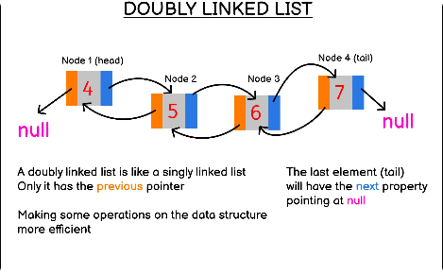
Introduction of Doubly linked list
Similar to a singly linked list, but each node also has a reference to the previous node, enabling bidirectional traversal.

Slide 9
Introduction of Doubly linked list
[5-mins]

Slide 10
Traversal in Doubly Linked List
Input: 10 <-> 20 <-> 30 <-> 40
Output: [10, 20, 30, 40] and [40, 30, 20, 10]
Explanation:
Forward traversal moves from the first node to the last: [10, 20, 30, 40].
Backward traversal moves from the last node to the first: [40, 30, 20, 10].

Slide 11
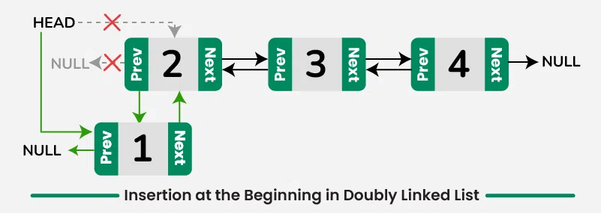
Insert at beginning in Doubly Linked List
// Function to insert a node at the front of Doubly Linked List
void insertAtFront(struct Node** head, int newData) {
// Allocate memory for new node
struct Node* newNode = (struct Node*)malloc(sizeof(struct Node));
// Assign data
newNode->data = newData;
// Make next of new node as head and prev as NULL
newNode->next = *head;
newNode->prev = NULL;
// Change prev of head node to new node (if list is not empty)
if (*head != NULL) {
(*head)->prev = newNode;
}
// Move the head to point to the new node
*head = newNode;
}

Slide 12
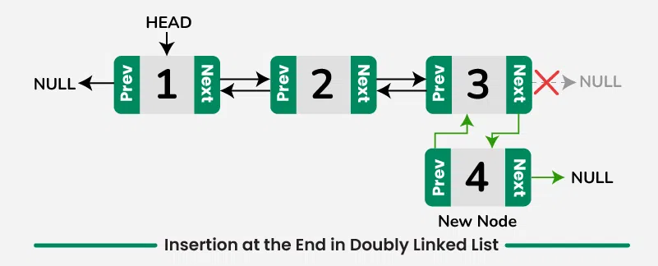
Insert at the End in Doubly Linked List
// Function to insert a node at the end of Doubly Linked List
void insertAtEnd(struct Node** head, int newData) {
struct Node* newNode = (struct Node*)malloc(sizeof(struct Node));
struct Node* temp = *head;
newNode->data = newData;
newNode->next = NULL;
// If the list is empty, new node becomes head
if (*head == NULL) {
newNode->prev = NULL;
*head = newNode;
return;
}
// Traverse to the last node
while (temp->next != NULL) {
temp = temp->next;
}
// Adjust pointers
temp->next = newNode;
newNode->prev = temp;
}

Slide 13
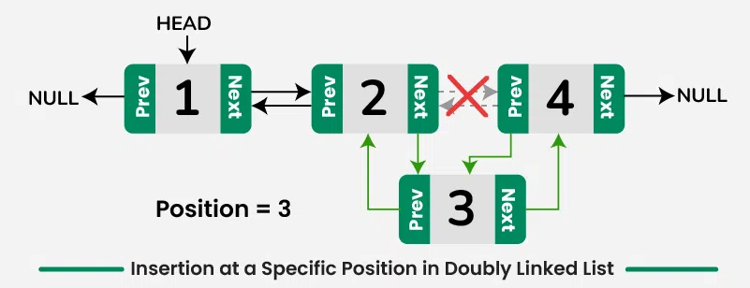
Insert at Specific position in Doubly Linked List
// Function to insert a node at a given position in Doubly Linked List
// Position starts from 1 (i.e., 1 = beginning)
void insertAtPosition(struct Node** head, int newData, int position) {
if (position <= 0) {
printf("Invalid position!\n");
return;
}
// Case 1: Insert at the beginning
if (position == 1) {
insertAtFront(head, newData);
return;
}
struct Node* newNode = (struct Node*)malloc(sizeof(struct Node));
newNode->data = newData;
struct Node* temp = *head;
for (int i = 1; temp != NULL && i < position - 1; i++) {
temp = temp->next;
}
// If position is greater than length + 1
if (temp == NULL) {
printf("Position out of range!\n");
free(newNode);
return;
}
newNode->next = temp->next;
newNode->prev = temp;
if (temp->next != NULL) {
temp->next->prev = newNode;
}
temp->next = newNode;
}

Slide 14
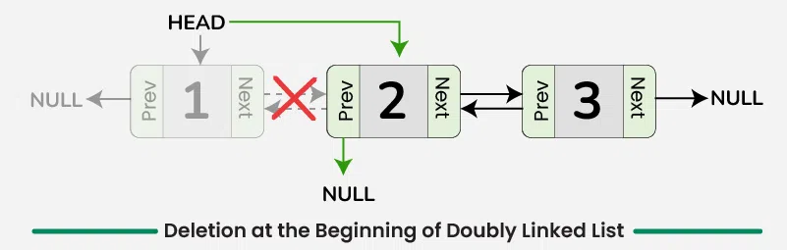
Deletion at beginning (Removal of first node) in a Doubly Linked List
// Function to delete a node from the beginning of a Doubly Linked List
void deleteAtBeginning(struct Node** head) {
if (*head == NULL) {
printf("List is empty, nothing to delete.\n");
return;
}
struct Node* temp = *head;
// Move head to the next node
*head = temp->next;
// If list is not empty after deletion, set prev of new head to NULL
if (*head != NULL) {
(*head)->prev = NULL;
}
// Free memory of old head
free(temp);
printf("Node deleted from beginning.\n");
}

Slide 15
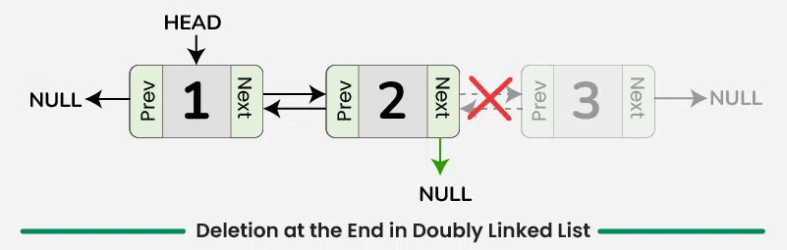
Deletion at end (Removal of last node) in a Doubly Linked List
// Function to delete a node from the end of a Doubly Linked List
void deleteAtEnd(struct Node** head) {
if (*head == NULL) {
printf("List is empty, nothing to delete.\n");
return;
}
struct Node* temp = *head;
// Traverse to the last node
while (temp->next != NULL) {
temp = temp->next;
}
// If there is only one node
if (temp->prev == NULL) {
*head = NULL;
} else {
temp->prev->next = NULL;
}
free(temp);
printf("Node deleted from end.\n");
}

Slide 16
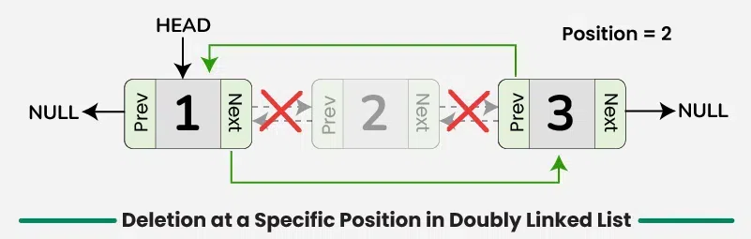
Delete a Doubly Linked List node at a given position
// Function to delete a node at a given position (1-based index)
void deleteAtPosition(struct Node** head, int position) {
if (*head == NULL || position <= 0) {
printf("Invalid operation.\n");
return;
}
struct Node* temp = *head;
// Case 1: Delete first node
if (position == 1) {
deleteAtBeginning(head);
return;
}
// Traverse to the node at given position
for (int i = 1; temp != NULL && i < position; i++) {
temp = temp->next;
}
// If position is out of range
if (temp == NULL) {
printf("Position out of range.\n");
return;
}
// Adjust links
if (temp->prev != NULL) {
temp->prev->next = temp->next;
}
if (temp->next != NULL) {
temp->next->prev = temp->prev;
}
free(temp);
printf("Node deleted from position %d.\n", position);
}

Slide 17

Assessment: WooFlash Quiz

Slide 18
Summary
[1-mins]
Doubly Linked List: Key Operations
Traversing: Move in both directions (forward & backward) using links.
Insertin: Add node at beginning, end, or specific position (update both prev & next).
Deletion: Remove node and adjust links on both sides.
Searching: Traverse forward or backward to locate an element (O(n)).

Slide 19
Ensure attainment of LO’s in alignment to the learning activities:
[2-mins]
Implement doubly linked list.

Slide 20
[1-min]
Next Session: Circular link-list

Slide 21
Review and Reflection from students

