Slide 1



Circular Linked list Session No.: 20 Course Name: Data Structures Course Code: R1UC308B Instructor Name: Akhilesh Kumar Tripathi Duration: 50 mins Date of Conduction of Class: 2025

Slide 2

Review
Students must have knowledge of Circular Link-list.

Slide 3

Pre-Class Assessment
[2-mins]

Slide 4

[1-mins]
Can you think of a real-world system where circular connections (like a loop) are useful?

Slide 5
Learning Outcomes
[2-mins]
By the end of this session, You will be able to:
Implement Circular linked list.

Slide 6
Session Outline
Introduction of Circular Link-list
Traverse operation on Circular Link-list.
Insert operation on Circular Link-list.
Delete operation performed on Circular Link-list
Provide hands-on activities and reinforce learning through an interactive WooClap and WooFlash tools.

Slide 7

Activity-1 (Think – Pair – Share)
[1-mins]
What is the difference between Singly link list and Circular link list

Slide 8
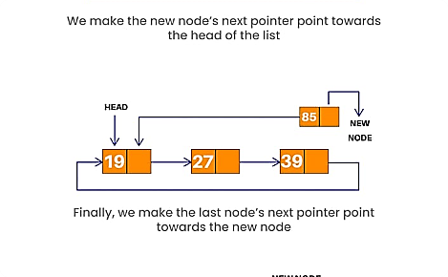
Introduction of Circular linked list
In this variation, the last node of the list points back to the first node, creating a circular structure.

Slide 9
Structure of a node
#include <stdio.h>
#include <stdlib.h>
// Structure of a Node
struct Node {
int data;
struct Node* next;
};
// Function to create a new node
struct Node* createNode(int data) {
struct Node* newNode = (struct Node*)malloc(sizeof(struct Node));
newNode->data = data;
newNode->next = NULL;
return newNode;
}
[5-mins]

Slide 10
Insert at Beginning
// Insert at Beginning
struct Node* insertAtBegin(struct Node* last, int data) {
struct Node* newNode = createNode(data);
if (last == NULL) {
last = newNode;
last->next = last;
} else {
newNode->next = last->next;
last->next = newNode;
}
return last;
}

Slide 11
Insert at End
// Insert at End
struct Node* insertAtEnd(struct Node* last, int data) {
struct Node* newNode = createNode(data);
if (last == NULL) {
last = newNode;
last->next = last;
} else {
newNode->next = last->next;
last->next = newNode;
last = newNode;
}
return last;
}

Slide 12
Delete from Beginning
// Delete from Beginning
struct Node* deleteFirstNode(struct Node* last) {
if (last == NULL) return NULL;
struct Node* head = last->next;
if (head == last) {
free(last);
last = NULL;
} else {
last->next = head->next;
free(head);
}
return last;
}

Slide 13
Delete from End
// Delete from End
struct Node* deleteLastNode(struct Node* last) {
if (last == NULL) return NULL;
struct Node* head = last->next;
if (head == last) {
free(last);
last = NULL;
} else {
struct Node* curr = head;
while (curr->next != last) {
curr = curr->next;
}
curr->next = head;
free(last);
last = curr;
}
return last;
}

Slide 14
Display the Circular Linked List
// Display the Circular Linked List
void display(struct Node* last) {
if (last == NULL) {
printf("List is empty\n");
return;
}
struct Node* temp = last->next;
do {
printf("%d ", temp->data);
temp = temp->next;
} while (temp != last->next);
printf("\n");
}

Slide 15
Driver code
// Driver code
int main() {
struct Node* last = NULL;
// Insert at end
last = insertAtEnd(last, 10);
last = insertAtEnd(last, 20);
last = insertAtEnd(last, 30);
printf("List after inserting at end: ");
display(last);
// Insert at beginning
last = insertAtBegin(last, 5);
printf("List after inserting at beginning: ");
display(last);
// Delete from beginning
last = deleteFirstNode(last);
printf("List after deleting first node: ");
display(last);
// Delete from end
last = deleteLastNode(last);
printf("List after deleting last node: ");
display(last);
return 0;
}

Slide 16
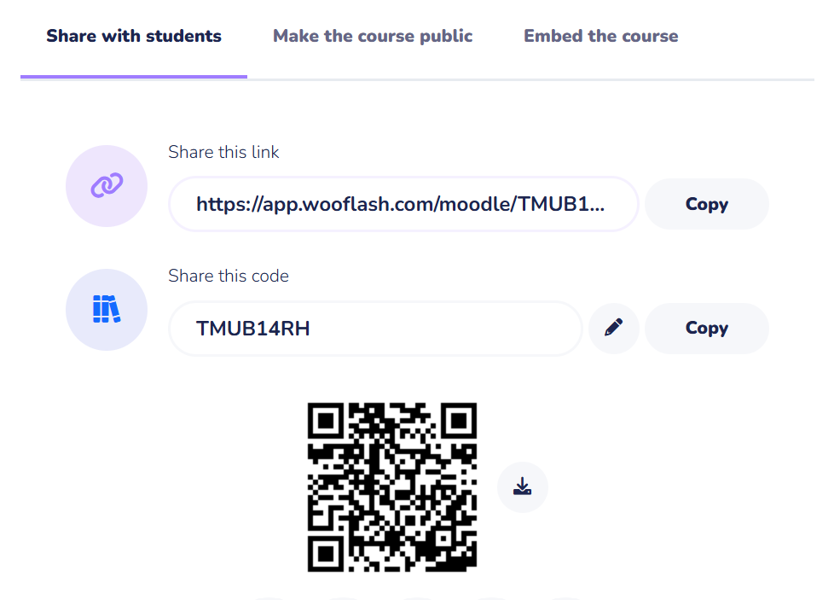
Assessment: WooFlash Quiz

Slide 17
Summary
[1-mins]
Each node has data and next; the last node points to the first, forming a circle.
Insert at Beginning/End: Adjust last->next and update last if inserting at end.
Delete from Beginning/End: Free the target node and update pointers to maintain circularity.
Display: Start from last->next (head) and traverse until back at head.
Efficient for queue-like operations, round-robin tasks, and scenarios needing circular traversal.

Slide 18
Ensure attainment of LO’s in alignment to the learning activities:
[2-mins]
Implement Circular linked list.

Slide 19
[1-min]
Next Session: Polynomial Representation

Slide 20
Review and Reflection from students

