Slide 1



Polynomial Representation Session No.: 22 Course Name: Data Strucutres Course Code: R1UC308B Instructor Name: Akhilesh Kumar Tripathi Duration: 50 mins Date of Conduction of Class:

Slide 2

Review
Pre-Requisite :
Linked List data structure (DLL)
Understanding of nodes, pointers/references, and dynamic memory allocation
Basic algebraic knowledge of polynomials (e.g., 2x² + 3x + 5)

Slide 3

Pre-Class Assessment
[2-mins]

Slide 4

[1-mins]
What is Linked List?

Slide 5
Learning Outcomes
[2-mins]
By the end of this session, You will be able to:
Represent polynomials using Linked Lists
Implement addition and multiplication of polynomials

Slide 6
Session Outline
Introduction to Polynomial Representation
Linked List-based Node Structure for Polynomials
Addition of Polynomials using Linked List
Multiplication of Polynomials using Linked List
Provide hands-on activities and reinforce learning through an interactive WooClap and WooFlash tools

Slide 7

Activity-1 (Think – Pair – Share)
[1-mins]
Think of how a polynomial like 3x² + 5x + 2 can be represented using a data structure.

Slide 8
Concept and Definition for (LO-1)
What is Polynomial Representation?
A polynomial is a mathematical expression consisting of terms in the form of coefficient × variable^exponent (e.g., 4x² + 3x + 5).
In computer science, Polynomial Representation refers to the way polynomials are stored and manipulated using data structures.
Linked lists are commonly used to dynamically represent polynomials by storing each term as a node with a coefficient, exponent, and a pointer to the next term.
This representation enables efficient addition, multiplication, and modification of polynomials without wasting memory.

Slide 9
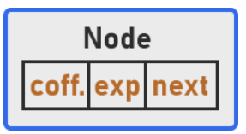
Linked List-based Node Structure for Polynomials
In polynomial representation using linked lists, each term is stored in a node with:
Coefficient
Exponent
Pointer to next node
For example, the polynomial:
P(x) = 4x³ + 9x² + 6x + 7
struct Node {
int coefficient;
int exponent;
struct Node *next;
}

Slide 10
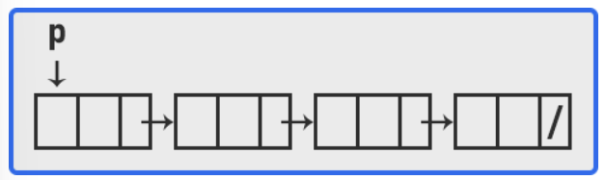
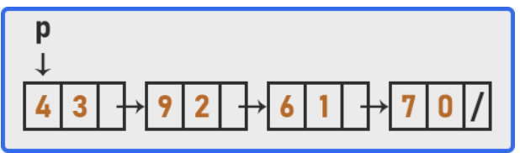
Linked List-based Node Structure for Polynomials
P(x) = 4x³ + 9x² + 6x + 7

Slide 11
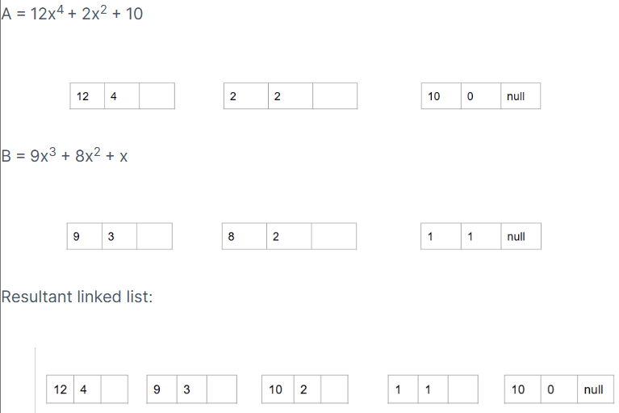
Addition of Polynomials using Linked List
It involves adding two polynomials by combining their coefficients.
We have to add the polynomials

Slide 12
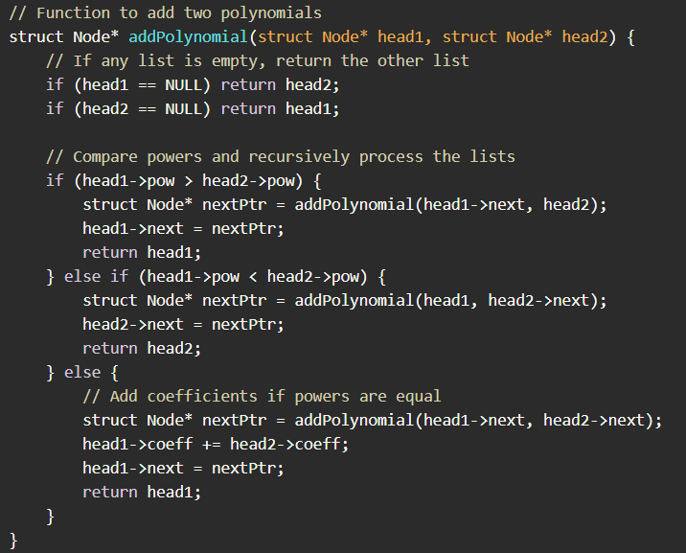
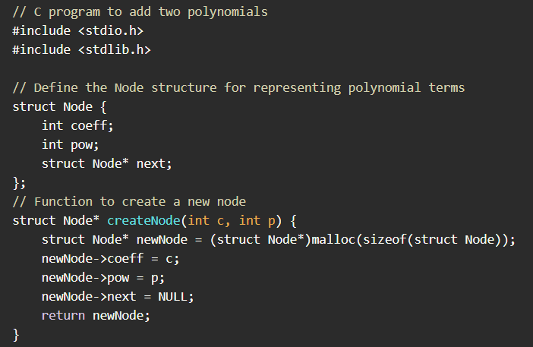
Algorithm for Polynomial Addition Here is an example of polynomial addition using linked list in a data structure in c:

Slide 13
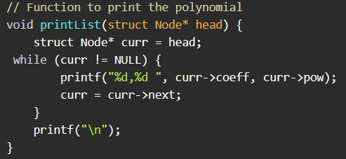
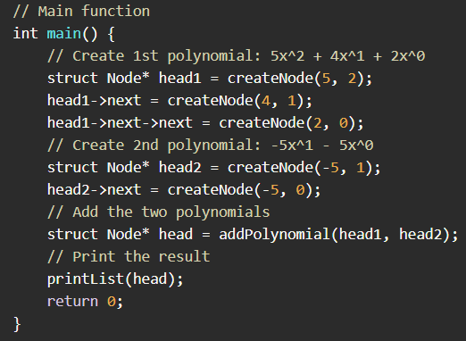
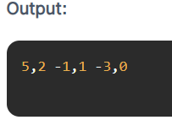
Algorithm for Polynomial Addition Here is an example of polynomial addition using linked list in a data structure in c:

Slide 14
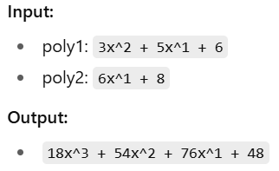
Multiplication of two polynomials using linked lists

Slide 15
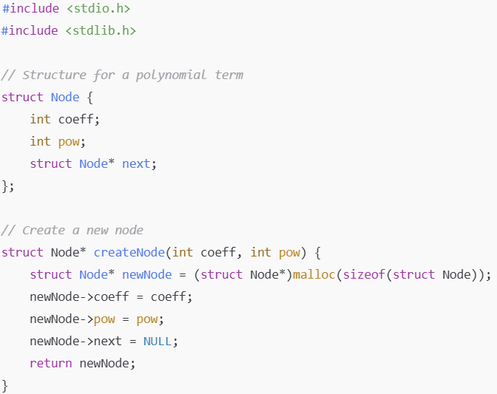
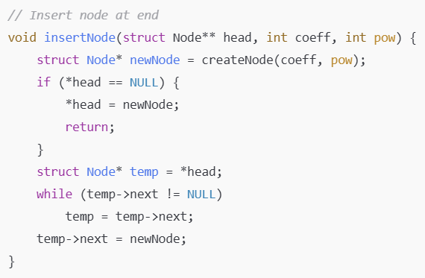
Algorithm for Polynomial Multiplication

Slide 16
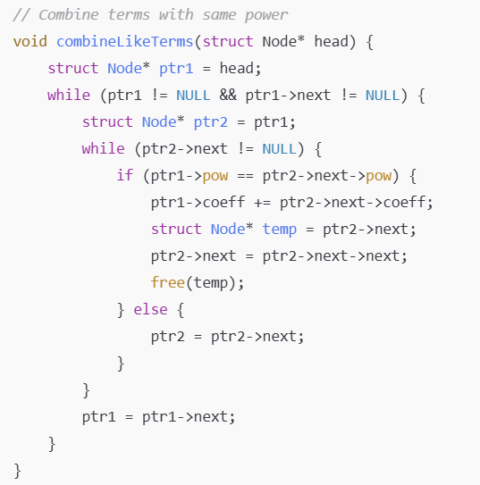
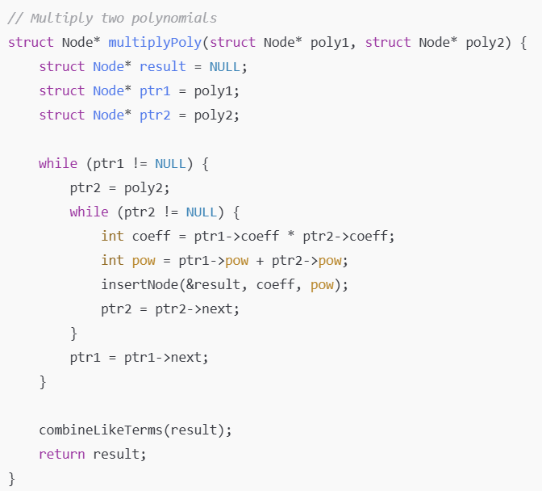
Algorithm for Polynomial Multiplication

Slide 17
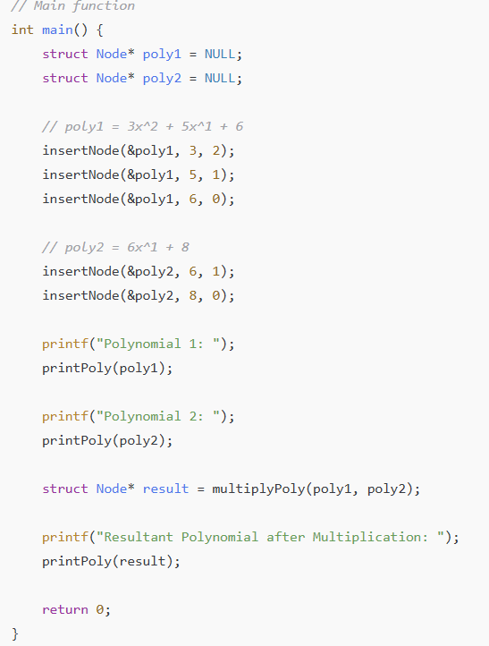
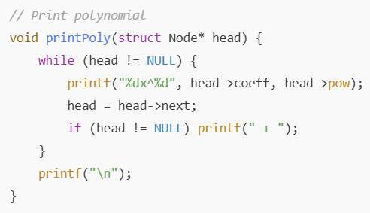
Algorithm for Polynomial Multiplication
Output:
Polynomial 1: 3x^2 + 5x^1 + 6x^0
Polynomial 2: 6x^1 + 8x^0
Resultant Polynomial after Multiplication: 18x^3 + 54x^2 + 76x^1 + 48x^0

Slide 18

Assessment: WooFlash Quiz

Slide 19
Summary
[1-mins]
Polynomial representation using linked lists provides a dynamic and efficient way to store and manipulate terms.
We explored the node structure containing coefficient, exponent, and pointer to the next node.
Learned algorithms for addition and multiplication of polynomials using linked lists.
This approach ensures memory efficiency and supports operations on polynomials of varying degrees.
Prepares the foundation for applying data structures to solve real-world computational problems.

Slide 20
[2-mins]
Ensure attainment of LO’s in alignment to the learning activities:
Represent polynomials using Linked Lists.
Implement addition and multiplication of polynomials.

Slide 21
[1-min]
Next Session:
Stack: Introduction, Abstract Data Type, Primitive Stack operations: Push & Pop.

Slide 22
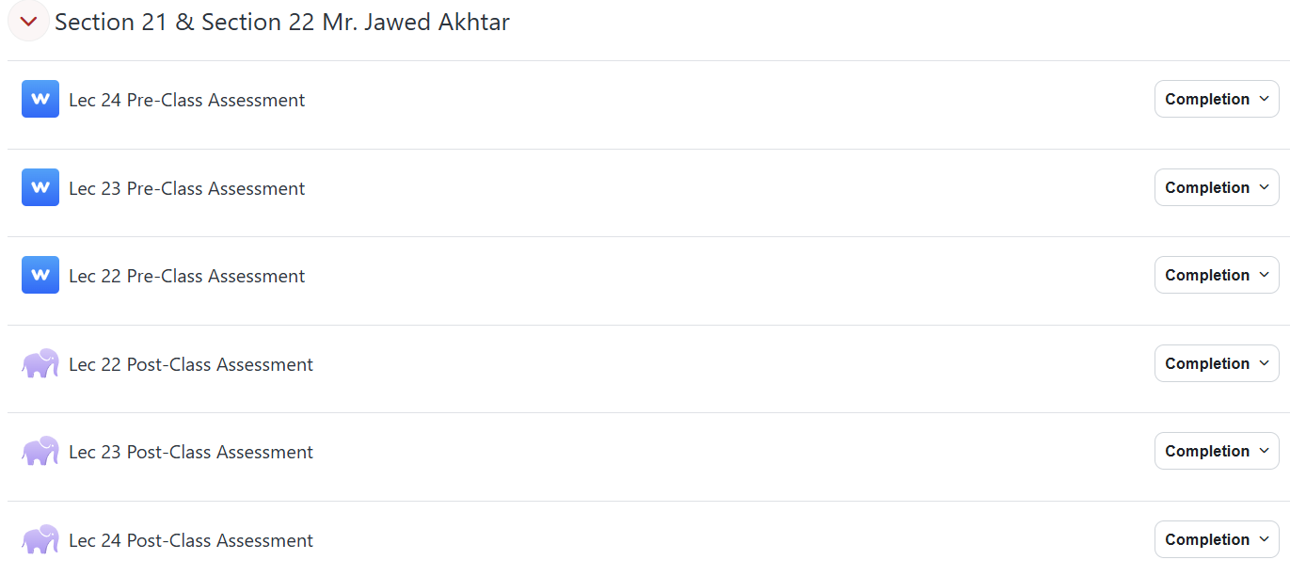
Review and Reflection from students

