Slide 1



Stack Data Structure Session No.: 23 Course Name: Data Structures Course Code: R1UC308B Instructor Name: Akhilesh Kumar Tripathi Duration: 50 mins Date of Conduction of Class:

Slide 2

Review
Pre-Requisite :
Basic knowledge of C programming (variables, loops, functions).
Understanding of arrays and linked lists as linear data structures.
Familiarity with memory concepts (static vs dynamic, pointers/references).
Basic idea of mathematical expressions (infix, prefix, postfix, operator precedence).

Slide 3

Pre-Class Assessment
[2-mins]

Slide 4

[1-mins]
When you open multiple apps on your phone and press the back button, why do they close in the reverse order you opened them?

Slide 5
Learning Outcomes
[2-mins]
By the end of this session, You will be able to:
Describe Stack as an Abstract Data Type and its characteristics.
Demonstrate primitive Stack operations such as Push and Pop with examples.

Slide 6
Session Outline
Introduction to Stack
Abstract Data Type (ADT)
Primitive Stack Operations
Provide hands-on activities and reinforce learning through an interactive WooClap and WooFlash tools

Slide 7

Activity-1 (Think – Pair – Share)
[1-mins]
Where do you see Last In, First Out (LIFO) behavior in daily life?

Slide 8
Concept and Definition for (LO-1)
Introduction to Stack
▶ A Stack is a linear data structure that follows a particular order in which the operations are performed.
▶ The order may be LIFO(Last In First Out) or FILO(First In Last Out). ▶ LIFO implies that the element that is inserted last, comes out first and FILO implies that the element that is inserted first, comes out last.
▶ A variable name Top is used to keep the position of the topmost element in the stack.
▶ we can access the elements only on the top of the stack

Slide 9
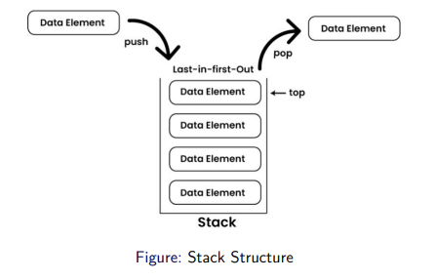
Representation of Stack data Structure :

Slide 10
Abstract Data Type
Abstract Data Type (ADT) defines a data structure (like Stack) in terms of the values it can hold and the operations that can be performed (Push, Pop, Peek).
Specifies what operations are performed, not how they are implemented.
Gives an implementation-independent view (array or linked list can be used).
Shows only essential features, hiding internal details (abstraction).

Slide 11
Primitive Stack operations
Push: Adds an element to the top of the stack
Pop: Removes the top element from the stack
Peek: Returns the top element without removing it
IsEmpty: Checks if the stack is empty
IsFull: Checks if the stack is full (in case of fixed-size arrays)

Slide 12
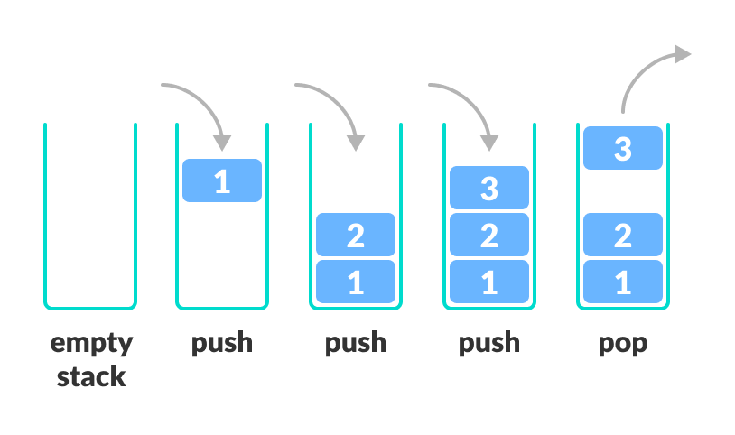
Primitive Stack operations
Push: Adds an element to the top of the stack
Pop: Removes the top element from the stack

Slide 13
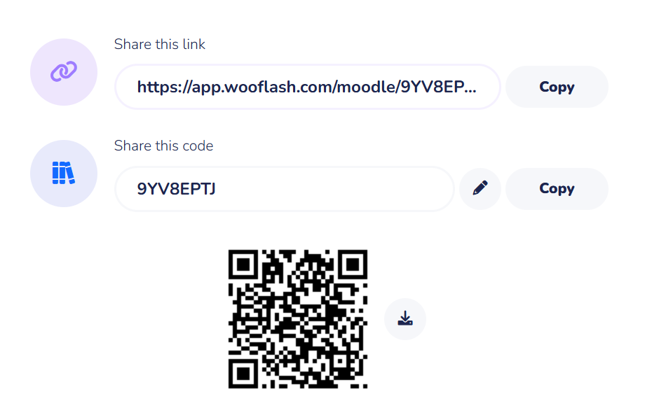
Assessment: WooFlash Quiz

Slide 14
Summary
[1-mins]
Stack is a linear data structure that works on the LIFO (Last In First Out) principle.
It can be represented as an Abstract Data Type (ADT), focusing on operations rather than implementation details.
The two primitive operations are:
Push → Insert an element on the top of the stack.
Pop → Remove the top element from the stack.

Slide 15
[2-mins]
Ensure attainment of LO’s in alignment to the learning activities:
Describe Stack as an Abstract Data Type and its characteristics.
Demonstrate primitive Stack operations such as Push and Pop with examples.

Slide 16
[1-min]
Next Session:
Array and Linked List Implementation of Stack

Slide 17
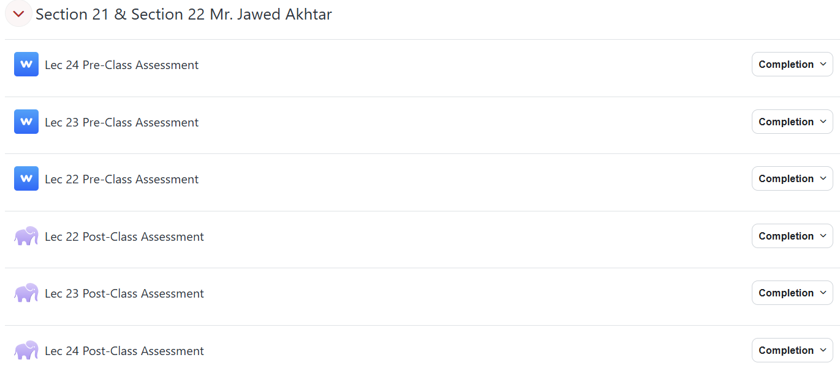
Review and Reflection from students

