Slide 1



Array and Linked List Implementation of Stack Session No.: 24 Course Name: Data Structures Course Code: R1UC308B Instructor Name: Akhilesh Kumar Tripathi Duration: 50 mins Date of Conduction of Class:

Slide 2

Review
Pre-Requisite :
Basic Knowledge of Data Structures – Arrays and Linked Lists
Understanding of Stack Concepts – LIFO principle, Push & Pop operations.
Familiarity with Memory Management – Static vs Dynamic memory allocation.
Programming Fundamentals – Knowledge of C for stack implementation.

Slide 3

Pre-Class Assessment
[2-mins]

Slide 4

[1-mins]
If you had a pile of books, how would you arrange them so that the last one placed is the first one to be taken out?

Slide 5
Learning Outcomes
[2-mins]
By the end of this session, You will be able to:
Implement stack using both array and linked list.
Compare the advantages and disadvantages of array vs linked list implementation of stack.

Slide 6
Session Outline
Stack Operations (Push, Pop, Peek/Top, Stack overflow & underflow)
Array Implementation of Stack
Linked List Implementation of Stack
Comparison: Array vs Linked List
Provide hands-on activities and reinforce learning through an interactive WooClap and WooFlash tools

Slide 7

Activity-1 (Think – Pair – Share)
[1-mins]
If stack is implemented using an array of size 5, and we push 6 elements, what will happen?

Slide 8
Concept and Definition for (LO-1)
Stack Operations
Push (Insert Element)
Adds an element to the top of the stack.
If the stack is full (in array implementation), it causes Stack Overflow.
Pop (Remove Element)
Removes the topmost element from the stack.
If the stack is empty, it causes Stack Underflow.
Peek / Top (View Element)
Returns the top element of the stack without removing it.
Useful to check the current item at the top.

Slide 9
Concept and Definition for (LO-1)
Stack Overflow and Underflow
Stack Overflow
Condition when trying to push an element into a full stack (in array).
Example: Trying to add more books when the stack is already full.
Stack Underflow
Condition when trying to pop from an empty stack.
Example: Trying to remove a book from an empty stack.

Slide 10
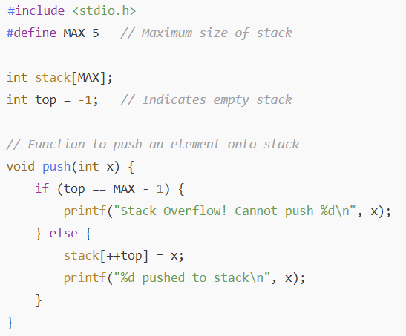
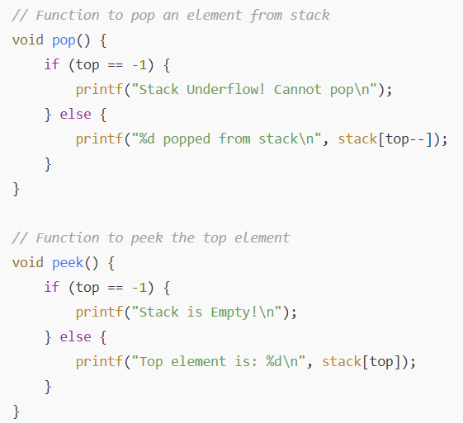
Concept and Definition for (LO-1)
Array Implementation of Stack

Slide 11
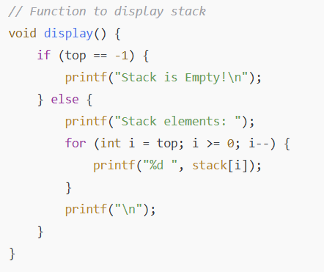
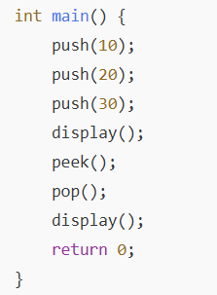
Concept and Definition for (LO-1)
Array Implementation of Stack

Slide 12
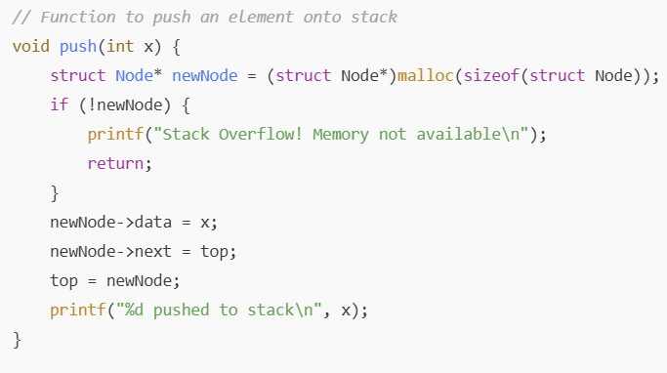
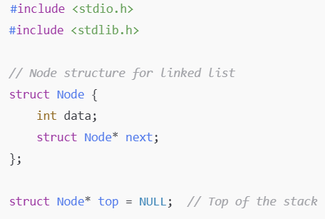
Concept and Definition for (LO-1)
Linked List Implementation of Stack

Slide 13
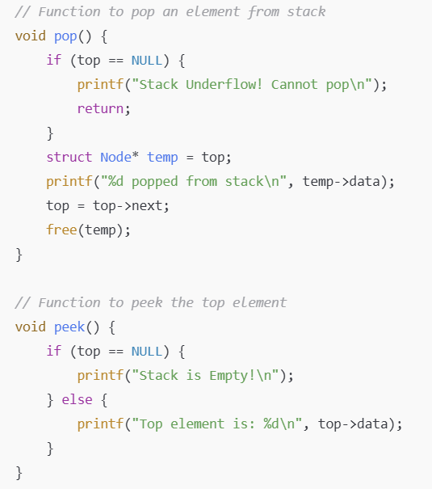
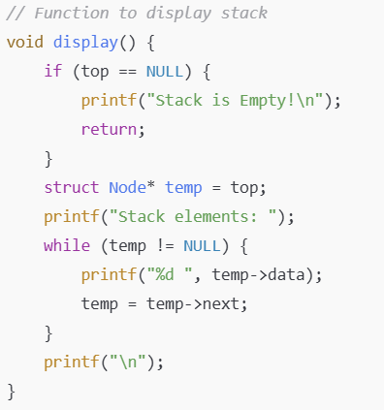
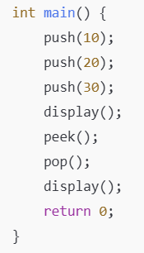
Concept and Definition for (LO-1)
Linked List Implementation of Stack

Slide 14
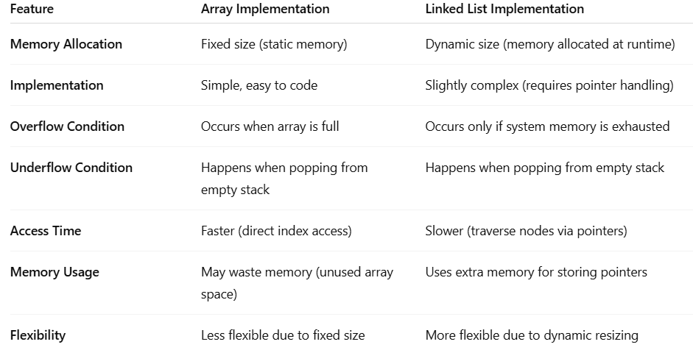
Concept and Definition for (LO-1)
Comparison: Array vs Linked List

Slide 15
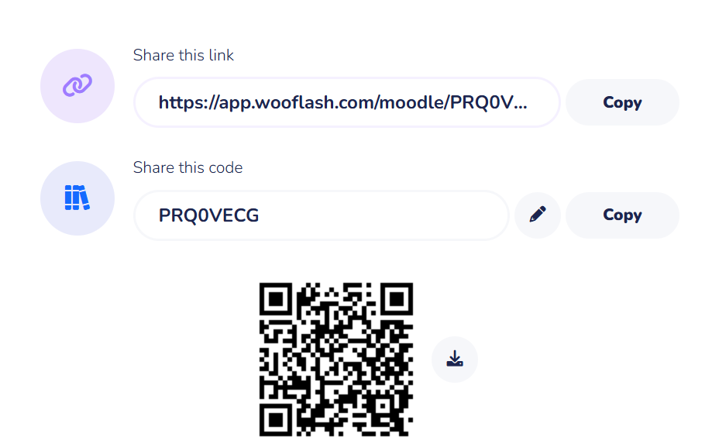
Assessment: WooFlash Quiz

Slide 16
Summary
[1-mins]
A Stack is a linear data structure that follows the LIFO (Last In, First Out) principle.
It can be implemented using Arrays or Linked Lists.
Choice of implementation depends on memory availability and application requirements.

Slide 17
[2-mins]
Ensure attainment of LO’s in alignment to the learning activities:
Describe Stack as an Abstract Data Type and its characteristics.
Demonstrate primitive Stack operations such as Push and Pop with examples.

Slide 18
[1-min]
Next Session:
Application of Stack: Prefix, Postfix Expression

Slide 19
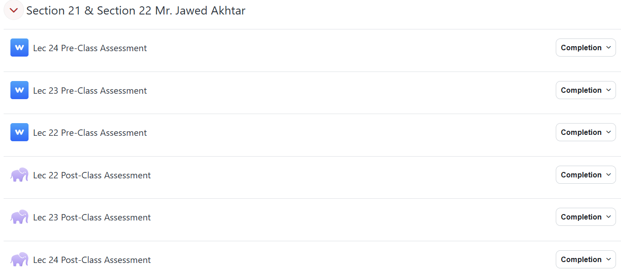
Review and Reflection from students

