Slide 1



Application of Stack: Prefix, Postfix Expression Session No.: 25 Course Name: Data Strucutres Course Code: R1UC308B Instructor Name: Akhilesh Tripathi Duration: 50 mins Date of Conduction :

Slide 2

Review
In previous sessions, we discussed: - Stack operations : Push and Pop
- Implementation of stack

Slide 3
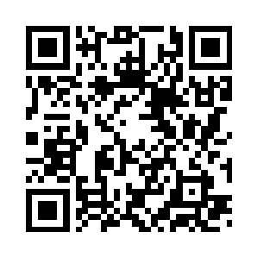
Pre-Class Assessment
[5-mins]

Slide 4

[1-mins]
Where can we use stack like arrangement in daily life?

Slide 5

At the end of this session students will be able to
Learning Outcomes
By the end of this session, You will be able to:
Learning Outcome 1: Explore various applications of stack
Learning Outcome 2: Understand Algebraic Expression

Slide 6
Session Outline
Stack applications
Algebraic Expression
Different types of notations
Precedence and Associativity

Slide 7
Activity-1 (Think – Pair – Share)
[5-mins]
Where do we see the concept of “Last In, First Out (LIFO)” in our daily life?
Why do we need a stack in computer systems?
How does a computer know where to return after completing a function call?
When you press Ctrl+Z (Undo) in MS Word, which data structure do you think is used?

Slide 8
Reflection- Learning Activity 1
Q 1: Where do we see the concept of “Last In, First Out (LIFO)” in our daily life?
Answer: A stack of plates/books. The last plate we put on top is the first one we take out.
Q 2: When you press Ctrl+Z (Undo) in MS Word, which data structure do you think is used?
Answer: A stack, since the most recent action (last done) is the first to be undone.

Slide 9
Reflection- Learning Activity 1
Q 3: How does a computer know where to return after completing a function call?
Answer: It uses a stack (call stack) to store return addresses of functions.
Q 4: Why do we need a stack in computer systems?
Answer: Because many computer processes follow LIFO order — e.g., function calls, undo operations, expression evaluation, and memory management.

Slide 10
Concept and Definition (LO-1)
Application of Stack :
Expression Evaluation and Conversion
Function Call Management (Call Stack)
Recursion
Undo/Redo Functionality
Browser History
Balanced Parentheses Checking
Backtracking Algorithms
Reversing Data
Depth-First Search (DFS)

Slide 11
Concept and Definition for (LO-2)
Algebraic Expression :
An algebraic expression is a legal combination of operands and the operators.
Operand is the quantity (unit of data) on which a mathematical operation is performed.
Operand may be a variable like x, y, z or a constant like 5, 4,0,9,1 etc.
Operator is a symbol which signifies a mathematical or logical operation between the operands. Example of familiar operators include +,-,*, /, ^
Considering these definitions of operands and operators now we can write an example of expression as x+y*z.

Slide 12
Concept and Definition for (LO-2)
Notation :
The way to write arithmetic expression is known as a notation.
An arithmetic expression can be written in three different but equivalent notations, i.e., without changing the essence or output of an expression.
These notations are –
Infix
Prefix
Postfix

Slide 13
Concept and Definition for (LO-2)
Algebraic Expression :
Mathematical expressions can be written in three common notations:
Infix Notation: This is the most common notation used by humans. The operator is placed between its operands. For example: (A + B) * C.
Prefix Notation (Polish Notation): The operator is placed before its operands. For example: * + A B C.
Postfix Notation (Reverse Polish Notation): The operator is placed after its operands. For example: A B + C *.

Slide 14
Concept and Definition for (LO-2)
Stacks are particularly useful for evaluating postfix and prefix expressions because the order of operations and parentheses are implicitly handled by the notation itself.
This makes the expressions easy to parse and evaluate with a simple algorithm.

Slide 15
Concept and Definition for (LO-2)
Precedence and associativity:
When it comes to evaluating mathematical expressions, precedence and associativity are two key rules that determine the order in which operators are applied.
These rules are essential for correctly interpreting expressions that have more than one operator..

Slide 16
Concept and Definition for (LO-2)
Precedence (Order of Operations):
Precedence defines which operator is evaluated first in an expression with multiple different operators.
For example, in the expression 3 + 4 * 2, multiplication has a higher precedence than addition. Therefore, 4 * 2 is calculated first, resulting in 8, and then 3 is added, giving a final result of 11.
The common hierarchy of operator precedence is:
Parentheses/Brackets ( )
Exponents/Powers ^
Multiplication * and Division /
Addition + and Subtraction -.

Slide 17
Concept and Definition for (LO-2)
Associativity :
Associativity is a rule that applies when an expression has two or more operators with the same precedence.
It determines the direction in which the operators are evaluated.

Slide 18
Concept and Definition for (LO-2)
Types of Associativity :
Left-to-Right Associativity: Operators are evaluated from left to right. Most arithmetic operators like +, -, *, and / are left-associative. For example, in the expression 10 - 5 - 2, the evaluation happens from left to right: (10 - 5) - 2, which equals 5 - 2 = 3.
Right-to-Left Associativity: Operators are evaluated from right to left. The exponentiation operator ^ is a common example of a right-associative operator. In the expression 2 ^ 3 ^ 2, the evaluation happens from right to left: 2 ^ (3 ^ 2), which equals 2 ^ 9 = 512. If it were left-associative, it would be (2 ^ 3) ^ 2, which equals 8 ^ 2 = 64.

Slide 19
Concept and Definition for (LO-2)
The use of stacks in evaluating infix expressions is what allows a program to correctly handle these rules by temporarily storing operators and reordering them as needed to produce a postfix or prefix expression, which then doesn't need to account for precedence or associativity.

Slide 20
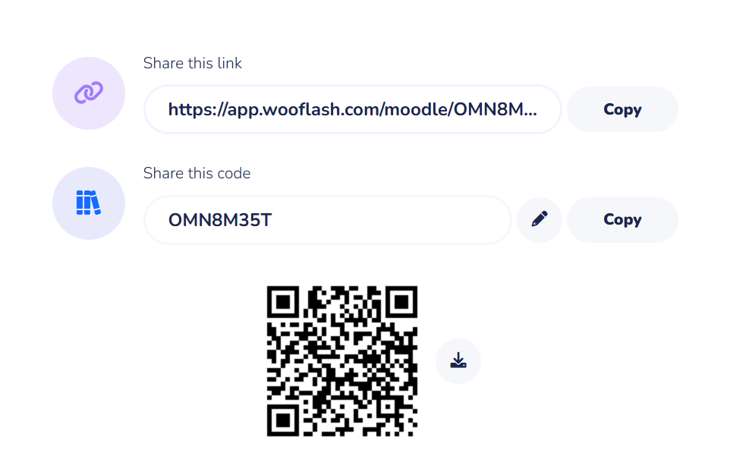
Post Class Assessment

Slide 21
Summary
[1-mins]
In short, a stack is a linear data structure that operates on a LIFO (Last-In, First-Out) principle. It's used to manage data where the most recently added item is the first one to be processed.
Applications:
Expression Handling: Infix → Postfix/Prefix conversion, evaluation of postfix/prefix.
Function Calls / Recursion: Call stack stores return addresses and local variables.
Undo/Redo Operations: In text editors, latest action undone first.
Browser Navigation: Back/forward buttons use stack to track visited pages.
Parentheses Matching: Validating brackets in compilers and editors.
Memory Management: Stack-based allocation in program execution.

Slide 22
At the end of this session students will be able to
Learning Outcomes
Ensure attainment of LO’s in alignment to the learning activities:
Learning Outcome 1: Explore various applications of stack
Learning Outcome 2: Understand Algebraic Expression

Slide 23
[1-min]
Next Session
Conversion of infix to postfix with algorithm

Slide 24
Review and Reflection from students
Any Question ?

Slide 25
THANKS

