Slide 1



Conversion of infix to postfix with algorithm Session No.: 26 Course Name: Data Strucutres Course Code: R1UC308B Instructor Name: Akhilesh Tripathi Duration: 50 mins Date of Conduction :

Slide 2

Review
In previous sessions, we discussed: - Stack operations - Application of Stack
- Infix, Prefix, and Postfix notations
- Precedence and Associativity
- Advantages of postfix and Prefix notations etc.

Slide 3

Pre-Class Assessment
[2-mins]

Slide 4

[1-mins]
In the expression A + B * C, which operation will be performed first? Why?
If we remove parentheses from (A + B) * C, how can we still evaluate it correctly?

Slide 5
Reflection- Opening Activity
(1) In the expression A + B * C, which operation will be performed first? Why?
Ans: Multiplication (B * C) will be performed first, because operator * has higher precedence than +.
(2) If we remove parentheses from (A + B) * C, how can we still evaluate it correctly?
Ans: By converting the expression into postfix form → A B + C *.
This postfix form makes the evaluation order clear without parentheses.

Slide 6
Learning Outcomes
[2-mins]
By the end of this session, You will be able to:
Learning Outcome: Able to convert from infix to postfix with algorithm using stack

Slide 7
Session Outline
1. Activity 1 (Think – Pair – Share)
2. Step by step Algorithm: Conversion of an Infix expression to Postfix expression
3. Example walkthrough 4. Activity 2: Hands-on activities and reinforce learning through an interactive Padlet tool.

Slide 8

Learning Activity 1 (Think – Pair – Share)
[3-mins]
"Why compilers prefer postfix expressions over infix ?"

Slide 9
Reflection- Learning Activity 1
The compiler scans the expression either from left to right or from right to left.
Consider the expression: a + b * c + d
The compiler first scans the expression to evaluate the expression b * c, then again scans the expression to add a to it.
The result is then added to d after another scan.
The repeated scanning makes it very inefficient. Infix expressions are easily readable and solvable by humans whereas the computer cannot differentiate the operators and parenthesis easily so, it is better to convert the expression to postfix (or prefix) form before evaluation.
The corresponding expression in postfix form is abc*+d+.

Slide 10
Algorithm : Conversion of an Infix expression to Postfix expression
Below are the steps to implement the above idea:
1. Scan the infix expression from left to right.
2. If the scanned character is an operand, put it in the postfix expression.
3. Otherwise, do the following
If the precedence of the current scanned operator is higher than the precedence of the operator on top of the stack, or if the stack is empty, or if the stack contains a ‘(‘, then push the current operator onto the stack.
Else, pop all operators from the stack that have precedence higher than or equal to that of the current operator. After that push the current operator onto the stack.

Slide 11
Algorithm Cont...
4. If the scanned character is a ‘(‘, push it to the stack.
5. If the scanned character is a ‘)’, pop the stack and output it until a ‘(‘is encountered, and discard both the parenthesis.
6. Repeat steps 2-5 until the infix expression is scanned.
7. Once the scanning is over, Pop the stack and add the operators in the postfix expression until it is not empty.
8. Finally, print the postfix expression.

Slide 12
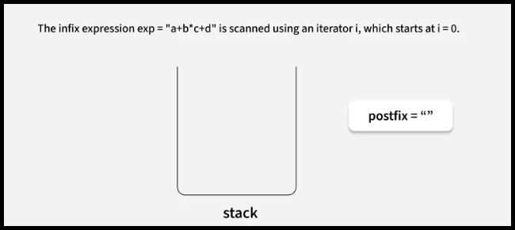
Example walkthrough
Convert the Infix Expression “a+b*c+d” to Postfix Expression using algorithm.
Step 1

Slide 13
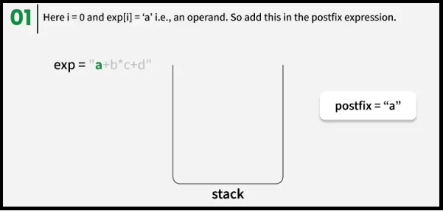
Example walkthrough
Convert the Infix Expression “a+b*c+d” to Postfix Expression using algorithm.
Step 2

Slide 14
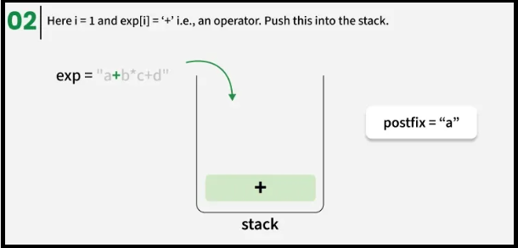
Example walkthrough
Convert the Infix Expression “a+b*c+d” to Postfix Expression using algorithm.
Step 3

Slide 15
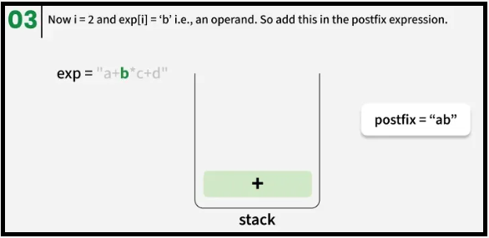
Example walkthrough
Convert the Infix Expression “a+b*c+d” to Postfix Expression using algorithm.
Step 4

Slide 16
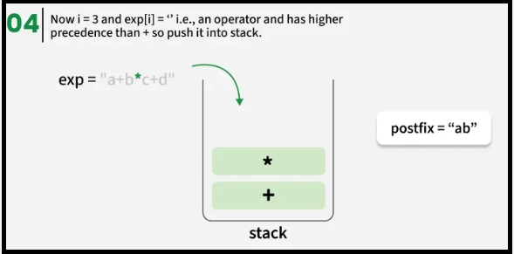
Example walkthrough
Convert the Infix Expression “a+b*c+d” to Postfix Expression using algorithm.
Step 5

Slide 17
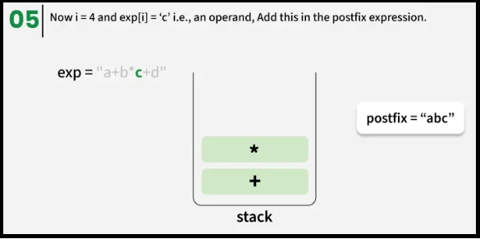
Example walkthrough
Convert the Infix Expression “a+b*c+d” to Postfix Expression using algorithm.
Step 6

Slide 18
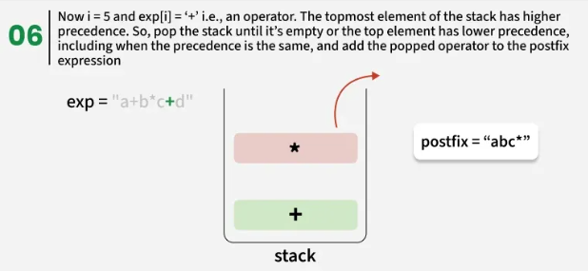
Example walkthrough
Convert the Infix Expression “a+b*c+d” to Postfix Expression using algorithm.
Step 7 (i)

Slide 19
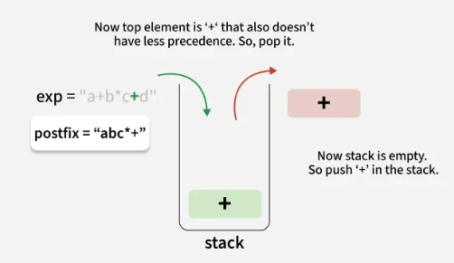
Example walkthrough
Convert the Infix Expression “a+b*c+d” to Postfix Expression using algorithm.
Step 7 (ii)

Slide 20
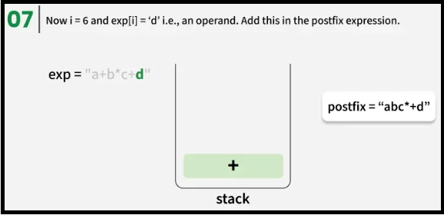
Example walkthrough
Convert the Infix Expression “a+b*c+d” to Postfix Expression using algorithm.
Step 8

Slide 21
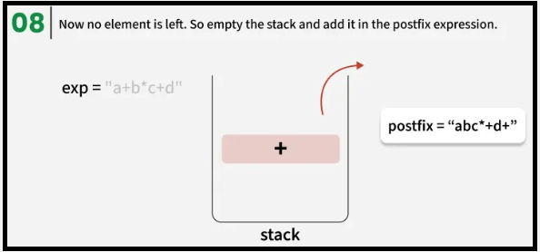
Example walkthrough
Convert the Infix Expression “a+b*c+d” to Postfix Expression using algorithm.
Step 9

Slide 22
Learning Activity 2 (Hands on)
[3-mins]
Covert the following infix expression to postfix using algorithm:
(1) K + L -M * N + (O ^ P) * W/U/V * T + Q
Note: Students will solve the given problems on their notebook.
After that they make PDF of their solutions and upload via padlet.

Slide 23
Summary
[1-mins]
Why Conversion?
Infix (A + B * C) → Ambiguous (needs precedence & parentheses).
Postfix (A B C * +) → Unambiguous, easy for computer to evaluate.
https://atechdaily.com/resources/images/posts/2020/4/359/infixtopostfix_flowchart.jpg

Slide 24
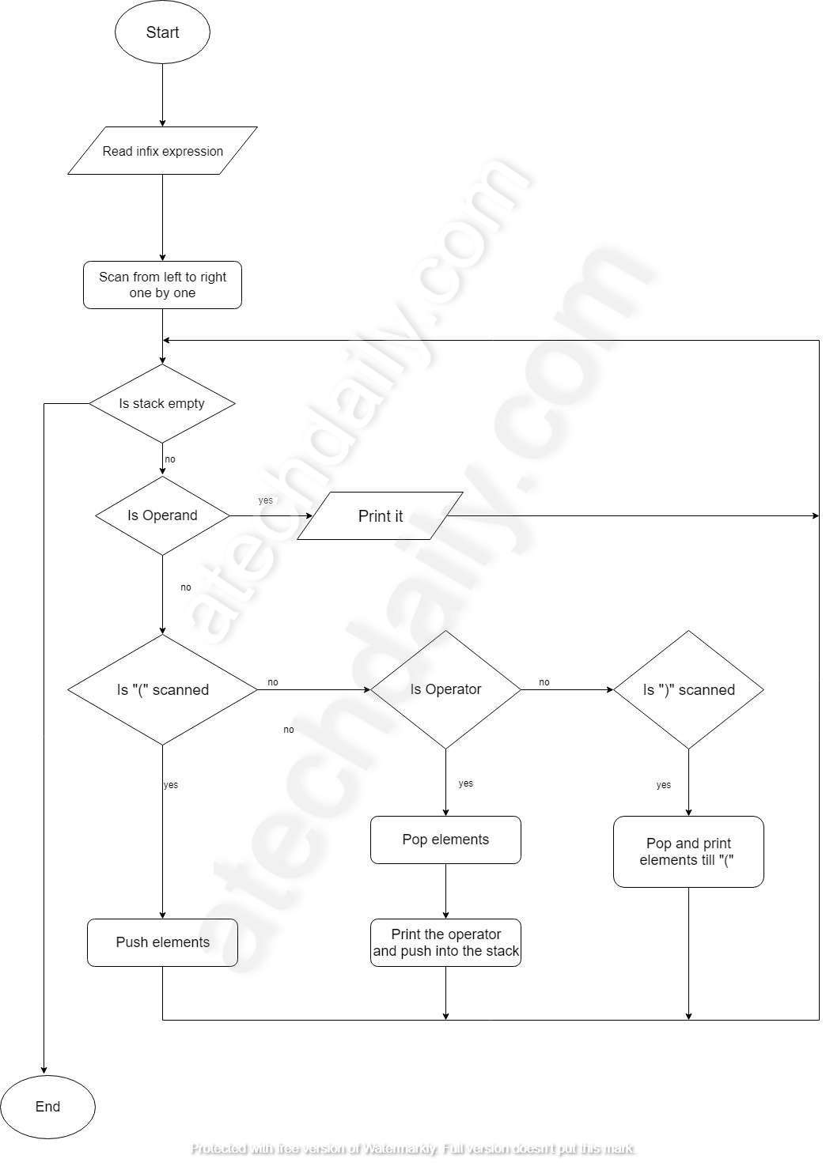

Slide 25
[2-mins]
Ensure attainment of LO’s in alignment to the learning activities:
Learning Outcome: Evaluation of postfix expression

Slide 26

Assessment: WooFlash Quiz
[2-mins]

Slide 27
[1-min]
Next Session:
Evaluation of postfix expression

Slide 28
ANY QUESTION ?
Review and Reflection from students

Slide 29
THANKS

