Slide 1



Evaluation of postfix expression Session No.: 27 Course Name: Data Strucutres Course Code: R1UC308B Instructor Name: Akhilesh Tripathi Duration: 50 mins Date of Conduction:

Slide 2

Review
In previous sessions, we discussed: - Stack operations and their application
- Infix, Prefix, and Postfix notations - Advantages of postfix notation
- Conversion of infix to postfix with algorithm

Slide 3

Pre-Class Assessment
[2-mins]

Slide 4

[1-mins]
We have seen Perfix, Postfix and Infix notations, so what do you think how it will be useful for us?

Slide 5
Learning Outcomes
[2-mins]
By the end of this session, You will be able to:
Learning Outcome: Evaluation of postfix expression

Slide 6
Session Outline
1. Activity 1 (Think – Pair – Share)
2. Introduction to postfix evaluation 3. Algorithm explanation 4. Example walkthrough 5. Activity 2 Hands-on activities and reinforce learning through an interactive Padlet tool.

Slide 7

Activity-1 (Think – Pair – Share)
[3-mins]
Evaluate the expression: 5 1 2 + 4 * + 3 - Hint: Use a stack and process from left to right.

Slide 8
Postfix Evaluation
Postfix evaluation, also known as Reverse Polish Notation (RPN), is a method of evaluating mathematical expressions where operators follow their operands.
It uses a stack data structure to efficiently determine the result without needing parentheses or operator precedence rules.

Slide 9
Algorithm
1. Scan from left to right: Process the postfix expression token by token.
2. Operands: If a token is an operand (a number), push it onto the stack.
3. Operators: If a token is an operator, pop the top two operands from the stack,
Operand 2 -> Top element
Operand 1 -> Next to TOP element
Perform the operation as follows:-
Result= Operand 1 Operation Operand 2
Push the result back onto the stack.
4. Result: After processing all tokens, the final result will be the only element remaining on the stack.

Slide 10
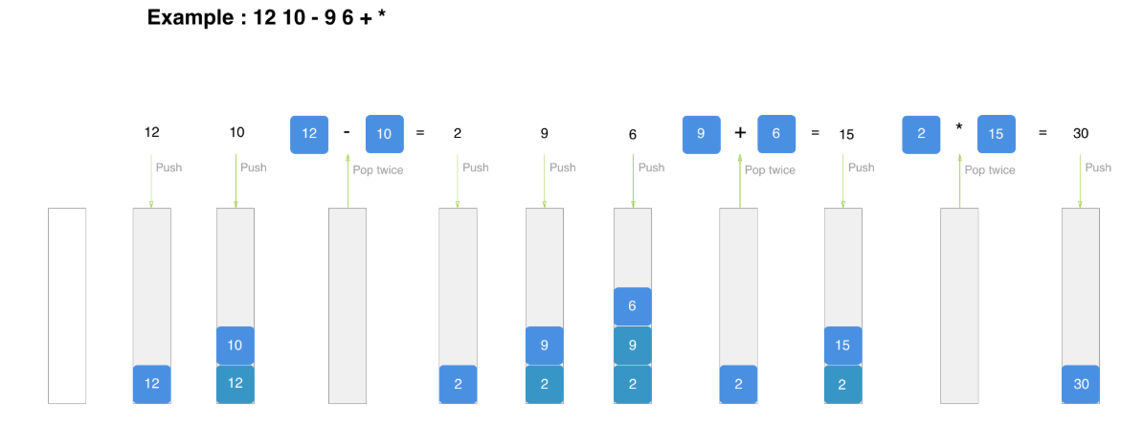
Example walkthrough

Slide 11
Activity-2 (Hands on)
[3-mins]
Evaluate the following expressions:
(1) 2 3 1 * + 9 -
(2) 5 3 + 6 2 / * 3 5 * /
Note: Students will solve the given problems in their notebook.
After that they make PDF of their solutions and upload via padlet.

Slide 12
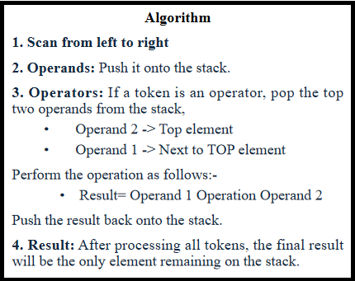
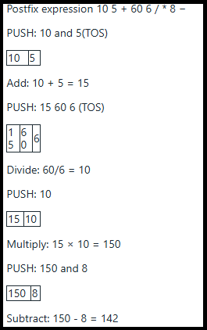
Summary
[1-mins]

Slide 13
[2-mins]
Ensure attainment of LO’s in alignment to the learning activities:
Learning Outcome: Evaluation of postfix expression

Slide 14

Assessment: WooFlash Quiz
[2-mins]

Slide 15
[1-min]
Next Session:
Queue

Slide 16
Review and Reflection from students

