Slide 1



Introduction Queue Session No.: 28 Course Name: Data Structures Course Code: R1UC308B Instructor Name: Mr. Akhilesh Tripathi Duration: 50 mins Date of Conduction:

Slide 2

Review
Pre-Requisite :
Students must have knowledge of C/C++ programming language.
Understanding of arrays and stack as linear data structures.

Slide 3

Pre-Class Assessment
[2-mins]

Slide 4

[1-mins]
What is Queue?

Slide 5
Learning Outcomes
[2-mins]
By the end of this session, You will be able to:
Illustrate the logical structure and working principle of a queue
Check and detect the conditions for Queue Full (Overflow) Queue Empty (Underflow)

Slide 6
Session Outline
Introduction to Queue
Types of Queue and operations
Applications of Queue
Provide hands-on activities and reinforce learning through an interactive WooClap and WooFlash tools.

Slide 7

Activity-1 (Think – Pair – Share)
[1-mins]
What makes a queue different from a stack?
Share 1 key difference
Data Structures: Queue

Slide 8
Concept and Definition for (LO-28)
What is Queue?
- A queue is a linear data structure that follows the First In First Out (FIFO) order of insertion and deletion
- It has mainly 2 pointers to perform operations: Front & Rear. The Rear is for insertion and the Front is for deletion
- It is a linear data structure that gives sequential one-way access to the elements. Even though we can implement it using an array

Slide 9
Concept and Definition for (LO-1)
Need of Queue:
Queues are required because many real-world and computer-based tasks must be processed in the same order they arrive — First-In-First-Out (FIFO). They help in:
Orderly Processing – Ensuring fairness by serving requests in arrival order.
Resource Management – Managing shared resources like CPU time, printers, or network bandwidth.
Data Flow Control – Temporarily holding data when producer speed differs from consumer speed.
Scheduling – Handling tasks in time-sharing systems, job scheduling, or event handling.
Avoiding Data Loss – Providing a buffer in communication systems, avoiding overflow when processing speed is slower than incoming data rate.

Slide 10
Concept and Definition for (LO-1) Classification / Types of Queue
Types of Queues:
There are five different types of queues that are used in different scenarios. They are:
Input Restricted Queue (this is a Simple Queue)
Output Restricted Queue (this is also a Simple Queue)
Circular Queue
Double Ended Queue (Deque)
Priority Queue

Slide 11
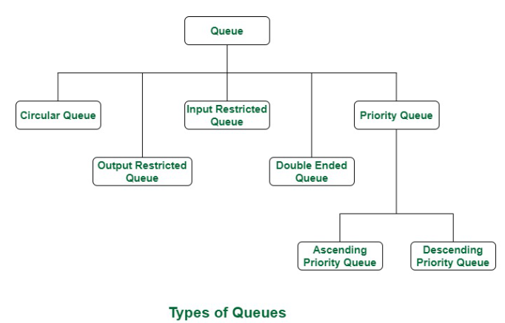
Classification of Data Structures :
[5-mins]

Slide 12
Applications of Queue:
Queue are used in various fields such as:
▶ Breadth-first search algorithm:
▶ Traffic Management:
▶ Network protocols:
▶ Resource Allocation:
▶ Printer queues
▶ Web servers:
[5-mins]

Slide 13
▶ Basic Operations on Queue :
Enqueue: Adds an element to the end (rear) of the queue. If the queue is full, an overflow error occurs.
Dequeue: Removes the element from the front of the queue. If the queue is empty, an underflow error occurs.
Peek/Front: Returns the element at the front without removing it.
Size: Returns the number of elements in the queue
isEmpty: Returns true if the queue is empty, otherwise false.
isFull: Returns true if the queue is full, otherwise false.

Slide 14
▶ Basic Operations on Queue :
Enqueue: Adds an element to the end (rear) of the queue. If the queue is full, an overflow error occurs.
void insert(int data){
if(!isFull()) {
if(rear == MAX-1) {
rear = -1;
}
intArray[++rear] = data;
itemCount++;
}
}

Slide 15
▶ Basic Operations on Queue :
Dequeue: Removes the element from the front of the queue. If the queue is empty, an underflow error occurs.
int dequeue() {
if (isEmpty()) {
printf("Queue Underflow!\n");
return -1;
}
return queue[front++];
}

Slide 16
▶ Basic Operations on Queue :
Peek/Front: Returns the element at the front without removing it.
int peek() {
if (front == -1 || front > rear) {
printf("Queue is Empty!\n");
return -1;
}
return queue[front];
}

Slide 17
▶ Basic Operations on Queue :
isEmpty: Returns true if the queue is empty, otherwise false.
int isFull() {
if (rear == MAX - 1)
return 1; // true
else
return 0; // false
}

Slide 18
▶ Basic Operations on Queue :
isFull: Returns true if the queue is full, otherwise false.
int isEmpty() {
if (front == -1 || front > rear)
return 1; // true
else
return 0; // false
}

Slide 19
▶ Pen paper Activity:
Q. A linear queue of size 4 is empty. Perform the operations:
Enqueue(11), Enqueue(22), Enqueue(33), Dequeue(), Enqueue(44), Dequeue(), Enqueue(55)
Show the final content of the queue and the positions of front and rear.

Slide 20
time and space complexity :-
time complexity:
Enqueue: O(1) because in a linear queue with fixed array we don’t shift elements
Dequeue: O(1) Still constant time since no shifting is done.
Display: O(n) Printing all elements in the queue.
Space Complexity: Array Storage: O(n) → Where n is the maximum queue size (fixed at initialization).
Pointers (front, rear): O(1) → Only two integer variables.
So total space complexity: O(n).

Slide 21

Assessment: WooFlash Quiz

Slide 22
[2-mins]
Ensure attainment of LO’s in alignment to the learning activities:
Illustrate the logical structure and working principle of a queue
Check and detect the conditions for Queue Full (Overflow) Queue Empty (Underflow)

Slide 23
[1-min]
Next Session:
Circular queues and its operation

