Slide 1



Implementation of queue using array and link-list" Session No.: 30 Course Name: Data Strucutres Course Code: R1UC308B Instructor Name: Akhilesh Tripathi Duration: 50 mins Date of Conduction :

Slide 2

Review
Pre-Requisite :
Students must have knowledge of C/C++ programming language.
Queue: Queue operation
Circular Queue and its operation

Slide 3
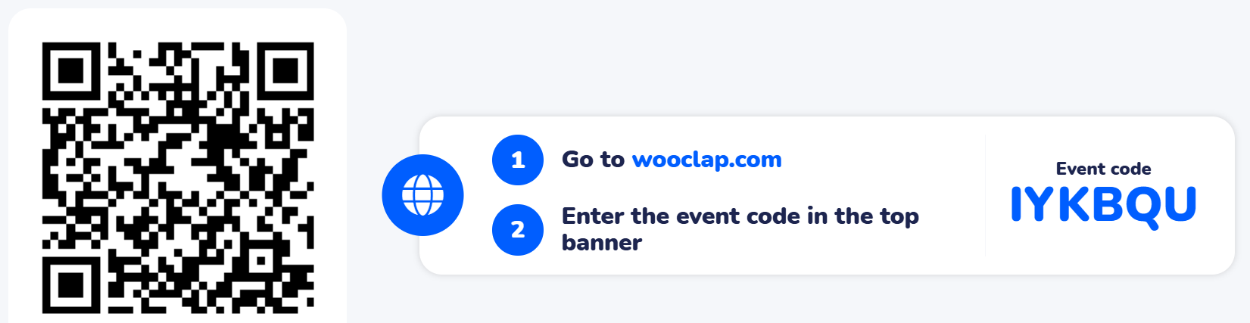
Pre-Class Assessment
[2-mins]

Slide 4

[1-mins]
Difference between linear queue and Circular Queue?

Slide 5
Learning Outcomes
[2-mins]
By the end of this session, You will be able to:
Differentiate between array and linked implementation of queues
Implement queue using array
and linked list

Slide 6
Session Outline
Introduction to Queue Implementations
Array Implementation
Linked List Implementation
Operations: Enqueue & Dequeue
Pseudocode for both
Complexity Analysis
Provide hands-on activities and reinforce learning through an interactive WooClap and WooFlash tools.

Slide 7

Activity-1 (Think – Pair – Share)
[1-mins]
“If you were designing a ticket booking system or a printer queue, would you use an array-based queue or a linked-list-based queue? Why?”
Data Structures: Implementation of Queue

Slide 8
Concept and Definition for (LO-28)
Queue using Array?
- Implemented using a fixed-size array
Requires Front and Rear pointers
Enqueue adds at Rear, Dequeue removes from Front
- May waste space if not circular

Slide 9
Concept and Definition for (LO-1)
Basic Operations:
Enqueue(x):
- Array: if Rear == size-1 then Overflow
- Linked: create new node, attach to Rear
Dequeue():
- Array: if Front > Rear then Underflow
- Linked: delete Front node

Slide 10
Concept and Definition for (LO-1)
Pseudocode: Queue using Array:
Enqueue(Q, x):
if (Rear == size-1) return Overflow
Rear = Rear + 1
Q[Rear] = x
Dequeue(Q):
if (Front > Rear) return Underflow
x = Q[Front]
Front = Front + 1
return x

Slide 11
Concept and Definition for (LO-1)
Pseudocode: Queue using Array:
peek():
if isEmpty():
print "Queue Empty"
else:
return Q[front]
isEmpty():
if front == -1:
return TRUE
else:
return FALSE

Slide 12
Concept and Definition for (LO-1)
Pseudocode: Queue using Array:
isFull():
if rear == size - 1:
return TRUE
else:
return FALSE

Slide 13
Concept and Definition for (LO-1)
Pseudocode: Queue using linked list :
*.To implement a queue with a linked list, we maintain:
A Node structure/class that contains:
data → to store the element.
next → pointer/reference to the next node in the queue.
Two pointers/references:
front → points to the first node (head of the queue).
rear → points to the last node (tail of the queue).

Slide 14
Concept and Definition for (LO-1)
Pseudocode: Queue using Linked List:
Enqueue(Q, x):
newNode = createNode(x)
if (Rear == NULL) Front = Rear = newNode
else Rear.next = newNode, Rear = newNode
Dequeue(Q):
if (Front == NULL) return Underflow
x = Front.data
Front = Front.next
if (Front == NULL) Rear = NULL
return

Slide 15
Concept and Definition for (LO-1)
Pseudocode: Queue using Linked List:
peek():
if front == NULL:
print "Queue Empty"
else:
return front.data
isEmpty():
if front == NULL:
return TRUE
else:
return FALSE

Slide 16
Concept and Definition for (LO-1)
Time and Space Complexity:
Array Implementation:
- Enqueue: O(1)
- Dequeue: O(1)
- Space: O(n)
Linked List Implementation:
- Enqueue: O(1)
- Dequeue: O(1)
- Space: O(n) + O(n) for pointers

Slide 17
Applications:
Circular Queue are used in various fields such as:
Array queues: fixed-size tasks like CPU scheduling
Linked queues: dynamic memory usage in OS, networks
Widely used in scheduling, buffering, resource management
[5-mins]

Slide 18
▶ Basic Operations on Circular Queue :
Enqueue: Adds an element to the end (rear) of the Circular queue. If the Circular queue is full, an overflow error occurs.
Dequeue: Removes the element from the front of the Circular queue. If the Circular queue is empty, an underflow error occurs.
Peek/Front: Returns the element at the front without removing it.
Size: Returns the number of elements in the Circular queue
isEmpty: Returns true if the Circular queue is empty, otherwise false.
isFull: Returns true if the Circular queue is full, otherwise false.

Slide 19

▶ Pen paper Activity:
Q. Implement a queue of size 5 using:
1. Array implementation
2. Linked list implementation

Slide 20
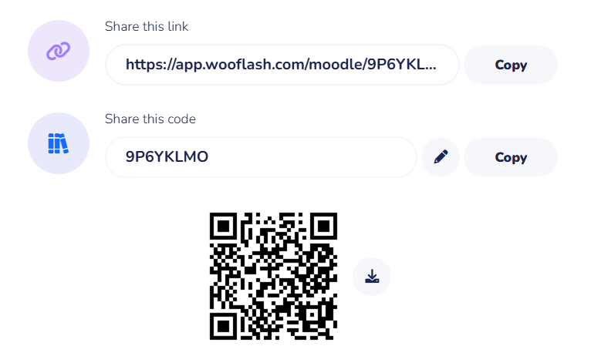
Assessment: WooFlash Quiz

Slide 21
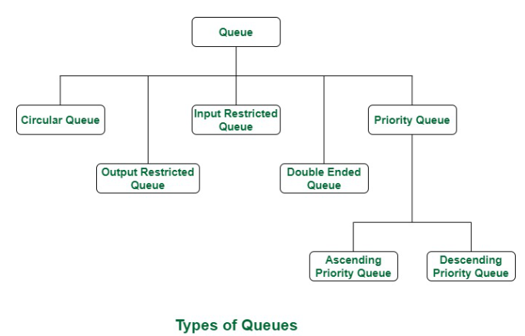
Summary
[1-mins]

Slide 22
[2-mins]
Ensure attainment of LO’s in alignment to the learning activities:
Explain the need of Circular Queue
Illustrate the logical structure and working principle of a Circular queue

Slide 23
[1-min]
Next Session:
Double Ended queue, and Priority Queue.

Slide 24
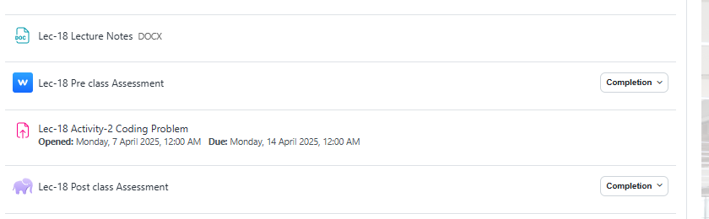
Review and Reflection from students

