Slide 1



Double Ended queue and Priority Queue Session No.: 31 Course Name: Data Strucutres Course Code: R1UC308B Instructor Name: Akhilesh Tripathi Duration: 50 mins Date of Conduction of Class:

Slide 2

Review
Pre-Requisite :
Students must have knowledge of Queue and Circular Queue.

Slide 3
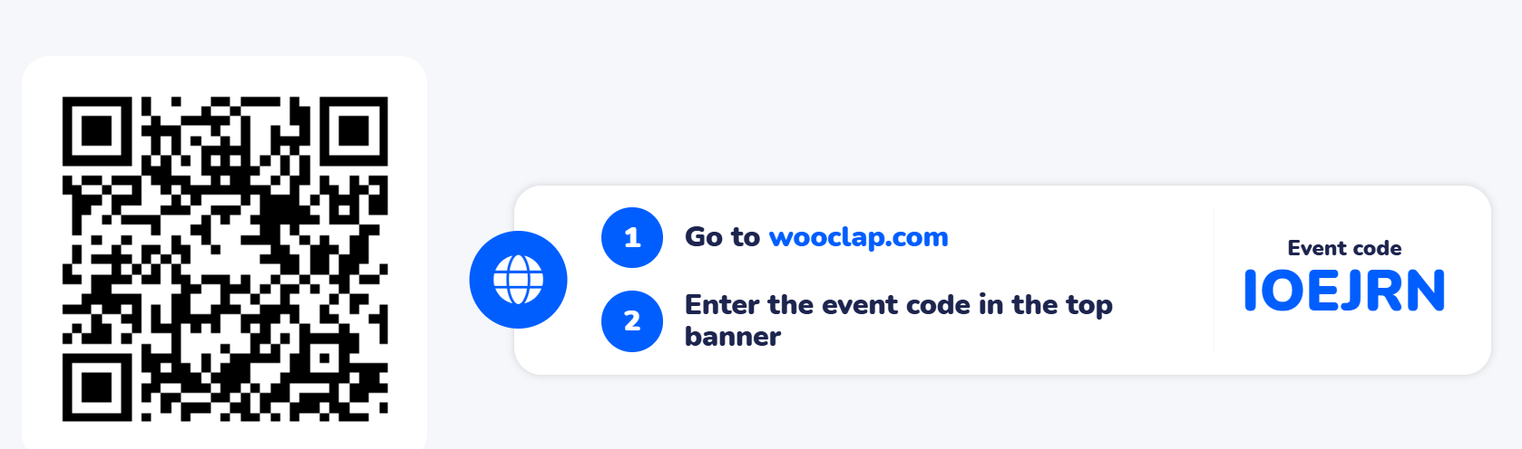
Pre-Class Assessment
[2-mins]

Slide 4

[1-mins]
What is Dequeue and Priority Queue?

Slide 5
Learning Outcomes
[2-mins]
By the end of this session, You will be able to:
To implement insertion and deletion operations from both ends
To analyze the applications of Deque and use of priority queues

Slide 6
Session Outline
What is Dequeue
Types of Dequeue
Operations on Dequeue
Application of Dequeue
What is Priority queue
Types of Priority Queue
Application of Priority Queue

Slide 7

Activity-1 (Think – Pair – Share)
[5-mins]
How can check palindrome ?
How can Job Schedule in Operating Systems

Slide 8
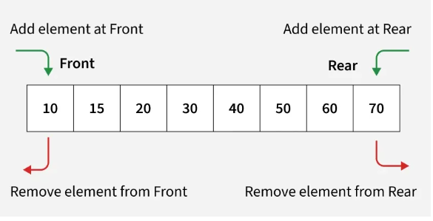
Concept and Definition for (LO-1)
DEQUEUE
Deque or Double Ended Queue is a generalized version of Queue Data Structure that allows insert and delete at both ends

Slide 9
Concept and Definition for (LO-1)
Types of Deque
Input Restricted Deque
Insertion → only at one end
Deletion → allowed at both ends
Output Restricted Deque
Deletion → only at one end
Insertion → allowed at both ends

Slide 10
Concept and Definition for (LO-1)
Operations in Deque
InsertFront(x) → insert element x at the front.
InsertRear(x) → insert element x at the rear.
DeleteFront() → remove element from the front.
DeleteRear() → remove element from the rear.
GetFront() → return element at front.
GetRear() → return element at rea.
IsEmpty() → check if deque is empty.
IsFull() → check if deque is full
Applications of Deque
Palindrome checking (insert at one end, delete from the other).
Undo/Redo operations in text editors.
Job scheduling (e.g., CPU task management).
Sliding window problems in competitive programming.

Slide 11
Concept and Definition for (LO-1)
#include <stdio.h> #define SIZE 5 int deque[SIZE]; int front = -1, rear = -1; // Insert element at front void insertFront(int x) { if ((front == 0 && rear == SIZE-1) || (front == rear+1)) { printf("Deque is Full\n"); return; } if (front == -1) { front = rear = 0; } else if (front == 0) { front = SIZE-1; } else { front--; } deque[front] = x; } | // Insert element at rear void insertRear(int x) { if ((front == 0 && rear == SIZE-1) || (front == rear+1)) { printf("Deque is Full\n"); return; } if (front == -1) { front = rear = 0; } else if (rear == SIZE-1) { rear = 0; } else { rear++; } deque[rear] = x; } | // Delete element from front void deleteFront() { if (front == -1) { printf("Deque is Empty\n"); return; } if (front == rear) { front = rear = -1; } else if (front == SIZE-1) { front = 0; } else { front++; } }

Slide 12
Concept and Definition for (LO-1)
// Delete element from rear void deleteRear() { if (front == -1) { printf("Deque is Empty\n"); return; } if (front == rear) { front = rear = -1; } else if (rear == 0) { rear = SIZE-1; } else { rear--; } } | // Get front element int getFront() { if (front == -1) { printf("Deque is Empty\n"); return -1; } return deque[front]; } | // Get rear element int getRear() { if (rear == -1) { printf("Deque is Empty\n"); return -1; } return deque[rear]; }

Slide 13
Concept and Definition for (LO-2)
Priority Queue
Definition
A Priority Queue is a special type of queue where each element is assigned a priority, and elements with higher priority are served before lower priority elements.
If two elements have the same priority, they are served according to their order in the queue (FIFO).
Types of Priority Queues
Ascending Priority Queue
Element with the lowest priority number is dequeued first.
Descending Priority Queue
Element with the highest priority number is dequeued first.

Slide 14
Concept and Definition for (LO-2)
Operations in Priority Queue
Insert(item, priority) → Insert an element along with its priority.
Delete() → Remove the element with the highest priority.
Peek() → Return the element with the highest priority without removing it.
IsEmpty() → Check if the queue is empty.
IsFull() → Check if the queue is full (array-based).
Applications of Priority Queue
Job Scheduling in Operating Systems (CPU scheduling).
Dijkstra’s Shortest Path Algorithm.
Huffman Coding (data compression).
Load balancing in networks.
Emergency systems (e.g., hospital patients treated by severity).

Slide 15
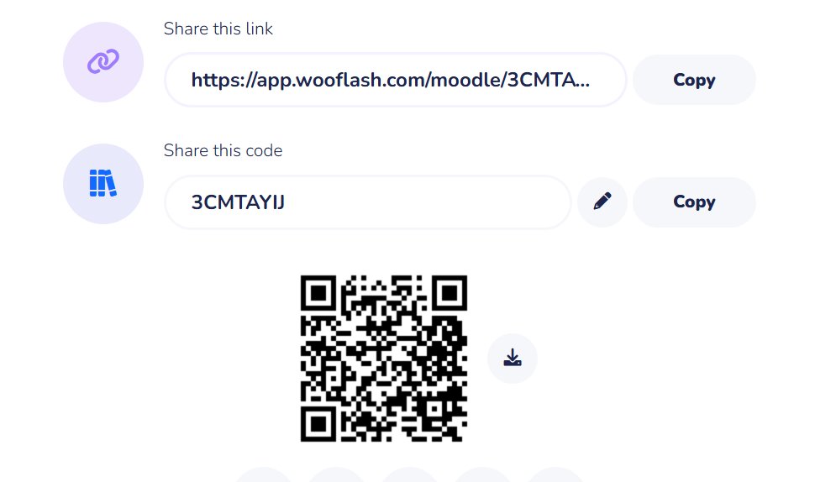
Assessment: Woo Flash Quiz

Slide 16
Summary
[1-mins]
A Deque is a linear data structure that allows insertion and deletion at both ends (front and rear).
It is more flexible than a normal queue.
Two variants exist:
Input-restricted deque → insertion at one end only.
Output-restricted deque → deletion at one end only.
Can be implemented using arrays or linked lists.
Summary of Priority Queue
A Priority Queue is a queue where each element has a priority, and elements with higher priority are served first.
Two variants:
Ascending priority queue → smallest priority dequeued first.
Descending priority queue → highest priority dequeued first.
Can be implemented using arrays, linked lists, or heaps.

Slide 17
Ensure attainment of LO’s in alignment to the learning activities:
[2-mins]
To implement insertion and deletion operations from both ends
To analyze the applications of Deque and use of priority queues

Slide 18
[1-min]
Next Session:
Introduction to Tree and Types of Tree

Slide 19
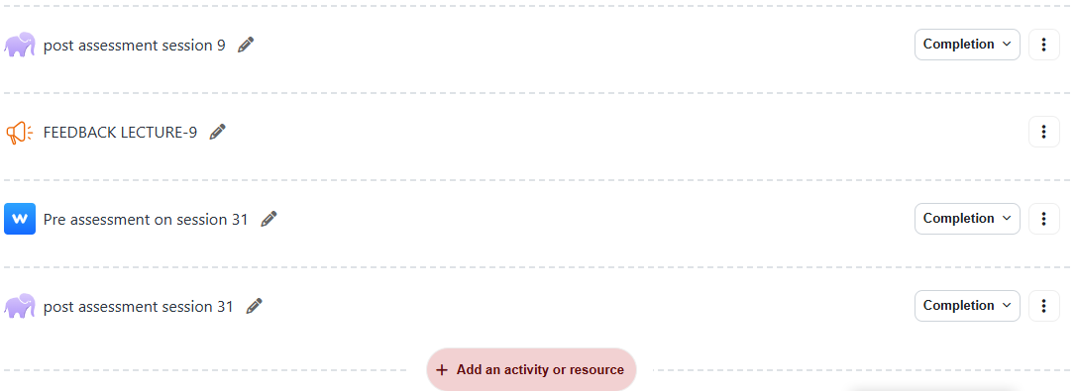
Review and Reflection from students

