Slide 1



Trees: Introduction of Tree and their types Session No.: 32 Course Name: Data Strucutres Course Code: R1UC308B Instructor Name: Akhilesh Tripathi Duration: 50 mins Date of Conduction of Class:

Slide 2

Review
Pre-Requisite :
Students must have knowledge of linear data structure.

Slide 3

Pre-Class Assessment
[2-mins]

Slide 4

[1-mins]
What is non linear data structure?

Slide 5
Learning Outcomes
[2-mins]
By the end of this session, You will be able to:
To explain the hierarchical structure and properties of trees
To differentiate between various types of trees and identify their applications

Slide 6
Session Outline
Introduction to tree
Properties of tree
Types of tree

Slide 7

Activity-1 (Think – Pair – Share)
[5-mins]
What is difference between linear data structure and non linear data structure
What is the advantage of tree over linear data structure

Slide 8
Concept and Definition for (LO-1)
INTRDUCTION TO TREE
▶ Tree data structure is a hierarchical structure that is used to represent and organize data in a way that is easy to navigate and search.
▶ It is a collection of nodes that are connected by edges and has a hierarchical relationship between the nodes.
▶ The topmost node of the tree is called the root, and the nodes below it are called the child nodes.

Slide 9
Concept and Definition for (LO-1)
INTRDUCTION TO TREE
▶ The node which is an immediate predecessor of a node is called the parent node of that node.
▶ Each node can have multiple child nodes, and these child nodes can also have their own child nodes, forming a recursive structure.
▶ The node which is the immediate successor of a node is called the child node of that node.
▶ Tree is considered a non-linear data structure.

Slide 10
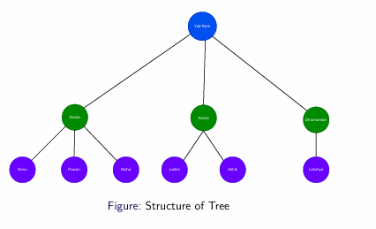
Concept and Definition for (LO-1)
INTRDUCTION TO TREE

Slide 11
Concept and Definition for (LO-1)
Basic Terminology of Trees
Node: An element in a tree, which contains data and possibly references to child nodes.
Edge: A connection between two nodes, representing the relationship between them.
Root: The topmost node in the tree, which serves as the starting point.
Parent Node: A node that has one or more child nodes.
Child Node: A node that is a descendant of another node.
Leaf Node: A node that does not have any children (also called terminal nodes).
Subtree: A tree formed from any node and its descendants.
Path: A sequence of nodes and edges from one node to another.
Level: The level of a node is its distance from the root. The root is at level 0.
.

Slide 12
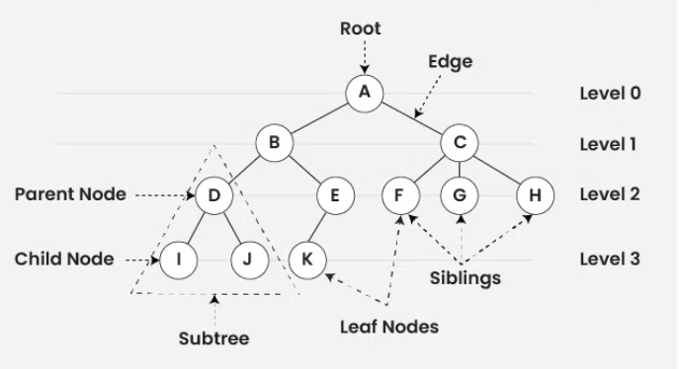
Concept and Definition for (LO-1)

Slide 13
Concept and Definition for (LO-1)
Properties of Tree Data Structure:
Number of edges: An edge can be defined as the connection between two nodes. If a tree has N nodes then it will have (N-1) edges. There is only one path from each node to any other node of the tree.
Depth of a node: The depth of a node is defined as the length of the path from the root to that node. Each edge adds 1 unit of length to the path. So, it can also be defined as the number of edges in the path from the root of the tree to the node.
Height of a node: The height of a node can be defined as the length of the longest path from the node to a leaf node of the tree.
Height of the Tree: The height of a tree is the length of the longest path from the root of the tree to a leaf node of the tree.
Degree of a Node: The total count of subtrees attached to that node is called the degree of the node. The degree of a leaf node must be 0. The degree of a tree is the maximum degree of a node among all the nodes in the tree.

Slide 14
Concept and Definition for (LO-2)
Types of Trees:
Binary Tree
A binary tree is a tree where each node has at most two children. These children are typically referred to as the left and right children.
Binary Tree Properties:
Each node has at most two children.
Left child comes before right child.

Slide 15
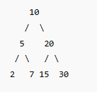
Concept and Definition for (LO-2)
Types of Trees:
Binary Search Tree (BST)
A binary search tree is a binary tree in which the nodes follow the ordering property:
Left subtree of a node contains only nodes with values less than the node's value.
Right subtree of a node contains only nodes with values greater than the node's value.
Advantages:
Efficient searching, insertion, and deletion.

Slide 16
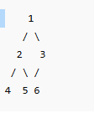
Concept and Definition for (LO-2)
Types of Trees:
Complete Binary Tree
A complete binary tree is a binary tree where all the levels, except possibly the last, are completely filled, and the nodes are as far left as possible.
Example:

Slide 17
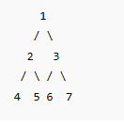
Concept and Definition for (LO-2)
Types of Trees:
Full Binary Tree
A full binary tree is a binary tree where every node has either 0 or 2 children (no node has only one child).

Slide 18
Concept and Definition for (LO-2)
Types of Trees:
AVL Tree (Self-Balancing Binary Search Tree)
An AVL tree is a binary search tree where the balance factor of every node is at most 1, meaning the heights of the left and right subtrees of any node differ by no more than 1.
Self-balancing: Automatically re-balances the tree when nodes are inserted or deleted, ensuring efficient operations.

Slide 19

Assessment: Woo Flash Quiz

Slide 20
Summary
[1-mins]
A tree is a hierarchical data structure with nodes connected by edges. It consists of a root node, parent-child relationships, and leaf nodes.
Types of Trees:
Binary Tree: Each node has at most two children.
Binary Search Tree (BST): Left child < parent < right child.
Applications: Searching, Sorting, Memory Management, Decision Making, Network Routing.

Slide 21
Ensure attainment of LO’s in alignment to the learning activities:
[2-mins]
To explain the hierarchical structure and properties of trees
To differentiate between various types of trees and identify their applications

Slide 22
[1-min]
Next Session:
Binary Tree and Its array and linked list representation, Strict Binary Tree, Complete Binary Tree

Slide 23

Review and Reflection from students

