Slide 1



Binary Tree and Its array and linked list representation, Strict Binary Tree, Complete Binary Tree Session No.: 32 Course Name: Data Strucutres Course Code: R1UC308B Instructor Name: Sachin Tyagi Duration: 50 mins Date of Conduction of Class:

Slide 2

Review
Pre-Requisite :
Students must have knowledge about non linear data structure ,array and linked list and basic concept about tree.

Slide 3

Pre-Class Assessment
[2-mins]

Slide 4

[1-mins]
How can represent binary tree with the help of array and linked list ?

Slide 5
Learning Outcomes
[2-mins]
By the end of this session, You will be able to:
Implement Binary Tree using Array and Linked List.
Differentiate between Strict and Complete Binary Trees.

Slide 6
Session Outline
Binary Tree Basics
Array Representation
Linked List Representation
Strict Binary Tree
Complete Binary Tree

Slide 7

Activity-1 (Think – Pair – Share)
[5-mins]
Why do we need different representations (array vs linked list) for binary trees? Which one would you prefer for sparse trees and why?
Differentiate between Strict and Complete Binary Trees.

Slide 8
Concept and Definition for (LO-1)
Binary tree is a tree data structure (non-linear) in which each node can have at most two children which are referred to as the left child and the right child. The topmost node in a binary tree is called the root, and the bottom-most nodes are called leaves. A binary tree can be visualized as a hierarchical structure with the root at the top and the leaves at the bottom.

Slide 9
Concept and Definition for (LO-1)
Representation of Binary Trees
1) Linked Node Representation 2) Array Representation

Slide 10
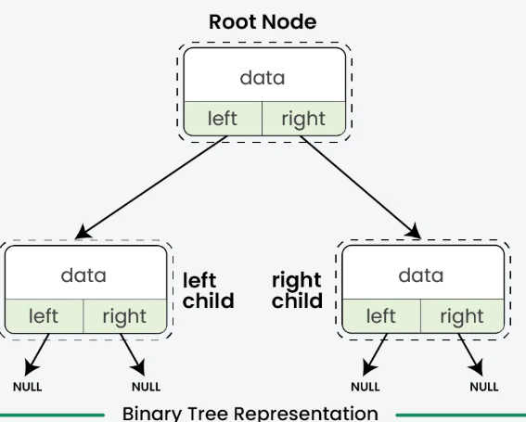
Concept and Definition for (LO-1)
1. Linked Node Representation This is the simplest way to represent a binary tree. Each node contains data and pointers to its left and right children. Advantages: 1)It can easily grow or shrink as needed, so it uses only the memory it needs. 2) Only uses memory for the nodes that exist, making it efficient for sparse trees. Disadvantages: 1)Needs extra memory for pointers. 2) Finding a node can take longer because you have to start from the root and follow pointers.

Slide 11
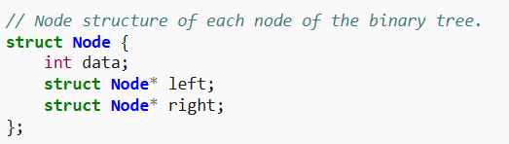
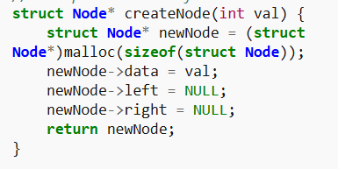
Concept and Definition for (LO-1)
.
Create/Declare a Node of a Binary Tree:

Slide 12
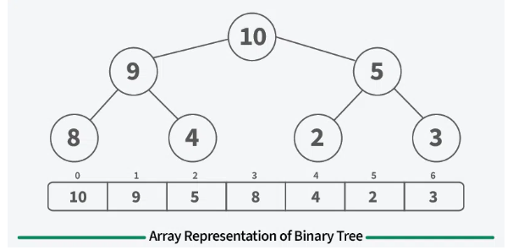
Concept and Definition for (LO-1)
Array Representation Array Representation is another way to represent binary trees, especially useful when the tree is complete (all levels are fully filled except possibly the last, which is filled from left to right). In this method: The tree is stored in an array. For any node at index i: Left Child: Located at 2 * i + 1 Right Child: Located at 2 * i + 2 Root Node: Stored at index 0

Slide 13
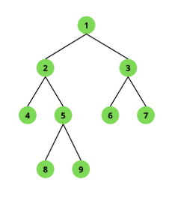
Concept and Definition for (LO-1)
Strict Binary Tree A strict binary tree, also known as a proper binary tree or a full binary tree, is a type of binary tree where every node has either zero or two children. This means that no node in a strict binary tree can have only one child. Key characteristics of a strict binary tree: Internal nodes: All internal nodes (non-leaf nodes) must have exactly two children. Leaf nodes: All leaf nodes (nodes with no children) have zero children.

Slide 14
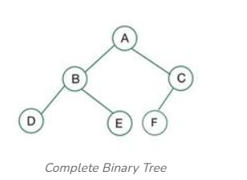
Concept and Definition for (LO-2)
Complete Binary Tree: A complete binary tree is a special type of binary tree where all the levels of the tree are filled completely except the lowest level nodes which are filled from as left as possible. | Properties of Complete Binary Tree: 1)A complete binary tree is said to be a proper binary tree where all leaves have the same depth. 2)In a complete binary tree number of nodes at depth d is 2^{d}. 3)In a complete binary tree with n nodes height of the tree is log(n+1). 4)All the levels except the last level are completely full.

Slide 15

Assessment: Woo Flash Quiz

Slide 16
Summary
Binary Tree: Max two children (left, right).
Array Representation: Simple indexing, best for complete trees.
Linked List Representation: Space-efficient, dynamic.
Strict Binary Tree: Every non-leaf has exactly 2 children.
Complete Binary Tree: All levels filled except last (left to right).
[1-mins]

Slide 17
Ensure attainment of LO’s in alignment to the learning activities:
[2-mins]
Implement Binary Tree using Array and Linked List.
To Differentiate between Strict and Complete Binary Trees.

Slide 18
[1-min]
Next Session: inorder, preorder and postorder traversing in binary tree.

Slide 19
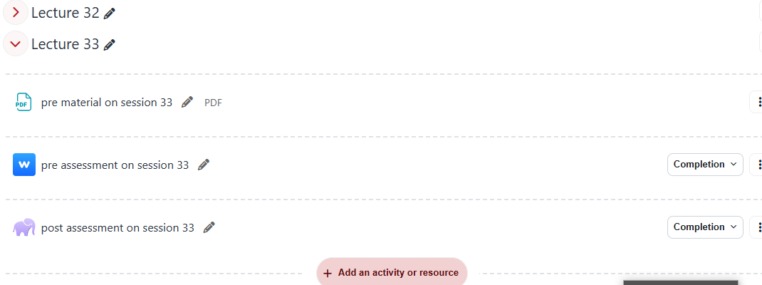
Review and Reflection from students

