Slide 1



Tree Traversal Algorithms: In-order, Pre-order, and Post order Session No.: 34 Course Name: Data Structures Course Code: R1UC308B Instructor Name: Akhilesh Tripathi Duration: 50 mins Date of Conduction of Class:

Slide 2

[1-mins]
Review
Pre-Requisite :
1. What is a binary tree?
2. What do we mean by 'visiting' a node?

Slide 3

Pre Session Assessment
[5 mins]

Slide 4
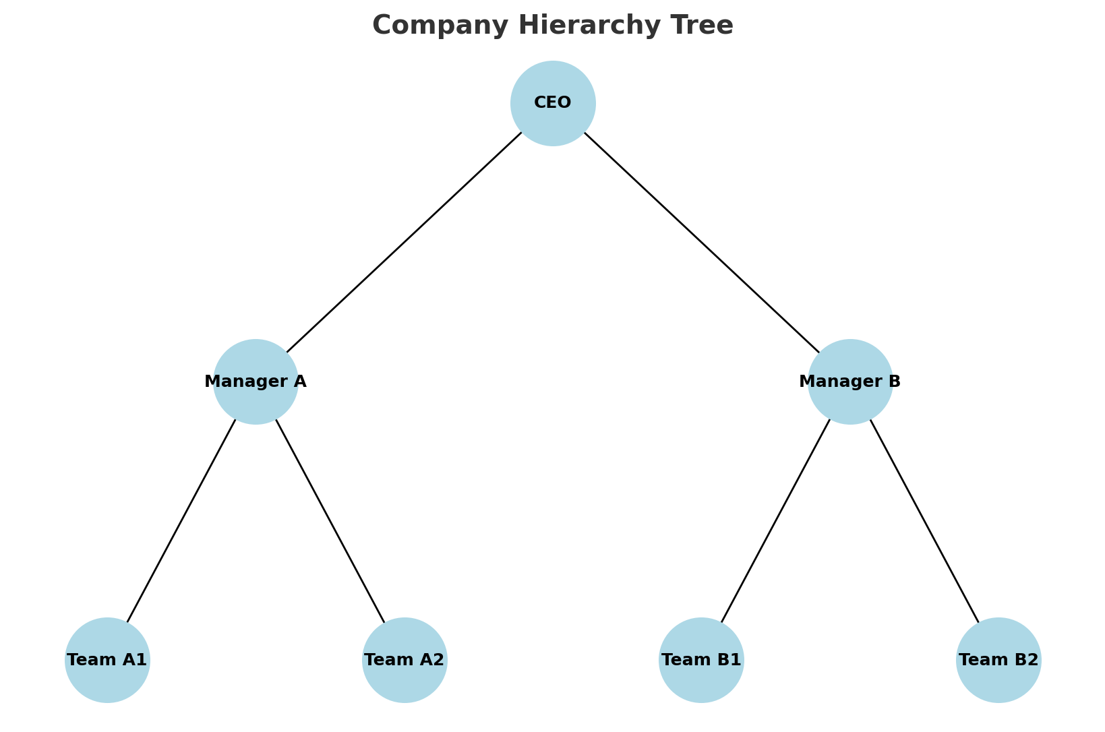
“Look at the company chart. The CEO is at the top, then come the managers, and then their teams. There are different possible ways to visit everyone in order.
Can you figure out how many distinct visiting orders there are, and describe them?

Slide 5
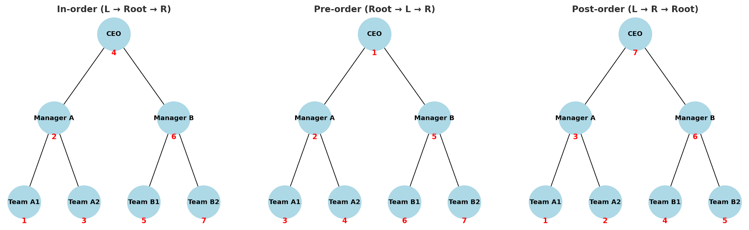
[10-mins]
“Look at the company chart. The CEO is at the top, then come the managers, and then their teams. There are different possible ways to visit everyone in order.
Can you figure out how many distinct visiting orders there are, and describe them?

Slide 6
Learning Outcomes
By the end of this session, You will be able to:
Explain the basic steps of in-order, pre-order, and post-order traversal.
Find out the traversal order in the given tree diagram.

Slide 7
Session Outline
Opening Question and Activity-1
Concepts and Definitions :Tree Traversal Algorithms
Applications of Tree Traversal Algorithms
Example of Tree Traversal Algorithms
Activity-2 : Problem Solving
Reinforce learning through an interactive Wooflash/Wooclap tools.

Slide 8
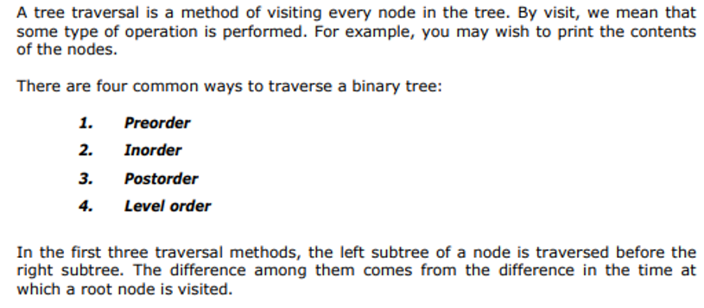
Concept and Definition
[15-mins]

Slide 9
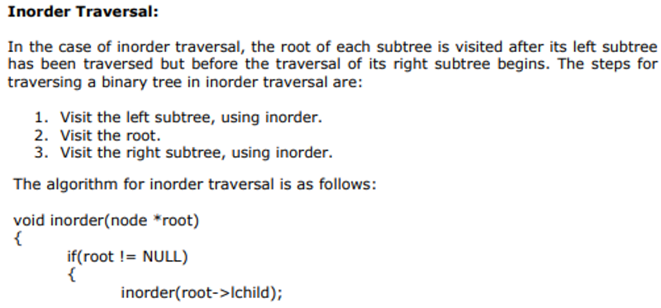
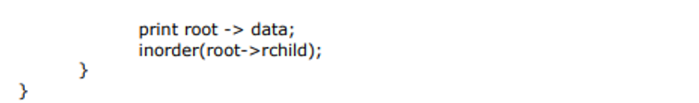
Concept and Definition

Slide 10
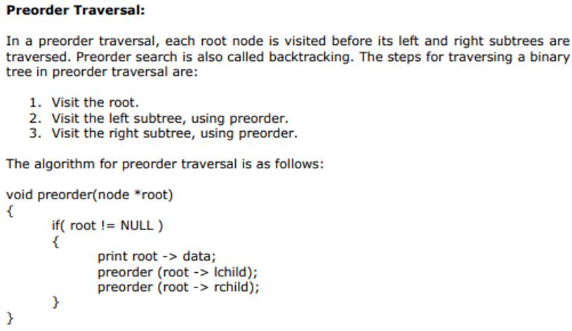
Concept and Definition

Slide 11
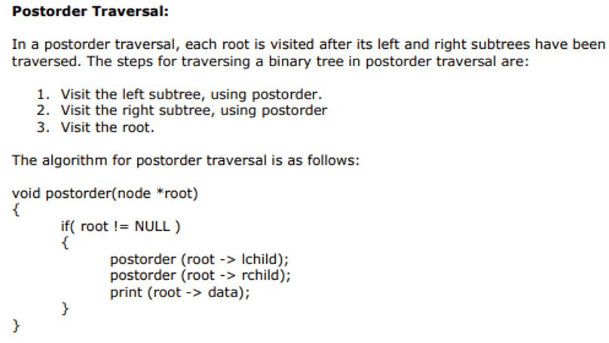
Concept and Definition

Slide 12
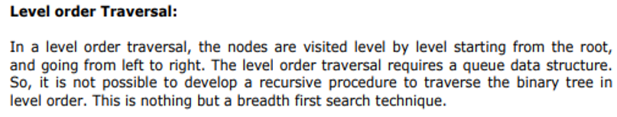
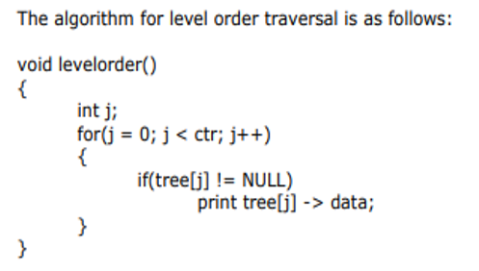
Concept and Definition

Slide 13


Real-World Applications
Deleting/freeing nodes in memory safely (used in garbage collection).
Evaluating expression trees (postfix notation).
Used in bottom-up algorithms (e.g., calculating height, subtree values).

Slide 14
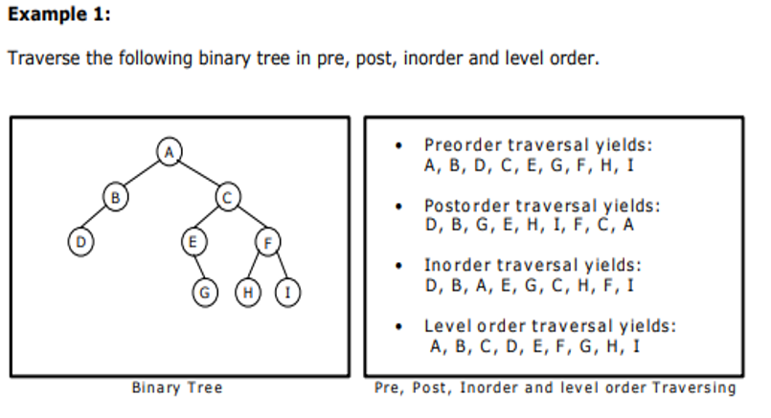
First Visit: Pre, Second Visit:In, Third Visit: Post, Level Visit

Slide 15
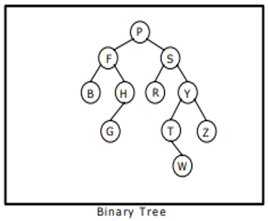
Activity-2
[10-mins]

Slide 16
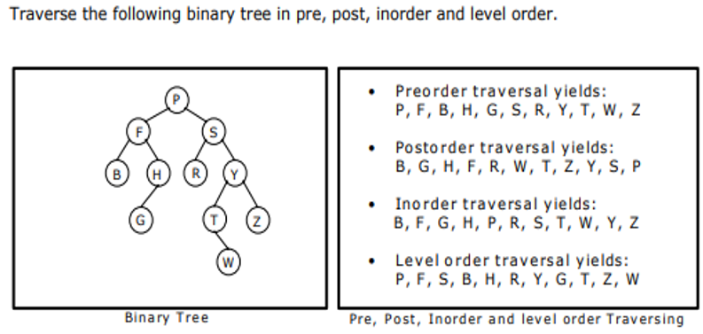
Activity-2 _Solution

Slide 17

Post Session Assessment
[5 mins]

Slide 18
Summary
[3-mins]

Slide 19
Learning Outcomes
By the end of this session, You will be able to:
Explain the basic steps of in-order, pre-order, and post-order traversal.
Find out the traversal order in the given tree diagram.

Slide 20
[1-min]
Next Session:
Constructing Binary Tree from given Tree Traversal

Slide 21
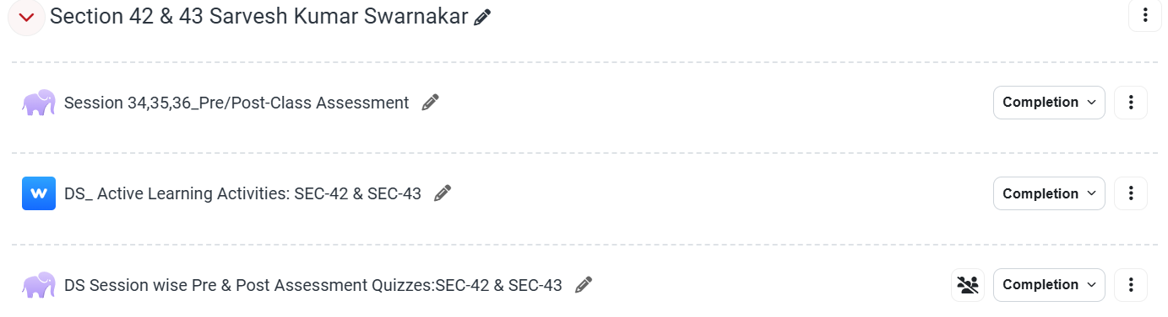
Review and Reflection from students

