Slide 1



Constructing Binary Tree From Given Tree Traversal Session No.: 35 Course Name: Data Structures Course Code: R1UC308B Instructor Name: Akhilrsh Tripathi Duration: 50 mins Date of Conduction of Class: 8 Dec 2025

Slide 2

[1-mins]
Review
Prerequisite:
1. What are the three main tree traversals?
2. How does in-order differ from pre-order/post-order?

Slide 3

Pre-Class Assessment
[4-mins]

Slide 4
[10-mins]
Why would we ever need to rebuild a tree structure from only its visiting order?

Slide 5
S.No. | Application Area | Why Tree Reconstruction is Needed
1 | Data Recovery & Restoration | To bring back a lost or damaged tree structure when only its visiting order is available.
2 | Compiler Design & Expression Evaluation | To rebuild expression trees from stored sequences for further processing.
3 | Data Storage & Transmission | To restore a tree that was saved as a sequence for saving space or sending data.

Slide 6
Learning Outcomes
By the end of this session, You will be able to:
Recall the definitions and basic steps of in-order, pre-order, and post-order traversal.
Apply algorithms to reconstruct binary trees from given traversal pairs.

Slide 7
Session Outline
Opening Question and Activity-1
Concepts and Definitions : Constructing Binary Tree from Given Tree Traversal
Example
Activity-2 : Problem Solving
Reinforce learning through an interactive Wooflash/Wooclap tools.

Slide 8
Concept and Definition
[15-mins]
Constructing Binary Tree
▶ Construct Binary Tree from Pre-order and In-order Traversal
▶ Construct Binary Tree from Post-order and In-order Traversal
▶ Construct Full Binary Tree from Pre-order and Post-order Traversal
▶ Construction from in-order and pre/post-order is very simple:
Find out the root node from pre-order/post-order.
Locate that node in the in-order.
Nodes in the left of root node in Step 2 are the in the left part of the root and nodes in the right of the root node are in the right part of the root node.
Make two groups of all nodes of the step 3 in post/pre-order.
Apply these steps recursively

Slide 9
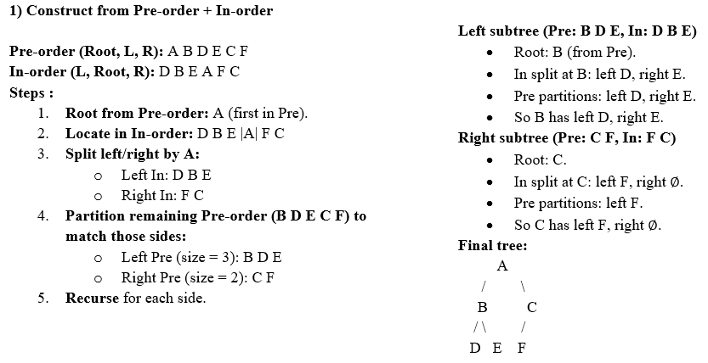
Concept and Definition

Slide 10
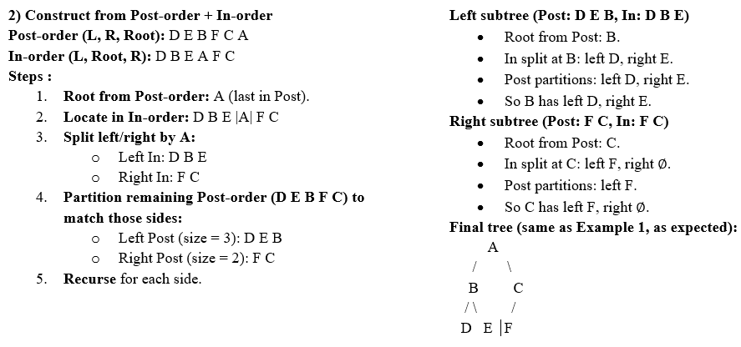
Concept and Definition

Slide 11
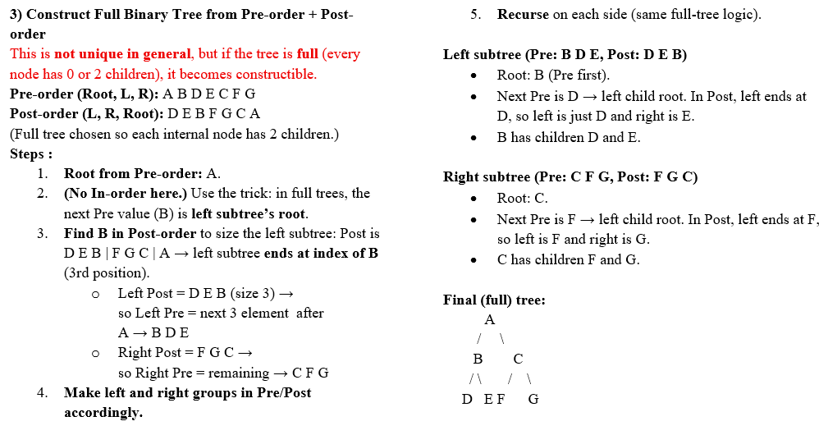
Concept and Definition

Slide 12
Activity-2
[10-mins]
Problem Set
1) Construct from Pre-order and In-order
Pre-order: M N P Q R S
In-order: P N Q M S R
2) Construct from Post-order and In-order
Post-order: X Y Z W V U
In-order: X W Y U Z V
3) Construct Full Binary Tree from Pre-order and Post-order
Pre-order: K L M N O P Q
Post-order: M N L P Q O K

Slide 13
Activity-2 Solution
[10-mins]
Problem Set
1) Construct from Pre-order and In-order
Pre-order: M N P Q R S
In-order: P N Q M S R
2) Construct from Post-order and In-order
Post-order: X Y Z W V U
In-order: X W Y U Z V
3) Construct Full Binary Tree from Pre-order and Post-order
Pre-order: K L M N O P Q
Post-order: M N L P Q O K
M
/ \
N R
/ \ /
P Q S
U
/ \
W V
/ \ /
X Y Z
K
/ \
L O
/ \ / \
M N P Q

Slide 14
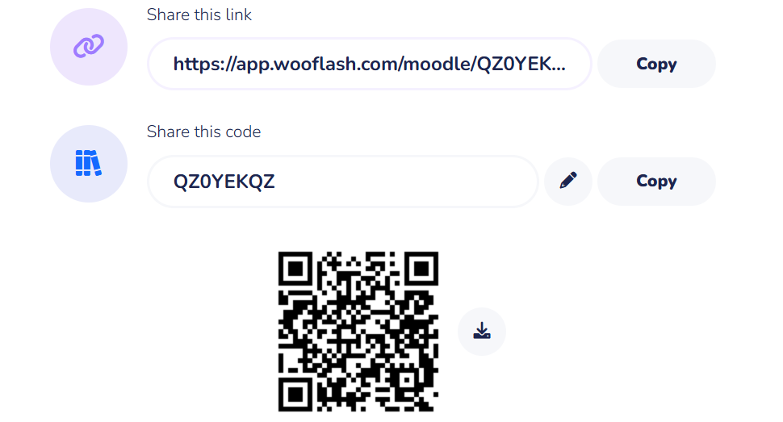
Post-Class Assessment
[04-mins]

Slide 15
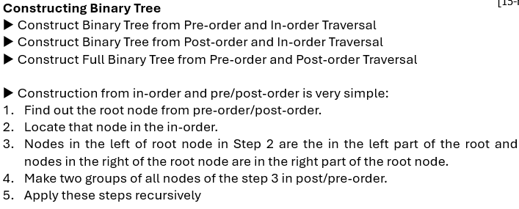
Summary
[3-mins]

Slide 16
[2-mins]
Ensure attainment of LO’s in alignment to the learning activities:
Recall the definitions and basic steps of In-order, Pre-order, and Post-order traversal.
Apply algorithms to reconstruct binary trees from given traversal pairs.

Slide 17
[1-min]
Next Session:
BST Operation: Searching, Insertion

Slide 18
Review and Reflection from students

