Slide 1



BST Operations: Searching, Insertion Session No.: 36 Course Name: Data Structures Course Code: R1UC308B Instructor Name: Akhilesh Tripathi Duration: 50 mins Date of Conduction of Class: 05 Dec 2025

Slide 2

[1-mins]
Review
Pre-Requisite :
1. What is a BT?
2. What are the different operations that can be performed on any data structure?

Slide 3

Pre-Class Assessment
[4-mins]

Slide 4
[10-mins]
“Have you ever used price filters while shopping online?
How do you think the website quickly finds products within your selected price range, such as ₹500 to ₹1000, without checking each product one by one?”
Suggest solution table wise.

Slide 5
[10-mins]
Idea is-
If price < 500 → skip left, go right.
If price > 1000 → skip right, go left.
So to handle/implement this idea we can use BST (Binary Search Tree )

Slide 6
Learning Outcomes
By the end of this session, You will be able to:
Define a Binary Search Tree and explain how it is constructed using given data.
Implement the step-by-step procedure of searching and inserting nodes in a BST

Slide 7
Session Outline
Opening Question and Activity-1
Concepts and Definitions :BST and associated operations
Applications of BST
Example
Activity-2 : Problem Solving
Reinforce learning through an interactive Wooflash/Wooclap tools.

Slide 8


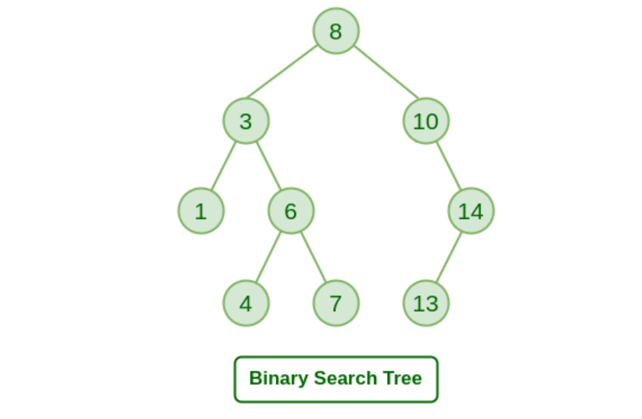
Binary Search Tree
A binary Search Tree is special kind of tree that satisfy the following conditions
If value of inserted node is bigger than the parent node then it will be right subtree.
If value of inserted node is smaller than the parent node then it will be left subtree.
This tree is known as binary search tree or ordered binary tree.
It used for searching an element.

Slide 9
Binary Search Tree Operation
Insert
Search
Delete

Slide 10
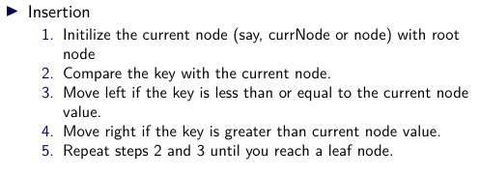
Concept and Definition

Slide 11
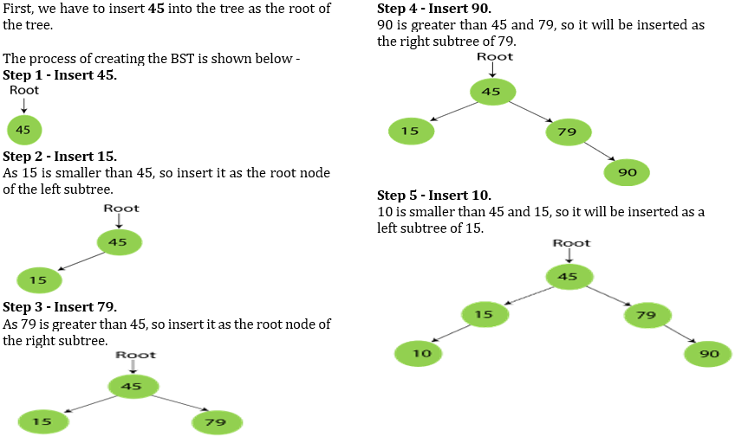
Insertion Operation
Construct a Binary Search Tree by INSERTING following data.- 45, 15, 79, 90, 10, 55, 12, 20, 50
[15-mins]

Slide 12
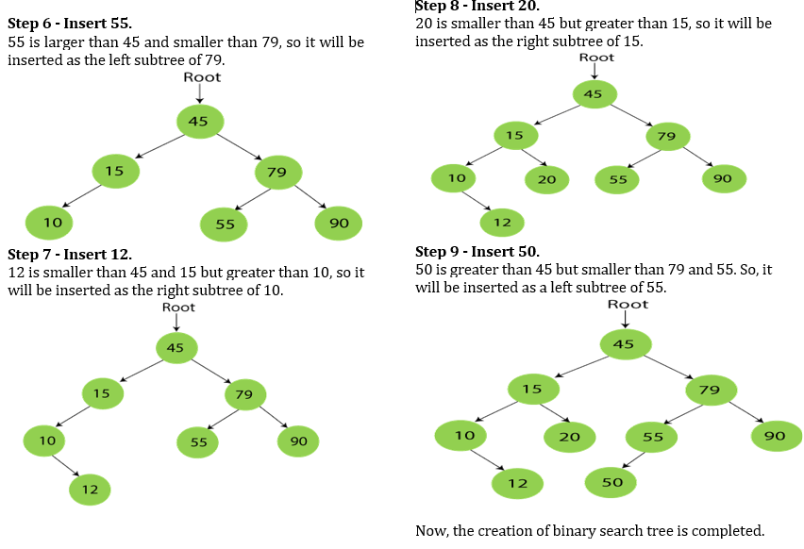
Insertion Operation

Slide 13
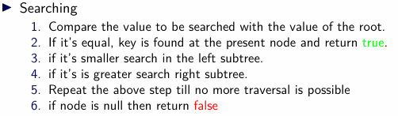
Concept and Definition

Slide 14
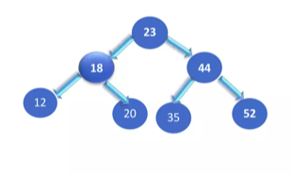
Example of searching in BST
If we have to search 12 than go to left sub tree

Slide 15
Activity-2
[10-mins]
You are given the following sequence of integers to insert into a BST in the given order: 50, 30, 20, 40, 70, 60, 80
Perform following tasks:
1. Construct the BST by inserting the elements one by one. Draw the tree after all insertions.
2. Search Operation: Search for 40 → Does it exist in the BST? Show the path traversed.
3. Insertion Operation: Insert the element 65 into the BST. Redraw the BST after insertion.

Slide 16
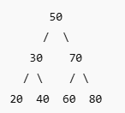
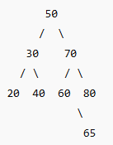
Activity-2 _Solution

Slide 17
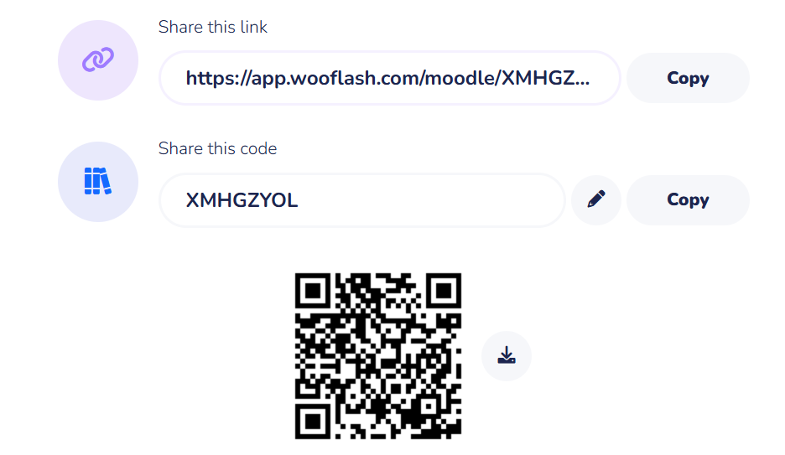
Post-Class Assessment
[04-mins]

Slide 18
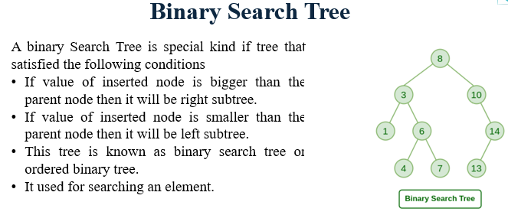
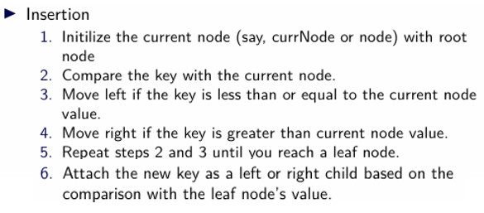
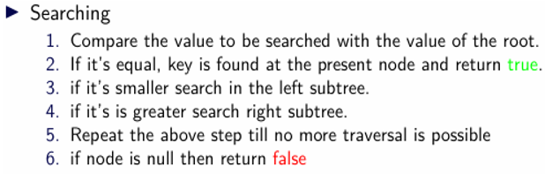
Summary
[3-mins]

Slide 19
[2-mins]
Ensure attainment of LO’s in alignment to the learning activities:
Define a Binary Search Tree and explain how it is constructed using given data.
Implement the step-by-step procedure of searching and inserting nodes in a BST

Slide 20
[1-min]
Next Session:
BST Operation : Deletion, Threaded Binary Trees

Slide 21
Review and Reflection from students

