Slide 1



BST Operation:Deletion And Threaded Binary Trees Session No.: 37 Course Name: Data Strucutres Course Code: R1UC308B Instructor Name: Akhilesh Tripathi Duration: 50 mins Date of Conduction of Class: 10 Dec 2025

Slide 2

Review
Pre-Requisite :
Students must have knowledge of Binary Search tree.

Slide 3

Pre-Class Assessment
[2-mins]

Slide 4

[1-mins]
What is BST?

Slide 5
Learning Outcomes
[2-mins]
By the end of this session, You will be able to:
Apply and analyze the deletion operation in a Binary Search Tree.
Replace null entries in tree by usefull information using Threaded Binary Tree.

Slide 6
Session Outline
Delete operation in BST
Threaded Binary Tree
Type of Threaded Binary Tree
Provide hands-on activities and reinforce learning through an interactive WooClap and WooFlash tools.

Slide 7

Activity-1 (Think – Pair – Share)
[5-mins]
What is BST?
What return search algo in BST ?

Slide 8
Concept and Definition for (LO-1)
BST_Delete(t,loc,par,left,right) 1. Call search(t) 2. If loc == NULL, then → Print "value not present" → Stop. 3. If loc has zero or one child Call deleteone() to remove the node. else if Node has two children Call deletetwo() to remove the node. 4. Exit | void delete(int t) { search(t); if(loc==null) { printf("value not present"); } else if(loc.left==null || loc.right==null) deleteone(); else deletetwo(); }

Slide 9
Concept and Definition for (LO-1)
Algo for deleting node having zero or one child Print "loc.data deleted" to show which node is being removed. Initialize a variable child. If loc.left == NULL → set child = loc.right. (means node has only right child). Else → set child = loc.left. (means node has only left child). 4. If par == NULL set root = child (case when loc is root node). Else if loc == par.left set par.left = child (loc was left child of its parent). Else → set par.right = child (loc was right child of its parent). 5. End. | Algo for deleting node having 2 children Set suc = loc.right (start from right subtree). Set parsuc = loc. While suc.left != NULL: parsuc = suc. suc = suc.left. (Now suc is inorder successor.) Swap loc.data with suc.data. Set loc = suc, par = parsuc. Call deleteone() to delete successor (which now has ≤ 1 child).

Slide 10
Concept and Definition for (LO-1)
void deleteone() { printf(” %d deleted”, loc.data); Node child; if(loc.left==null) child=loc.right; else child=loc.left; if(par==null) root=child; else if(loc==par.left) par.left=child; else par.right=child; } | void deletetwo() { Node suc=loc.right; Node parsuc=loc; while(suc.left!=null) { parsuc=suc; suc=suc.left; } int tt=loc.data; loc.data=suc.data; suc.data=tt; loc=suc; par=parsuc; deleteone(); }

Slide 11
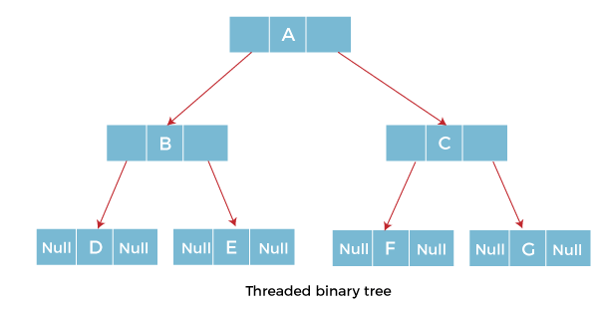
Concept and Definition for (LO-2)
Threaded Binary Tree
In the linked representation of binary trees, more than one half of the link fields contain
NULL values which results in wastage of storage space. If a binary tree consists of n nodes then n+1
link fields contain NULL values.
So in order to effectively manage the space, a method was devised by Perlis and Thornton in which the NULL
links are replaced with special links known as threads.
Such binary trees with threads are known as threaded binary trees.
Each node in a threaded binary tree either contains a link to its child node or thread to other nodes in the tree.
Types of Threaded Binary Tree
There are two types of threaded Binary Tree:
One-way threaded Binary Tree
Two-way threaded Binary Tree

Slide 12
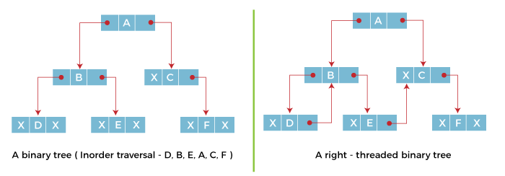
Concept and Definition for (LO-2)
One-way threaded Binary trees:
In one-way threaded binary trees, a thread will appear either in the right or left link field of a node. If it appears in the right link field of a node then it will point to the next node that will appear on performing in order traversal. Such trees are called Right threaded binary trees. If thread appears in the left field of a node then it will point to the nodes inorder predecessor. Such trees are called Left threaded binary trees. Left threaded binary trees are used less often as they don't yield the last advantages of right threaded binary trees. In one-way threaded binary trees, the right link field of last node and left link field of first node contains a NULL. In order to distinguish threads from normal links they are represented by dotted lines.

Slide 13
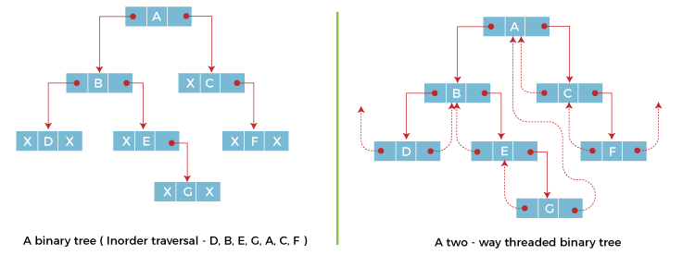
Concept and Definition for (LO-2)
Two-way threaded Binary Trees:
In two-way threaded Binary trees, the right link field of a node containing NULL values is replaced by a thread that points to nodes inorder successor and left field of a node containing NULL values is replaced by a thread that points to nodes inorder predecessor.

Slide 14
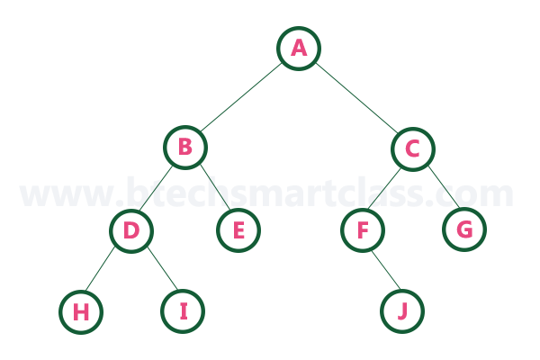
Activity-2 (Think – Pair – Share)
Make Tow-Way Threaded Binary Tree
[10-mins]

Slide 15

Assessment: WooFlash Quiz

Slide 16
Summary
[1-mins]
Topic: The session covers Deletion operation in Binary Search Tree (BST) and Threaded Binary Trees.
BST Deletion Cases:
Node not found.
Node with 0 or 1 child.
Node with 2 children (replaced by inorder successor/predecessor).
Threaded Binary Tree Motivation: In linked binary trees, more than half of link fields are NULL → causes space wastage.
Origin: Concept introduced by Perlis and Thornton.
Definition: In a threaded binary tree, NULL links are replaced by threads pointing to inorder predecessor/successor.
Types of Threaded Binary Trees:
One-way threaded tree: Either left or right null replaced by a thread.
Two-way threaded tree: Both left and right nulls replaced by threads.
Right Threaded Trees: Thread in right link points to inorder successor.
Left Threaded Trees: Thread in left link points to inorder predecessor (less common).

Slide 17
Ensure attainment of LO’s in alignment to the learning activities:
[2-mins]
Apply and analyze the deletion operation in a Binary Search Tree.
Replace null entries in tree by usefull information using Threaded Binary Tree.

Slide 18
[1-min]
Next Session:
Heaps and Heap Sort

Slide 19
Review and Reflection from students

