Slide 1



Heaps and Heap Sort Session No.: 38 Course Name: Data Strucutres Course Code: R1UC308B Instructor Name: Akhilesh Kumar Tripathi Duration: 50 mins Date of Conduction :

Slide 2

Review
Pre-Requisite :
Students must have knowledge of Complete Binary tree and sorting.

Slide 3

Pre-Class Assessment
[2-mins]

Slide 4

[1-mins]
What is Complete Binary Tree ?

Slide 5
Learning Outcomes
[2-mins]
By the end of this session, You will be able to:
Construct min and max Heap tree.
Implement and apply Heap Sort to sort an unsorted list .

Slide 6
Session Outline
Introduction of Heap Tree
Heapify Concept
Heap Sort
Provide hands-on activities and reinforce learning through an interactive WooClap and WooFlash tools.

Slide 7
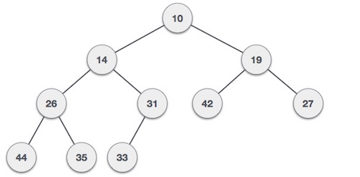
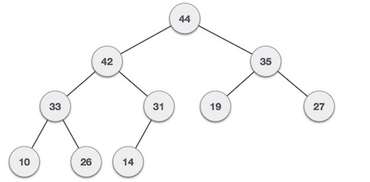
Concept and Definition for (LO-1)
Heap tree is a complete binary tree. Heap tree is of two types:
Min-Heap − Where the value of the each node is less than or equal to either of its children. | Max-Heap − Where the value of the each node is greater than or equal to either of its children.

Slide 8
Heap Sort Procedure (Ascending Order using Max Heap)
Build HeapConvert the array into a Max Heap (for ascending order).
Use Heapify to maintain heap property.
2. Swap & Reduce Heap SizeSwap the root (maximum element) with the last element.Reduce the heap size by 1.
3. HeapifyApply heapify on the new root to restore heap property.
4. RepeatContinue swapping root with last element and heapifying until only one element remains.
Heapify Logic For a node at index i: Left child = 2i + 1Right child = 2i + 2 Swap i with the largest of (i, left, right) if heap property is violated.

Slide 9
Concept and Definition for (LO-2)
void heapify(int a[],int n,int i) { int lar,l,r,t; lar =i; l=2*i+1; r=l+1; if(l<n && a[l]>a[lar]) lar=l; if(r<n && a[r]>a[lar]) lar=r; if(lar!=i) { t=a[lar]; a[lar]=a[i]; a[i]=t; heapify(a,n,lar); } } void buildheap(int a[],int n) { int i; for(i=(n/2)-1;i>=0;i--) heapify(a,n,i); } | void heapsort(int a[],int n) { int t; while(n>1) { t=a[n-1]; a[n-1]=a[0]; a[0]=t; n=n-1; heapify(a,n,0); } }

Slide 10
Activity-1 (Think – Pair – Share)
Apply heap sort to sort the following numbers:
10,30,40,20,100,90,70,80,50,60
[10-mins]

Slide 11

Assessment: WooFlash Quiz

Slide 12
Summary
[1-mins]
Heap Definition: A heap is a complete binary tree that satisfies the heap property.
Max-Heap: Each parent node is greater than or equal to its children.
Min-Heap: Each parent node is less than or equal to its children.
Heapify Concept: A process to maintain the heap property by adjusting nodes, typically used in heap construction and heap sort.
Heap Sort Steps:
Build a max-heap from the array.
Swap root (largest element) with last element.
Reduce heap size and call heapify.
Repeat until array is sorted.
Complexity:
Building heap: O(n)
Each heapify call: O(log n)
Heap Sort: O(n log n)
Key Point: Heap sort is an in-place, comparison-based, and non-stable sorting algorithm.

Slide 13
Ensure attainment of LO’s in alignment to the learning activities:
[2-mins]
Construct min and max Heap tree.
Implement and apply Heap Sort to sort an unsorted list .

Slide 14
[1-min]
Next Session:
Introduction of Graph and representation graph in memory.

Slide 15
Review and Reflection from students

