Slide 1



Introduction of Graph and representation in memory Session No.: 39 Course Name: Data Strucutres Course Code: R1UC308B Instructor Name: Akhilesh Tripathi Duration: 50 mins Date of Conduction:

Slide 2

Review
Pre-Requisite :
Students must have knowledge of array and linked list.

Slide 3

Pre-Class Assessment
[2-mins]

Slide 4

[1-mins]
What is 2D-array and linked list?

Slide 5
Learning Outcomes
[2-mins]
By the end of this session, You will be able to:
Represent a Graph in memory using Adjacency Matrix (array-based storage).
Represent a Graph in memory using Adjacency List (linked list-based storage).

Slide 6
Session Outline
Introduction to Graph
Represent a graph in memory using adjacency matrix.
Represent a graph in memory using adjacency list.
Provide hands-on activities and reinforce learning through an interactive WooClap and WooFlash tools.

Slide 7
Concept and Definition for (LO-1)
Graph A graph is a nonlinear data structure that consist a set of vertices (called nodes) and edges. Graph have many to many relationships.
Adjacent vertices (or neighbours) are two vertices connected by a common edge. In other words, there is a direct edge between the two vertices in the graph.
A path P in a graph G=(V,E) is defined as a sequence of edges:
P=e1,e2,e3,…,ek
Cycle is a path that starts and ends at the same vertex, with no repeated edges or vertices (except for the starting/ending vertex).
A connected graph is a graph in which there is a path between every pair of vertices. This means that all vertices are reachable from any other vertex in the graph.
A disconnected graph is a graph in which at least one pair of vertices is not connected by a path.
A complete graph is a type of graph in which every pair of distinct vertices is connected by a unique edge. In other words, all possible edges that can exist between the vertices are present in the graph.
If a complete graph has n vertices, then:
Number of edges =n(n−1)/2 in undirected graph.
Number of edges=n(n−1)​ for a directed graph.

Slide 8
Concept and Definition for (LO-1)
A weighted graph is a graph in which each edge is assigned a numerical value called a weight. These weights typically represent costs, distances, durations, capacities, or other measures associated with the connection between two vertices.
A directed graph (or digraph) is a type of graph in which every edge has a direction. This means the edges are ordered pairs of vertices, where the first vertex is the start (or tail) and the second is the end (or head).
A self-loop is an edge in a graph that connects a vertex to itself. In other words, it is an edge where the starting and ending vertices are the same.
Parallel edges (or multiple edges) are two or more edges that connect the same pair of vertices in a graph.
The degree of a vertex in a graph refers to the number of edges connected to that vertex.
Types of Degree:
Undirected Graph:
The degree of a vertex v, denoted by deg(v), is the total number of edges connected to v.
Self-loops are counted twice because they connect the vertex to itself twice.
Directed Graph:
In-degree: The number of edges coming into a vertex v.
Out-degree: The number of edges going out of a vertex v.

Slide 9
Concept and Definition for (LO-1)
Simple Graph:A simple graph is a graph that:
Has no self-loops
Has no parallel edges
Multigraph:A multigraph is a graph that:
Allows parallel edges
May or may not have self-loop
Cyclic Graph: A cyclic graph is a graph that contains at least one cycle. A cycle is a path in which the starting vertex and the ending vertex are the same, and no other vertices or edges are repeated (except the starting/ending vertex).
An acyclic graph is a graph that does not contain any cycles.
A regular graph is a graph in which every vertex has the same degree. The degree of a vertex is the number of edges connected to it.
If every vertex has degree k, the graph is called a k-regular graph.
An articulation point (or cut vertex) in a graph is a critical vertex that, if removed, disconnects parts of the graph.
A bridge (also known as a cut-edge) in a graph is an edge that, if removed, disconnects the graph.
A biconnected graph is a connected graph in which there are no articulation points or bridge.
A discrete graph is a type of graph in which there are no edges between the vertices. In other words, all the vertices are isolated, and each vertex is not connected to any other vertex by an edge.

Slide 10
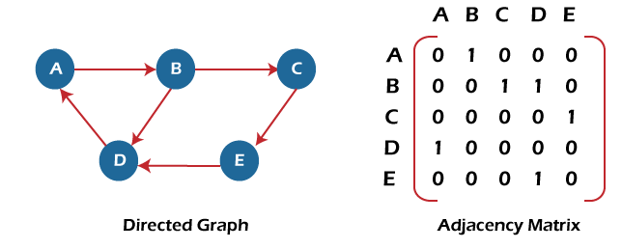
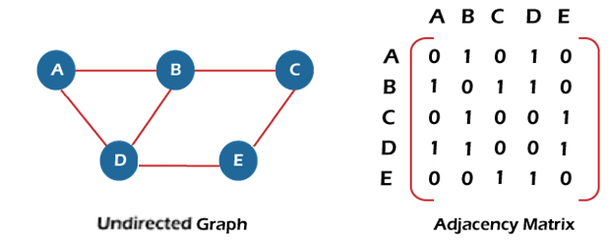
Concept and Definition for (LO-1)
Graph representation: There are two ways to store Graphs into the computer's memory:
Sequential representation (Adjacency matrix representation)
Linked list representation ( Adjacency list representation)
Sequential representation
We can use an adjacency matrix to represent the undirected graph or directed graph.
If a Graph G consists of n vertices, then the adjacency matrix for that graph is n x n, and the matrix A = [a_{ij}] can be defined as -
A_{ij} = 1 {if there is a direct edge from V_{i} to V_{j}}
A_{ij} = 0 {Otherwise}

Slide 11
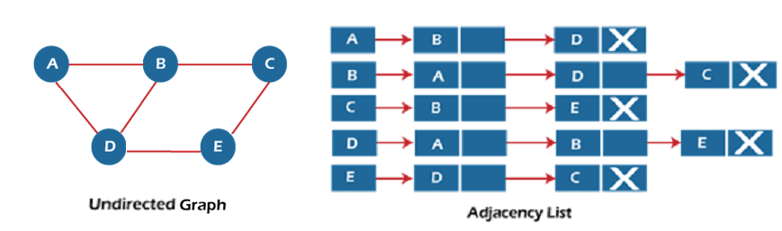
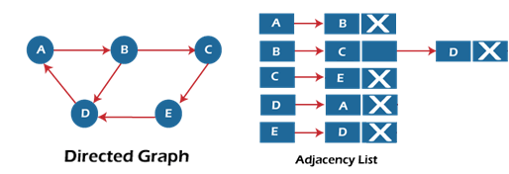
Concept and Definition for (LO-2)
Linked list representation
In linked list (adjacency list) representation, each vertex of the graph has a linked list that stores all the vertices adjacent to it. An array of size V (number of vertices) is maintained, where each entry points to the head of a linked list. This method is space-efficient for sparse graphs, requiring only O(V + E) space.

Slide 12
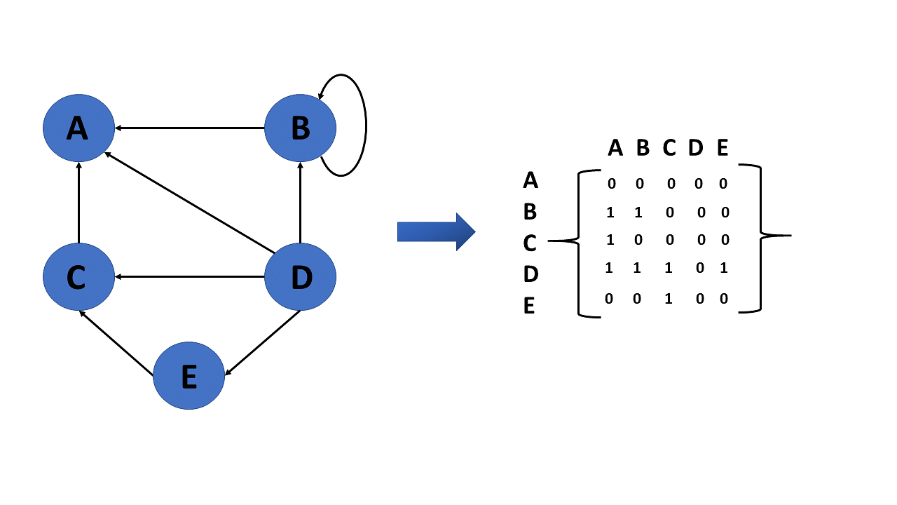
Activity 1- Think-Pair Share [10 min]
Represent following graph using adjacency matrix and adjacency list:

Slide 13

Assessment: WooFlash Quiz

Slide 14
Summary
A graph G(V,E) consists of vertices (nodes) and edges (connections).
Graphs can be directed, undirected, weighted, unweighted, simple, multigraph, cyclic, acyclic, regular, connected or disconnected.
Path = sequence of edges,
cycle = path that starts and ends at same vertex.
Degree of vertex: undirected → number of edges; directed → in-degree & out-degree.
Special terms: self-loop (edge to itself), parallel edges (multiple edges), articulation point (critical vertex), bridge (critical edge).
Adjacency Matrix (sequential representation): n×n matrix, entry 1 if edge exists else 0, uses O(V²) space.
Adjacency List (linked list representation): each vertex stores a linked list of neighbors, uses O(V+E) space, efficient for sparse graphs.
[1-mins]

Slide 15
[2-mins]
Ensure attainment of LO’s in alignment to the learning activities:
Represent a Graph in memory using Adjacency Matrix (array-based storage).
Represent a Graph in memory using Adjacency List (linked list-based storage).

Slide 16
[1-min]
Next Session:
Graph traversal BFS and DFS

Slide 17
Review and Reflection from students

