Slide 1



Graph Traversal: BFS and DFS Session No.: 40 Course Name: Data Strucutres Course Code: R1UC308B Instructor Name: Akhilesh Tripathi Duration: 50 mins Date of Conduction:

Slide 2
Review
Pre-Requisite :
Students must have knowledge of graph, stack and queue.
Basics of graph, stack and queue discussed in previous classes

Slide 3

Pre-Class Assessment
[2-mins]

Slide 4

[1-mins]
What do you mean by Traversing?

Slide 5
Learning Outcomes
[2-mins]
By the end of this session, You will be able to:
Explain Traversing in the Graph: BFS and DFS.
Apply BFS and DFS in graph for traversing.

Slide 6
Session Outline
Graph
Traversing in graph
BFS: Breadth first search
DFS: Depth First Search
Provide hands-on activities and reinforce learning through an interactive WooClap and WooFlash tools.

Slide 7

Activity-1 (Think – Pair – Share)
[5-mins]
Imagine you are writing a program for a new social media platform called “Linkedin." The platform needs a feature that helps users find new friends who are closely connected to their existing network, specifically finding "friends of friends."

Slide 8

Answer following based on previous activity
What graph structure is used to represent users and their friendships in a social network?
What does a “friend of a friend” represent in graph terms?
Why is BFS more suitable than DFS for finding friends of friends?
At what BFS level (depth) do we find “friends of friends”?
What data structure does BFS use to keep track of nodes to visit?
Scan for response

Slide 9
Graph Traversal Techniques
The previous connectivity problem, as well as many other graph problems, can be solved using graph traversal techniques
There are two standard graph traversal techniques:
Depth-First Search (DFS)
Breadth-First Search (BFS)

Slide 10
Graph Traversal (Contd.)
In both DFS and BFS, the nodes of the undirected graph are visited in a systematic manner so that every node is visited exactly one.
Both BFS and DFS give rise to a tree:
When a node x is visited, it is labeled as visited, and it is added to the tree
If the traversal got to node x from node y, y is viewed as the parent of x, and x a child of y

Slide 11
Depth-First Search
DFS follows the following rules:
Select an unvisited node x, visit it, and treat as the current node
Find an unvisited neighbor of the current node, visit it, and make it the new current node;
If the current node has no unvisited neighbors, backtrack to the its parent, and make that parent the new current node;
Repeat steps 3 and 4 until no more nodes can be visited.
If there are still unvisited nodes, repeat from step 1.

Slide 12
Illustration of DFS
0
1
0
2
1
4
4
9
10
5
7
2
11
8
5
9
6
7
11
6
Graph G
8
10
DFS Tree

Slide 13
Implementation of DFS
Observations:
the last node visited is the first node from which to proceed.
Also, the backtracking proceeds on the basis of "last visited, first to backtrack too".
This suggests that a stack is the proper data structure to remember the current node and how to backtrack.

Slide 14
DFS (Pseudo Code)
DFS(input: Graph G) {
Stack S; Integer x, t;
while (G has an unvisited node x){
visit(x); push(x,S);
while (S is not empty){
t := peek(S);
if (t has an unvisited neighbor y){ visit(y); push(y,S); }
else
pop(S);
}
}
}

Slide 15
Breadth-First Search
BFS follows the following rules:
Select an unvisited node x, visit it, have it be the root in a BFS tree being formed. Its level is called the current level.
From each node z in the current level, in the order in which the level nodes were visited, visit all the unvisited neighbors of z. The newly visited nodes from this level form a new level that becomes the next current level.
Repeat step 2 until no more nodes can be visited.
If there are still unvisited nodes, repeat from Step 1.

Slide 16
Illustration of BFS
0
1
0
2
4
2
1
4
9
5
9
10
10
5
7
11
8
6
7
8
11
6
BFS Tree
Graph G

Slide 17
BFS (Pseudo Code)
BFS(input: graph G) {
Queue Q; Integer x, z, y;
while (G has an unvisited node x) {
visit(x); Enqueue(x,Q);
while (Q is not empty){
z := Dequeue(Q);
for all (unvisited neighbor y of z){ visit(y); Enqueue(y,Q);
}
}
}
}

Slide 18
Things for you to Do
Use BFS as a way to determine of the input graph G is connected, and if not, to output the number of connected components
Modify BFS so that the level of each node in the BFS tree is computed.
Give another class for graph, this time using a linked lists representation.

Slide 19

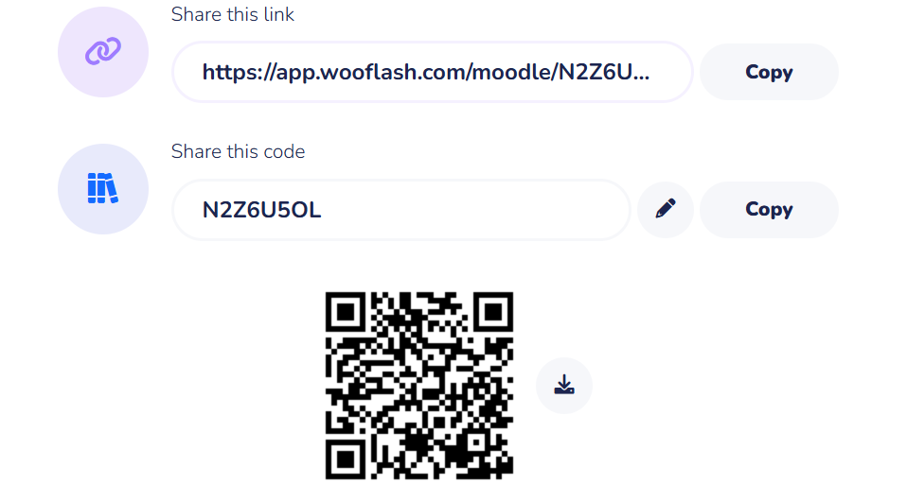
Assessment: WooFlash Quiz

Slide 20
Summary
[1-mins]
Feature | BFS | DFS
Structure | Queue | Stack/Recursion
Traversal | Level-by-level | Depth-first
Shortest Path | ✔ Yes | ✖ No
Memory | High | Low
Good For | Shortest path, leveled search | Backtracking, exploring all paths

Slide 21
Learning Outcomes
[2-mins]
By the end of this session, You will be able to:
Explain Traversing in the Graph: BFS and DFS.
Apply BFS and DFS in graph for traversing.

Slide 22

Review and Reflection from students

