Slide 1
Web Design project on Rim Naija using html and Css
BY
Benjamin Riman

Slide 2
RIM NAIJA Website
START DATE : 27th August 2021
END DATE : 2nd September 2021
NAME OF COORDINATOR: MR Oso
NAME OF DEVELOPER : Benjamin Riman
DATE OF SUBMISSION : 3rd SEPTEMBER 2021

Slide 3
SYSTEM ANALYSIS
Rim Naija is a website that enables you to read novels online.
It has different genres of books and it’s easy to use. You can also follow up on your favorite authors.

Slide 4
Website Name: Rim Naija
Number of Pages: 4
Page Names:
1. Home.html
2. New.html
3. Genre.html
4. About.html
Number of css files: 3
css file Names :
1. Riman.css
2. Rimanforcontent.css
3. Rimanside.css

Slide 5
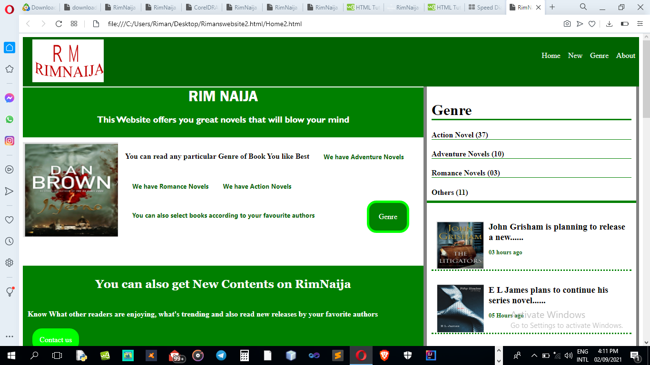
The home.html introduces you to the website

Slide 6
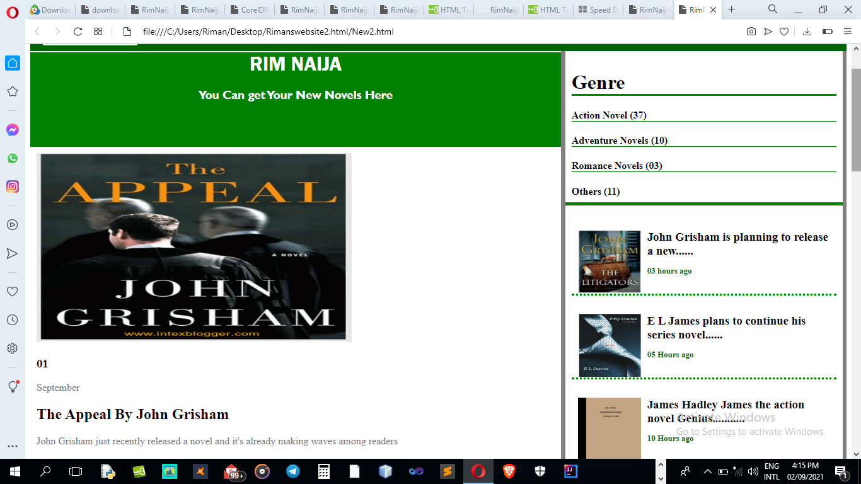
The New.html shows new novels that have been released

Slide 7
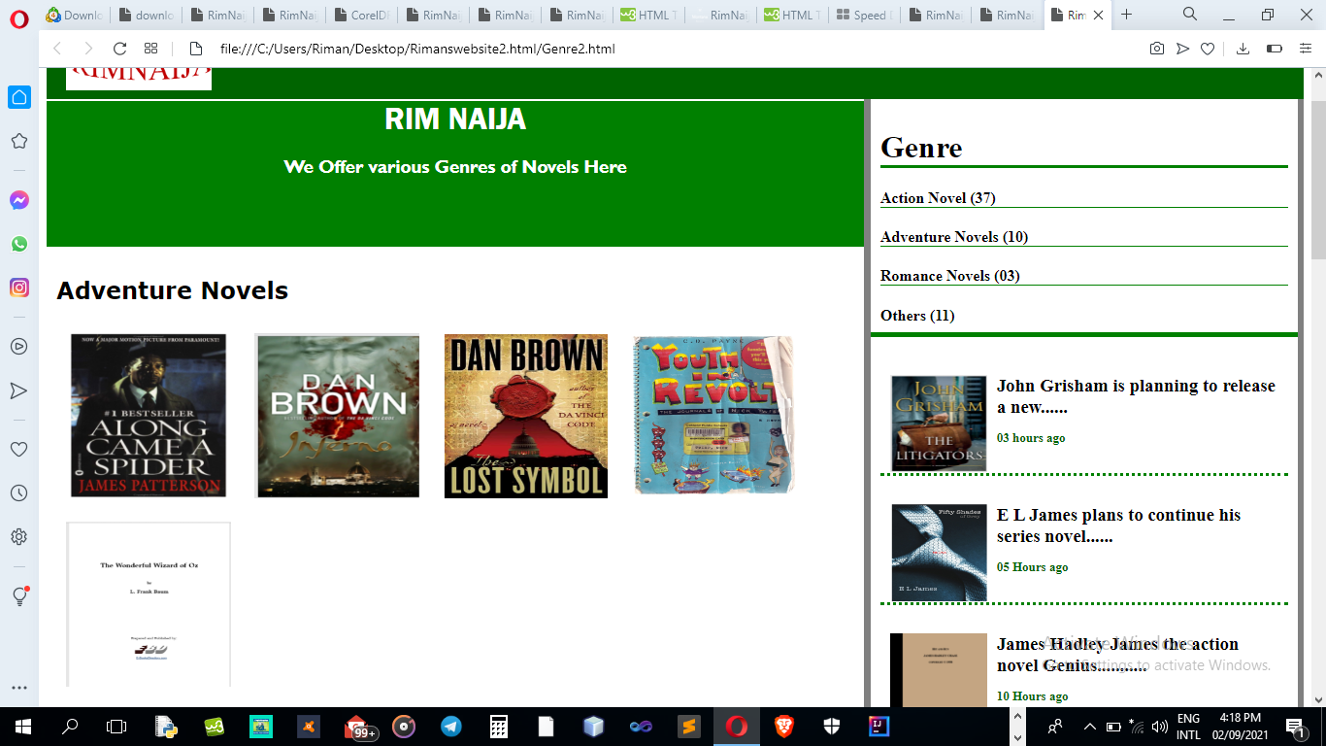
The Genre.html talks about the various different types of novels

Slide 8
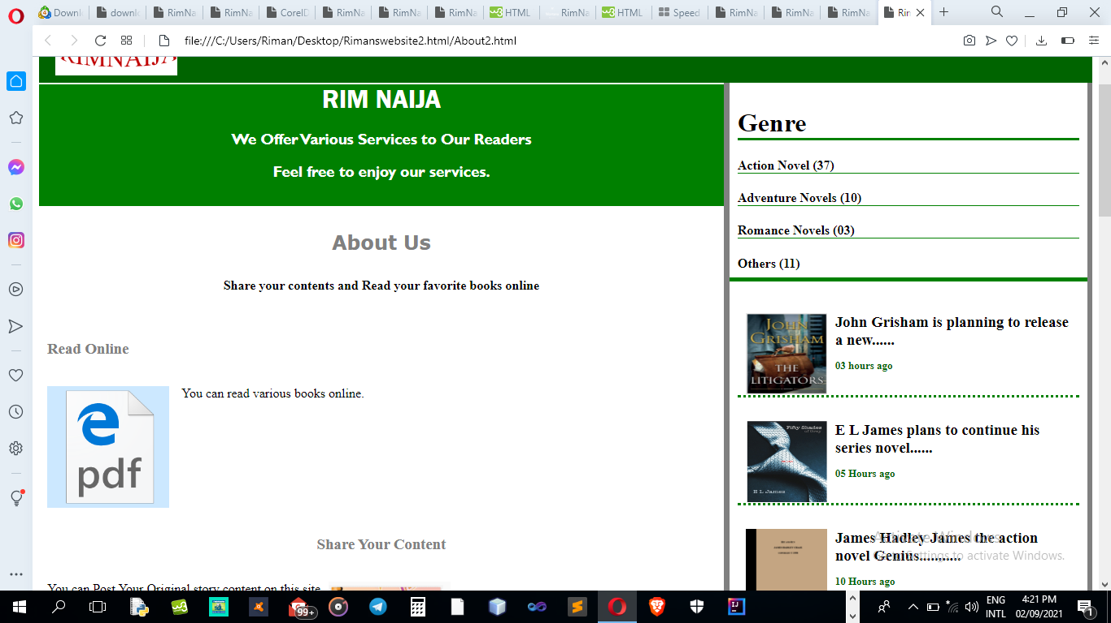
The About.html talks abut all the services RimNaija offers

Slide 9
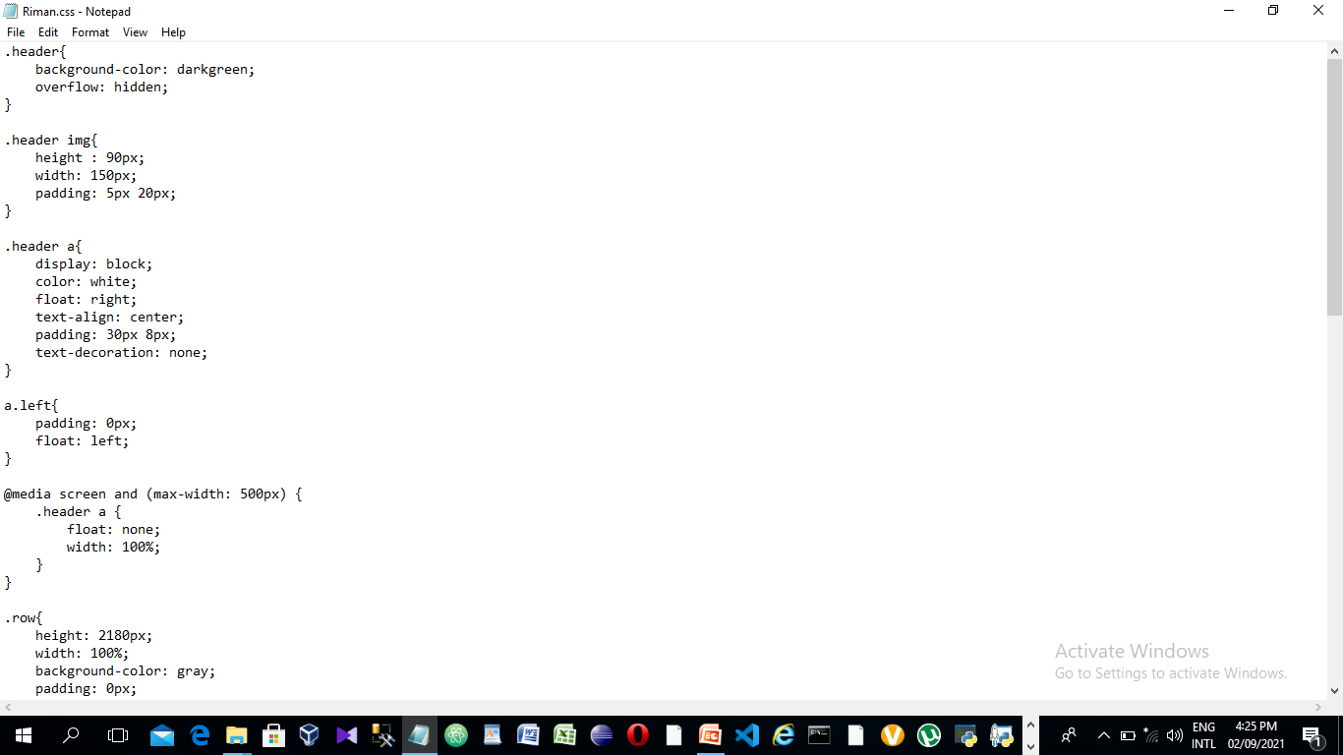
Riman.css designs the layout of the site together with the header and footer

Slide 10
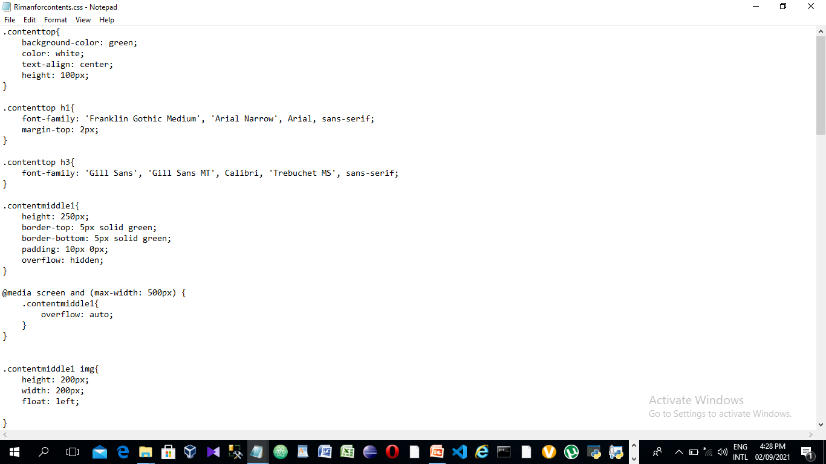
Rimanforcontents.css designs the main left column of Rim Naija

Slide 11
PROBLEM THAT OCCURRED DURING CREATION
Lack of much time.

Slide 12
ACKNOWLEDGEMENT
I have benefited a lot from my coordinator Mr Oso and other faculty members.

Slide 13
CONFIGURATION
Hardware: PC compatible with an HP, 4-GB RAM, and 500GB of Hard disk Operating System: Microsoft Windows 10 Software: Atom, visual studio code
PROJECT FILE DETAILS
S/No | File Name | Remarks
 | Home2.html New2.html Genre2.html About2.html Riman.css Rimanforcontents.html Rimanside.css | It contains the home page of the website RimNaija. It contains new releases of novels in the website RimNaija. It contains the different genres of novels in the website website RimNaija. It contains what Rim Naija offers. It contains the layout of the website. It contains the styling of the main container of the website. It contains the styling of the side container of the website.

Slide 14
Createmydb Inc
END

