Slide 1
PYTHON BUSINESS PROJECT
INSTRUCTOR : VIJAY KUMAR
SUBMITTED BY : RIMA NIGAM

Slide 2
PROJECT OUTLINE
1
INTRODUCTION OF THE DATASET
2
BUSINESS QUESTIONS
3
OBJECTIVES OF THE ANALYSIS
4
5
DATA VALIDATION
6
DATA VISUALIZATION
STUDY FRAMEWORK .
7
8
MODELLING AND MODEL FINDINGS
9
CONCLUSIONS & RECOMMENDATIONS
UNIVARIATE & BIVARIATE ANALYSIS

Slide 3
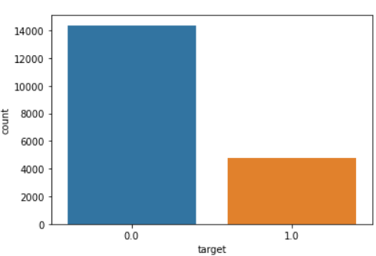
INTRODUCTION
PROJECT ON JOB CHANGE OF DATA SCIENTIST
A company which is active in Big Data and Data Science wants to hire data scientists among people who successfully pass some courses which are conducted by the company. Many people signup for their training. Company wants to know which of these candidates really wants to work for the company after training or looking for a new employment because it helps to reduce the cost. Information related to demographics, education, experience are in hands from candidates signup and enrollment.
This dataset is designed to understand the factors that lead a
person to leave current job. By model(s) that uses the current
credentials, demographics, experience data will help to predict
the probability of a candidate looking for a new job or will work
for the company, as well as interpreting affected factors on
employee decision.

Slide 4
PROBLEM STATEMENTS & OBJECTIVES
Does the Education Level of the Employees affect their status of a job change?
How much the experience plays a key role in changing a job?
Does gender affects the job status?
Which type of discipline maximum working employees belongs to?
Which company type is the most common among working employees?
What are the main reasons for employees to look for a job change?
Objectives
To find out the employees who are leaving the company.
To find out the attributes that influence the Employee Decision.
Through this project, we are going to find out the reasons and factors contributing for a job change in employees and find out the ways to retain them.

Slide 5
Study Framework of X and Y variable
INDEPENDENT VARIABLES
DEPENDENT VARIABLE
CITY
EDUCATION_LEVEL
ENROLLED_UNIVERSITY
PREDICTOR
TARGET(0,1)
EXPERIENCE
GENDER
MAJOR_DISCIPLINE
COMPANY SIZE/TYPE
CITY DEVELOPMENT
LAST NEW JOB

Slide 6
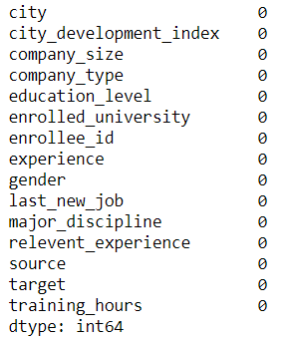
HANDLING MISSING VALUES
Handling missing values is an important part of the EDA process. The variables which are having very few missing values as compared to the size of the dataset, we may choose to drop the rows that have missing values or impute the missing values based on the non-missing values with some value.
In this dataset, certain columns are having missing values and I treated those values.

Slide 7
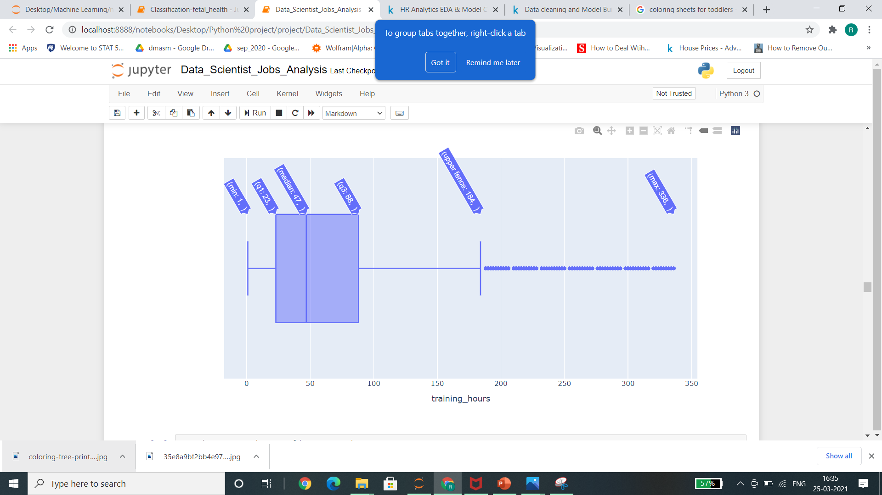
OUTLIER DETECTION
In this dataset, there is only one column which is having an outlier as maximum variables are binary, ordinal and Nominal. It is negatively skewed and after treating it became positively skewed somehow but the score went down.

Slide 8
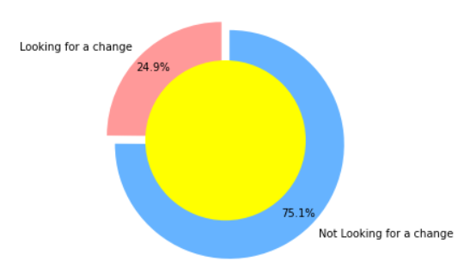
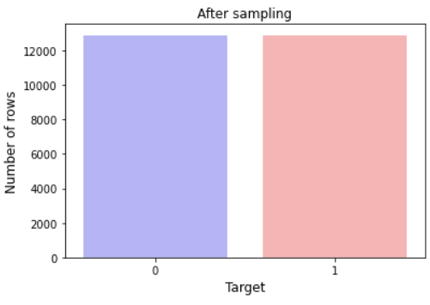
EXPLORATORY DATA ANALYSIS
From the below graph, We can see that data is imbalance and there are around 75% number of employees which are not looking for job change. This Problem can be solve using Over-Sampling or Under-Sampling. Using SMOTE technique the data is balanced.

Slide 9
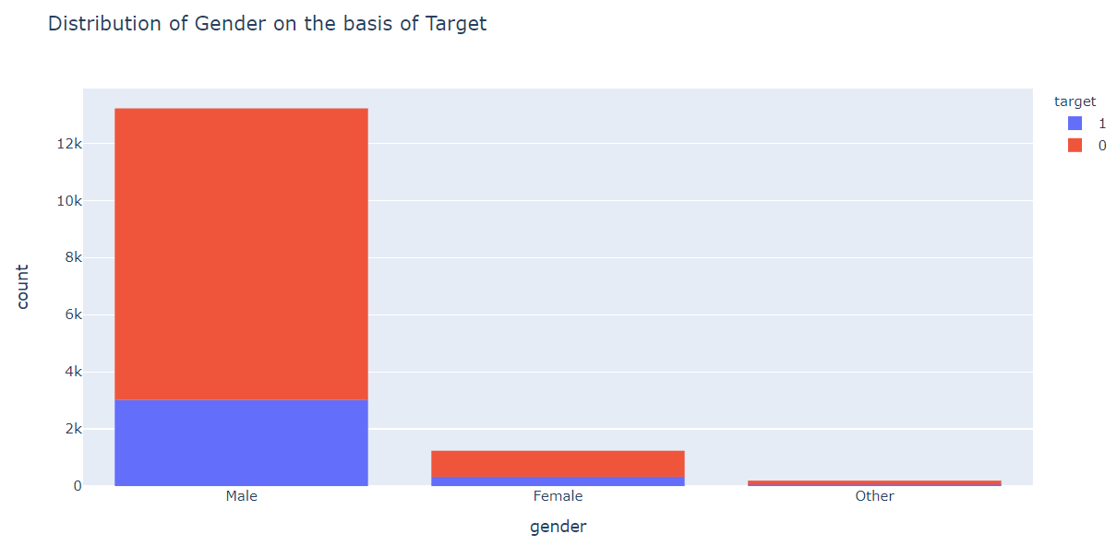
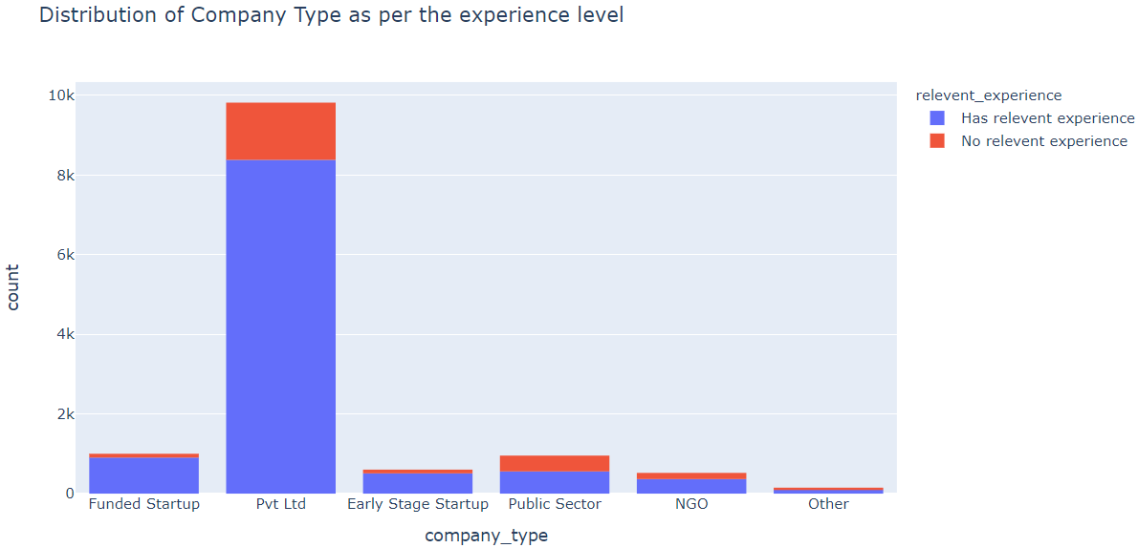
EXPLORATORY DATA ANALYSIS
The company seems to be Gender biased as maximum people selected after the training are males and maximum males are not looking for a job change even.
Maximum employees selected and having relevant experience were working in Pvt Ltd Companies.

Slide 10
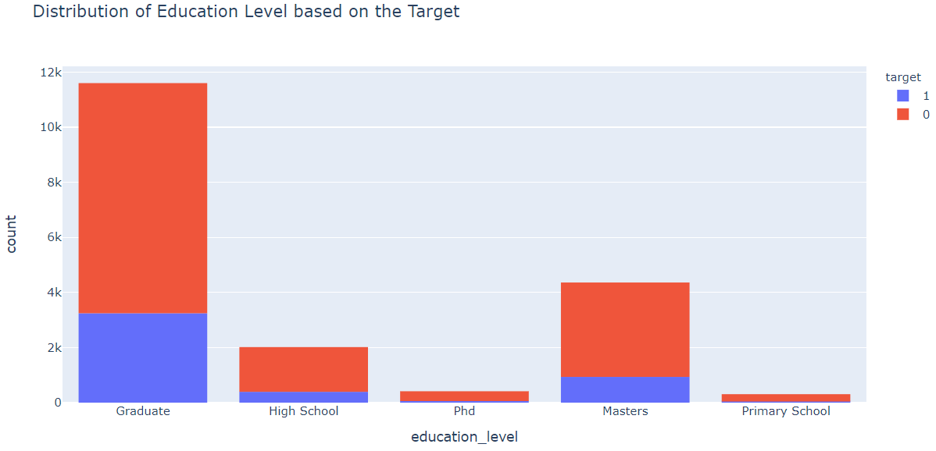
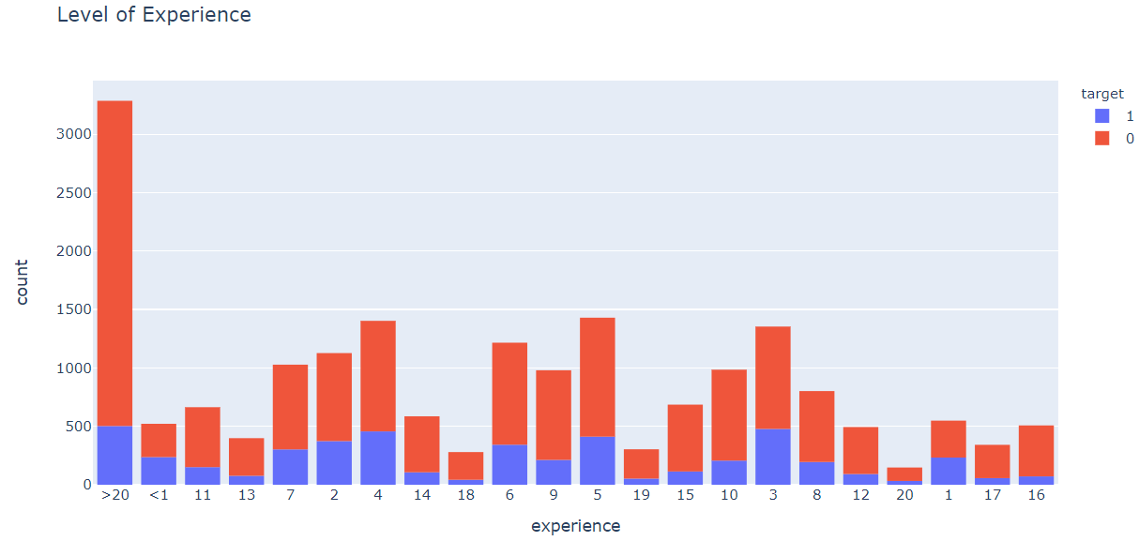
EXPLORATORY DATA ANALYSIS
More number of Graduates are working in this company.
Maximum people with more than 20 years of experience are not looking for job change as may be they are satisfied and comfortable with their current job.

Slide 11
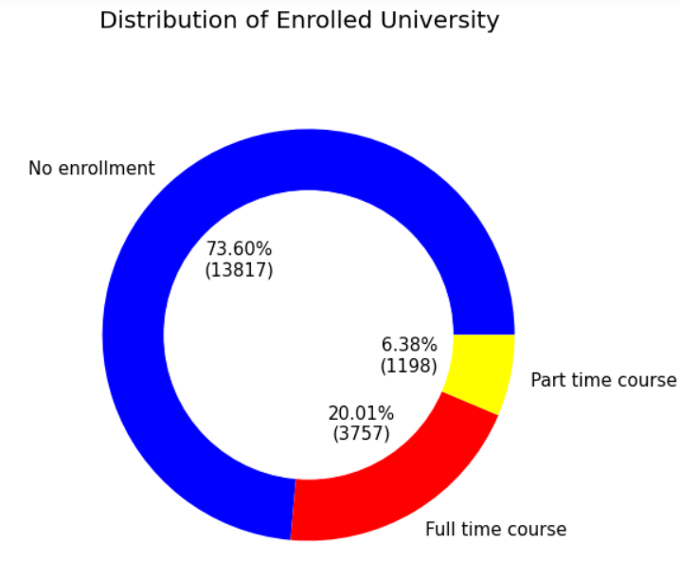
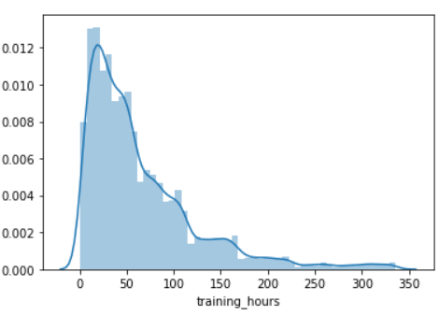
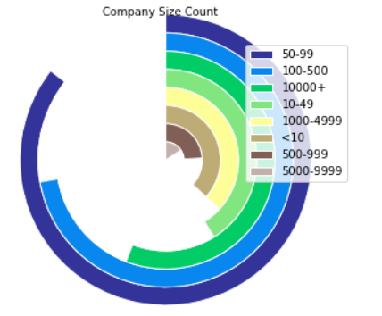
EXPLORATORY DATA ANALYSIS
Maximum employees are not enrolled in any university.
Most Employees have undergone about 50 hours of training and some of them have undergone Extensive training of more than 100 hours.
Maximum companies are having around 50-99 number of employees working under them.

Slide 12
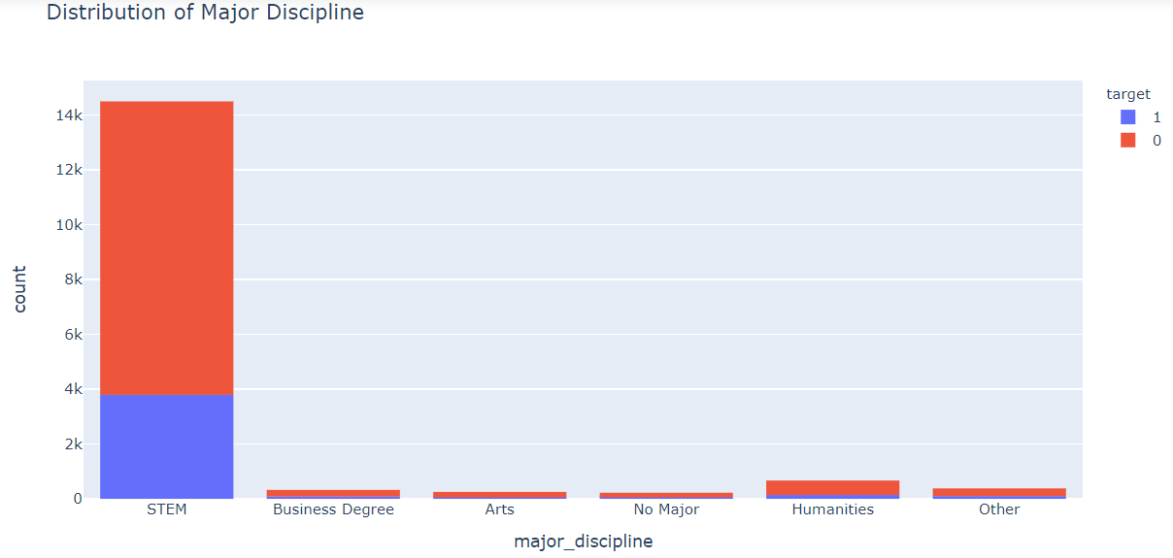
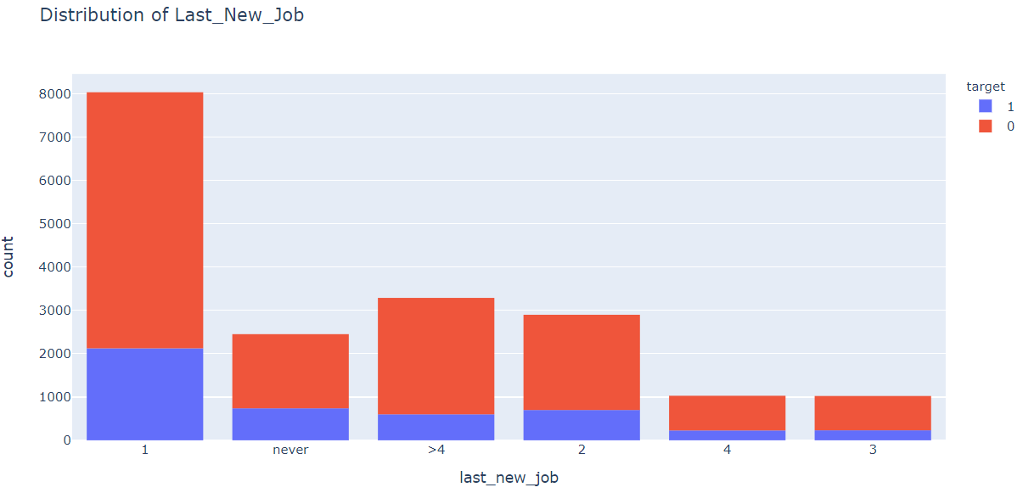
EXPLORATORY DATA ANALYSIS
STEM stands for science, technology, engineering and mathematics and refers to any subjects that fall under these four disciplines. Maximum employees working belongs to this discipline are not looking for a job change.
Maximum difference in years between the previous job and the current job of the employee is 1 year.

Slide 13
RELATIONSHIP OF VARIABLES
There is a significant relationship between the Target variable and the Gender having p-value-0.010.
The Company Type and the Target variable also has a significant relationship at p-value less than 0.05.
There is some relation between the Education level and the Target at the significance level of 0.05.
Other Categorical Variables also showed some relationship with the Target variable while doing Chi-square test.

Slide 14
MODEL BUILDING
There are many models for machine learning, and each model has its own strengths and weaknesses. In this project, I have tried various classification algorithms and tuned the parameters using the GridSearchCV which tries all the combinations of the values passed in the dictionary and evaluates the model for each combination using the Cross-Validation method. Hence after using this function we get accuracy/loss for every combination of hyperparameters and we can choose the one with the best performance.
The classifiers I used to find the best model out of them are:-
Logistic Regression
K-Nearest Neighbors(KNN) Classifier
Support Vector Machine(SVM)
Decision Tree Classifier
Random Forest Classifier
AdaBoost Classifier

Slide 15
LOGISTIC REGRESSION MODEL
Logistic Regression is a Machine Learning classification algorithm that is used to predict the probability of a categorical dependent variable.
SCORES FOR THE LOGISTIC REGRESSION MODEL
K-Fold Score | 0.7448421178090067
Best Parameters | {'C': 10, 'max_iter': 1000, 'penalty': 'l2', 'solver': 'newton-cg', 'tol': 0.001}
Best Score | 0.8280106614974556
Test Score | 0.8309749951540997

Slide 16
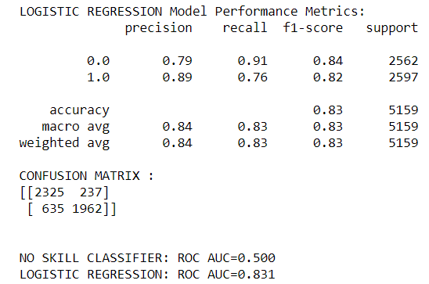
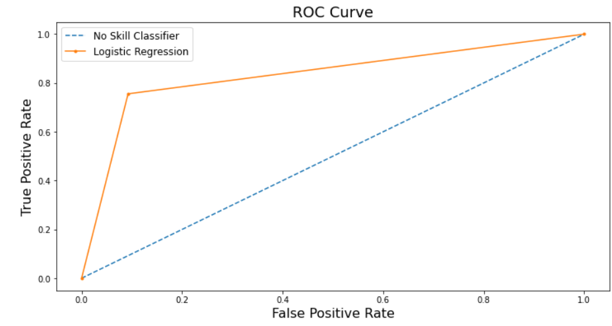
CLASSIFICATION REPORT AND CONFUSION MATRIX

Slide 17
K-NEAREST NEIGHBORS(KNN)
K-Nearest Neighbors operates by checking the distance from some test example to the known values of some training example. The group of data points/class that would give the smallest distance between the training points and the testing point is the class that is selected.
SCORES FOR THE K-NEAREST NEIGHBORS (KNN) MODEL
K-Fold Score | 0.7160588365585095
Best Parameters | {'leaf_size': 10, 'n_neighbors': 10}
Best Score | 0.6839835231402956
Test Score | 0.702267881372359

Slide 18
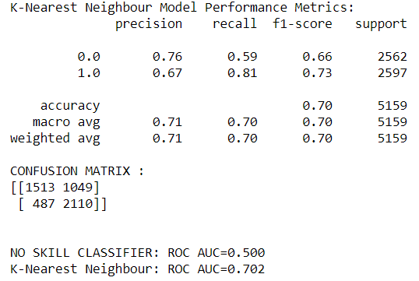
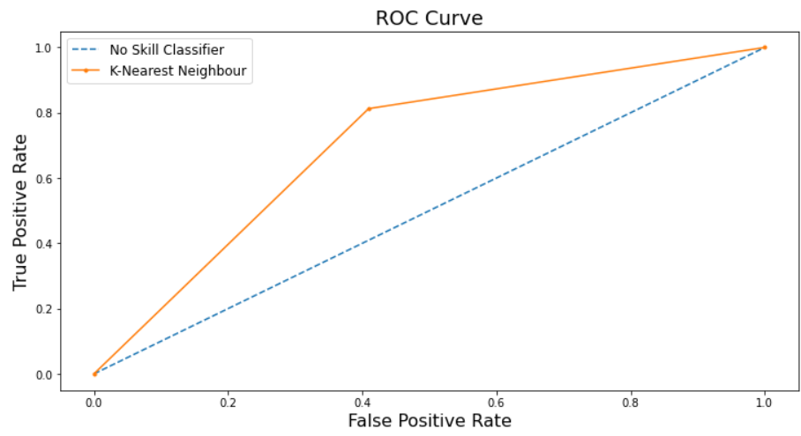
CLASSIFICATION REPORT AND CONFUSION MATRIX

Slide 19
SUPPORT VECTOR MACHINE(SVM)
Support Vector Machines work by drawing a line between the different clusters of data points to group them into classes. Points on one side of the line will be one class and points on the other side belong to another class. The classifier will try to maximize the distance between the line it draws and the points on either side of it, to increase its confidence in which points belong to which class.
SCORES FOR THE SUPPORT VECTOR MACHINE(SVM) MODEL
K-Fold Score | 0.7000600883810515
Best Parameters | {'C': 2, 'class_weight': 'balanced', 'dual': False}
Best Score | 0.8259812574047872
Test Score | 0.8286111593950982

Slide 20
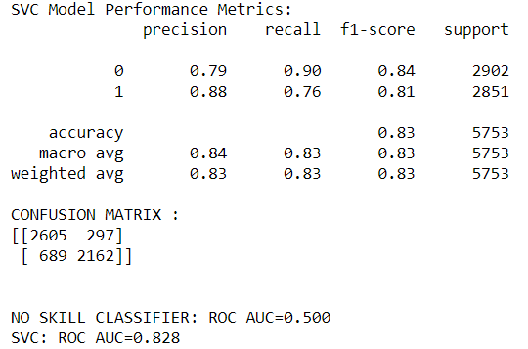
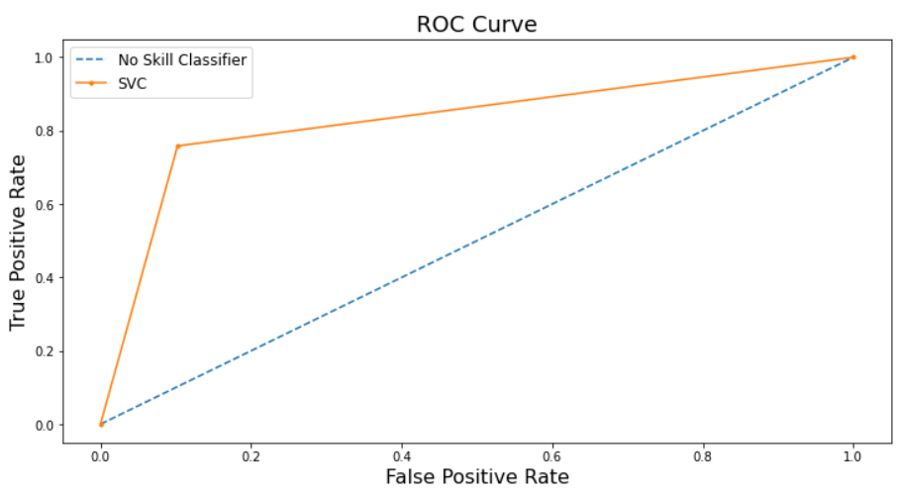
CLASSIFICATION REPORT AND CONFUSION MATRIX

Slide 21
DECISION TREE CLASSIFIER
A Decision Tree Classifier functions by breaking down a dataset into smaller and smaller subsets based on different criteria. Different sorting criteria will be used to divide the dataset, with the number of examples getting smaller with every division.
SCORES FOR THE DECISION TREE CLASSIFIER MODEL
K-Fold Score | 0.764974729275915
Best Parameters | {'criterion': 'gini', 'max_features': 'auto'}
Best Score | 0.7404926994216721
Test Score | 0.757691639144794

Slide 22
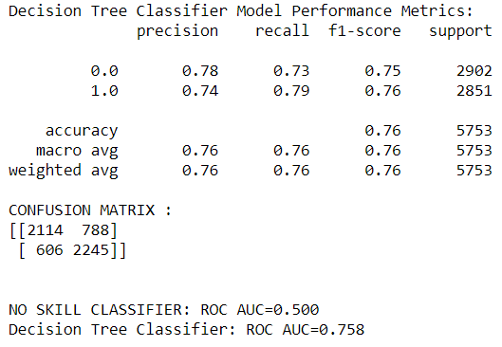
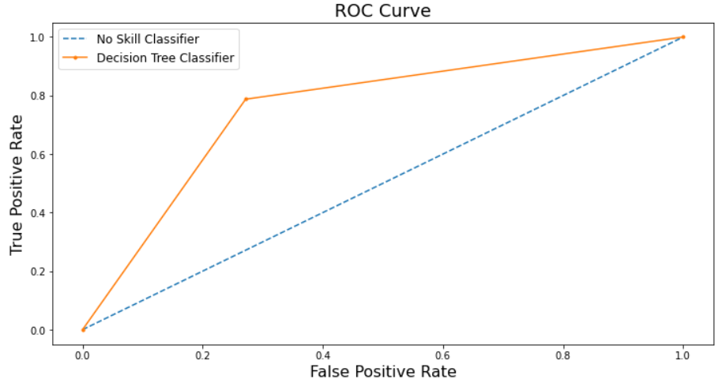
CLASSIFICATION REPORT AND CONFUSION MATRIX

Slide 23
RANDOM FOREST CLASSIFIER
The Random Forest Classifier is a set of decision trees from randomly selected subset of training set. It aggregates the votes from different decision trees to decide the final class of the test object.
SCORES FOR THE RANDOM FOREST CLASSIFIER MODEL
K-Fold Score | 0.8100695905891273
Best Parameters | {'class_weight': 'balanced', 'max_depth': 12, 'max_features': 'sqrt', 'min_samples_leaf': 1, 'min_samples_split': 2, 'n_estimators': 1000}
Best Score | 0.7577034488184975
Test Score | 0.7599513297410047

Slide 24
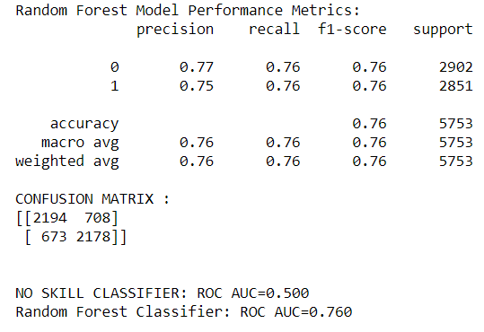
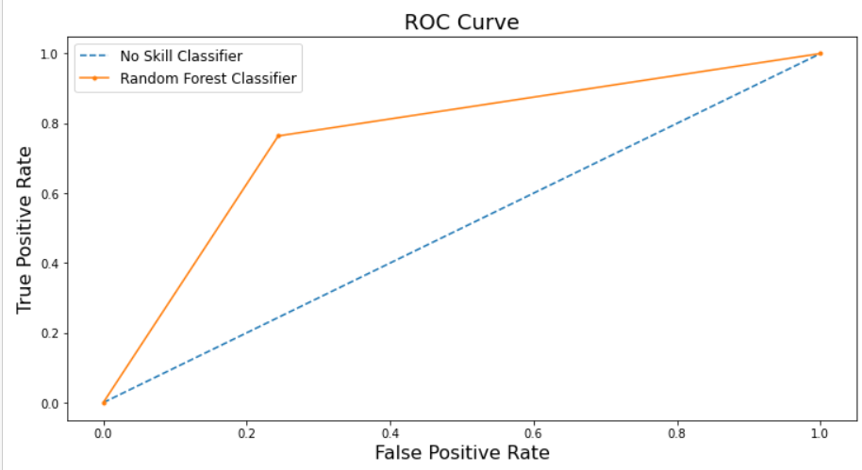
CLASSIFICATION REPORT AND CONFUSION MATRIX

Slide 25
ADABOOST MODEL
AdaBoost classifier builds a strong classifier by combining multiple poorly performing classifiers so that you will get high accuracy strong classifier. The basic concept behind AdaBoost is to set the weights of classifiers and training the data sample in each iteration such that it ensures the accurate predictions of unusual observations.
SCORES FOR THE ADABOOST MODEL
K-Fold Score | 0.784096626613387
Best Parameters | {'base_estimator': DecisionTreeClassifier(max_depth=5), 'n_estimators': 40}
Best Score | 0.8058149500028385
Test Score | 0.8096645228576395

Slide 26
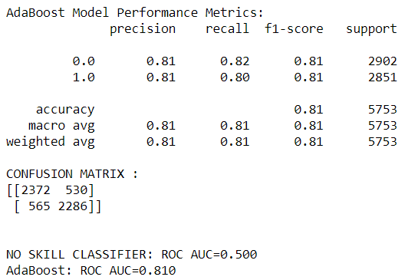
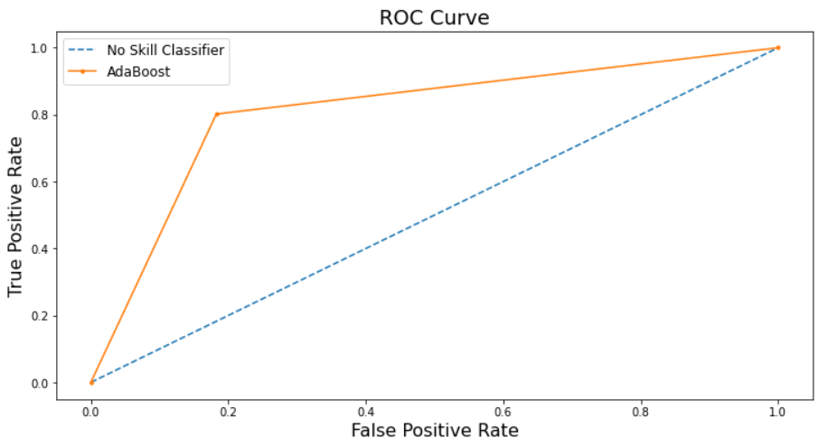
CLASSIFICATION REPORT AND CONFUSION MATRIX

Slide 27
COMPARISON OF MODELS
MODEL | TEST SCORES | TRAINING SCORES | K FOLD SCORES | ACCURACY
Logistic Regression | 0.8277420476273248 | 0.8287626580903125 | 0.7448421178090067 | 83%
Decision Tree Classifier | 0.757691639144794 | 0.798478856099787 | 0.764974729275915 | 76%
K-Neighbors Classifier | 0.702267881372359 | 0.7615701478071238 | 0.7160588365585095 | 70%
Random Forest Classifier | 0.7599513297410047 | 0.7816071971837107 | 0.7600695905891273 | 76%
AdaBoost Classifier | 0.8096645228576395 | 0.8527532704593854 | 0.784096626613387 | 81%
Support Vector Classifier | 0.8286111593950982 | 0.8278934330044765 | 0.7000600883810515 | 83%

Slide 28
FINAL CONCLUSION OF THE MODELS
After comparing all the six models, I came to this conclusion which will help to choose the best model out of all the models to get the best results.
Out of all the models, AdaBoost Classifier , SVC and Logistic Regression showed the best scores.
K-Fold Cross Validation scores are a bit higher in AdaBoost Classifier Model.
It seems to be that SVC and Logistic Regression with 83% are the best performing models followed by AdaBoost.
As per the Classification Report, maximum predictions were caught correctly in SVC and the AdaBoost Classifier.
As per the test and the training scores, the Logistic Regression and the Support Vector Classifier came out to be the best fit models.
So, as per the other scores Logistic Regression, Support Vector Classifier and AdaBoost Classifier model are the best performing models.

Slide 29
FINDINGS & RECOMMENDATIONS
The more the level of experience, the more the employee stays with the company.
Graduates are more likely to be a part of this company.
The company is giving extensive training to its employees.
The number of the employees in the company ranges from 50-99.
A large number of employees working in the company belongs to STEM discipline.
Maximum difference in years between the previous job and the current job of the employees is 1 year.
Males are preferred more over females in the company.
RECOMMENDATIONS
Company should focus on retaining more female employees.
Company should manage the long and extensive training hours.
Also, company should try to add more employees of other discipline having different education level.
This Analysis further indicates there is a need to add more features to the model in order to predict the job change status.

Slide 30
THANK YOU !!!

