Slide 1
MULTI LINEAR REGRESSION PROJECT

Slide 2
INTRODUCTION
PROJECT ON CARBON DIOXIDE(CO₂) LEVELS IN CANADA
In this project, I have built various model of the ‘CARBON DIOXIDE(CO₂) LEVELS IN CANADA’ dataset which contains various information of the vehicles that are responsible for emitting CO₂ levels. This dataset captures the details of how CO2 emissions by a vehicle can vary with the different features. The dataset has been taken from Canada Government official open data website. This is a compiled version. This contains data over a period of 7 years.
Canadians top the chart with cars that emit an average 206 grams of CO2 (gCO2) per kilometer. That's just from the fuel used to move them around. It's roughly equal to 8.7 litres of gasoline per 100 kilometers. American cars are only slightly less climate polluting.

Slide 3
Study Framework of X and Y variable
INDEPENDENT VARIABLES
DEPENDENT VARIABLE
MAKE
TRANSMISSION
PREDICTOR
CO₂ EMISSIONS
FUEL TYPE AND CONSUMPTION
VEHICLE CLASS
ENGINE SIZE
CYLINDERS

Slide 4
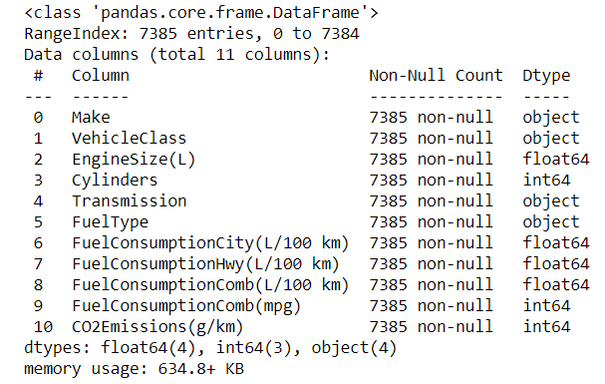
HANDLING MISSING VALUES
Handling missing values is an important part of the EDA process. The variables which are having very few missing values as compared to the size of the dataset, we may choose to drop the rows that have missing values or impute the missing values based on the non-missing values with some value.
In this dataset, there is no missing values.

Slide 5
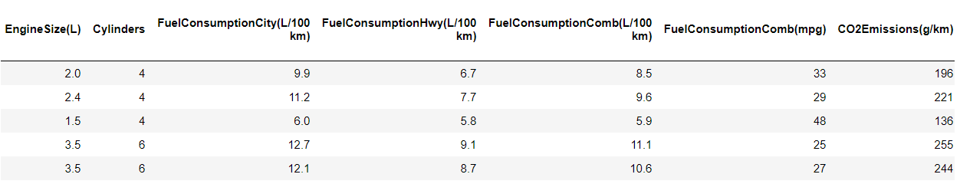
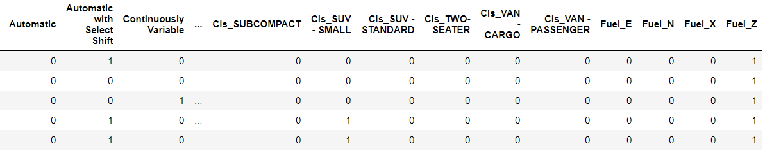
ENCODING
Encoding or continuization is the transformation of categorical variables to binary or numeric counterparts.In this dataset, there are four categorical variables – Make, Vehicle Class, Transmissions and Fuel Type. For these categorical variables I created the dummy variables.

Slide 6
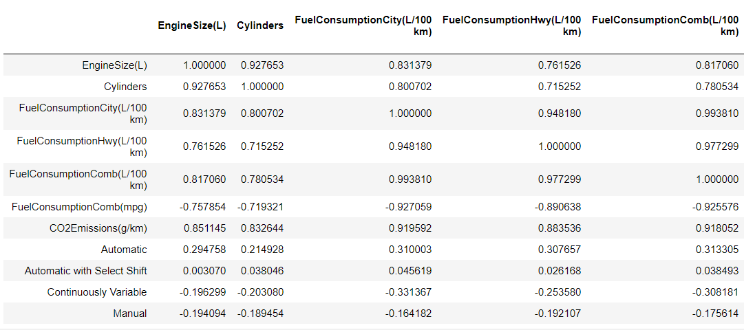
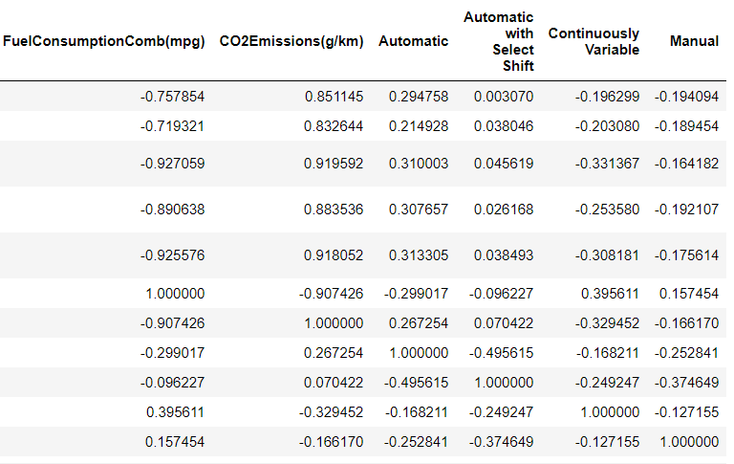
CORRELATION
Correlation quantifies the direction and strength of the relationship between two numeric variables, X and Y. Here, I found a strong positive relationship between CO₂ Emissions(Y) and Engine Size(X) followed by Cylinders(X), Fuel Consumption Hwy(X) and Fuel Consumption City(X).

Slide 7
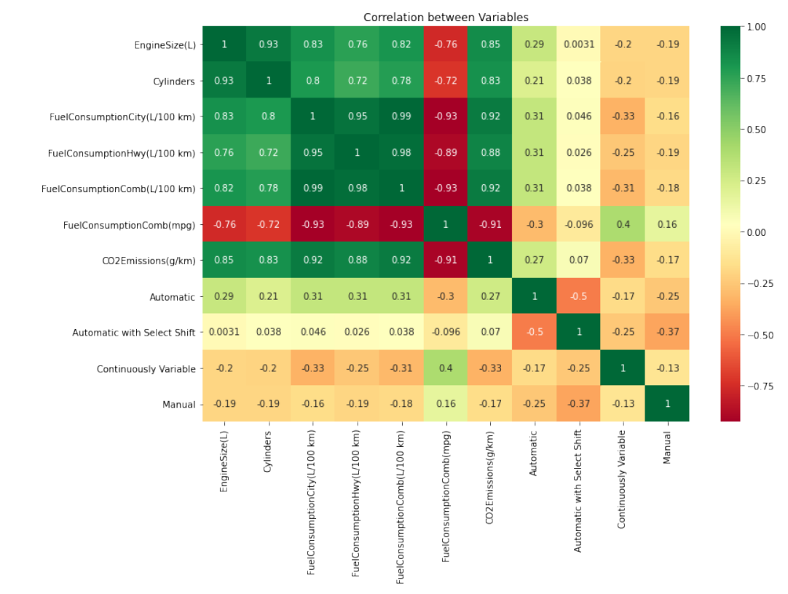
HEATMAP

Slide 8
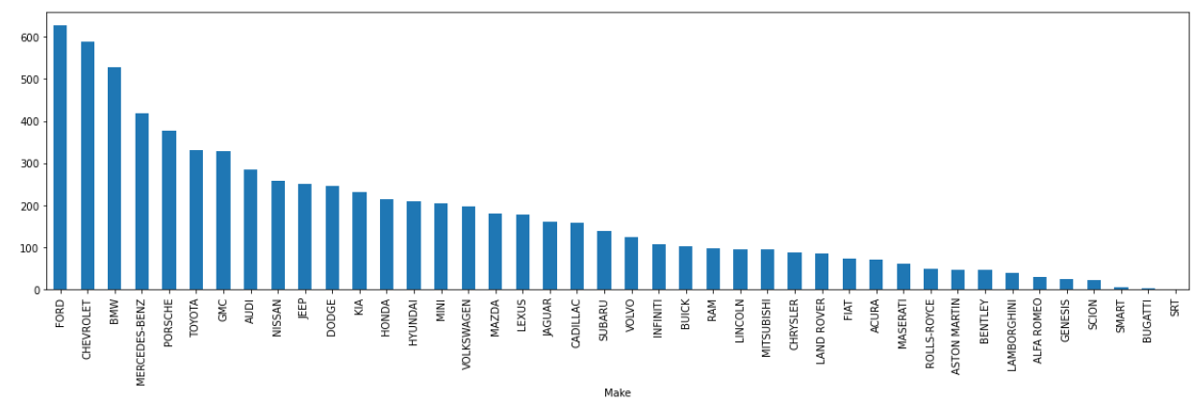
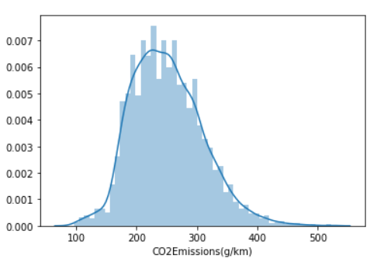
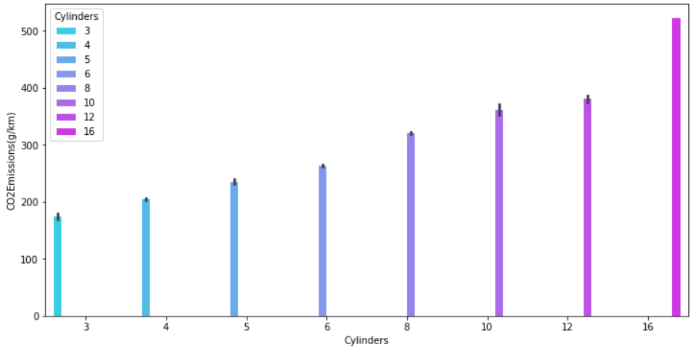
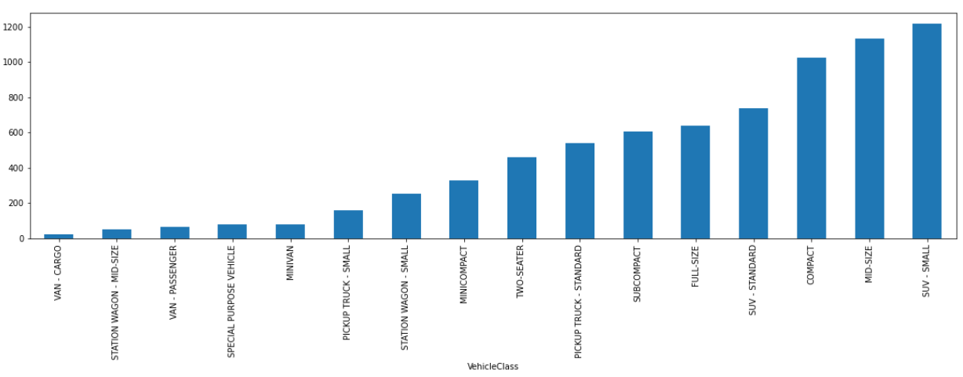
VISUALIZATION

Slide 9
MODEL BUILDING
There are many models for machine learning, and each model has its own strengths and weaknesses. In this project, I have tried various linear algorithms and tuned the parameters using the GridSearchCV which tries all the combinations of the values passed in the dictionary and evaluates the model for each combination using the Cross-Validation method. Hence after using this function we get accuracy/loss for every combination of hyperparameters and we can choose the one with the best performance.
The Regressors I used to find the best model out of them are:-
Linear Regression
K-Nearest Neighbors(KNN) Regressor
Support Vector Regression(SVR)
Decision Tree Regressor
Random Forest Regressor
AdaBoost Regressor

Slide 10
LINEAR REGRESSION MODEL
Multiple linear regression is the most common form of linear regression analysis. As a predictive analysis, the multiple linear regression is used to explain the relationship between one continuous dependent variable and two or more independent variables. The independent variables can be continuous or categorical (dummy coded as appropriate).
SCORES FOR THE LINEAR REGRESSION MODEL
K-Fold Score | 0.9912998595828526
Best Parameters | 'copy_X': True, 'fit_intercept': True, 'normalize': False
Best Score | 0.9935089987945259
Test Score | 0.9905644278209543

Slide 11
R2,MSE,RMSE AND ADJUSTED R2
R-squared is how well the regression model fits the observed data. Here, an r-squared of 99% reveals that 99% of the data fit the regression model that indicates a better fit for the model.
The mean squared error tells you how close a regression line is to a set of points. The lower value of 31.5 indicates a good model.
RMSE is a good measure of how accurately the model predicts the response. Here, Lower value of RMSE indicate better fit.
A lower adjusted R-squared indicates that the additional input variables are not adding value to the model. Here, a higher adjusted R-squared indicates that the additional input variables are adding value to the model.
VALUES FOR THE LINEAR REGRESSION MODEL
R Square | 0.9905644278209543
Mean Squared Error (MSE) | 31.53070249833977
Root Mean Squared Error (RMSE) | 5.615220609943991
Adjusted R Square | 0.9902472657309024

Slide 12
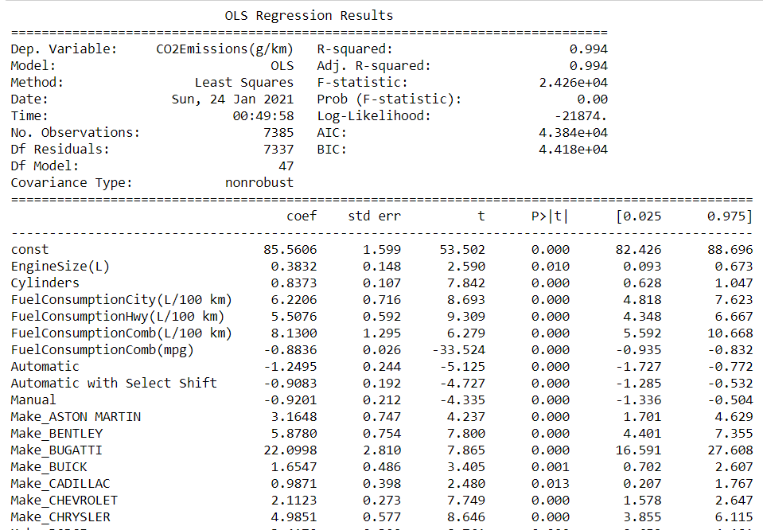
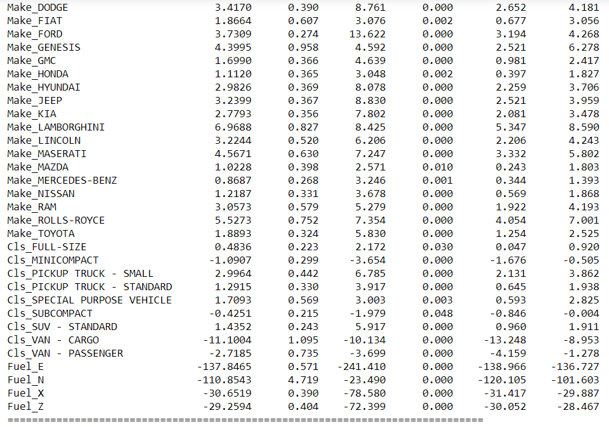
P-VALUES FOR INDEPENDENT VARIABLES

Slide 13
K-NEAREST NEIGHBORS(KNN)
KNN regression is a non-parametric method that, in an intuitive manner, approximates the association between independent variables and the continuous outcome by averaging the observations in the same neighbourhood. The size of the neighborhood needs to be set by the analyst or can be chosen using cross-validation (we will see this later) to select the size that minimizes the mean-squared error.
SCORES FOR THE K-NEAREST NEIGHBORS REGRESSOR (KNN) MODEL
K-Fold Score | 0.9859396495085806
Best Parameters | 'algorithm': 'ball_tree', 'leaf_size': 10, 'metric': 'manhattan', 'n_neighbors': 5, 'weights': 'distance'
Best Score | 0.9827187347583346
Test Score | 0.9869259431496133

Slide 14
R2,MSE,RMSE AND ADJUSTED R2
R-squared is how well the regression model fits the observed data. Here, an r-squared of 98% reveals that 98% of the data fit the regression model that indicates a better fit for the model.
The mean squared error tells you how close a regression line is to a set of points. The lower value of 43.6 indicates a good model.
RMSE is a good measure of how accurately the model predicts the response. Here, Lower value of RMSE indicate better fit.
A lower adjusted R-squared indicates that the additional input variables are not adding value to the model. Here, a higher adjusted R-squared indicates that the additional input variables are adding value to the model.
VALUES FOR THE K-NEAREST NEIGHBORS (KNN)REGRESSOR MODEL
R Square | 0.9869259431496133
Mean Squared Error (MSE) | 43.68936924794039
Root Mean Squared Error (RMSE) | 6.609793434589344
Adjusted R Square | 0.986486479053802

Slide 15
SUPPORT VECTOR REGRESSION(SVR)
Support Vector Regression is similar to Linear Regression in that the equation of the line is y= wx+b In SVR, this straight line is referred to as hyperplane. The data points on either side of the hyperplane that are closest to the hyperplane are called Support Vectors which is used to plot the boundary line.
SCORES FOR THE SUPPORT VECTOR REGRESSION (SVR) MODEL
K-Fold Score | 0.8825932702433461
Best Parameters | 'degree': 3, 'gamma': 1, 'kernel': 'poly'
Best Score | 0.993667601249679
Test Score | 0.9949816144963228

Slide 16
R2,MSE,RMSE AND ADJUSTED R2
R-squared is how well the regression model fits the observed data. Here, an r-squared of 99% reveals that 99% of the data fit the regression model that indicates a better fit for the model.
The mean squared error tells you how close a regression line is to a set of points. The lower value of 16.7 indicates a good model.
RMSE is a good measure of how accurately the model predicts the response. Here, Lower value of RMSE indicate better fit.
A lower adjusted R-squared indicates that the additional input variables are not adding value to the model. Here, a higher adjusted R-squared indicates that the additional input variables are adding value to the model.
VALUES FOR THE SUPPORT VECTOR REGRESSOR MODEL
R Square | 0.9949816144963228
Mean Squared Error (MSE) | 16.769859562923813
Root Mean Squared Error (RMSE) | 4.0951018989670835
Adjusted R Square | 0.9948129292693084

Slide 17
DECISION TREE REGRESSOR
A Decision Tree Regression is used for the continuous output problem. Continuous output means the output of the result is not discrete, i.e., it is not represented just by a discrete, known set of numbers or values. Decision tree regression observes features of an object and trains a model in the structure of a tree to predict data in the future to produce meaningful continuous output.
SCORES FOR THE DECISION TREE REGRESSOR MODEL
K-Fold Score | 0.9934725180238967
Best Parameters | 'max_depth': 8, 'max_features': 'auto', 'splitter': 'best'
Best Score | 0.9931643096144154
Test Score | 0.9932996833198097

Slide 18
R2,MSE,RMSE AND ADJUSTED R2
R-squared is how well the regression model fits the observed data. Here, an r-squared of 99% reveals that 99% of the data fit the regression model that indicates a better fit for the model.
The mean squared error tells you how close a regression line is to a set of points. The lower value of 19.1 indicates a good model.
RMSE is a good measure of how accurately the model predicts the response. Here, Lower value of RMSE indicate better fit.
A lower adjusted R-squared indicates that the additional input variables are not adding value to the model. Here, a higher adjusted R-squared indicates that the additional input variables are adding value to the model.
VALUES FOR THE DECISION TREE REGRESSOR MODEL
R Square | 0.994263709167482
Mean Squared Error (MSE) | 19.16887245966396
Root Mean Squared Error (RMSE) | 4.378227090919789
Adjusted R Square | 0.9940708926689099

Slide 19
RANDOM FOREST REGRESSOR
Random Forest Regression is a supervised learning algorithm that uses ensemble learning method for regression. ... A Random Forest operates by constructing several decision trees during training time and outputting the mean of the classes as the prediction of all the trees.
SCORES FOR THE RANDOM FOREST REGRESSOR MODEL
K-Fold Score | 0.9948677484204543
Best Parameters | 'max_depth': 8, 'max_features': 'auto', 'n_estimators': 80
Best Score | 0.995017068227962
Test Score | 0.9947419712329947

Slide 20
R2,MSE,RMSE AND ADJUSTED R2
R-squared is how well the regression model fits the observed data. Here, an r-squared of 99% reveals that 99% of the data fit the regression model that indicates a better fit for the model.
The mean squared error tells you how close a regression line is to a set of points. The lower value of 17.5 indicates a good model.
RMSE is a good measure of how accurately the model predicts the response. Here, Lower value of RMSE indicate better fit.
A lower adjusted R-squared indicates that the additional input variables are not adding value to the model. Here, a higher adjusted R-squared indicates that the additional input variables are adding value to the model.
VALUES FOR THE RANDOM FOREST REGRESSOR MODEL
R Square | 0.9947492966482069
Mean Squared Error (MSE) | 17.54619244608105
Root Mean Squared Error (RMSE) | 4.18881754748056
Adjusted R Square | 0.9945728024178945

Slide 21
ADABOOST REGRESSOR MODEL
An AdaBoost regressor is a meta-estimator that begins by fitting a regressor on the original dataset and then fits additional copies of the regressor on the same dataset but where the weights of instances are adjusted according to the error of the current prediction.
SCORES FOR THE ADABOOST REGRESSOR MODEL
K-Fold Score | 0.9357005834592664
Best Parameters | 'base_estimator': DecisionTreeRegressor(max_depth=10), 'n_estimators': 100
Best Score | 0.9970402436527174
Test Score | 0.9950116751992586

Slide 22
R2,MSE,RMSE AND ADJUSTED R2
R-squared is how well the regression model fits the observed data. Here, an r-squared of 99% reveals that 99% of the data fit the regression model that indicates a better fit for the model.
The mean squared error tells you how close a regression line is to a set of points. The lower value of 16.6 indicates a good model.
RMSE is a good measure of how accurately the model predicts the response. Here, Lower value of RMSE indicate better fit.
A lower adjusted R-squared indicates that the additional input variables are not adding value to the model. Here, a higher adjusted R-squared indicates that the additional input variables are adding value to the model.
VALUES FOR THE ADABOOST REGRESSOR MODEL
R Square | 0.9950116751992586
Mean Squared Error (MSE) | 16.669406186787857
Root Mean Squared Error (RMSE) | 4.0828184121741025
Adjusted R Square | 0.9948440004160404

Slide 23
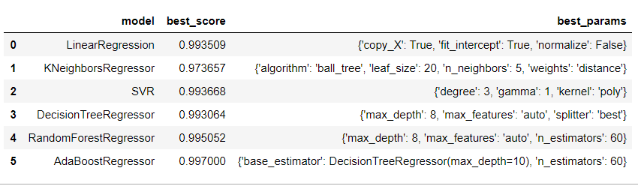
COMPARISON OF MODELS
Out of all the six models built, all the models showed the best scores except the Linear Regression that has a bit low score as compared to other models. Their test scores are also close to the best scores except the Decision Tree Regressor Model and the Linear Regression Model. The best parameters are also listed above.

Slide 24
COMPARISON OF MODELS
MODEL | K-FOLD SCORES | TEST SCORES | TRAINING SCORES | R SQUARED VALUE | MSE | RMSE | ADJUSTED R SQUARED VALUE
Linear Regression | 0.9912998595 | 0.99056442782 | 0.99371780751 | 0.9905644278209 | 31.5307024983397 | 5.61522060994399 | 0.990247265730902
Decision Tree Regressor | 0.9934725180 | 0.99301478613 | 0.99640723661 | 0.9942637091674 | 19.1688724596639 | 4.37822709091978 | 0.994070892668909
K-Neighbors Regressor | 0.9859396495 | 0.98692594314 | 0.99964313523 | 0.9869259431496 | 43.6893692479403 | 6.60979343458934 | 0.986486479053802
Random Forest Regressor | 0.9948677484 | 0.99474197123 | 0.99706789315 | 0.9947492966482 | 17.5461924460810 | 4.18881754748056 | 0.994572802417894
AdaBoost Regressor | 0.9357005834 | 0.99501167519 | 0.99858661897 | 0.9950116751992 | 16.6694061867878 | 4.08281841217410 | 0.994844000416040
Support Vector Regressor | 0.8825932702 | 0.99498161449 | 0.99518684192 | 0.9949816144963 | 16.7698595629238 | 4.09510189896708 | 0.994812929269308

Slide 25
FINAL CONCLUSION
After comparing all the six models, I came to this conclusion which will help to choose the best model out of all the models to get the best results.
All the models gave the best score as around 99% except the K-Neighbors Regressor whose best score came out to be 97% which is also a good score.
The test scores are also near to the best scores of all the models except the Decision Tree Regressor whose best score is 99% and test score is 90%.
The K-fold cross Validation score of all the models are high around 99% except the AdaBoost Regressor 93% and Support Vector Regressor 82%.
The R-Squared values are good for all the models which is around 99%.
The MSE values are lower in Random Forest Regressor, AdaBoost Regressor and Support Vector Regressor which indicates a good model.
The RMSE values are a bit higher in Linear Regressor and K-Neighbors Regressor, though not much higher and lower in other models indicating a better fit models.
The Adjusted R-Square values are almost same and higher for all the models except with the Linear Regression which indicates that additional input variables are adding value to the model.
The testing and the training scores for all the models are almost near to each other that means there is no overfitting and underfitting, instead they are the best fit models.
So, after comparing all the scores, it seems that Linear Regressor Model ,Random Forest Regressor the best model followed by the Decision Tree Regressor Model but I will choose the Linear Regression Model as it will be easy and less complex to deploy.

Slide 26
THANK YOU !!!

