Slide 1
SQL PROJECT
Presentation Date : 14th April, 2021
Instructor : Tareq Jaber
Submitted By : Rima Nigam

Slide 2
PROJECT OUTLINE
1
INTRODUCTION OF THE PROJECT
2
EXECUTIVE SUMMARY
3
PROBLEM STATEMENTS
4
5
SQL QUERIES
6
CONCLUSIONS
OBJECTIVES OF THE PROJECT.

Slide 3
INTRODUCTION
PROJECT ON BANK DATABASE CREATION USING SQL
This project is basically to create a Bank database having various details about the bank customers, bank employees, login details of the customers, transaction and balance details of the customers.
There is total 17 tables which are having relationship with each other.
Based on the relationship between tables, we can extract the more
meaningful information about the customers.
It also includes extra error information if a customer fails to
make any transaction or unable to login his/her account.
A record that causes an account to go into the overdraft is
also maintained in the table as Bank charges certain fee for that.

Slide 4
Executive Summary
This report is part of a SQL Project, as a capstone for the Data Science and Application Program. The final goal is to find out the Customer’s details based on the available data. The aim of this report is to understand the database entities in more details and have practical experience of working with different objects of SQL. All steps are going to be explained and supported by SQL codes including SQL Views and procedures.

Slide 5

PROBLEM STATEMENTS
Which is the most preferred account type as per the customer?
How many customers are maintaining the checking and saving account based on the province?
How many customers are maintaining minimum balance in their accounts?
Which is the most selected User Security Question among the Bank Customers?
How many bank customers are having Active Account Status?
What is the maximum Interest Rate Value in the financial Year?

Slide 6
Objectives of this Project
The foremost aim of Profiling bank customer’s data is that it will cognize the issuer's decisions about whom to give banking facilities.
Through this project, the issuers will be able to get a better understanding of their potential and current customers.
This project will help in finding the best technique, which will help banks to get higher profitability by focusing on the valuable customer which are considered as the main engine in the bank's profitability.

Slide 7
SQL QUERIES

Slide 8
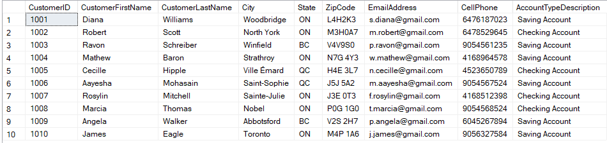
1) How many customers are maintaining checking account from ON province ?
Conclusion: Out of all the 10 records, there were only three customers who are maintaining the checking Account from Ontario Province.

Slide 9
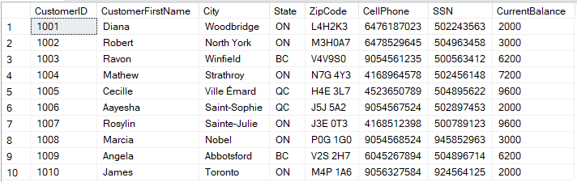
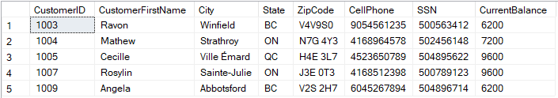
2) List out all the customers with total account balance greater than 5000.
Conclusion: After combining the Customer and Account Table , bank is able to get the balance details of each customer. So, there are 5 customers who are maintaining the account balance more than 5000.

Slide 10
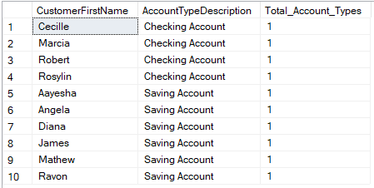
3) Which is the most preferrable account type among the customers ?
Conclusion: To get the account type of the customer, we can combined the Customer table to Account and the Account Type table. After applying the query we got the counts of the Account Type. So, four customers are maintaining the Checking Account and Six are maintaining the Saving Account.

Slide 11
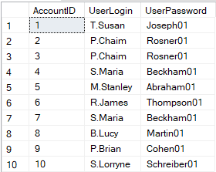
4) How to access any particular user’s login and password using Account Id ?
Conclusion: Using the User Logins and the Login Account table, the bank can be able to look into the User Login and password of each customer based on their Account ID. In case the customer forgets any of them, the bank can retrieve the same for its customers.

Slide 12
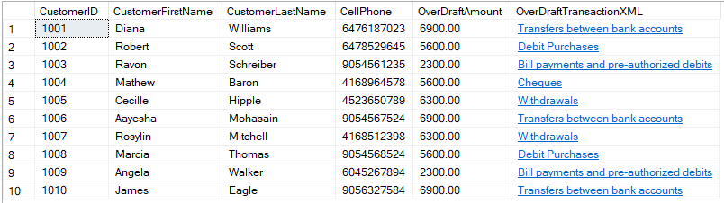
5) Based on the customer’s details how can we check the overdraft amount of all the customers ?
Conclusion: By using the Customer and Overdraft Log table, bank can easily find out the overdraft amount and transaction details of each customer in order to charge certain fee for the transactions.

Slide 13
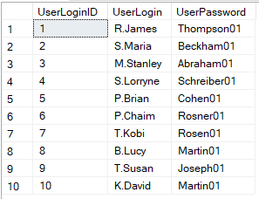
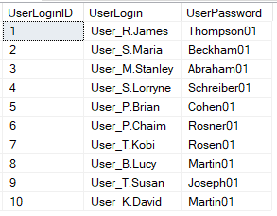
6) What is the need to add “User_” as a prefix to everyone’s login (username) ?
Conclusion: In order to make User Login ID more consistent, bank prefixed the login ID with the “User_” keyword so that they can easily distinguish between the employee and the customer ID.

Slide 14
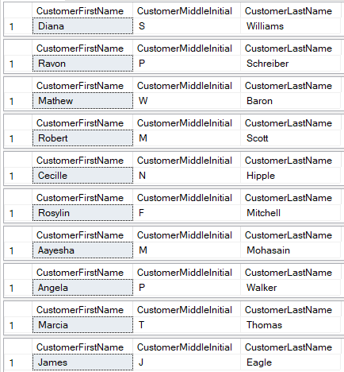
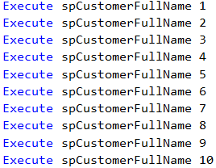
7) How to get the customer’s full name based on the Account Id ?
Conclusion: The bank sometimes needs the full name of the customers based on the Account ID to do further operations. By using SQL procedure, the bank can easily get into the customer details based on their Account ID.

Slide 15
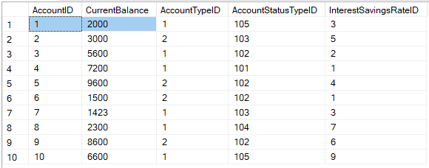


8) How to directly show the effect of the deposit on the Current Balance value for the particular account ?
Conclusion: It is a common practice that customer deposits the amount in the bank for saving or transactional purposes. So, in order to directly show its effects on the current balance, a procedure is created to update the balance as per the account ID.

Slide 16
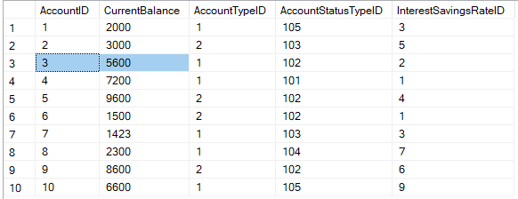


9) How to directly show the effect of the withdrawal on the Current Balance value for the particular account ?
Conclusion: In the case of withdrawal as well, bank wants to update the current balance based on the Account Id of the customers.

Slide 17
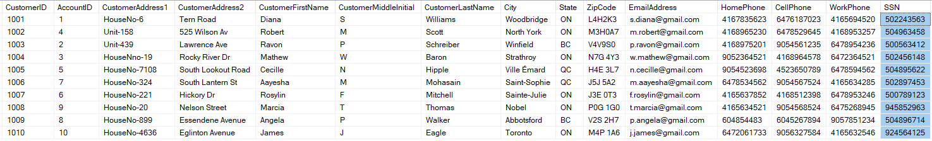
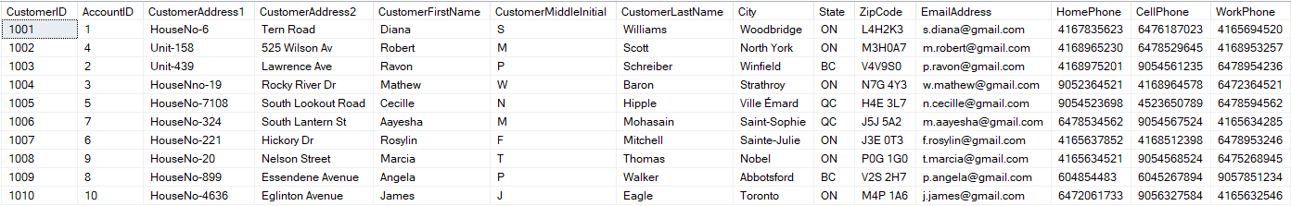
10) Why it is required to remove SSN column from the Customer table ?
Conclusion: Using SSN number, the personal information could also be revealed to unauthorized people, which could lead to identity theft and other types of fraud. So in order to keep it secure bank removed SSN from Customer Table.

Slide 18
CONCLUSIONS

Slide 19
Final Conclusions
Bank is having only two type of accounts at present : Checking and Saving Account. Out of which customer are keeping more of Saving Account.
Maximum customers are maintaining the minimum balance in their accounts.
Most of the customers belongs to the Ontario Branch.
The overdraft transaction is mostly done above 5000 for various purposes. The bank charges an overdraft fee, a record was maintained for each transaction that causes an account to go into overdraft.
Customers have a user logins to allow them to access all of their accounts.

Slide 20
THANK
YOU !!!

