Slide 1
TRAP
CHECK
BANGKOK · SAMPLE SCAN
Pad Thai
AI scam & fair-price detector for travelers
฿500
SCAM SCORE
Know the local price before you pay.
92
/ 100
Fair range ฿50–120
Built for travelers, by travelers

Slide 2
THE PROBLEM
Travel prices are hard to verify in the moment
A traveler sees a price. Local context is missing.
200–500%
73%
฿500
0
overcharge claim in project brief
survey claim in project brief
instant price-check tools*
for a street-side Pad Thai
Local reference: ฿50–120
The friction
• No quick way to compare a bill with local prices
• Language barriers make negotiation harder
• Reviews describe places; they rarely check the price in front of you
*Treat percentages and market-wide claims as hypotheses until independently sourced.
TRAPCHECK / KNOW THE LOCAL PRICE BEFORE YOU PAY
02

Slide 3
THE SOLUTION
One photo. Three useful answers.
01
02
03
📷
◉
✓
→
→
SNAP
READ
DECIDE
Bill, menu, meter or price tag
AI vision or offline OCR
Score, fair range, local tip
No signup · No photo storage · Offline fallback
TRAPCHECK / KNOW THE LOCAL PRICE BEFORE YOU PAY
03

Slide 4
HOW IT WORKS
A resilient analysis pipeline
PHOTO
AI VISION
PRICE ENGINE
→
→
Upload + validation
Gemini Flash*
Fuzzy match + deterministic score
↓
MANUAL
OFFLINE OCR
AI reads; math decides.
→
User-entered item + price
Tesseract + regex
If vision is unavailable, OCR and manual entry keep the scan usable. Gemini requires an API key; offline/manual paths do not.
TRAPCHECK / KNOW THE LOCAL PRICE BEFORE YOU PAY
04

Slide 5
SCAM SCORE
A transparent score, grounded in local ranges
AI extracts the item and amount. The scoring formula makes the verdict.
SAFE
IN RANGE
OVERCHARGED
Below fair minimum
Within reference range
Above fair maximum
Verdict bands in code: SAFE <35 · OVERCHARGED 35–64 · SCAM ≥65
Price references can vary by neighborhood, season and venue. Always show the range and context.
TRAPCHECK / KNOW THE LOCAL PRICE BEFORE YOU PAY
05

Slide 6
DATA & COVERAGE
Three launch cities, seeded local references
🇹🇭
🇮🇩
🇮🇳
BANGKOK
BALI
JAIPUR
THB
IDR
INR
Pad Thai · taxi · tickets
Nasi Goreng · rides · activities
Food · transport · attractions
Seeded JSON price data · fuzzy matching handles common item-name variations · community reports add local context
Project prompt says 45+ entries; verify dataset count before presenting as a measured total.
TRAPCHECK / KNOW THE LOCAL PRICE BEFORE YOU PAY
06

Slide 7
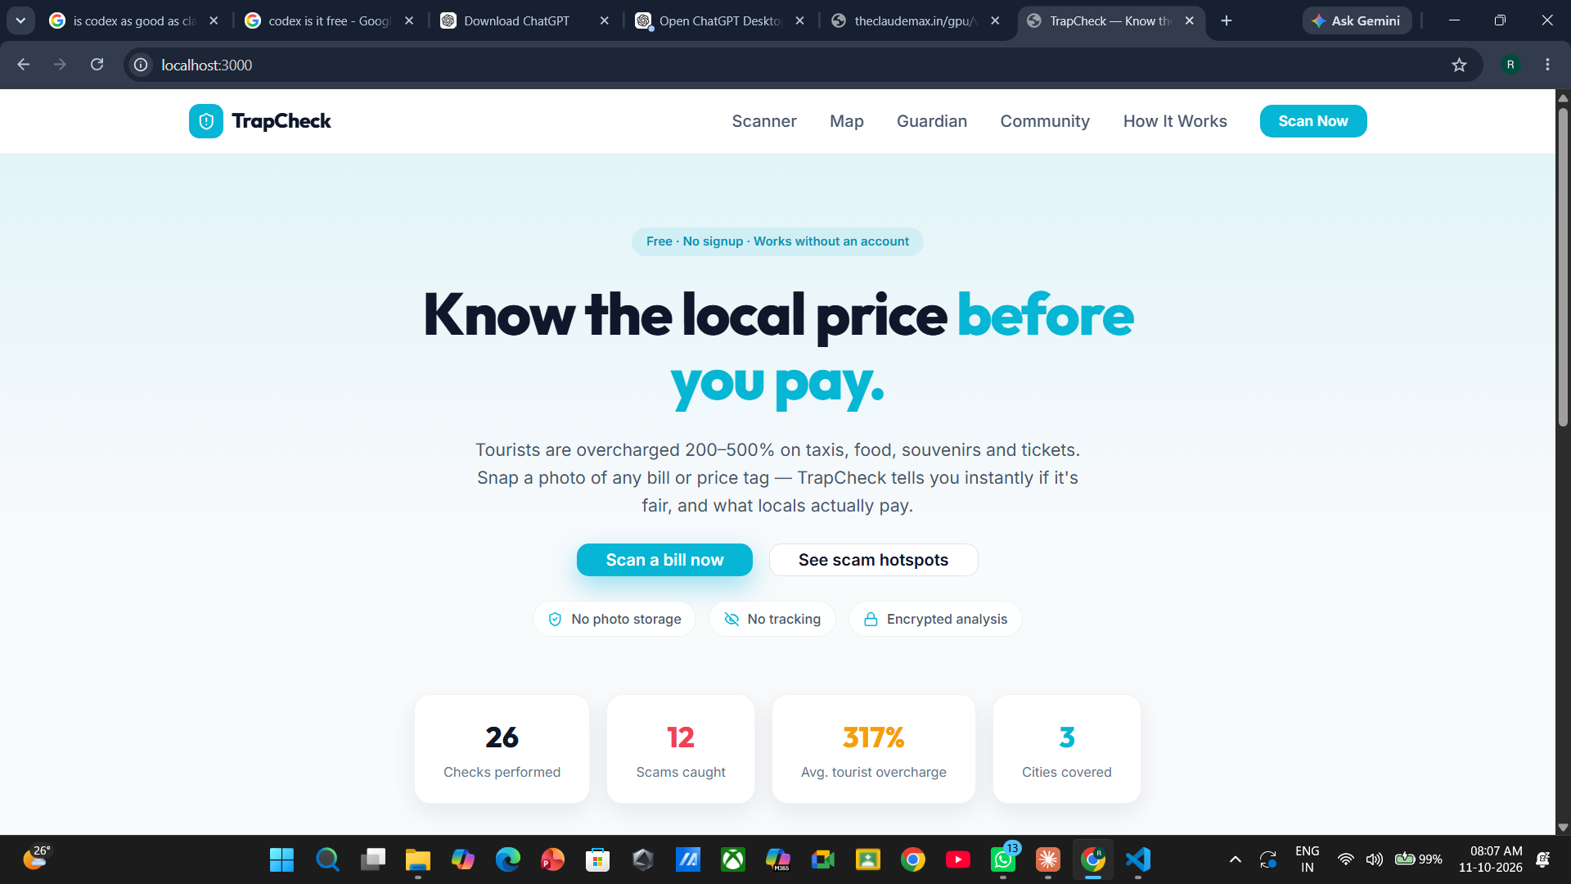
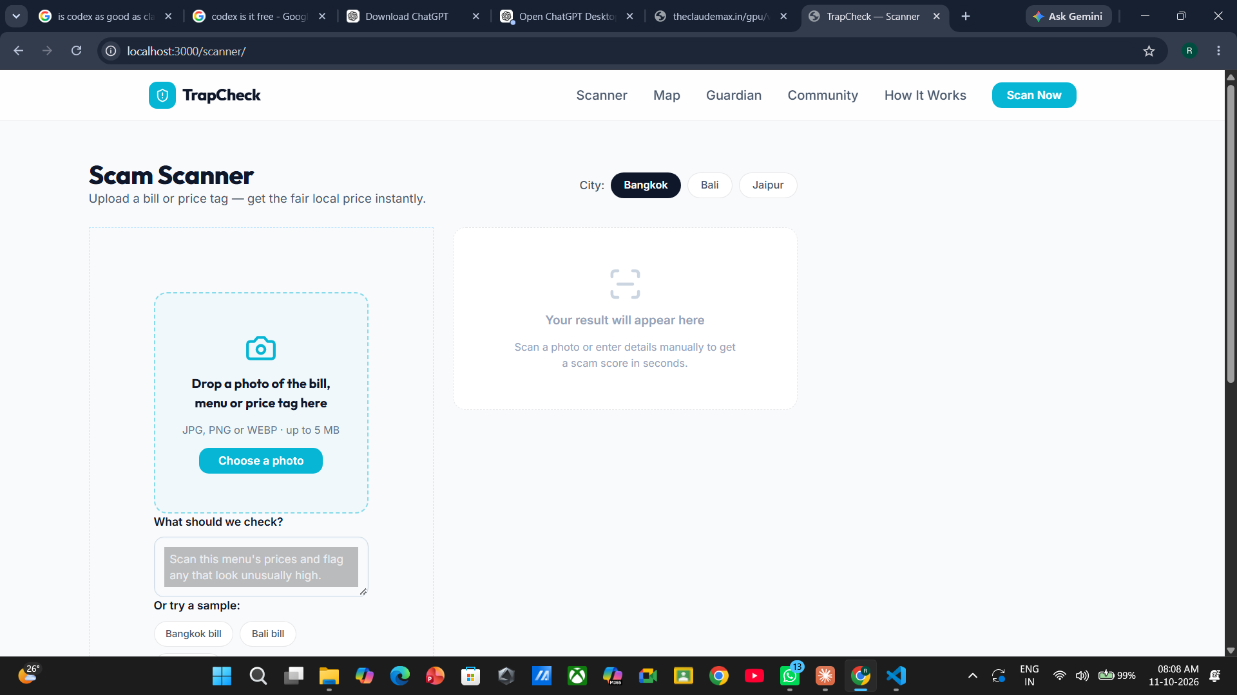
APP SCREENS
The product is already taking shape
Landing page · privacy cues and live stats
Scanner · city choice, upload and sample bills
Live UI captures supplied by the team
TRAPCHECK / KNOW THE LOCAL PRICE BEFORE YOU PAY
07

Slide 8
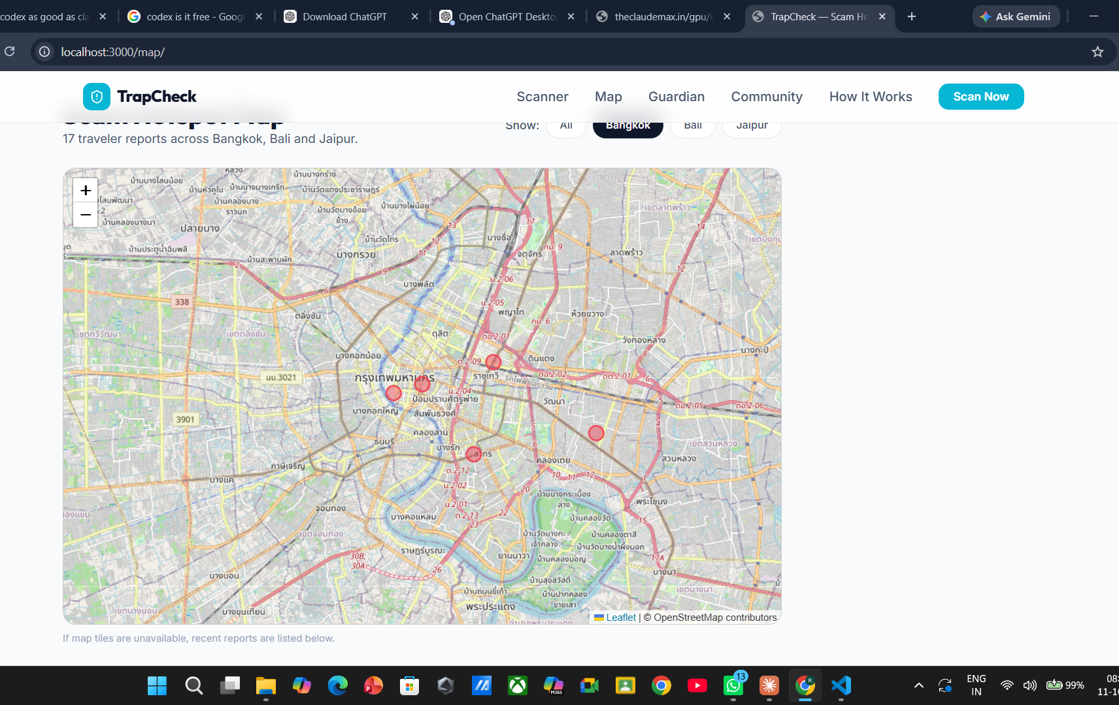
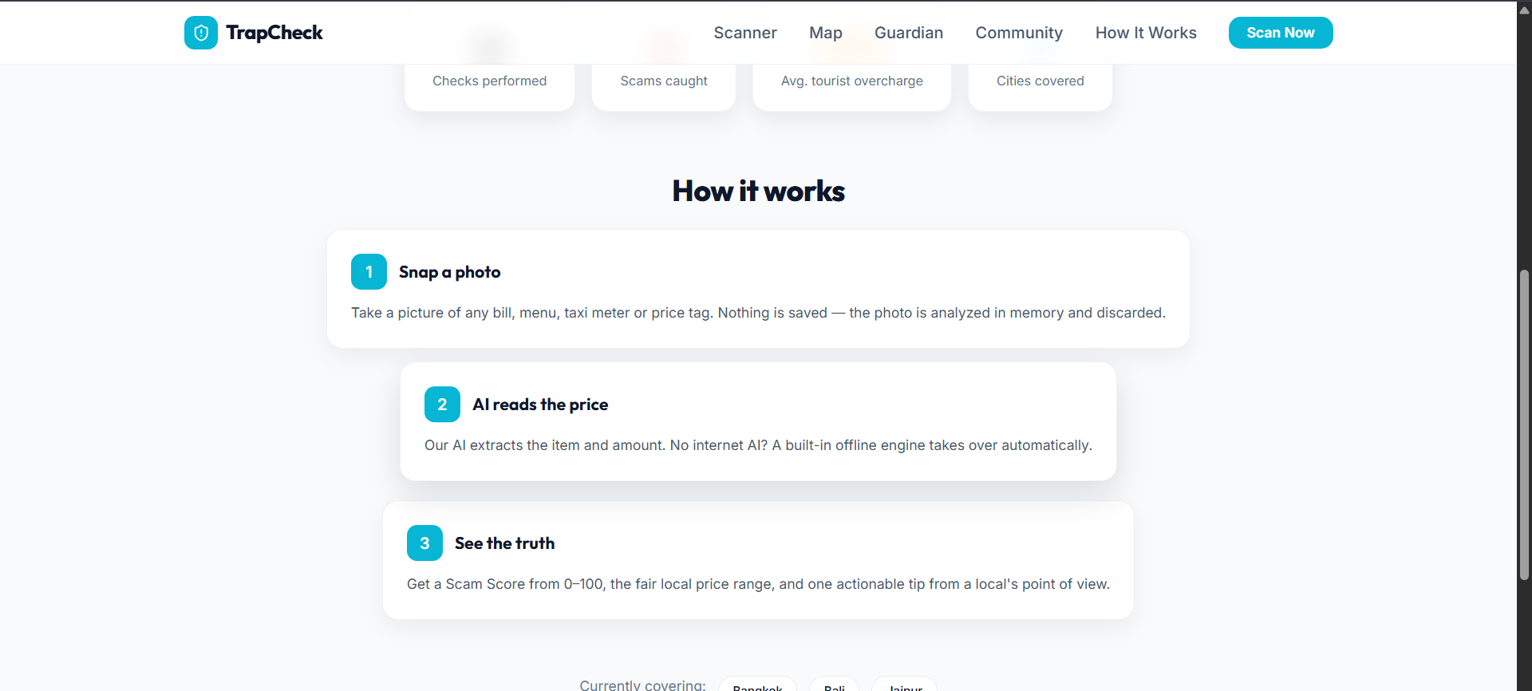
PRODUCT IN USE
Map and scan flow
HOTSPOT MAP
Leaflet + OpenStreetMap with city filters and report markers.
App flow · upload, analyze and compare
TRAPCHECK / KNOW THE LOCAL PRICE BEFORE YOU PAY
08

Slide 9
BUILD & TRUST
Privacy and practical engineering
NO SCANNER PHOTO STORAGE
OFFLINE FALLBACK
ONE LANGUAGE
Images analyzed in memory; not saved by scan flow
OCR and manual entry work without Gemini
Python Reflex app across UI and backend
OPEN MAP DATA
LOCAL PRICE ENGINE
COMMUNITY REPORTS
Leaflet + OpenStreetMap
JSON references + rapidfuzz matching
Traveler submissions stored in SQLite
Gemini Flash is optional and needs a configured API key. Avoid claiming “fully private” for every network path.
TRAPCHECK / KNOW THE LOCAL PRICE BEFORE YOU PAY
09

Slide 10
JUDGE WALKTHROUGH
Demo: make the price check concrete
01
Open Scanner and choose Bangkok
THE NEXT MILE
02
Load the sample bill: Pad Thai, ฿500
More destinations
Crowdsourced local prices
Multicurrency support
Offline mobile experience
03
Compare with the shown local range: ฿50–120
04
Switch to Bali; try Nasi Goreng at IDR 250,000
Millions of travelers deserve a fairer way to check the price in front of them.
05
Show the hotspot map, Guardian and Community pages
TRAPCHECK / KNOW THE LOCAL PRICE BEFORE YOU PAY
10

