Slide 1
V-SET2: Visual Story Editing Tool version 2.
Yi-Chun Chen (Rimi)

Slide 2
Revision History
Tool version | Slide update
V-SET v1.0.0 | Introduction, System structure
V-SET v2.0.0 | New functions in version 2.0

Slide 3
Outline
Content in version 1: (P4 ~P7)
Related authoring issues
Elements of stories
Update for final project, version 2:(P8 ~P14)
Alternative story queue
Interface

Slide 4
Related Authoring Issues
Graphical user interface for authoring to editing stories without knowing programming language/scripts.
Quickly show the result of generated content.
V-SET is a prototype of a story editing tool.

Slide 5
Elements of stories
To present a story, we have…
A sequence of story events.
Characters
Interactions between characters (dialogue)
Places
When events ordered by discoursed time, it forms the storyline.

Slide 6



Place
Characters
Interaction content
Story events
Timeline

Slide 7


Data Flow
Story content
Editing actions
Interface
Visual display
Unconfirmed content
Display Queue
Editing Buffer
Compiled content
Look Up Maps
Confirmed content
Visual materials
Saved content
Current content
Visual Materials and Story Data

Slide 8
New Functions in V2
In version 2, V-SET support new functions:
Create story branches.
Transition conditions between story branches.
Add multiple choice questions to take in user input.

Slide 9
Alternative Story Queue
Original story queue
Multiple story queue
Event
Event
Event
Event
Event
Event
Condition
Event
Event
Event
*User input decide story sequences.

Slide 10
User input
Multiple choice question
Conditions: check variable change after users make choices.
Condition: Mood > 30
Variable, operator, value
Choice 1
Mood + 50
Choice 2
Mood - 10
Choice 3
Mood = 30

Slide 11
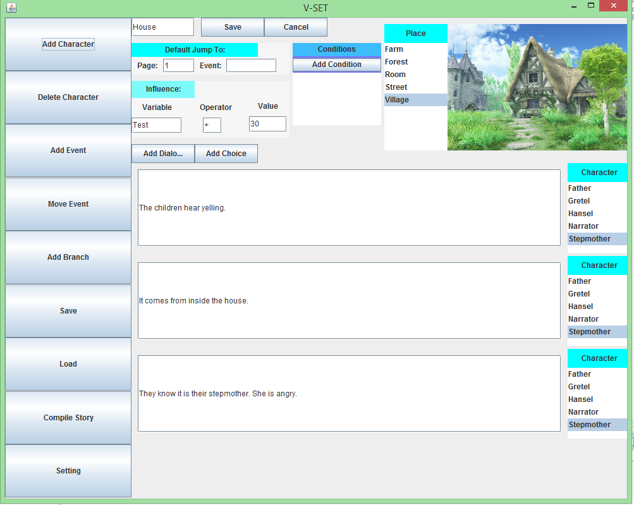
Interface
Jump to chosen event
Apply change to variable
Edit dialogue

Slide 12
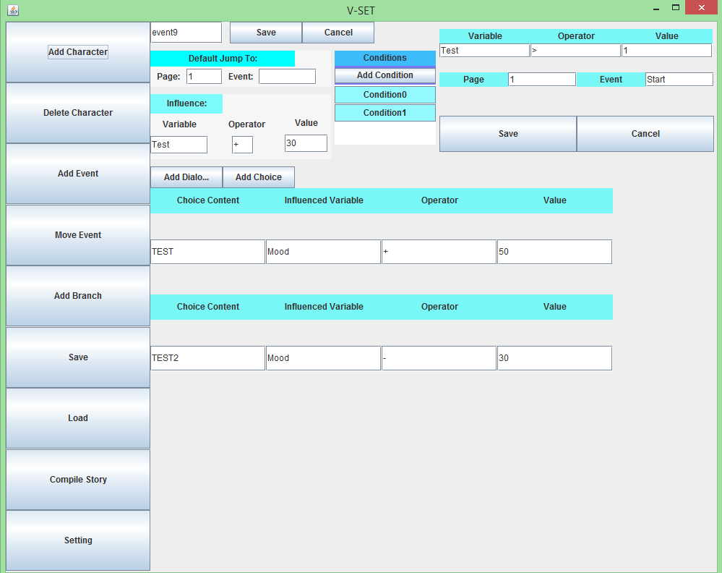
Interface
Add conditions
and details (if condition happen jump to assigned event)
Set multiple choices

Slide 13
Detail class diagram is in Design Document.

Slide 14
Demo Version 2 https://youtu.be/lMltTl59548 Github https://github.com/RimiChen/V_SET

