Slide 1
Sellintelligence
Digital Marketing Campaign Conversion Prediction & ROAS Optimization
Capstone Project | Presented by: Rimi Kumari
Notes:
Good morning everyone. I'm Rimi, and my capstone project is Sellintelligence - predicting digital marketing conversions with machine learning to maximise return on ad spend.

Slide 2
Agenda
Problem Statement & Objectives
Dataset Overview
Methodology - End-to-End Pipeline
Exploratory Data Analysis
Feature Engineering & Preprocessing
Model Selection & Evaluation (4 Classifiers)
Champion Model - Why Logistic Regression
Churn Analysis
Business Impact & ROAS
Power BI Dashboard (Live Demo)
Conclusions & Recommendations
Notes:
Here's the flow: the problem, the data, my methodology, model building and evaluation, then the churn analysis, the business impact, and a live look at the dashboard.

Slide 3
Problem Statement & Objectives
The problem: marketing shows ads to everyone, but not everyone converts - wasted ad spend drags down return on ad spend (ROAS)
The goal: build a machine learning model that predicts which customers will convert, using demographic and engagement data
Business objectives:
Improved targeting - focus budget on customers likely to buy
Cost optimisation - stop paying to advertise to customers who won't convert
Better campaigns - understand which factors actually drive conversion
Deliverables: documented notebook, trained model, final report, interactive Power BI dashboard (churn patterns + model performance)
Notes:
The core problem is simple: marketing teams show ads to everyone, but not everyone converts. Every ad shown to someone who was never going to buy is wasted money, and that drags down ROAS. My objective was a model that predicts, per customer, whether they'll convert - so budget goes to the right people.

Slide 4
Dataset Overview
8,000
customers
Digital marketing campaign dataset
Demographics: Age, Gender, Income
Campaign: Channel (Email, PPC, Referral, SEO, Social Media), Type (Awareness, Consideration, Conversion, Retention)
Engagement: AdSpend, CTR, WebsiteVisits, PagesPerVisit, TimeOnSite, EmailOpens/Clicks, SocialShares
History: PreviousPurchases, LoyaltyPoints
Target: Conversion (1 / 0)
20
features - no missing values
87.65%
converted (class 1)
12.35%
did not convert - the class that protects budget
Notes:
8,000 customers, 20 features, no missing values. The key number: 87.65% converted, only 12.35% didn't. That imbalance shaped every decision - accuracy alone means nothing here.

Slide 5
Methodology - End-to-End Pipeline
1. Load & inspect the data (8,000 rows, baseline conversion 87.65%)
2. EDA - channels, income, correlation checks
3. Feature engineering - one-hot encoding + standard scaling
4. Train 4 classifiers on a stratified 80/20 split
5. Honest evaluation - preprocessing inside sklearn Pipelines, 5-fold stratified CV (no data leakage)
6. Score all customers -> lead tiers + churn risk
7. Export everything to Power BI for the interactive dashboard
7 STEPS
raw data
→ live dashboard
Notes:
The end-to-end pipeline: load, explore, engineer features, train four classifiers, then re-evaluate everything leak-free with pipelines and 5-fold CV, score every customer, and export to Power BI.

Slide 6
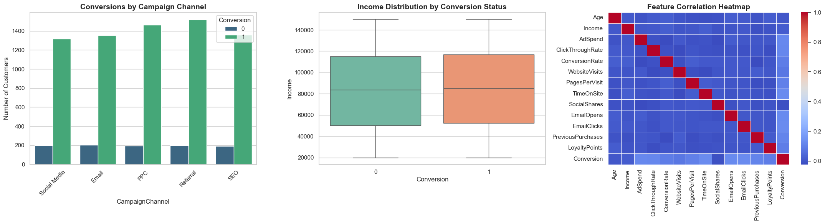
Exploratory Data Analysis
All five channels deliver similar conversion volumes; income doesn't separate buyers from non-buyers; no problematic feature correlations
Notes:
Three findings: no channel dominates, income doesn't separate buyers from non-buyers, and no redundant features. The takeaway: behaviour, not demographics, is where the signal lives.

Slide 7
Feature Engineering & Preprocessing
Dropped non-predictive columns: CustomerID + two masked vendor columns
One-hot encoded categoricals (Gender, Channel, Campaign Type) with drop_first=True - avoids the dummy variable trap
StandardScaler on numerics - so Income can't dominate Age just because of scale
16 raw features became 21 model features
Leakage control (the part most projects miss):
First pass fit the scaler before splitting - that leaks test information
Fixed by rebuilding preprocessing inside sklearn Pipeline + ColumnTransformer - every CV fold fits its own scaler/encoder
Class imbalance: class_weight='balanced' so the 13% non-converters are not ignored
Notes:
Standard preprocessing - but the highlight is honesty: my first pass fitted the scaler on the whole dataset before splitting, a subtle data leak. I caught it and rebuilt preprocessing inside a pipeline so each CV fold fits its own scaler. Finding and fixing that was one of my biggest learnings.

Slide 8
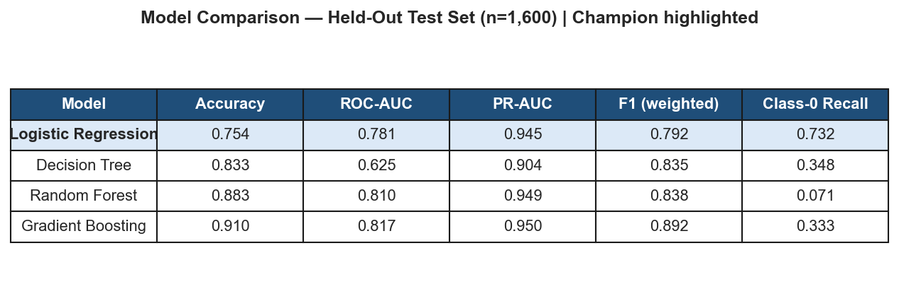
Model Selection - 4 Classifiers
Logistic Regression - interpretable linear baseline
Decision Tree - simple non-linear model
Random Forest - bagging ensemble (300 trees)
Gradient Boosting - boosting ensemble, strongest headline numbers
All trained on the same stratified 80/20 split inside the same leak-free pipeline - scores are directly comparable
Watch the LAST column - the share of non-converters each model catches. It decides the champion.
Notes:
Four classifiers under identical conditions. Gradient boosting has the best accuracy at 0.91 and the best AUC. But look at the last column - class-0 recall, the share of non-converters caught. That column decides the champion, and I'll come back to it.

Slide 9
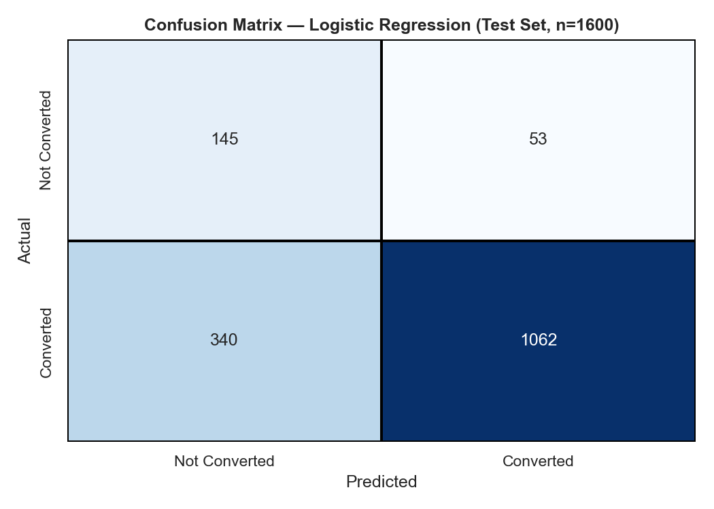
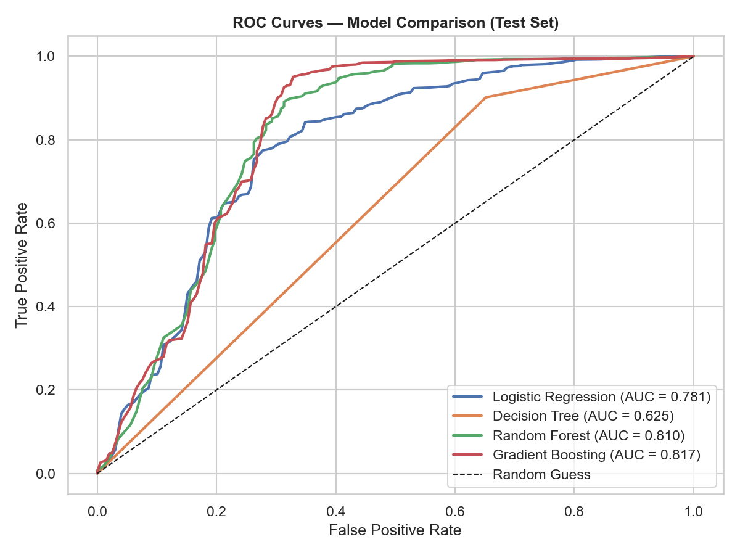
Evaluation - Confusion Matrix & ROC
The champion catches 145 of 198 real non-converters (73%) - every one is a saved ad. All four models sit comfortably above the random-guess diagonal.
Notes:
Left: the champion's confusion matrix - 145 of 198 real non-converters caught, 73%, at the cost of some false alarms. Right: ROC curves - all four models comfortably above the random diagonal.

Slide 10
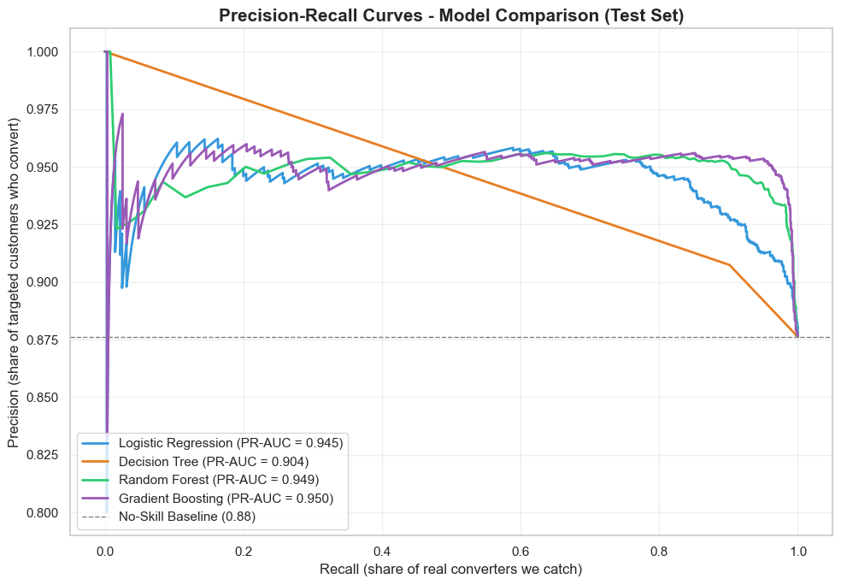
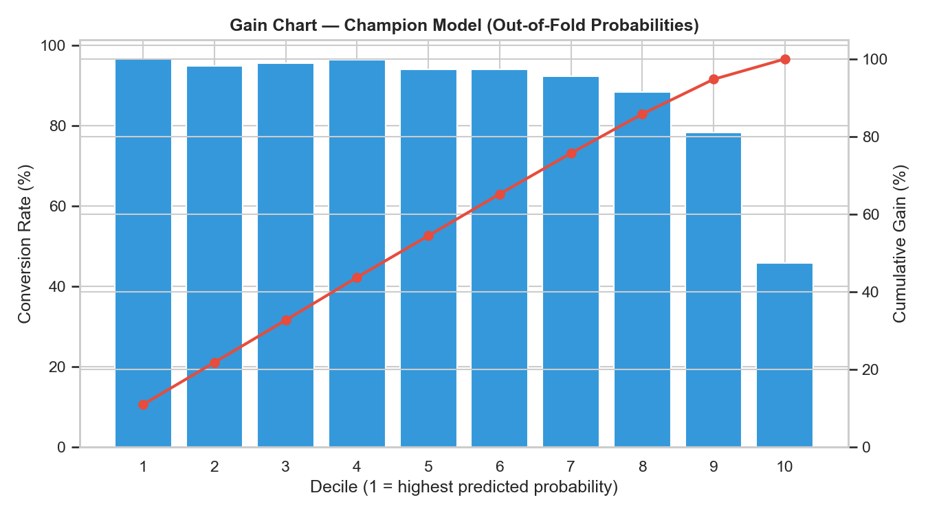
Precision-Recall & Gain Analysis
With 87% of customers converting, a no-skill model already has 0.88 precision - the PR curve shows real skill as lift above that line. Top decile converts at 96.6% vs the 87.7% average.
Notes:
Because of the imbalance, precision-recall is the honest view - a no-skill model already sits at 0.88 precision, so skill is the lift above that line. The gain chart: top decile converts at 96.6% versus the 87.7% average.

Slide 11
Champion Model - Why Logistic Regression?
Gradient Boosting has the best headline numbers: accuracy 0.910, ROC-AUC 0.817
But the business goal is protecting ad budget - catching customers who will NOT convert:
Logistic Regression catches 73% of non-converters
Gradient Boosting catches only 33% - Random Forest just 7%
A model that misses two-thirds of non-buyers cannot power an ad-suppression strategy, whatever its AUC
Logistic Regression is also fully interpretable - coefficients show exactly what drives conversion (CTR, pages per visit, time on site, email engagement)
Champion: Logistic Regression (ROC-AUC 0.781, PR-AUC 0.945, Class-0 recall 0.73)
Notes:
THE key slide. Why logistic regression when gradient boosting has better accuracy? Because the business goal is protecting ad budget - catching people who will NOT buy. LR catches 73% of them, GB 33%, RF 7%. A model missing two-thirds of non-buyers can't power ad suppression, whatever its AUC. And LR is fully interpretable. Choosing by business fit, not leaderboard - the main lesson of this project.

Slide 12
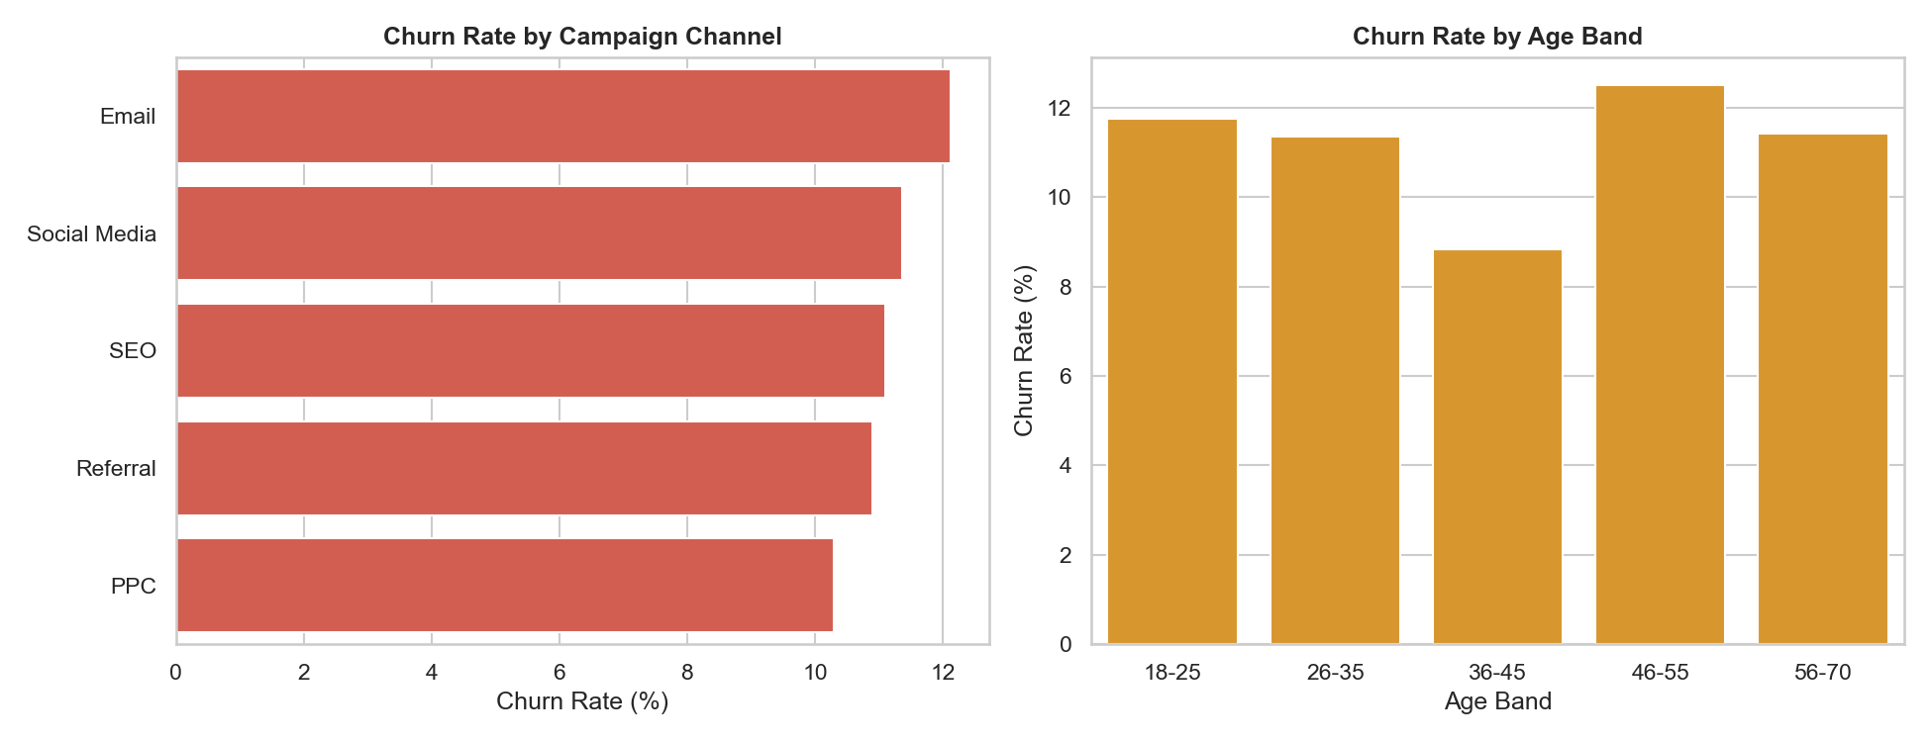
Churn Analysis
Churn proxy (no subscription dates in the data): an existing customer (PreviousPurchases > 0) who didn't convert this campaign
7,162 existing customers - 798 lapsed (11.1%)
Churn risk score = 1 - P(conversion), banded into High / Medium / Low tiers
Key patterns:
Low-engagement customers churn at 17.6% vs 9.3% - the earliest warning signal
Email channel churns most (12.1%); PPC is most loyal (10.3%)
1,445 High-Risk customers -> route into Retention campaigns
Notes:
No subscription dates, so churn is a proxy I state openly: an existing customer who didn't convert counts as lapsed - 798 of 7,162, 11.1%. Two patterns: low-engagement customers churn at nearly double the rate, and email churns most while PPC is most loyal. The 1,445 high-risk customers go into retention campaigns.

Slide 13
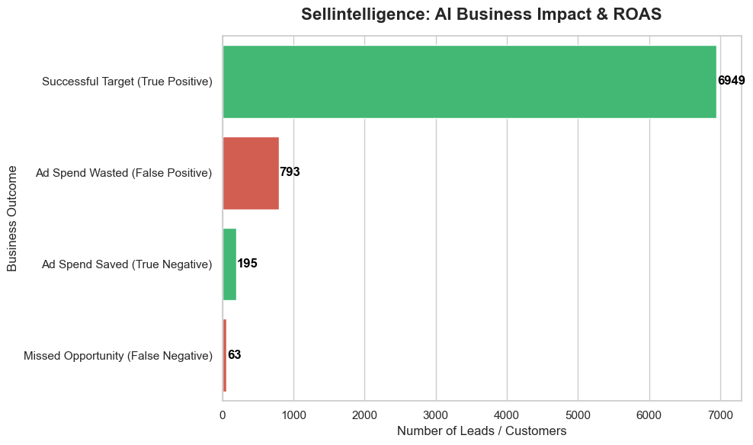
Business Impact & ROAS
AI lead tiers across 8,000 customers:
Hot leads: 6,868 - focus premium ad budget here
Warm leads: 995 - cheaper retargeting
Cold leads: 137 - suppress the ads
ROAS simulation at $50 per ad impression:
195 correctly-suppressed non-converters = $9,750 saved
A conservative floor - a tuned threshold grows the suppression pool several times over
Strategy: deploy as a suppression list first - immediate, measurable saving
Notes:
Turning predictions into money: 6,868 hot leads, 995 warm, 137 cold. At $50 per ad, suppressing the correctly-identified non-converters saves about $9,750 - and that's the conservative default-threshold floor. Deploy as a suppression list first: immediate, measurable saving.

Slide 14
Power BI Dashboard - 3 Interactive Pages
Marketing Summary - KPI cards, ROAS impact, lead quality, top conversion drivers, conversion by type / channel / age / gender / income, with campaign slicers
Churn Patterns - churn KPIs (7,162 / 798 / 11.1%), churn rate by channel, age band and campaign type, risk tiers, engagement effect - every chart cross-filters
Model Performance - metrics table, confusion matrix, ROC & PR curves, gain chart, with a Model slicer that flips the whole page between the four classifiers
All data flows straight from the notebook exports - refresh once, everything updates
(Live demo - watch the pages react as I click)
Notes:
Everything lands in a three-page Power BI dashboard - marketing summary, churn patterns, model performance. All visuals are live and cross-filter each other. DEMO: click Email in the channel slicer on page 1; click the High Risk donut slice on page 2; switch the Model dropdown to Random Forest on page 3 and watch the confusion matrix flip.

Slide 15
Conclusions & Recommendations
Built an end-to-end pipeline: EDA -> features -> 4 models -> honest evaluation -> churn scoring -> dashboard
Champion Logistic Regression catches 73% of non-converters - the metric that directly protects ad budget
Recommendations:
Deploy as an ad-suppression list first ($9,750 immediate simulated saving)
Tier the contact strategy: premium ads for Hot, retargeting for Warm, suppress Cold
Retention campaigns for the 1,445 High-Risk churn customers; watch engagement drops
Retrain quarterly and monitor Class-0 recall; tune the threshold to the real cost ratio
Future work: real churn labels (purchase timestamps), per-customer ad costs, uplift modelling
Notes:
To wrap up: end-to-end pipeline from raw campaign data to an interactive decision tool. Champion catches 73% of non-converters. Deploy as a suppression list, tier the contact strategy, retention for high-risk, retrain quarterly. Future work: real churn labels and uplift modelling. Thank you.

Slide 16
Questions ?
Notes:
Pause. Breathe. You prepared 40 answers in the guide - most questions will be one of them.

Slide 17
Thank You!
Notes:
Thank the panel. Done!

