Slide 1

DATABASE SYSTEMS — REVIEW 2
Social Media Analytics Engine
We built a social media analytics engine to demonstrate relational database design and advanced SQL on large-scale social interaction data.
Team Members:-
  Chinmayi Gadre – 1262252785
  Pournami Roy – 1262252045
  Tanishka Tiwari – 1262253274
  Anushree Singh – 1262252008
  Palak Soni – 1262252891
1
Notes:
1

Slide 2
MOTIVATION
Problem Statement
Why social analytics needs structured relational data
FROM RAW ACTIVITY ...
The focus of this project is not basic CRUD. Social platforms generate large volumes of connected activity, and answering real questions about that activity requires the database itself to do the analytical work.
  Users
  Posts
  Comments
  Followers
  Interactions (views, likes, saves, shares)
We analyse users, posts, comments, followers and engagement to surface trends, rankings and activity patterns — not just to store and retrieve rows.
... TO STRUCTURED INSIGHT
  Engagement trends over time
  Creator and post rankings
  Peak activity patterns
2
Notes:
2

Slide 3
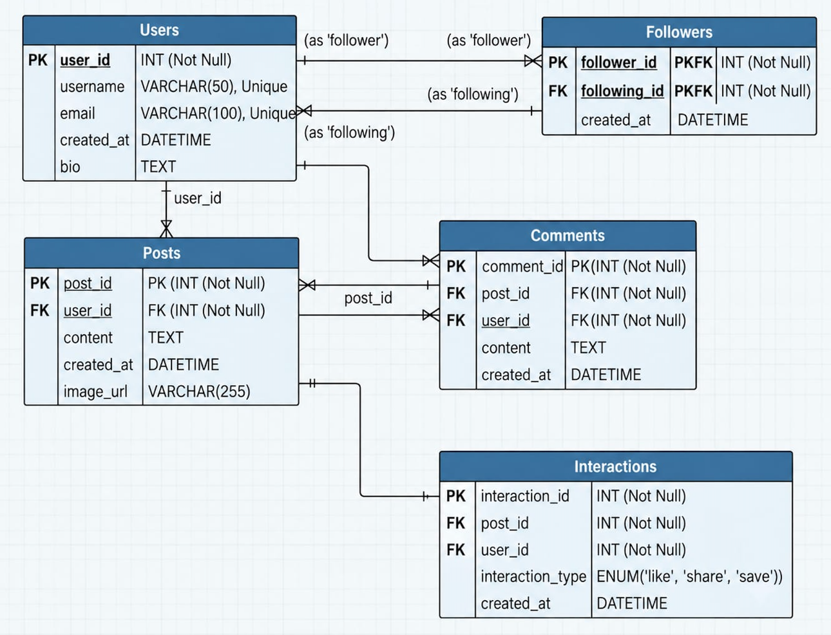
DATA MODEL
ER / Schema
Five core tables, connected by primary and foreign keys
  Users create posts
  Posts receive comments and interactions
  Followers models a self-referencing many-to-many relationship
3
Notes:
3

Slide 4
SCHEMA DEFINITION
DDL + Constraints
Table | Constraints
users | PK (AUTO_INCREMENT); UNIQUE username, email; CHECK email format; NOT NULL (except bio)
posts | PK; FK -> users ON DELETE CASCADE; CHECK post_type IN (text, image, video, link)
comments | PK; FK -> posts CASCADE; FK -> users CASCADE
followers | Composite PK (follower_id, followee_id); both FK -> users CASCADE; CHECK follower_id <> followee_id
interactions | PK (BIGINT); FK -> posts, users CASCADE; CHECK interaction_type IN (like, share, save, view); UNIQUE (post_id, user_id, interaction_type)
PRIMARY KEY · FOREIGN KEY · UNIQUE (single & composite) · CHECK (value list & pattern) · NOT NULL · AUTO_INCREMENT · DEFAULT — the database enforces integrity instead of relying only on application code.
4
Notes:
4

Slide 5
QUERY LAB
Advanced Queries
We use joins, CTEs, subqueries, aggregates and window functions for analytics — not simple lookup queries.
Requirement | SQL Techniques Used
Top-performing posts by weighted engagement | JOIN, GROUP BY, HAVING, conditional aggregate
Rank creators overall and within their country | CTE, RANK, DENSE_RANK, PERCENT_RANK, PARTITION BY
Trending posts — activity in the last 7 days, regardless of publish date | CTE, UNION ALL, weighted SUM, DENSE_RANK, date filtering
Compare each post against its author's own average | Window AVG with PARTITION BY, CASE, CTE
Daily engagement totals with a 7-day moving average | Window frame ROWS BETWEEN, LAG, running total
5
Notes:
5

Slide 6
REUSABLE LOGIC
Stored Functions
Functions centralise reusable scoring logic inside the database.
CalculatePostEngagement(post_id)
CalculateUserEngagement(user_id)
CalculateWindowEngagement(post_id, start, end)
RETURNS DECIMAL(10,1)
RETURNS DECIMAL(12,1)
RETURNS DECIMAL(10,1)
Weighted score for one post: view 0.2, like 1, save 2, comment 2, share 3.
Sums a creator's total points by calling the post-level function across all of their posts.
Same weighted score, but counted only from interactions and comments between two moments in time.
6
Notes:
6

Slide 7
ROW-BY-ROW PROCESSING
Cursor Procedures
Both procedures use cursors for row-by-row processing and stateful report generation.
GenerateUserEngagementReport(user_id)
GenerateTrendingPostReport(start, end, limit)
A creator opens their analytics page and asks for a summary of their whole catalogue.
The editorial team wants the trending list for a chosen week or month.
  Cursor walks every post belonging to that user
  Scores each with CalculatePostEngagement, keeps a running total and best post
  SIGNAL SQLSTATE '45000' if the user id does not exist
  Cursor selects posts with activity in the window — not posts published in it
  Scores each with CalculateWindowEngagement and inserts if it earned any points
  Returns the ranked list with RANK() OVER (ORDER BY points DESC)
7
Notes:
7

Slide 8
AUTOMATED RULES
Triggers
Triggers automatically enforce business rules and record database events.
Trigger | Fires On | Purpose
trg_no_self_engagement | BEFORE INSERT ON interactions | Integrity — rejects a user liking, saving, sharing or viewing their own post
trg_interaction_audit | AFTER INSERT ON interactions | Auditing — copies every engagement event, with its timestamp, into interaction_audit
trg_post_delete_audit | AFTER DELETE ON posts | Auditing — records what was removed once cascade deletes its comments and interactions
Application creates the triggers after the bulk data load — there is no value in writing 177,000 audit rows for generated seed data.
8
Notes:
8

Slide 9
PERFORMANCE
Indexing & Optimisation
Measured on 177,342 interactions, average of three runs
Query | Without Index | With Index | Change
Active users, last 3 days | 86 ms | 38 ms | 2.3x faster
Trending, last 7 days | 65 ms | 61 ms | No real change
Daily activity, 45 days | 72 ms | 67 ms | No real change
Accounts that never engage | 12 ms | 12 ms | Already fast
Indexes pay off when a query needs a small, selective slice of a large table. When a query reads most of the table, a full scan is cheaper and the optimiser ignores the index — and every index still costs storage and slows down inserts.
9
Notes:
9

Slide 10
SUMMARY
Architecture & Conclusion
Browser
Node.js + Express
MySQL 8.0
HTML / CSS / JS dashboard
mysql2 pool, parameterised queries
tables, views, functions, procedures, triggers
No data is hardcoded — every page fetches from the API. Query text lives server-side; the browser sends an id, never SQL.
WHAT THIS PROJECT DEMONSTRATES
  A normalised schema with PK, FK, UNIQUE, CHECK and CASCADE constraints enforcing integrity
  14 analytical queries using joins, CTEs, subqueries and window functions
  Stored functions reused across procedures, the API and ad-hoc queries
  Two cursor-based procedures for stateful, row-by-row report generation
  Triggers for integrity and auditing, and indexes chosen from measured query performance
10
Notes:
10

