Slide 1
Hunting
Job
—Team members
Abhay Singh
Rimma Rani Laxmi Shah
Sri Ratnala
—Guided by : Satyanna Kodimala

Slide 2
01
Problem Statement
02
Objective
03
Microservices
04
Project Overview
Outline
07
Technology and Tool
used
08
Implementation
09
Conclusion
05
Architecture
06
Application flow

Slide 3
—Problem Statement
Users should be able to register with the application so that they can login and use the functionalities of the application.
Users should be able to login with username and password in order to access the functionalities of the application.
User should be able to see all the listed Jobs .
User should be able to save Jobs to a Wishlist so that they can access them later .
User should be able to access items saved to my Wishlist .

Slide 4
—Objective
A user can search for a job on home page as well as can register itself. Logged in user can search job in a particular category. User should also able to put few job in watch list.

Slide 5
Microservices
Authentication API
Authentication API
Wishlist API

Slide 6
Project Overview
Wishlist
Login
Dashboard
Authentication
API
Wishlist
API
Home
Register
SQL
Server
Mongo
Db

Slide 7
Architecture
Login/Register
Authentication API
JWT validator
SQL Server
Token generated
POST request
Front End
Angular
POST /GET/
DELETE
Wishlist API
Add job in Wishlist
Delete Wishlist job
Mongo Db
GET/DELETE
Listed Jobs
External API
GET
GET

Slide 8

—User
Project flow chart
Home
Login
Register
Wishlist
Listed jobs
View Wishlist
Delete Wishlist
Add to Wishlist
Search Books

Slide 9







Technologies and tools used

Slide 10
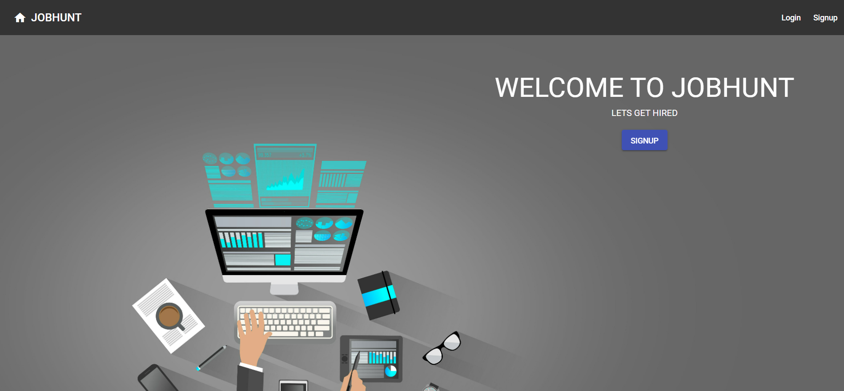
Implementation
HOME PAGE

Slide 11
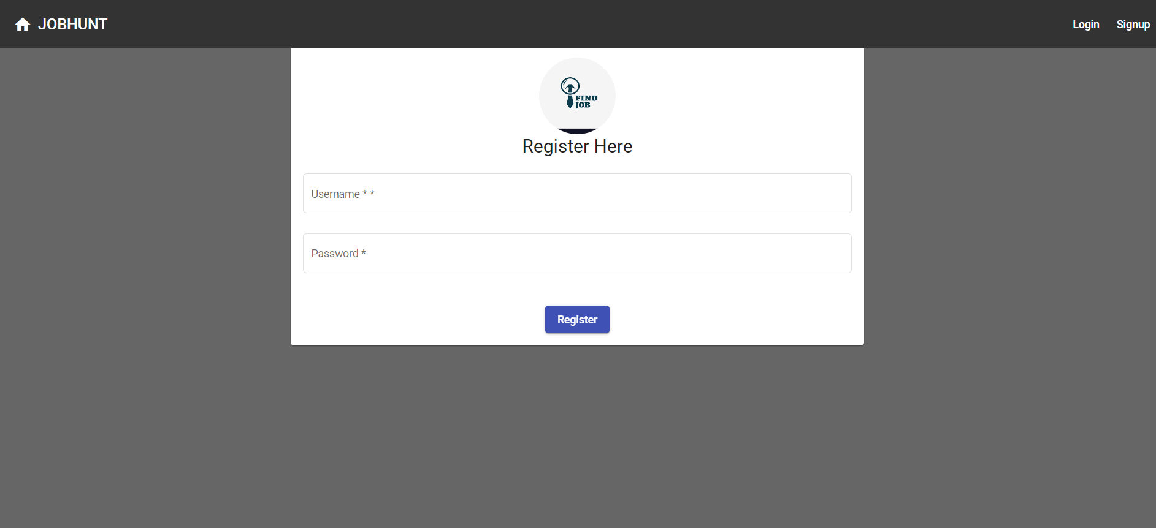
REGISTER PAGE

Slide 12
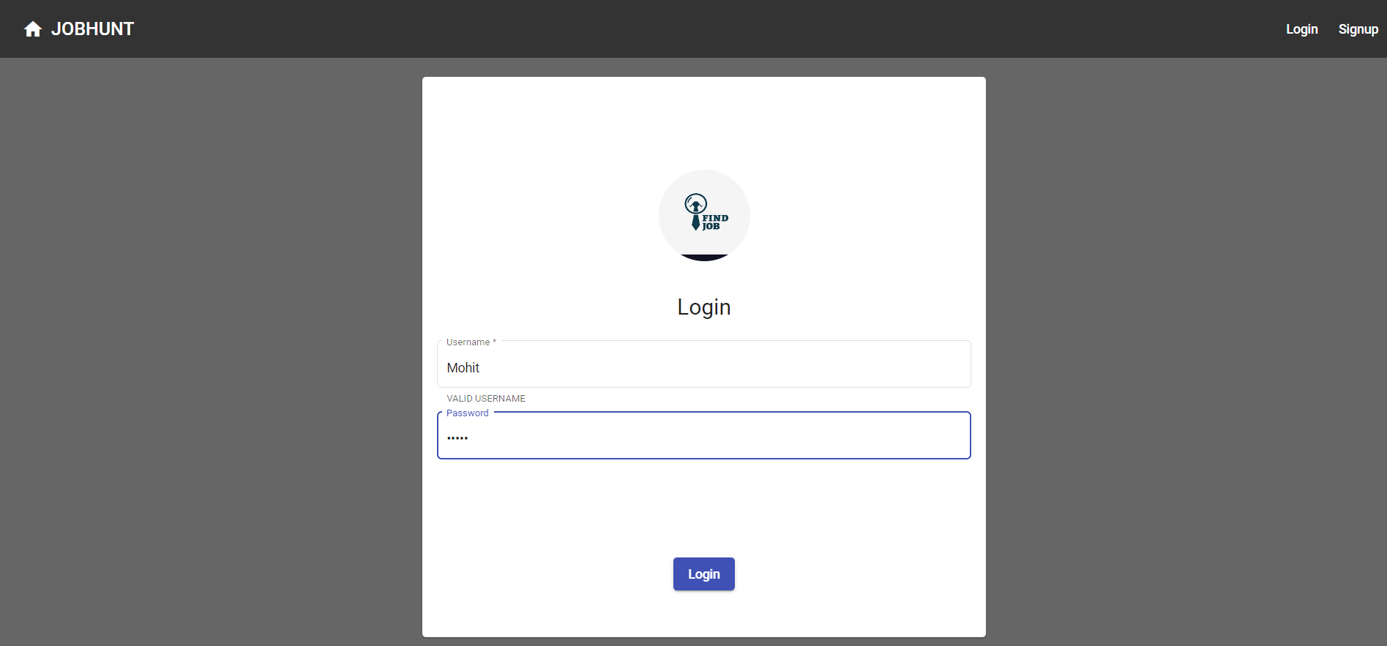
SIGN IN PAGE

Slide 13
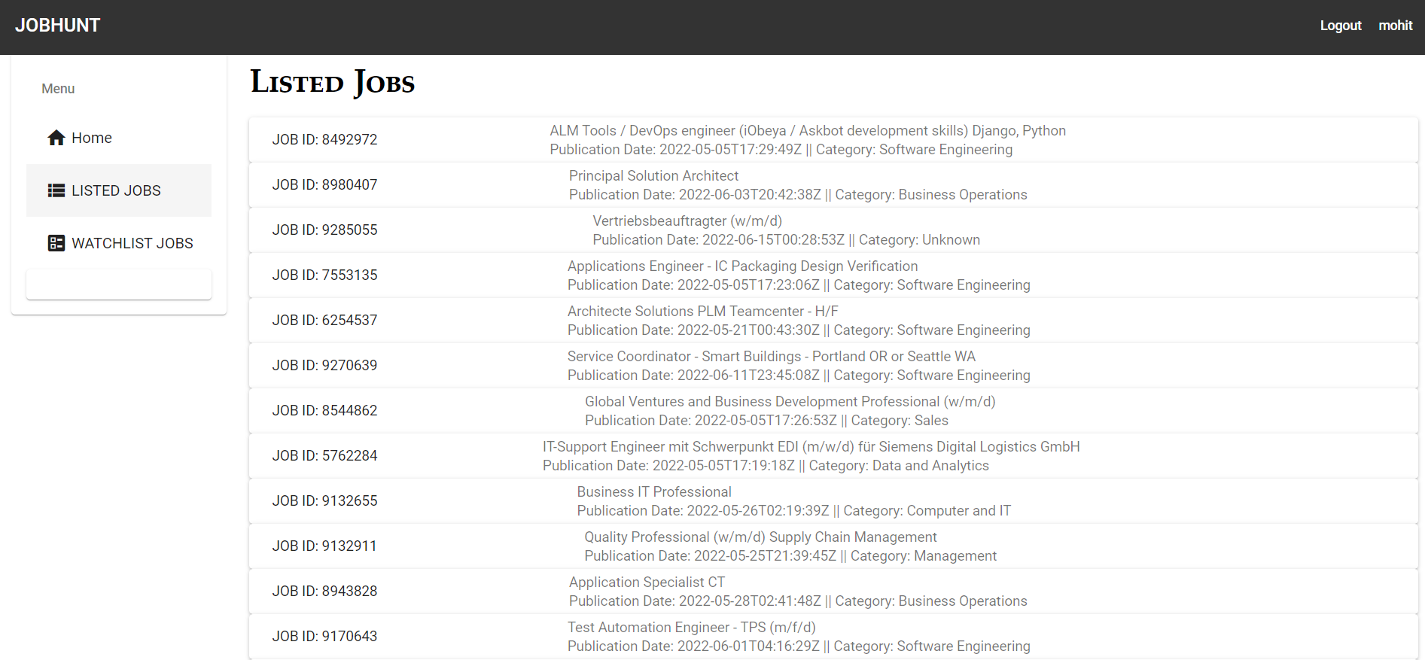
USER PAGE

Slide 14
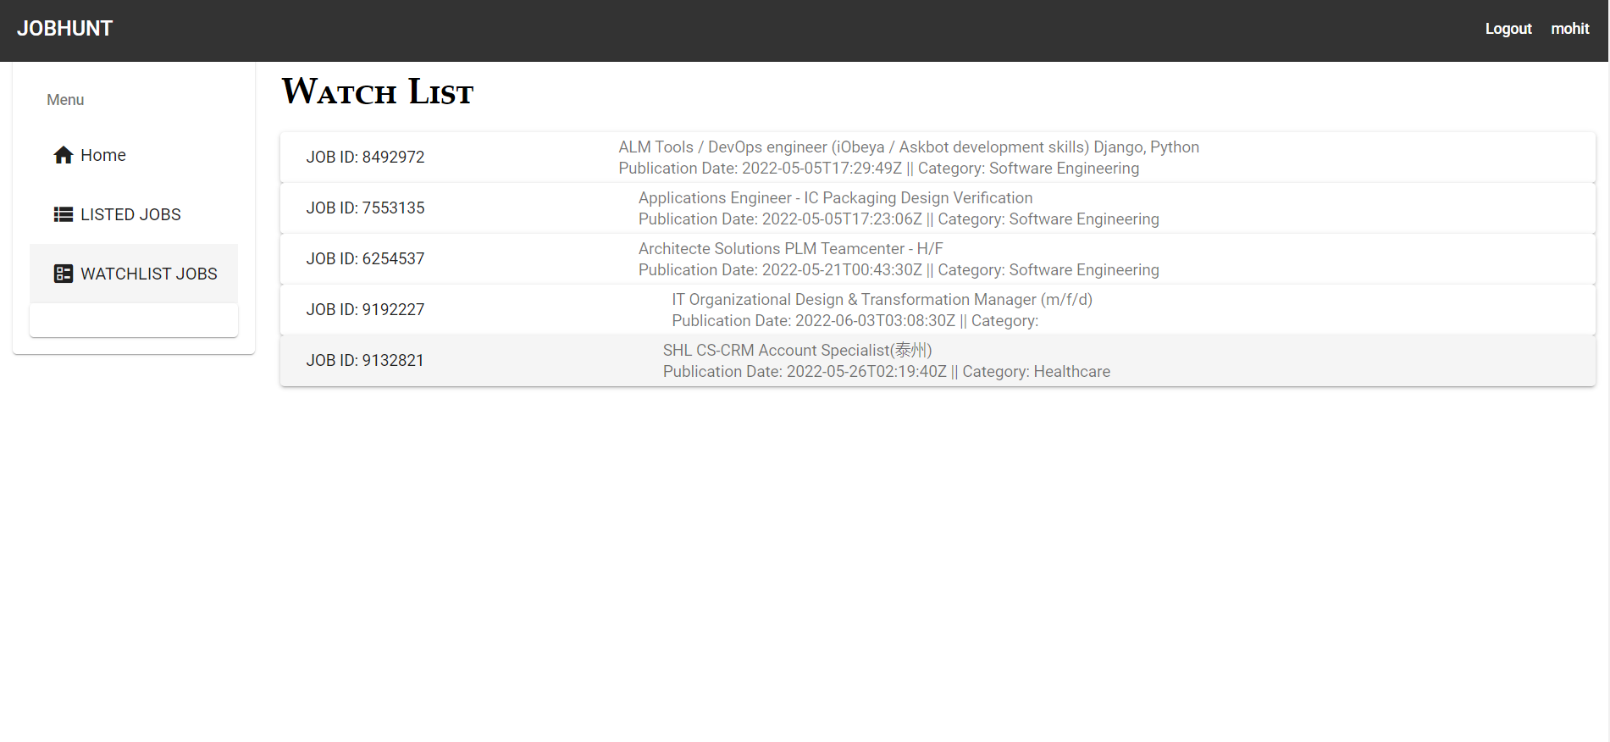
USER PAGE

Slide 15

Conclusion !
conclusion
The Job Hunt app help users to view Available Jobs and add them to their Wishlist . They can also add new jobs and remove already added jobs in the Wishlist

Slide 16
THANK- YOU

