Slide 1
AI Identity Platform
Enterprise Digital Identity, Trust & Deepfake Detection
Technical Presentation
1

Slide 2
Problem Statement
• Digital identity systems require reliable identity and fraud verification.
• Deepfakes and synthetic media create additional identity risk.
• Enterprise decisions require multiple evidence sources.
• The platform combines identity, biometric, document, behavioral and risk signals.
• Fraud Intelligence, Trust Scoring and Alert Center support operational decisions.
2

Slide 3
Solution Overview
• FastAPI API Gateway provides REST and OpenAPI/Swagger interfaces.
• AI modules process identity, face, deepfake, voice and document evidence.
• Device, behavioral, geo-location and historical signals add contextual evidence.
• Fraud Intelligence and Trust Scoring combine evidence for risk-aware decisions.
• AI Identity Copilot, Knowledge Graph, Dashboard and Alert Center support investigation.
3

Slide 4
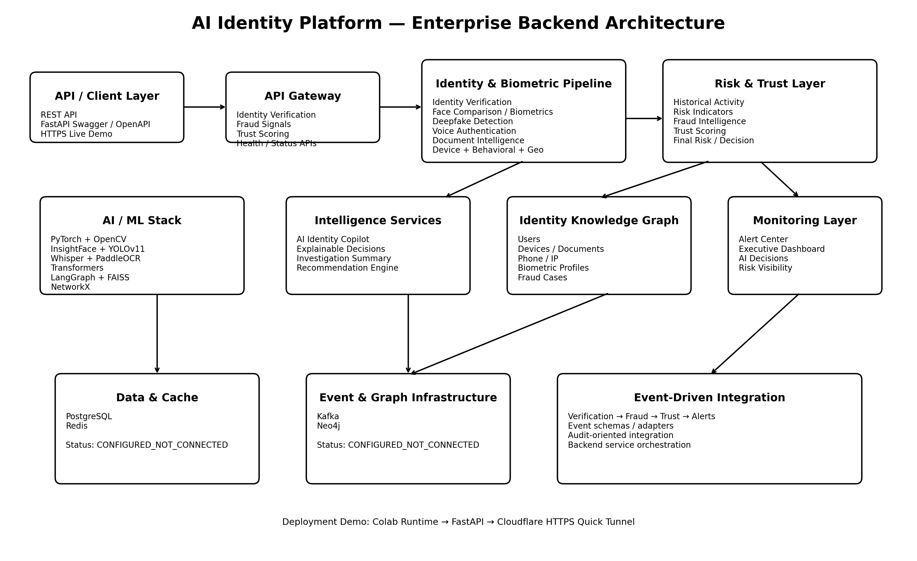
System Architecture
4

Slide 5
Core AI & Intelligence Modules
• Identity Verification
• Deepfake Detection — EfficientNet-B0
• Voice Authentication
• Document Intelligence / OCR
• Device Intelligence and Behavioral Biometrics
• Geo-location, Historical Activity and Risk Indicators
• Face Comparison and AI Identity Copilot
• Identity Knowledge Graph, FAISS and LangGraph
5

Slide 6
Identity Verification & Deepfake Detection
97.66 / 100
Identity Verification
72.90%
Deepfake Fake Probability
0.8606
Face Similarity
0.70
Face Match Threshold
• Deepfake model: EfficientNet-B0 with 224×224 image input.
• Class mapping: Real / Fake.
• Same-person face comparison produced similarity 0.8606.
• Different-person comparison produced similarity -0.2435.
• Deepfake probability is an AI risk estimate, not forensic proof.
6

Slide 7
Voice, Document & Contextual Intelligence
71.48 / 100
Voice Authentication
87.78 / 100
Document Intelligence
100 / 100
Device Intelligence
88.75 / 100
Behavioral Biometrics
• Geo-location: 100 / 100
• Historical Activity: 92.40 / 100
• Risk Indicators: 85.25 / 100
• These signals contribute to the integrated trust and fraud assessment.
7

Slide 8
Fraud Intelligence & Trust Scoring
50.0 / 100
Fraud Risk Score
MEDIUM
Fraud Risk Level
80.36 / 100
Validated Trust Score
9
Trust Signals
• Fraud Intelligence identified a HIGH deepfake indicator in the controlled assessment.
• Recommended action: ADDITIONAL_VERIFICATION.
• End-to-end integrated decision: MANUAL_REVIEW.
• Trust evidence coverage: 100%.
8

Slide 9
AI Identity Copilot & Knowledge Graph
• AI Identity Copilot completed 6/6 analyst query tests.
• Provides identity summary, risk interpretation and recommended action.
• Knowledge Graph initially contained 7 nodes and 9 relationships.
• Entity types include User, Device, Document, Phone Number, IP Address, Biometric Profile and Fraud Case.
• Controlled anomaly detection identified a device associated with two users.
9

Slide 10
Executive Dashboard & Alert Center
• Executive Dashboard covers verification success, deepfake alerts, risk indicators, trust score and AI decisions.
• Fraud-attempt count is explicitly marked unavailable where supporting data was not available.
• Alert Center implements deepfake, fraud-risk, identity-risk, trust-score, verification and manual-review alerts.
• Verified alert state: 6 total alerts, 2 active and 4 clear.
• Deepfake and manual-review alerts were active in the controlled scenario.
10

Slide 11
REST API & Live Demonstration
• FastAPI API Gateway with OpenAPI / Swagger documentation.
• Public HTTPS demonstration through Google Colab and Cloudflare Quick Tunnel.
• GET /health → HTTP 200
• POST /api/v1/identity/verify → HTTP 200
• POST /api/v1/fraud/signals → HTTP 200
• POST /api/v1/trust/score → HTTP 200
11

Slide 12
Validated Project Metrics
97.66 / 100
Identity
72.90%
Deepfake
71.48 / 100
Voice
87.78 / 100
Document
100 / 100
Device
88.75 / 100
Behavioral
100 / 100
Geo-location
92.40 / 100
Historical
12

Slide 13
Infrastructure & Integration Status
• PostgreSQL adapter/configuration implemented — CONFIGURED_NOT_CONNECTED.
• Redis adapter/configuration implemented — CONFIGURED_NOT_CONNECTED.
• Kafka configuration/event schemas implemented — CONFIGURED_NOT_CONNECTED.
• Neo4j schema/service configuration implemented — CONFIGURED_NOT_CONNECTED.
• Event-driven flow: Verification → Fraud → Trust → Alerts.
• No live infrastructure connection is claimed for the Colab demonstration.
13

Slide 14
Deployment & Limitations
• Current live demonstration runs FastAPI inside Google Colab.
• Cloudflare Quick Tunnel provides temporary public HTTPS access.
• The public URL depends on the active Colab runtime and tunnel process.
• Enterprise-scale requirements such as 250M records, sub-2-second latency, HA and horizontal scaling were not load-tested.
• Production deployment requires persistent infrastructure and real service connections.
14

Slide 15
Project Deliverables
• Complete Source Code
• Identity Verification Engine
• Deepfake Detection Module
• Voice Authentication Engine
• Trust Scoring Engine
• Executive Dashboard and Alert Center
• REST APIs
• Architecture Diagram
• Deployment Guide
• Technical Presentation
• Live Demonstration
15

Slide 16
Conclusion
Integrated AI identity verification, fraud intelligence, trust scoring and live API demonstration
AI Identity Platform
16

