Slide 1
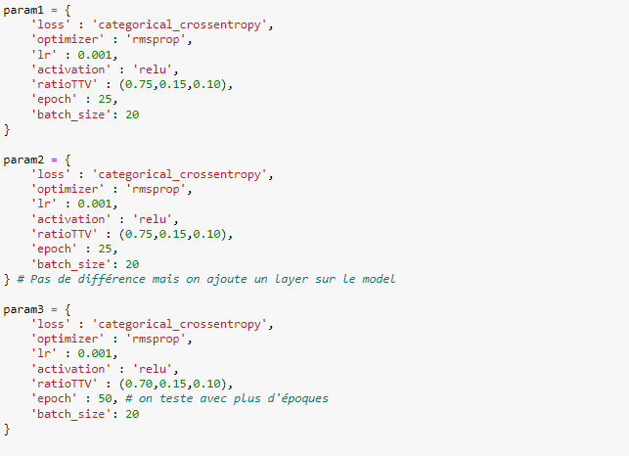
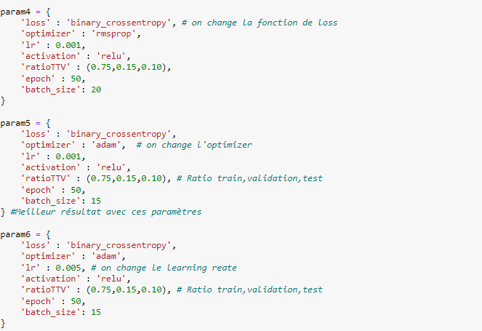
loss: 0.2769 - accuracy: 0.8857 - val_loss: 0.2252 - val_accuracy: 0.9073 - lr: 0.0010
loss: 0.1631 - accuracy: 0.9347 - val_loss: 0.1847 - val_accuracy: 0.9154 - lr: 0.0010
loss: 0.2317 - accuracy: 0.9075 - val_loss: 0.1832 - val_accuracy: 0.9173 - lr: 0.0010
loss: 0.2005 - accuracy: 0.9202 - val_loss: 0.1355 - val_accuracy: 0.9460 - lr: 0.0010
loss: 0.1924 - accuracy: 0.9224 - val_loss: 0.1667 - val_accuracy: 0.9327 - lr: 0.0010
loss: 0.2881 - accuracy: 0.8785 - val_loss: 0.2312 - val_accuracy: 0.9031 - lr: 0.0050

Slide 2
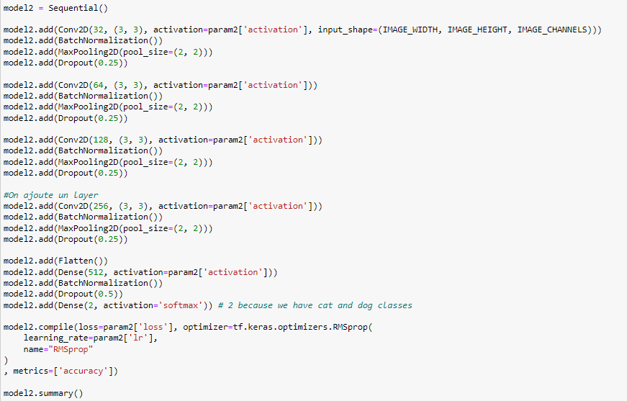
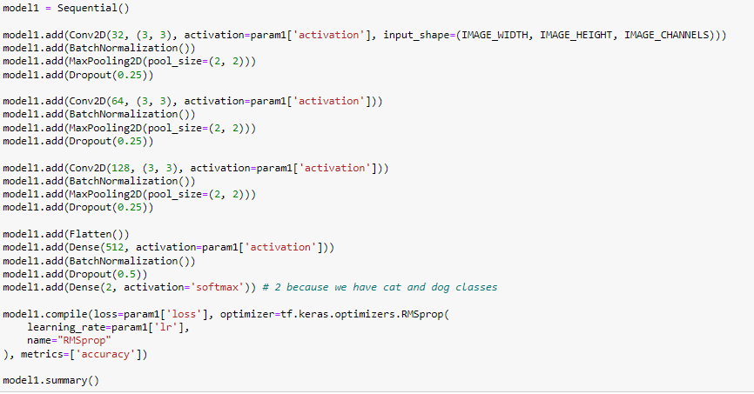

Slide 3
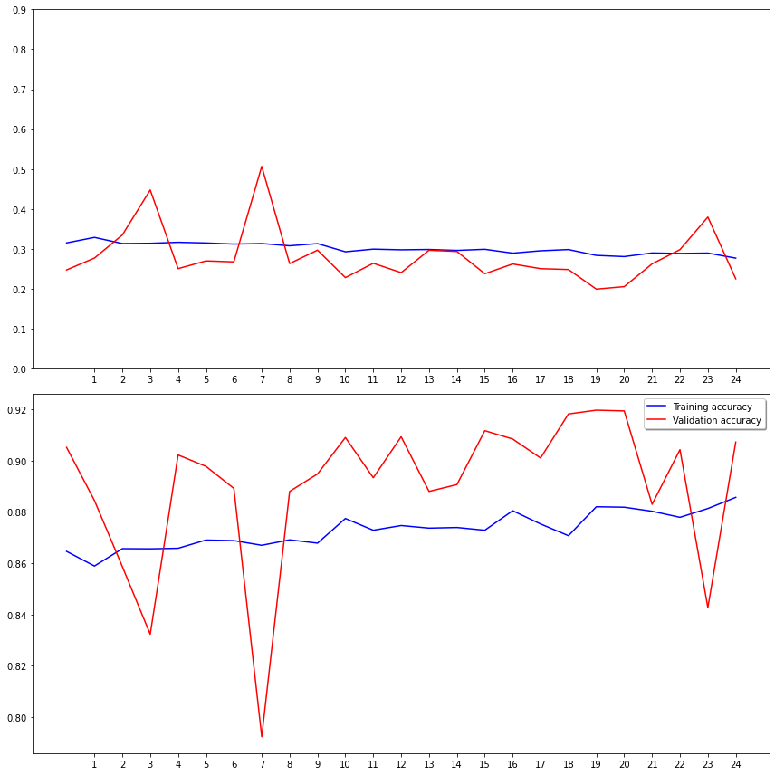
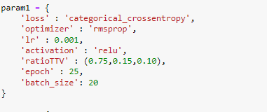

Slide 4
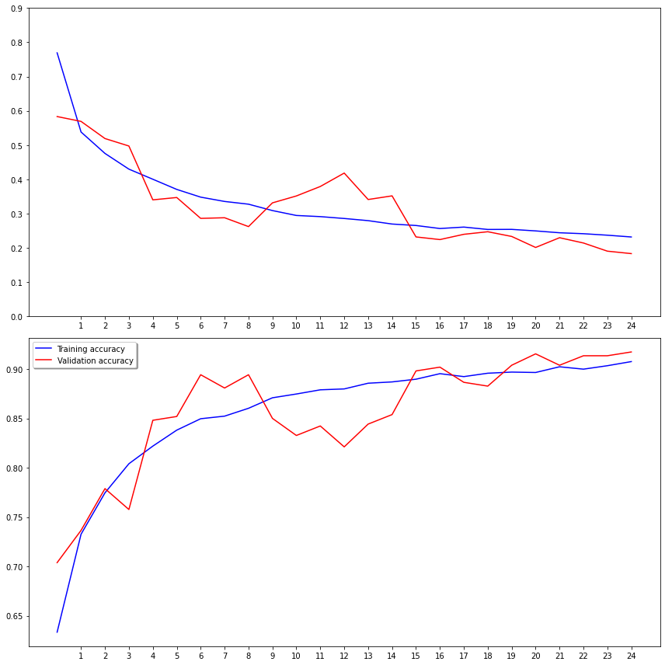
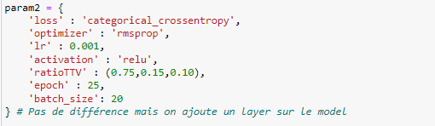

Slide 5
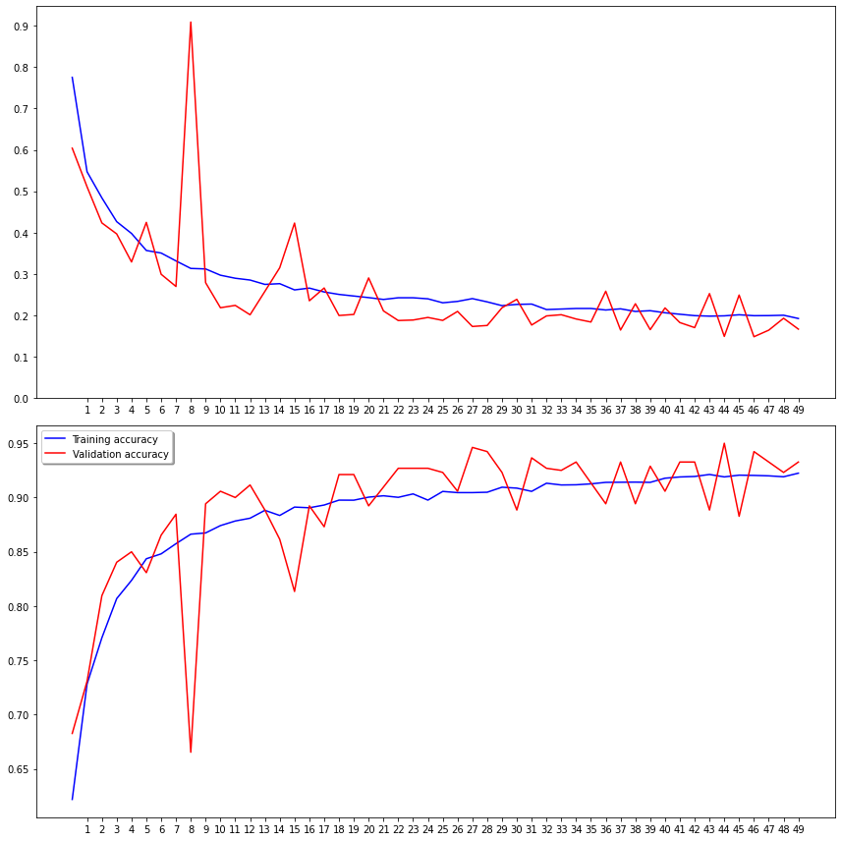
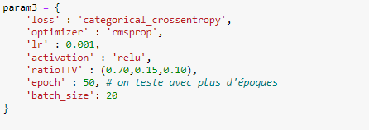

Slide 6
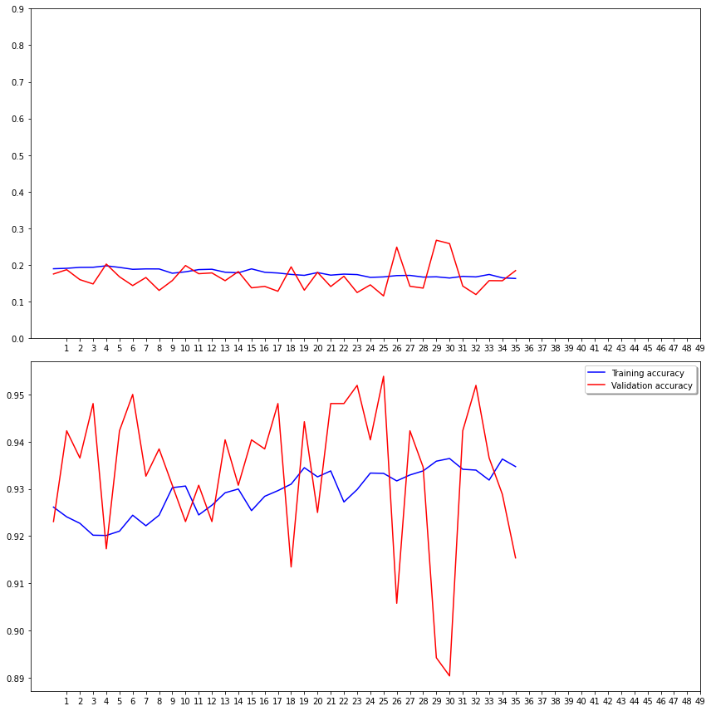
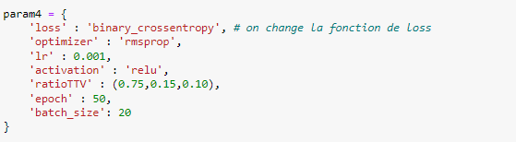

Slide 7
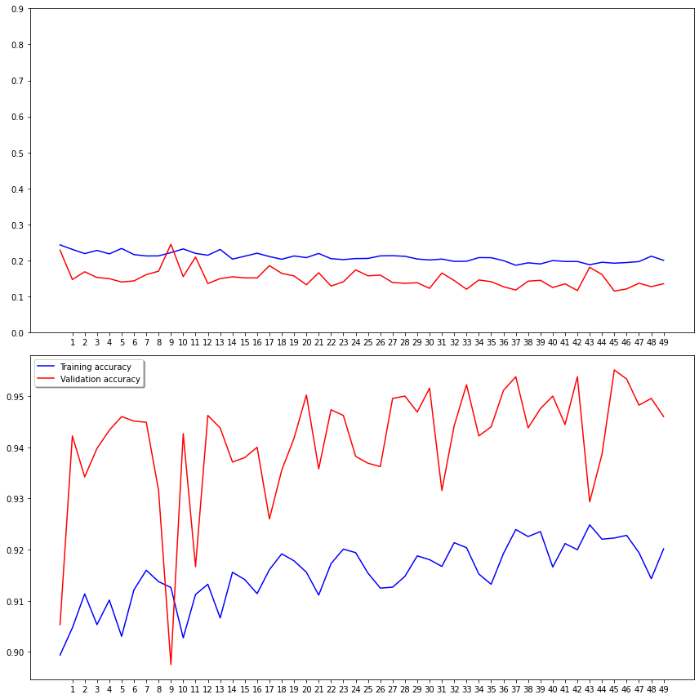
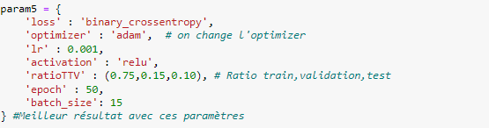

Slide 8
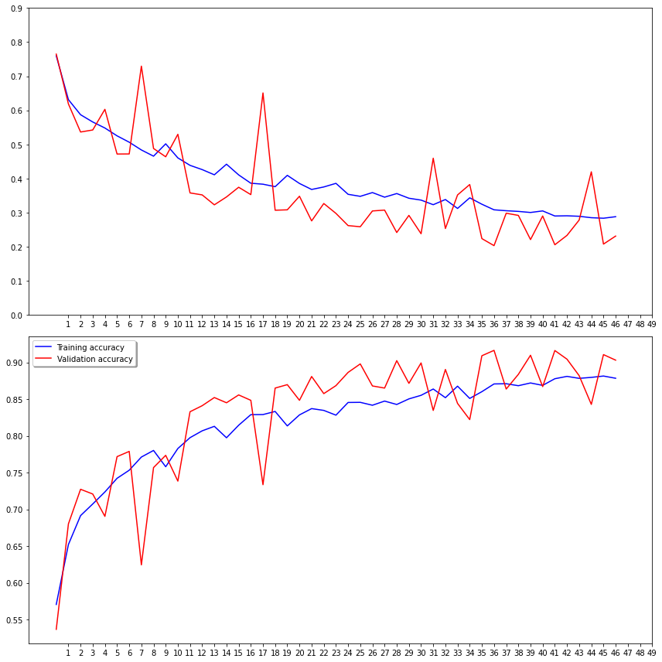
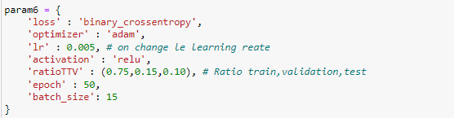

Slide 9
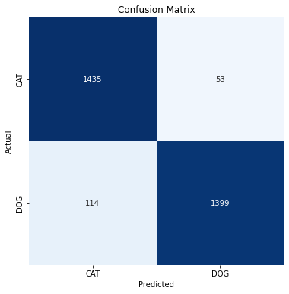
Accuracy: 0.9443518827057648

