Slide 1


Implementation of BGP Protocol in a WAN Network
Ecole D’ingénieurs Sup Galilée
Télécommunications et Réseaux
Option : Networking and Telecommunications
Directed by ;
Pr. Nguyen Thi-Mai-Trang
Presented by:
HANOU Rimy
BELKHODJA Ibrahim
JUIN 2024
Notes:
HELLO everyone. today we will be presenting our project about implementation of BGP (Border Gateway Protocol) in a WAN (W area N) Network.

Slide 2


Objective
1
BGP and OSPF Introduction
2
Contents
Topology and Scenarios
3
Results
4
Conclusion
5
Notes:
Without wasting time lets see our table of content.
First of all , we are going to see the objective of our project , then we will see a short description of what is BGP protocol and ospf protocol
After that we will see the topology and scenario proposed and finally, we finish our presentation by seeing the main results and a conclusion.

Slide 3
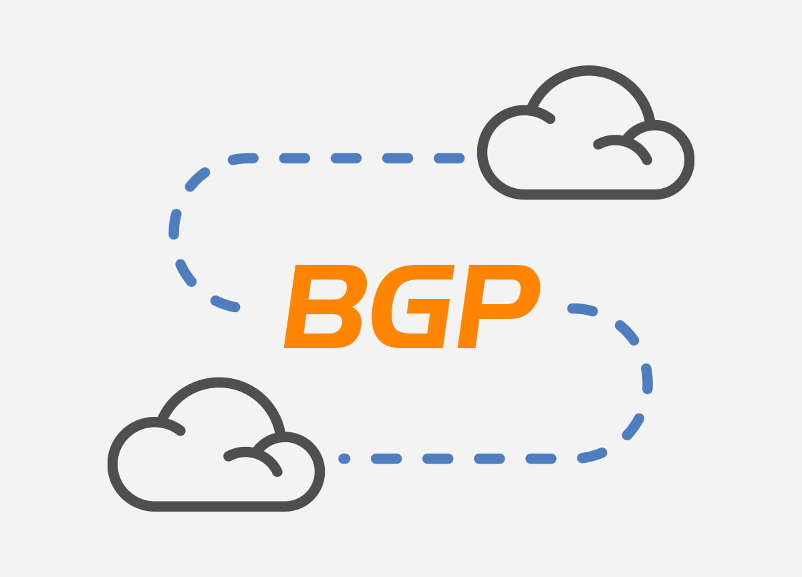
Objective
Our main objective was to establish seamless communication between a department in Company A and a department in Company B by using BGP routing protocol to manage the communication between different Autonomous Systems, or AS and OSPF to manage the communication within AS.
Notes:
The main objective of our project was to establish seamless communication between a department in Enterprise A and a department in Enterprise B by leveraging BGP to manage the communication between different Autonomous Systems, or AS. Adn by using Ospf protocol to manage communication within each company ( AS ).

Slide 4

01
BGP and OSPF Introduction

Slide 5

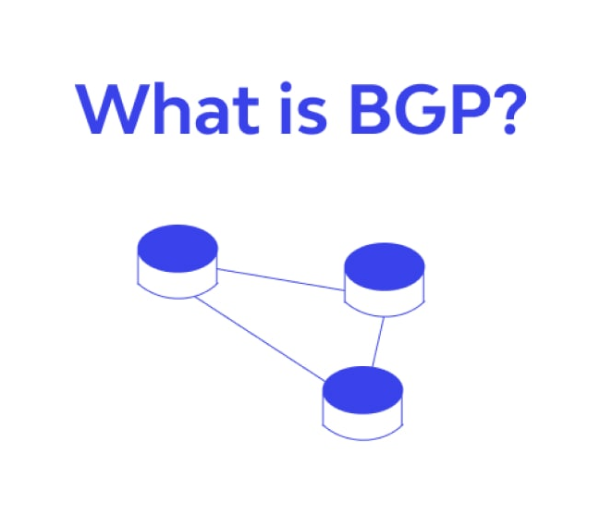
BGP Protocol
1
BGP (Border Gateway Protocol) is the primary protocol used to route traffic across the internet.
2
Manages how packets are routed between autonomous systems (AS), which are large networks under a common administration.
3
eBGP ( externe BGP) is used for communication between different autonomous systems.
4
Path vector mechanism, policy-based routing, and scalability to support the global internet.
Notes:
To understand our project we need to know what is BGP protocol :

Slide 6
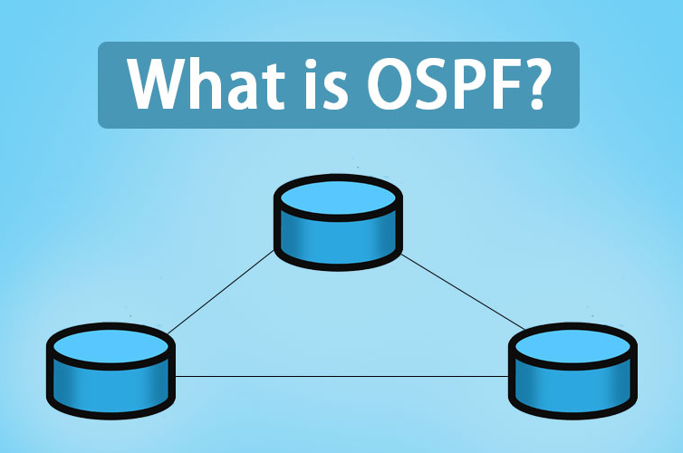
OSPF Protocol
1
OSPF (Open Shortest Path First) is a link-state routing protocol used within an autonomous system (AS).
2
Designed for efficient and rapid convergence, ensuring reliable and dynamic routing.
3
Supports multi-area configurations to optimize traffic and reduce routing table size.
4
Suitable for large and complex networks due to its efficient use of resources and hierarchical structure.
Notes:
Our second main protocol OSPF which is essential in our project is :

Slide 7
02
Topology and Scenarios

Slide 8
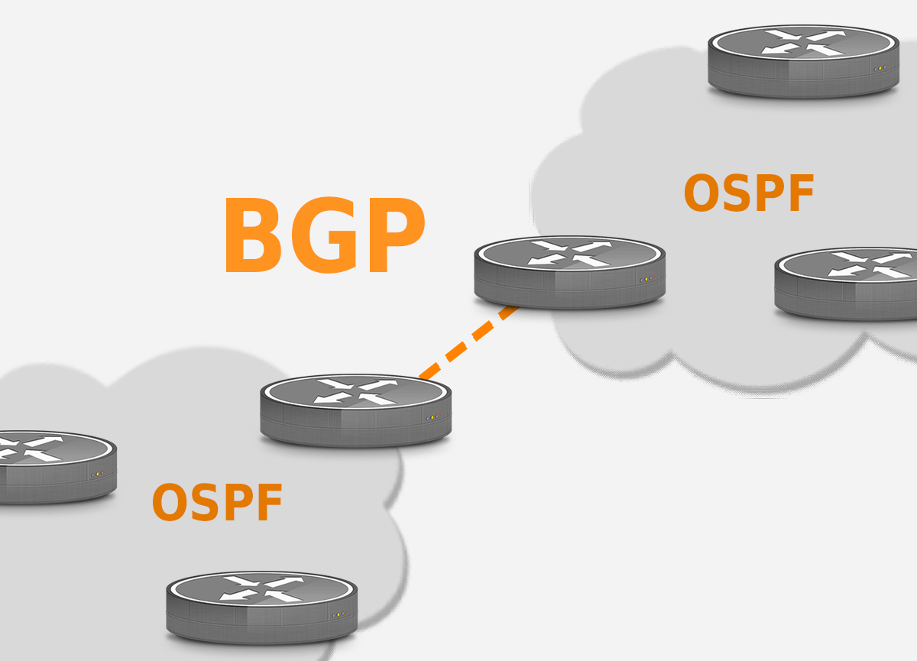
Topology
Company B
Company A and Company B:
Two main entities in the network.
Interconnected via BGP to enable communication between them.
Internal Structure:
Each Company connected via OSPF.
Company A
Notes:
- Now that we have seen what is bgp and ospf we can begin presenting our topology .
Our network architecture is composed of :
the picture we see is just a simple exemple to understand the basic consept of our topology.

Slide 9
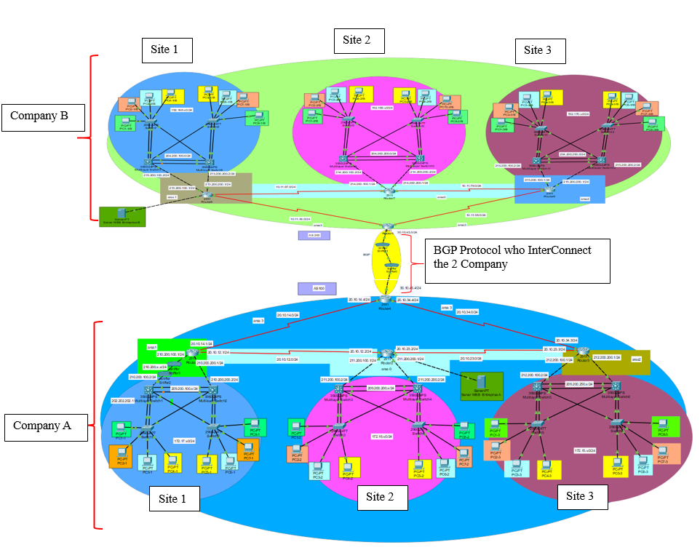
Topology
Company A and Company B:
Two main entities in the network.
Interconnected via BGP to enable communication between them.
Internal Structure:
Each Company consists of three sites, connected via OSPF, and includes a web server.
Each site contains four departments represented by four different VLANs.
Objective:
Create a robust, secure, and optimized network topology with adequate redundancy.
Notes:
In the simulation we have this picture which represents what we disscussed about in more details :
Like we see in the picture within each company we find 3 sites and within each site we find for departements correspending to 4 different vlans ( like we see with 4 different colors )
And inside each company finnaly we find a web server .
The objective of using a topology like this is :
Create a robust, secure, and optimized network topology with adequate redundancy.

Slide 10
Used Protocols
 | HSRP (Hot Standby Router Protocol) | STP (Spanning Tree Protocol) | EtherChannel | PortFast | SSH (Secure Shell) | VPN (Virtual Private Network)
Function | Ensure redundancy of default gateways. | Prevent switching loops | Aggregate multiple physical links into a single logical link. | Accelerate port convergence | Secure remote access to network devices. | Secure communications over public networks
Usage | Configures multiple routers as backup gateways to ensure network connection continuity. | Creates a loop-free topology by disabling redundant paths while ensuring redundancy. | Increases bandwidth and ensures link redundancy between switches. | Used on ports connected to end devices to speed up connection establishment. | Encrypts remote command sessions to protect sensitive information. | Allows secure connections between different company sites over the Internet.
Notes:
To ensure seemless communication withing each company we nedded to use different protocols to ensure robust communication , effectiveness again the panes , and security for exemple like we see in the table :

Slide 11
Scenarios
Scenario 1: Intra-Company Communication Scenario 2: Inter-Company Communication
Objective: Establish communication between different sites within Company A. | Objective: Establish communication between departments of Company A and Company B.
Focus: Analyze how packets traverse the private network to reach other sites. | Focus: Analyze packet traversal using BGP between AS.
Key Protocols and Features: HSRP, STP, EtherChannel, Portfast, SSH, VPN, OSPF. | Key Protocol: BGP
Outcome: Evaluate network performance and resilience. | Outcome: Assess BGP effectiveness for inter-enterprise communication.
Notes:
To ensure good simulation and to study the effectiveness of our implementations we proposed 2 main scenario :
Scenario 1 : communication between different sites within Company A.
Scenario 2 : communication between departments of Company A and Company B.

Slide 12
03
Results

Slide 13
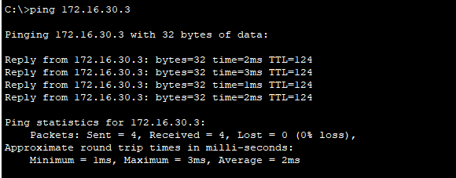
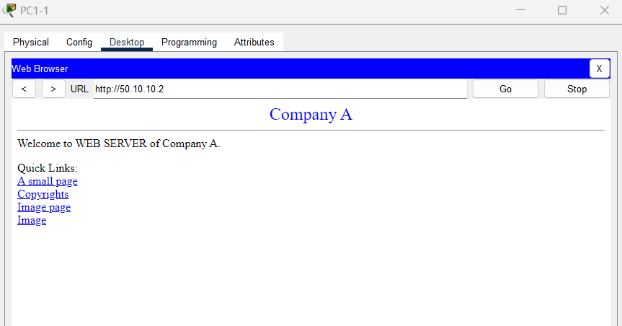
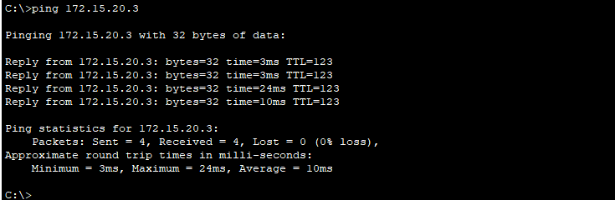
Scenario 1
Ping PC 1-Site1 To PC 2- Site 2 in Company A
Network Performance: Achieved efficient and reliable communication within Company A.
Resilience: Redundancy mechanisms ensured high availability and quick recovery from failures.
Ping PC 1-Site1 To PC 3- Site 3 in Company A
Notes:
Like we see in the different pictures first we succeeded in communication between pc 1 of site 1 with the different pcs in eache site of company A
This successful communication ensures that we Achieved efficient and reliable communication within Company A which means that our implementations of the different mechanism to ensure redundancy and the implementation of protocol ospf was successful.
We also could connect the web server of the company which ensures a certain applicability to the communication inside the company.

Slide 14
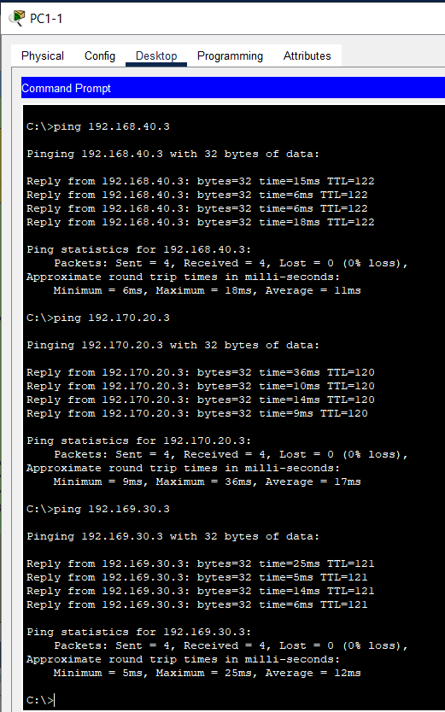
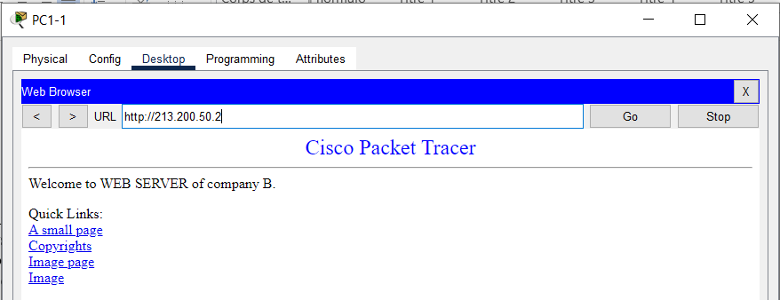
Scenario 2
Ping From PC 1 site 1 of Company A to PCs of Company B
Effectiveness of BGP: Successfully demonstrated BGP's ability to handle inter-Company communication, ensuring robust and secure connectivity.
Performance: Evaluated BGP’s role in maintaining stable connections and optimizing routing between Companies.
Connecting To WEB SERVER of Company B From PC 1 site 1 of Company A
Notes:
We can see the same results in scenario 2 we successfully established communication between the different department in each company which prove Effectiveness of BGP in handling routing between different company.
We could also communicate with web server of company B from company A.

Slide 15
04
Conclusion

Slide 16
Conclusion
This project enabled us to apply our networking knowledge in designing, configuring, and managing a complex network using BGP and OSPF protocols..
Network topology integrating two companies in different countries, connected via a WAN.
Robust and secure connectivity was achieved using BGP for external connectivity and OSPF for internal routing..
Redundancy mechanisms like HSRP, STP, EtherChannel, and PortFast ensured network availability and performance optimization.
Notes:
finnaly in conclusion with the different results we acquired we can say with confidence That :

Slide 17
Thanks For
Watching

