Slide 1
Available sites for portfolio

Slide 2

WIX
Wix.com Ltd. is a cloud-based web development platform that was first developed and popularised by the Israeli company also called Wix. It allows users to create HTML5 websites and mobile sites through the use of online drag and drop tools. Users must purchase premium packages in order to connect their sites to their own domains, remove Wix ads, access to form builder, add e-commerce capabilities, or buy extra data storage and bandwidth.Wix App Market offers both free and subscription-based applications, with a revenue split of 70% for the developer and 30 percent for Wix.

Slide 3
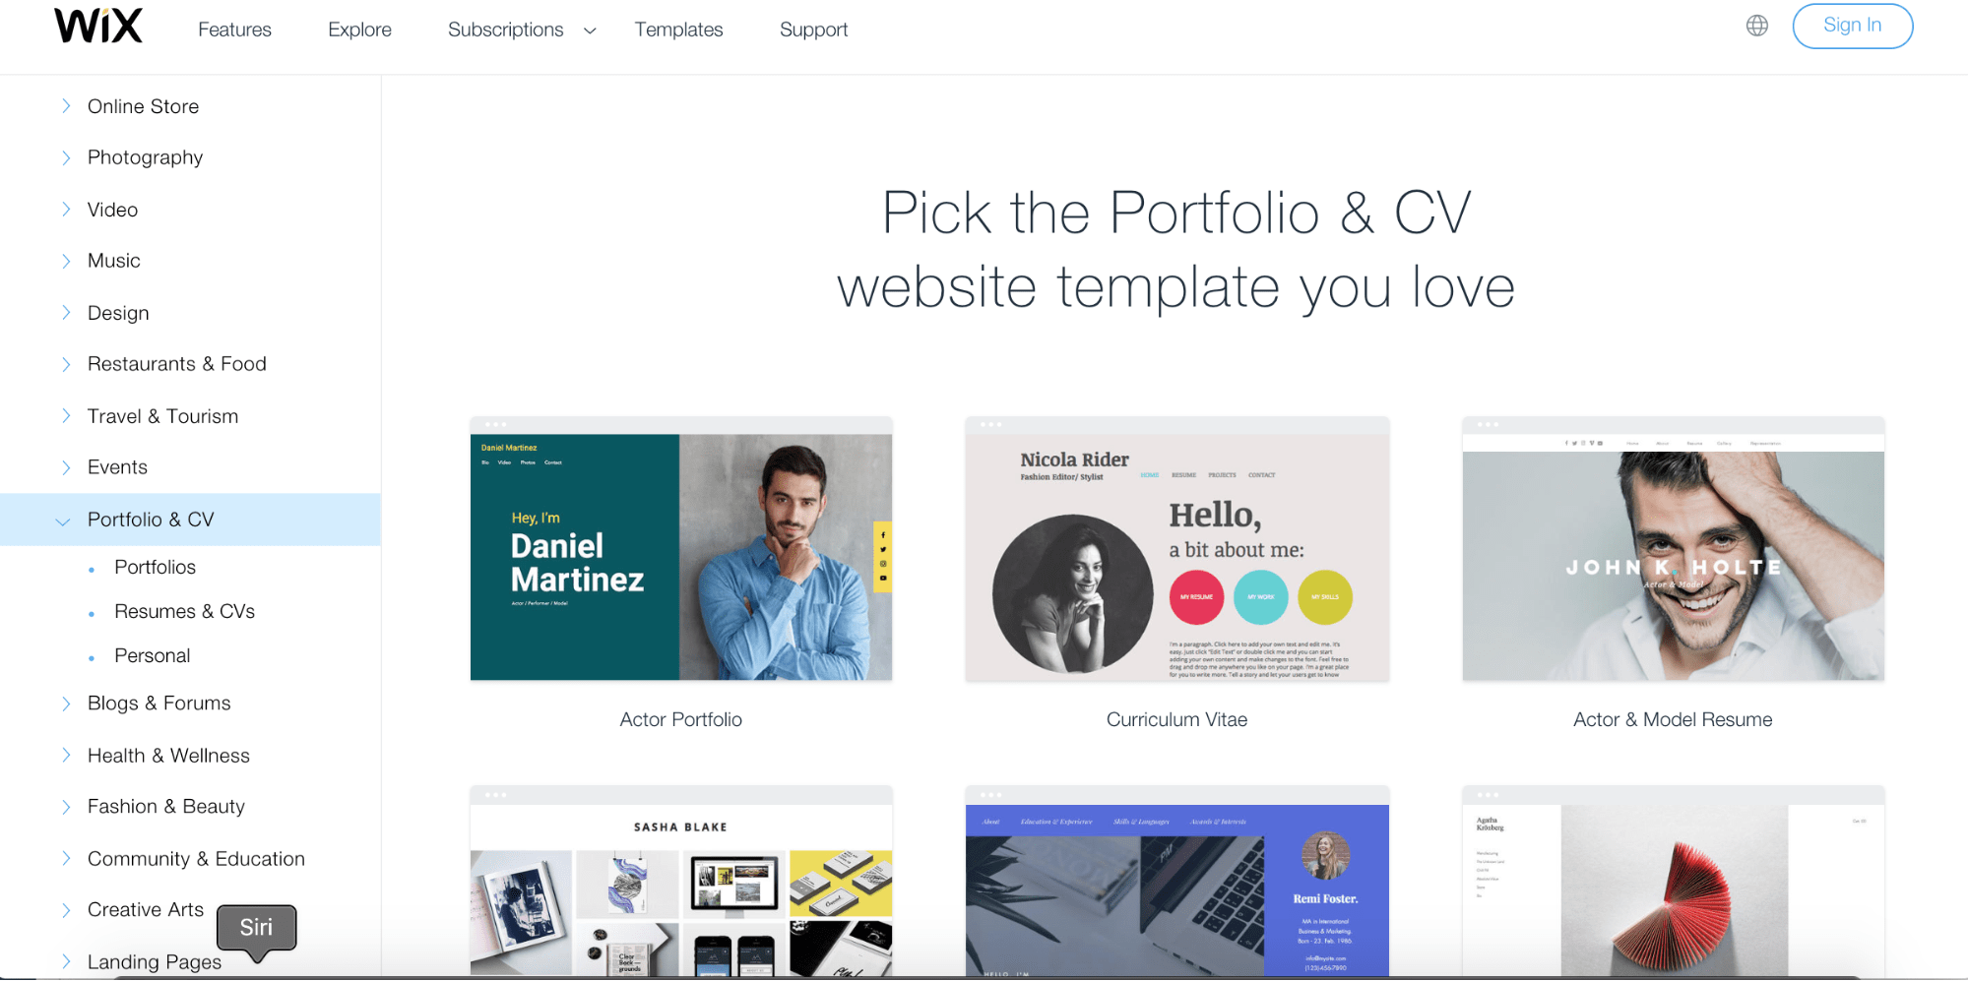

Slide 4

Portfoliobox.net -a tool for creating an online portfolio of photographers, designers, artists, stylists, models, and architects. The site is translated into Russian. It is possible to connect an online store, block, download videos. Up to 50 images can be placed for free.

Slide 5
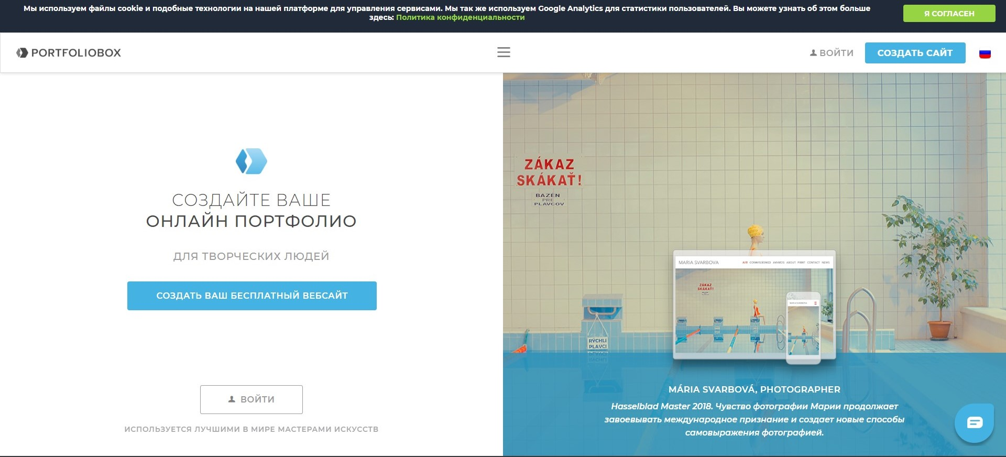

Slide 6
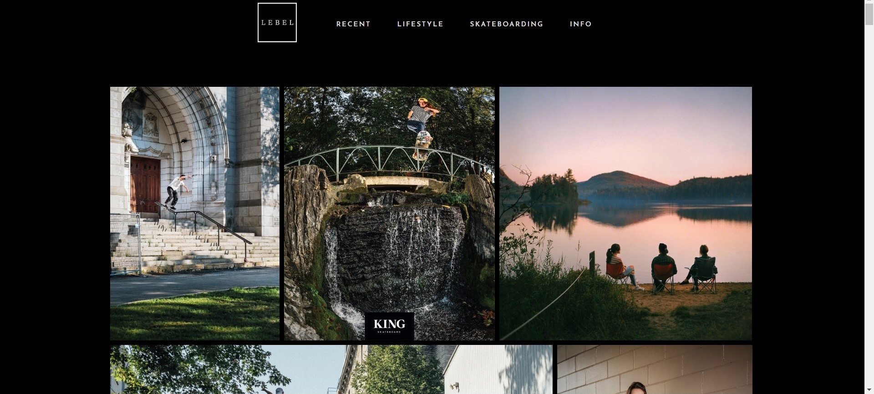

Slide 7

Myportfolio.com – a platform for creating websites aimed at designers and photographers. Portfolio is free for Adobe Creative Cloud users.

Slide 8
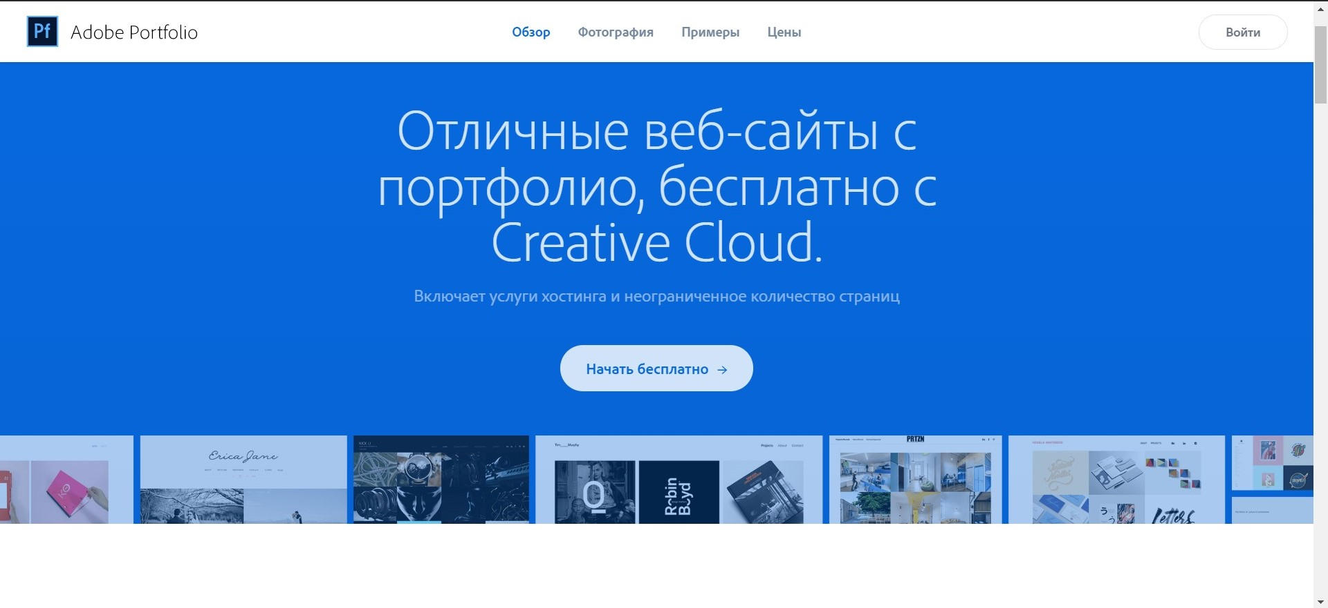

Slide 9

Squarespace.com -site Builder. It has a wide range of functionality (you can deploy a photo gallery, online store, landing page, blog, etc.).

Slide 10
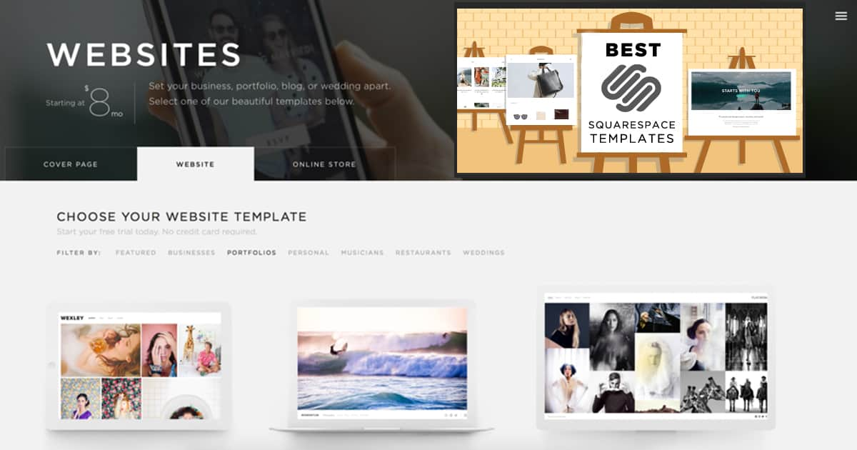

Slide 11

Krop.com -platform for creating websites-portfolio of designers, illustrators, and photographers. The service is paid.

Slide 12
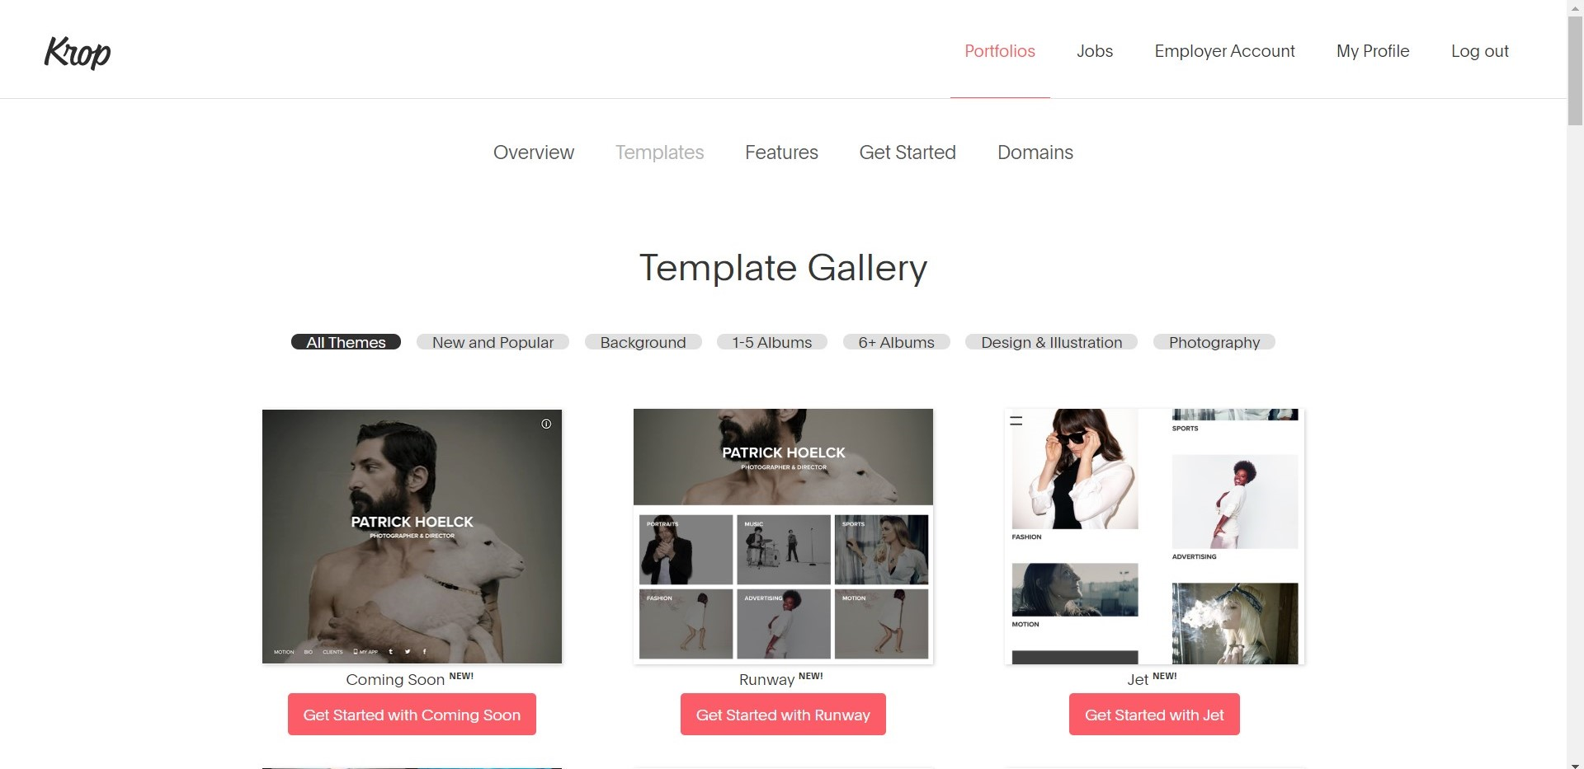

Slide 13
the end

