Slide 1



X
Analysis of Kimia Farma business performance for 2020-2023
Kimia Farma - Big Data Analytics
Presented by
Rinaldy Buana Saputra

Slide 2





Insert your photo here
Rinaldy Buana Saputra
B.Sc. in Computer Science
As a Computer Science graduate from Widyatama University, I have gained internship experience as a Product Owner where I honed my skills in user research, backlog management, and product testing. In addition, I also have experience in working with teams. My interest in data analysis and visualization drove me to develop these skills to become a reliable data analyst. I am committed to contributing to data-driven decision-making across industries.
Karawang, Jawa Barat
rinaldybuana@gmail.com
linkedin.com/in/rinaldybuanasaputra/

Slide 3
Courses and Certification
Dicoding Indonesia / Learn Basic Data Science | https://www.dicoding.com/certificates/EYX4YN8GRZDL <Nov, 2023> Dicoding Indonesia / Learn Basic Structured Query Language | https://www.dicoding.com/certificates/53XE48M69ZRN <Nov, 2023> Dicoding Indonesia / Getting Started with Python | https://www.dicoding.com/certificates/07Z6W1D3WZQR <Nov, 2023>

Slide 4

About Company
Kimia Farma is a leading pharmaceutical company in Indonesia, founded in 1817. The company plays a role in drug production, distribution, and research, as well as providing health services. With an extensive network of drug factories and pharmacies, Kimia Farma provides access to quality pharmaceutical products throughout the country. In addition, the company is active in public health programs and international cooperation to improve global health. As an interested individual, I see an opportunity to contribute to Kimia Farma's vision in improving public health and welfare.

Slide 5
Project Portfolio
As a Big Data Analytics Intern at Kimia Farma, I evaluate the company's business performance from 2020 to 2023.Four datasets are provided: kf_final_transaction.csv, kf_inventory.csv, kf_kantor_cabang.csv, and kf_product.csv. This dataset includes information about transactions, inventory, branch offices, and products. I'll create analysis tables and dashboards using Google Looker Studio. The main objective is to present an analysis of business performance, including revenue comparisons, top 10 total transactions, and net sales per branch and province, as well as identification of branches with the highest but lowest transaction ranks. With this, Kimia Farma's management can gain deep insights for business performance during the period.
Project explanation video here!
Github link here! Data visualization link here!

Slide 6
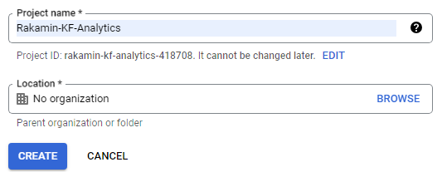
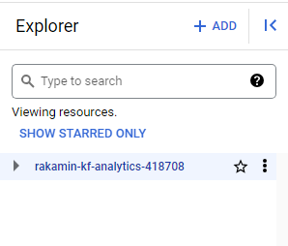
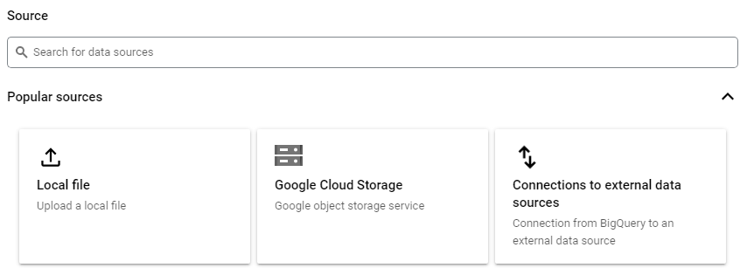
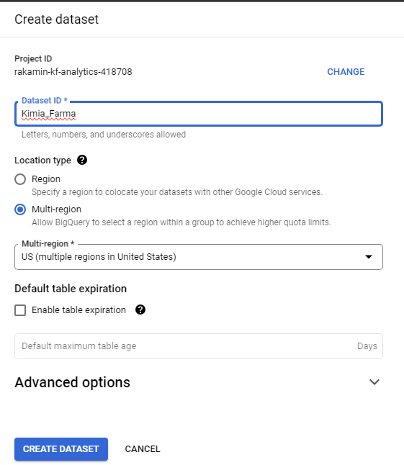
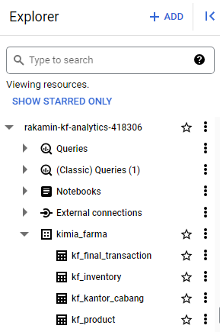
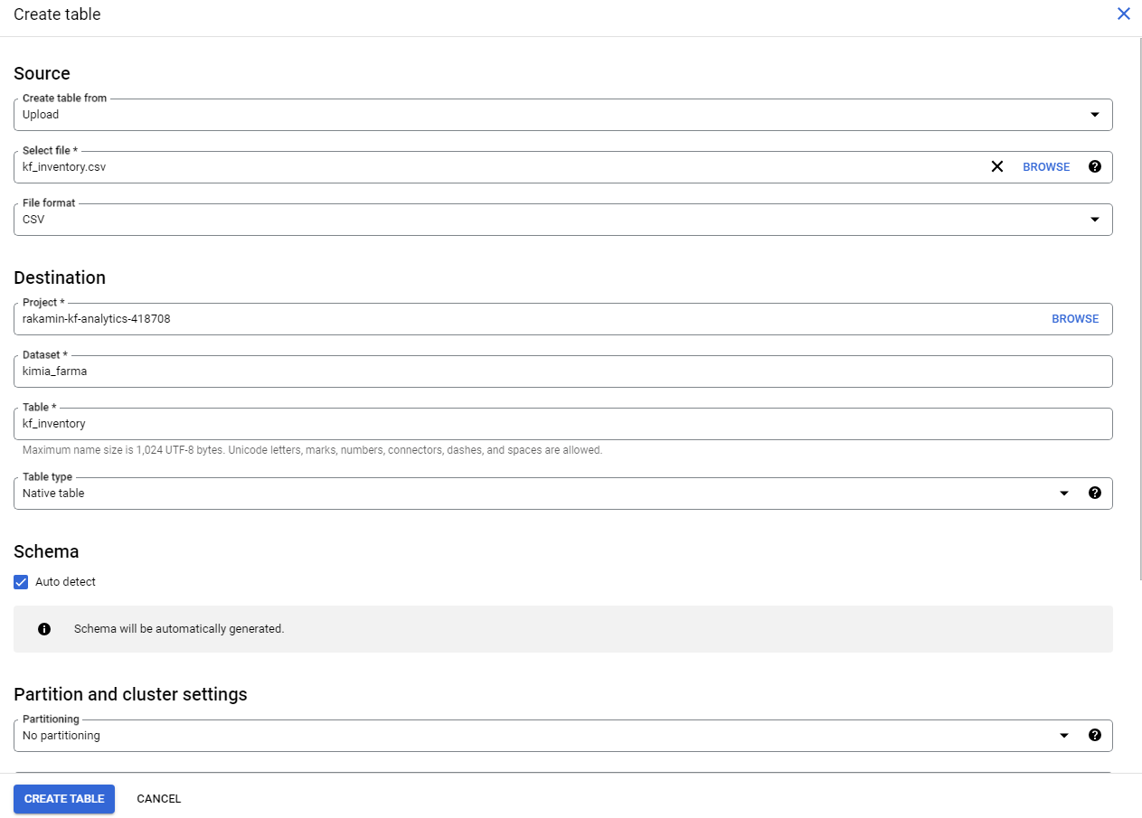
Importing Dataset to BigQuery
1
2
3
4
5
6

Slide 7
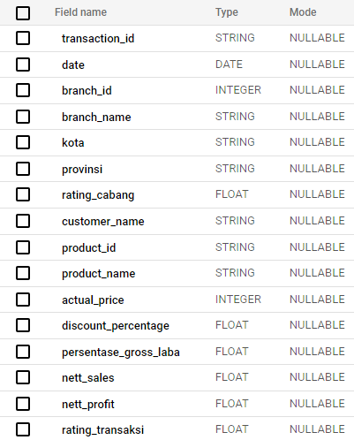
Analysis Table
-transaction_id: A unique ID for each transaction.
-date: The date of the transaction.
-branch_id: ID of the branch where the transaction took place.
-branch_name: The name of the branch where the transaction took place.
-kota: The city where the branch is located.
-provinsi: The province in which the branch is located.
-rating_cabang: Assessment of service quality in related branches.
-customer_name: The name of the customer making the transaction.
-product_id: ID of the product purchased.
-product_name: The name of the product purchased.
-actual_price: Original price of the product before discount.
-discount_percentage: The percentage discount given on the product.
-persentase_gross_laba: The percentage of gross profit from product sales, calculated based on the price range.
-nett_sales: The selling price of the product after deducting the discount.
-nett_profit: Net profit from product sales, calculated by multiplying nett_sales by persentase_gross_laba.
-rating_transaksi: Customer assessment of transaction experience.

Slide 8
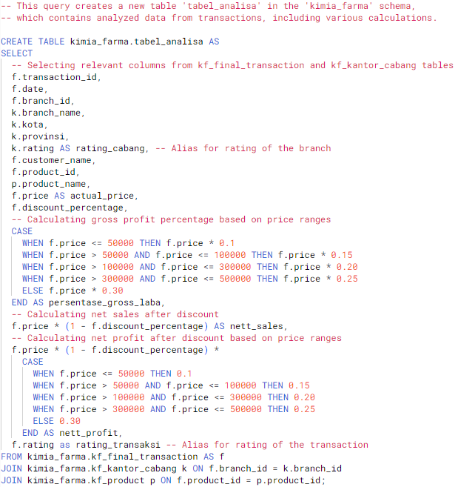
BigQuery Syntax
SELECT: Select specific columns from the tables referenced.
CASE: Used to create conditionals, in this case to calculate the percentage of gross profit and net profit based on the price of goods.
JOIN: Combines data from multiple tables based on specific columns that have the same value.
AS: Alias the resulting columns.
FROM: Indicates the data source, which is the kf_final_transaction table.
JOIN: Aggregates data from kf_kantor_cabang tables based on branch_id.
JOIN: Aggregates data from kf_product tables based on product_id.

Slide 9
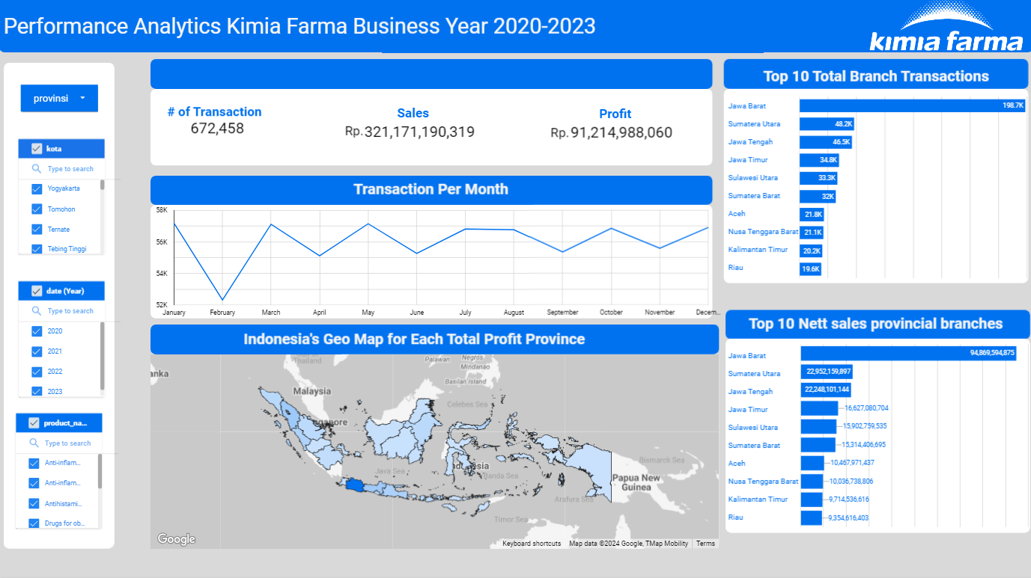
Dashboard Performance Analytics

Slide 10
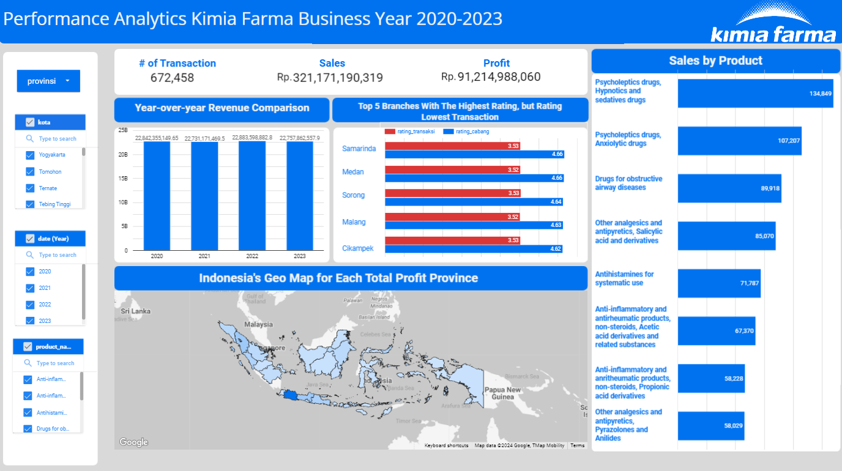
Dashboard Performance Analytics

Slide 11
Conclusion
In conclusion, Kimia Farma has shown stable business performance during the 2020-2023 period, with West Java being the main market and several branches having growth potential that can be improved. This analysis provides valuable insights for company management in planning strategies to increase sales and profitability in the future.

Slide 12
Thank You
X

