Slide 1


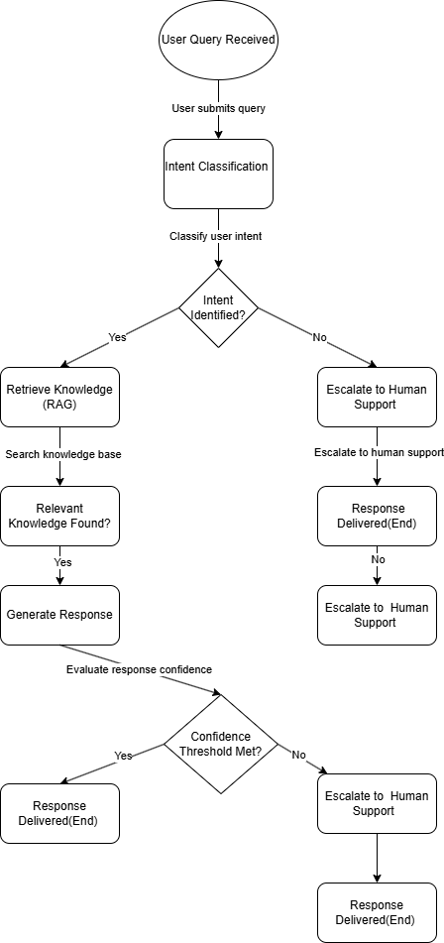
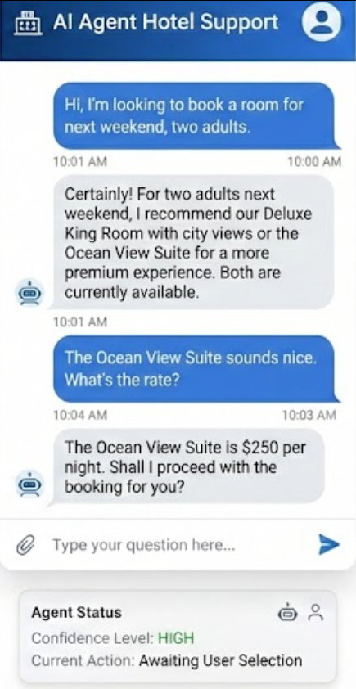
Research:
Conversational AI in customer support has evolved from early rule-based chatbots, such as ELIZA-style systems, to data-driven and learning-based models trained on large dialogue datasets (Shum, He and Li, 2018). While task-oriented dialogue systems introduced intent classification and slot-filling to support structured interactions, they often struggle with open-ended and knowledge-intensive enquiries common in hotel guest support scenarios (Wang et al., 2022).
Retrieval-Augmented Generation (RAG), introduced in 2020, improves response reliability by grounding language model outputs in externally retrieved documents, thereby reducing hallucination in knowledge-intensive tasks (Lewis et al., 2020). More recent research on agentic large language models enables conversational systems to reason about actions and autonomously select tools such as retrieval modules or escalation mechanisms, supporting more adaptive and reliable guest support in hospitality environments (Russell and Norvig, 2021).
UFCFXK-30-3: Digital Systems Project
Student name: Nguyen Nhat Minh
Project Title: Design and Development of an AI Agent–Based
Customer Support System for Hotel Using Retrieval-Augmented Generation
A QR Code link to video submission
Abstract:
This project investigates the design and implementation of an AI agent–based hotel guest support system aimed at improving the accuracy and reliability of automated customer assistance in hospitality environments. Traditional rule-based chatbots often fail to handle complex, context-dependent guest enquiries, leading to incorrect information and reduced service quality.
The proposed system integrates large language models with Retrieval-Augmented Generation (RAG) to ground responses in hotel-specific knowledge such as policies, facilities, and services. An agentic decision-making mechanism is incorporated to interpret guest intent, retrieve relevant information, and determine whether a request can be resolved autonomously or requires escalation to hotel staff.
The project demonstrates a functional prototype that highlights the practicality of AI agents in supporting hotel guest interactions while reducing hallucination and improving trustworthiness.
Key requirements:
Functional Requirements
The system must classify guest intent from natural language input.
The system must retrieve relevant hotel information using vector similarity search.
The system must generate context-aware responses grounded in retrieved content.
The system must escalate enquiries when confidence is low or no relevant knowledge is found.
The system should log interactions and agent decisions for transparency.
Non-Functional Requirements
The system must respond within an acceptable time for real-time guest interaction.
The system should be modular, extensible, and maintainable.
The system should be robust to incomplete or ambiguous guest enquiries.
Testing
Testing focuses on validating core functionality rather than exhaustive performance benchmarking. Unit testing is applied to components such as intent classification and document retrieval. Scenario-based testing evaluates end-to-end guest interactions, including successful query resolution and escalation cases. Interaction logs are reviewed to verify correct agent decision-making.
Planning and Management:
The project follows a sequential technical workflow focused on the development of an AI agent for hotel guest support. The process begins with defining core guest support scenarios, including booking enquiries, policy clarification, and service complaints. Next, a hotel-specific knowledge base is constructed from policy documents, service descriptions, and FAQs, which is then processed into vector embeddings to enable semantic retrieval.
Following this, a Retrieval-Augmented Generation pipeline is implemented by integrating a large language model with the retrieval component to ensure responses are grounded in hotel knowledge. An AI agent control layer is then developed to analyse guest intent, manage retrieval actions, and generate responses. A confidence-based decision mechanism is incorporated to determine whether a request can be resolved automatically or requires escalation to hotel staff.
Finally, the system is integrated into a simple user interface to support end-to-end guest interactions. The completed AI agent is evaluated through representative hotel guest scenarios to verify retrieval accuracy, response relevance, and correct escalation behaviour.
Aims and objectives:
Aim
To design and implement an AI agent–based hotel guest support system that autonomously interprets guest enquiries, retrieves relevant hotel knowledge, and provides accurate and reliable responses.
Objectives
To review literature on conversational AI, Retrieval-Augmented Generation, and agentic systems within customer service and hospitality contexts.
To design an AI agent architecture supporting intent classification, knowledge retrieval, response generation, and escalation.
To implement a RAG pipeline that grounds responses in hotel-specific documentation.
To develop a confidence-based escalation mechanism for routing complex or uncertain queries to hotel staff.
To demonstrate the system through a functional prototype focused on hotel guest support scenarios.
Design, Implementation & Testing
State Diagram
Implementation artefacts (if any)
References:
Lewis, P., Perez, E., Piktus, A., et al. (2020) Retrieval-augmented generation for knowledge-intensive NLP tasks. Advances in Neural Information Processing Systems [online]. 33, pp. 9459–9474. Available from: https://papers.nips.cc/paper/2020/hash/6b493230205f780e1bc26945df7481e-paper.pdf [Accessed 24 November 2023].
Russell, S. and Norvig, P. (2021) Artificial Intelligence: A Modern Approach. 4th edn. Harlow: Pearson.
Shum, H.-Y., He, X. and Li, D. (2018) From ELIZA to XiaoIce: Challenges and opportunities with social chatbots. Frontiers of Information Technology & Electronic Engineering [online]. 19 (1), pp. 10–26. Available from: https://doi.org/10.1631/FITEE.1700826 [Accessed 24 November 2023].
Wang, Y., Zhang, Y., Liu, Y., Li, C. and Song, J. (2022) Task-oriented dialogue systems in customer service: A survey. ACM Computing Surveys [online]. 55 (4), pp. 1–37. Available from: https://doi.org/10.1145/3485133 [Accessed 28 March 2025].

