Slide 1
OpenCL

Slide 2
OpenCL
Standardized
Initiated by Apple
Developed by the Khronos Group

Slide 3
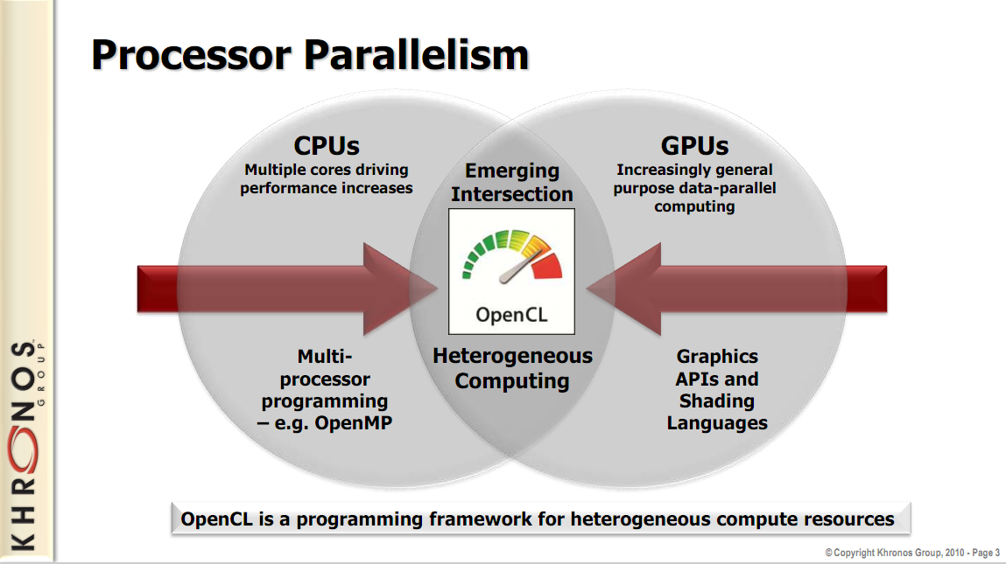

Slide 5

OpenCL
Open Compute Language
For heterogeneous parallel-computing systems
Cross-platform
  Implementations for
    ATI GPUs
    NVIDIA GPUs
    x86 CPUs
  Is cross-platform really one size fits all?
Image from: http://developer.apple.com/softwarelicensing/agreements/opencl.html

Slide 6
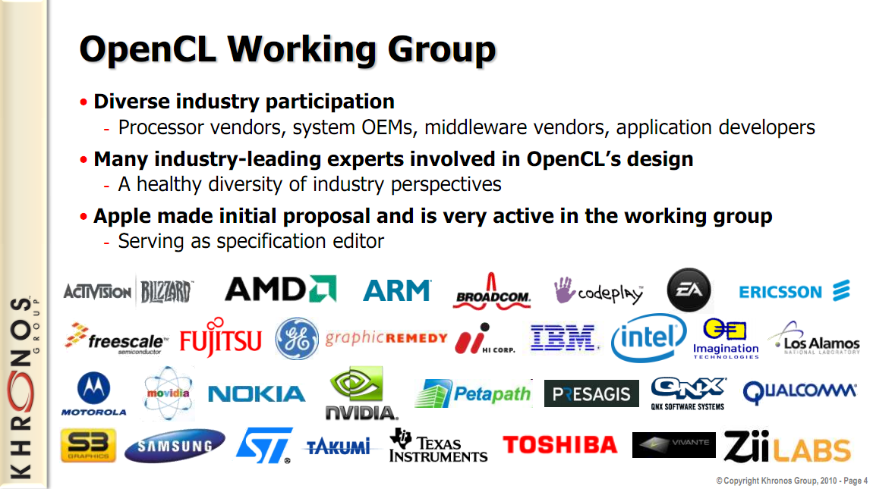
Image from: http://www.khronos.org/developers/library/overview/opencl_overview.pdf

Slide 7
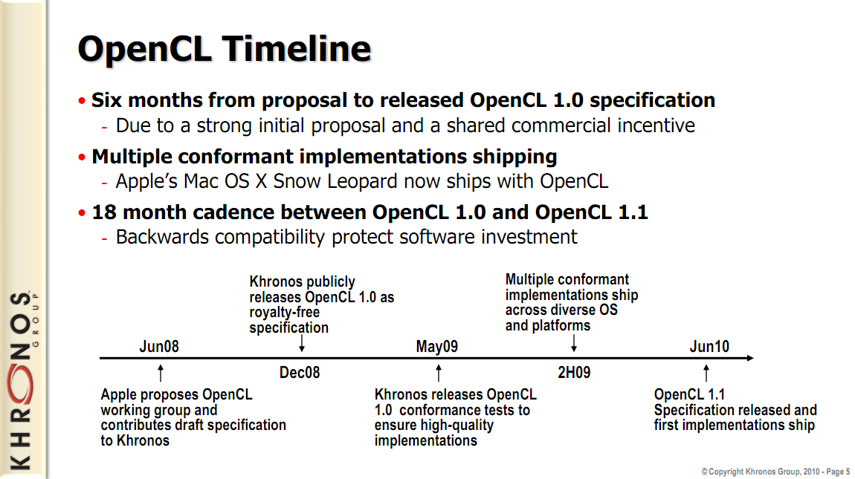
Image from: http://www.khronos.org/developers/library/overview/opencl_overview.pdf

Slide 8
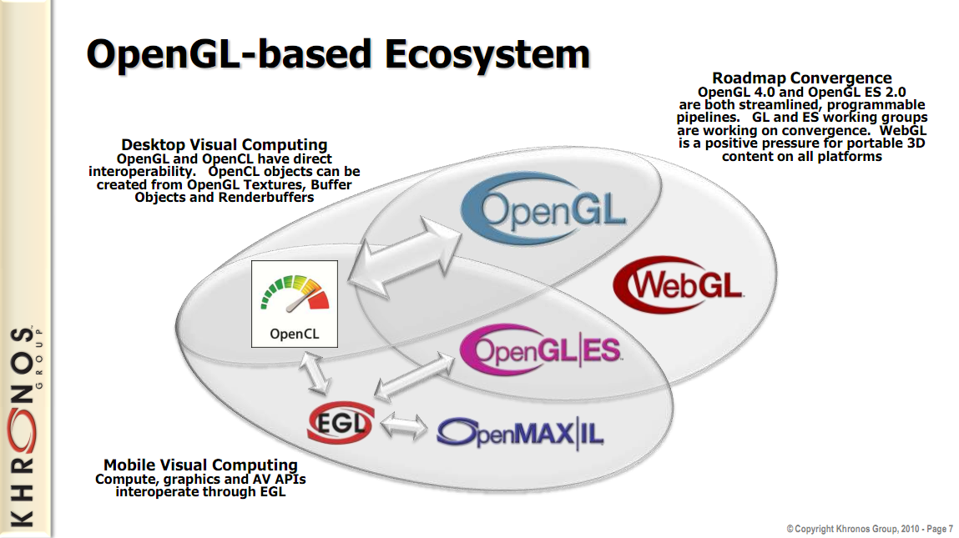
Image from: http://www.khronos.org/developers/library/overview/opencl_overview.pdf

Slide 9
OpenCL
API similar to OpenGL
Based on the C language
Easy transition form CUDA to OpenCL

Slide 10
OpenCL Relation to Khronos Embedded Ecosystem
© 2009 Nokia V1-OpenCLEnbeddedProfilePresentation.ppt / 2009-02-26 / JyrkiLeskelä
Notes:
Here’s an overview of the Khronos embedded API ecosystem.
Khronos is a home for many media acceleration APIs. Perhaps the most well-known API in Khronos is OpenGL for 3D graphics.
Most Khronos APIs, however, are media acceleration APIs targeted at embedded or mobile devices.
An example is OpenGL ES, which is mostly a subset of OpenGL, where ES stands for Embedded Systems.
While the megahertz race is slowing down, the need for more processing power continues to grow.
GPUs have been harnessed to do various kinds of number crunching in addition to just rendering textured triangles,
often called GPGPU for General Purpose processing on GPUs (though the “generalness” of the processing is somewhat limited).
Some processing could be done directly using the graphics API, and various vendors have defined APIs to make GPGPU easier,
Nvidias CUDA is an example. However, those APIs have only targeted GPUs, and in some cases only GPUs of a single vendor.
OpenCL provides GPGPU-type parallel processing power across not just different HW vendors, but also across GPUs, CPUs, even DSPs and FPGAs.

Slide 11
OpenCL 1.0 Embedded Profile One-Slider
© 2009 Nokia V1-OpenCLEnbeddedProfilePresentation.ppt / 2009-02-26 / JyrkiLeskelä

Slide 12
Embedded Profile Main Differencies
The embedded profile is defined to be a subset for each version of OpenCL:
Online compiler is optional
No 64-bit integers, or integer vectors
Float 2D/3D images can only be used with nearest neighbor sampling
Macro __EMBEDDED_PROFILE__ is added in the language and CL_PLATFORM_PROFILE capability will return the string EMBEDDED_PROFILE if the OpenCL implementation supports the embedded profile only.
Minimum requirements for constant buffer size, object allocation size, constant argument count and local memory size are scaled down.
Image support and floating point support is aligned with OpenGL ES 2.0 texture requirements
The extensions of full profile can be applied to embedded profile
© 2009 Nokia V1-OpenCLEnbeddedProfilePresentation.ppt / 2009-02-26 / JyrkiLeskelä
Notes:
Why not integer vectors? Ints of which length? Vectors of which length? (3,4, many?)

Slide 13
Floating Point Numbers in Embedded Profile
INF and NAN values for floats are not mandated
Accuracy requirements of some single precision floating-point operations are relaxed from full profile:
  x / y <= 3 ulp
  exp <= 4 ulp
  log <= 4 ulp
Float add, sub, mul, mad can be rounded to zero resulting an error <= 1 ulp due to strict HW area.
Denormalized numbers for the half float data type can be flushed to zero.
The precision of conversions from normalized integers is <= 2 ulp for the embedded profile (instead of <= 1.5 ulp)
© 2009 Nokia V1-OpenCLEnbeddedProfilePresentation.ppt / 2009-02-26 / JyrkiLeskelä
Notes:
ulp = unit in the last place
Is 4 ulp the same as the last 4 bits are not necessarily accurate? Or does that means 4 units at the mantissa accuracy-> 2 bits?

Slide 14
Image Support in Embedded Profile
Image support is an optional feature within an OpenCL device
If Images are supported, the minimum requirements for the supported image capabilities are lowered to the level of OpenGL ES 2.0 textures
  Kernel must be able to read >= 8 simultaneous image objects
  Kernel must be able to write >= 1 simultaneous image objects
  Width and height of 2D image >= 2048
  Number of samplers >= 8
Image formats are similar to corresponding OpenGL ES 2.0 texture formats
Support for 3D images is optional for embedded implementations
© 2009 Nokia V1-OpenCLEnbeddedProfilePresentation.ppt / 2009-02-26 / JyrkiLeskelä

Slide 15



Potential Mobile Device Use-Cases
  Image post-processing and enhancement
  Image editing software
  Compatibility for devices lacking high-end imaging HW
  Machine vision, Local media search, Augmented reality
  Support emerging new coding schemes quickly
    For example web-originated media codecs
  Streaming math/algorithm libraries
  Physics modeling
  Gaming engines and WOW effects
© 2009 Nokia V1-OpenCLEnbeddedProfilePresentation.ppt / 2009-02-26 / JyrkiLeskelä
Notes:
What do you mean with “compatibility for devices lacking high-end imaging HW”?
And “Local media search”?
Any examples of web-originated media codecs?
Examples for streaming math / algorithm other than image processing / vision?

Slide 16

OpenCL and CUDA
Compute Unit (CU) correspond to
  CUDA streaming multiprocessors (SMs)
  CPU core
  etc.
Processing Element correspond to
  CUDA streaming processor (SP)
  CPU ALU

Slide 17
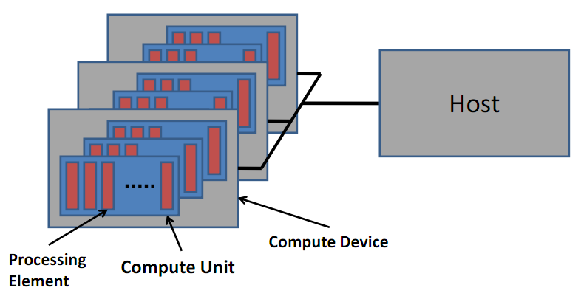
OpenCL and CUDA
Image from: http://developer.amd.com/zones/OpenCLZone/courses/pages/Introductory-OpenCL-SAAHPC10.aspx

Slide 18
OpenCL
(Open Computing Language)
A standard based upon C for portable parallel applications
Task parallel and data parallel applications
Focuses on multi platform support (multiple CPUs, GPUs, …)
Development initiated by Apple.
Developed by Khromos group who also managed OpenGL
OpenCL 1.0 2008. Released with Max OS 10.6 (Snow Leopard)
OpenCL 1.1 June 2010
Similarities with CUDA
Implementation available for NVIDIA GPUs
Wikipedia “OpenCL http://en.wikipedia.org/wiki/OpenCL

Slide 19
OpenCL Programming Model
Uses data parallel programming model, similar to CUDA
Host program launches kernel routines as in CUDA, but allows for just-in-time compilation during host execution.
OpenCL “work items” corresponds to CUDA threads
OpenCL “work groups” corresponds to CUDA thread blocks
Work items in same work group can be synchronized with a barrier as in CUDA.

Slide 20
Structure of OpenCL main program
Get information about platform and devices available on system
Select devices to use
Create an OpenCL command queue
Create memory buffers on device
Transfer data from host to device memory buffers
Create kernel program object
Build (compile) kernel in-line (or load precompiled binary)
Create OpenCL kernel object
Set kernel arguments
Execute kernel
Read kernel memory and copy to host memory.

Slide 21
Platform
"The host plus a collection of devices managed by the OpenCL framework that allow an application to share resources and execute kernels on devices in the platform."
Platforms represented by a cl_platform object, initialized with clGetPlatformID()
http://opencl.codeplex.com/wikipage?title=OpenCL%20Tutorials%20-%201

Slide 22
Simple code for identifying platform
//Platform
cl_platform_id platform;
clGetPlatformIDs (1, &platform, NULL);
Returns number of OpenCL platforms available. If NULL, ignored.
Number of platform entries
List of OpenCL platforms found.
(Platform IDs)
In our case just one platform, identified by &platform

Slide 23
Context
“The environment within which the kernels execute and the domain in which synchronization and memory management is defined.
The context includes a set of devices, the memory accessible to those devices, the corresponding memory properties and one or more command-queues used to schedule execution of a kernel(s) or operations on memory objects.”
The OpenCL Specification version 1.1
http://www.khronos.org/registry/cl/specs/opencl-1.1.pdf

Slide 24
Code for context
//Context
cl_context_properties props[3];
props[0] = (cl_context_properties) CL_CONTEXT_PLATFORM;
props[1] = (cl_context_properties) platform;
props[2] = (cl_context_properties) 0;
cl_context GPUContext = clCreateContextFromType(props,CL_DEVICE_TYPE_GPU,NULL,NULL,NULL);
//Context info
size_t ParmDataBytes;
clGetContextInfo(GPUContext,CL_CONTEXT_DEVICES,0,NULL,&ParmDataBytes);
cl_device_id* GPUDevices = (cl_device_id*)malloc(ParmDataBytes);
clGetContextInfo(GPUContext,CL_CONTEXT_DEVICES,ParmDataBytes,GPUDevices,NULL);

Slide 25
Command Queue
“An object that holds commands that will be executed on a specific device.
The command-queue is created on a specific device in a context.
Commands to a command-queue are queued in-order but may be executed in-order or out-of-order. ...”
The OpenCL Specification version 1.1
http://www.khronos.org/registry/cl/specs/opencl-1.1.pdf

Slide 26
Simple code for creating a command queue
// Create command-queue
cl_command_queue GPUCommandQueue = clCreateCommandQueue(GPUContext,GPUDevices[0],0,NULL);

Slide 27
Make File
(Program called scalarmulocl)
CC = g++
LD = g++ -lm
CFLAGS = -Wall -shared
CDEBUG =
LIBOCL = -L/nfs-home/mmishra2/NVIDIA_GPU_Computing_SDK/OpenCL/common/lib
INCOCL = -I/nfs-home/mmishra2/NVIDIA_GPU_Computing_SDK/OpenCL/common/inc
SRCS = scalarmulocl.cpp
OBJS = scalarmulocl.o
EXE = scalarmulocl.a
all: $(EXE)
$(OBJS): $(SRCS)
$(CC) $(CFLAGS) $(INCOCL) -I/usr/include -c $(SRCS)
$(EXE): $(OBJS)
$(LD) -L/usr/local/lib $(OBJS) $(LIBOCL) -o $(EXE) -l OpenCL
clea:
rm -f $(OBJS) *~
clear
References: http://mywiki-science.wikispaces.com/OpenCL
Submitted by: Manisha Mishra

Slide 28
OpenCL and CUDA
CUDA | OpenCL
Kernel | Kernel
Host program | Host program
Thread | Work item
Block | Work group
Grid | NDRange (index space)

Slide 29
Structure of OpenCL main program
Get information about platform and devices available on system
Select devices to use
Create an OpenCL command queue
Create memory buffers on device
Transfer data from host to device memory buffers
Create kernel program object
Build (compile) kernel in-line (or load precompiled binary)
Create OpenCL kernel object
Set kernel arguments
Execute kernel
Read kernel memory and copy to host memory.

Slide 30
OpenCL and CUDA
Work Item (CUDA thread) – executes kernel code
Index Space (CUDA grid) – defines work items and how data is mapped to them
Work Group (CUDA block) – work items in a work group can synchronize

Slide 31
OpenCL and CUDA
OpenCL: each thread has a unique global index
  Retrieve with get_global_id()
CUDA | OpenCL
threadIdx.x | get_local_id(0)
blockIdx.x * blockDim.x + threadIdx.x | get_global_id(0)

Slide 32
OpenCL and CUDA
CUDA | OpenCL
gridDim.x | get_num_groups(0)
blockIdx.x | get_group_id(0)
blockDim.x | get_local_size(0)
gridDim.x * blockDim.x | get_global_size(0)

Slide 33
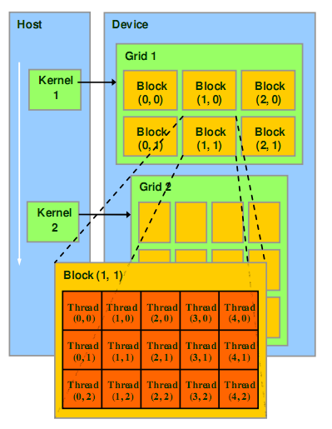
OpenCL and CUDA
Recall CUDA:
Image from: http://courses.engr.illinois.edu/ece498/al/textbook/Chapter2-CudaProgrammingModel.pdf

Slide 34
OpenCL and CUDA
In OpenCL:
get_global_size(0)
Index Space
get_local_size(0)
Work Group
(0, 0)
Work Group
(1, 0)
Work Group
(2, 0)
Work Group (0,0)
get_
global_
size(1)
Work
Item
(0, 0)
Work
Item
(1, 0)
Work
Item
(2, 0)
Work
Item
(3, 0)
Work
Item
(4, 0)
Work Group
(0, 1)
Work Group
(1, 1)
Work Group
(2, 1)
get_
local_
size(1)
Work
Item
(0, 1)
Work
Item
(1, 1)
Work
Item
(2, 1)
Work
Item
(3, 1)
Work
Item
(4, 1)
Work
Item
(0, 2)
Work
Item
(1, 2)
Work
Item
(2, 2)
Work
Item
(3, 2)
Work
Item
(4, 2)

Slide 35
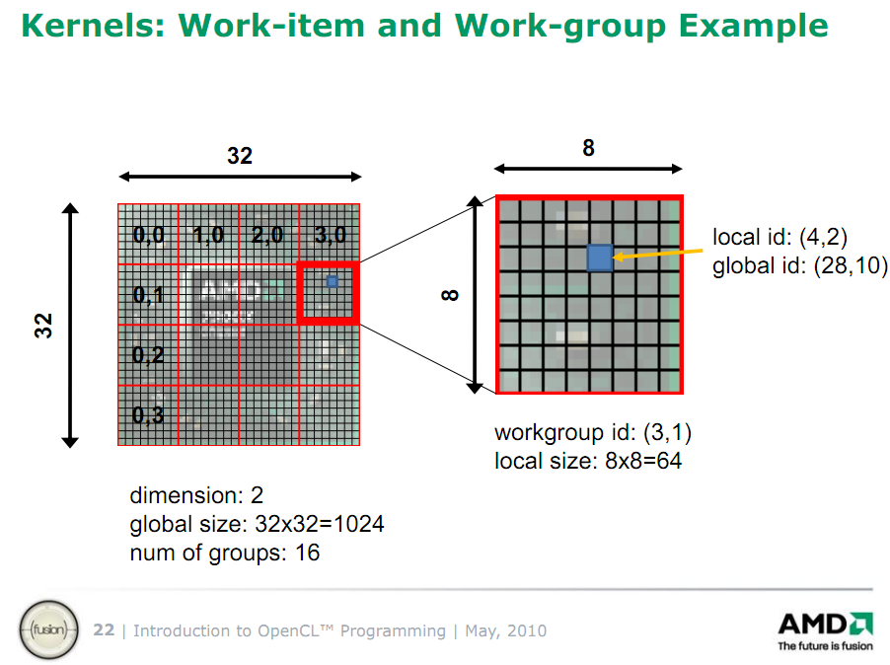
Image from http://developer.amd.com/zones/OpenCLZone/courses/pages/Introductory-OpenCL-SAAHPC10.aspx

Slide 36
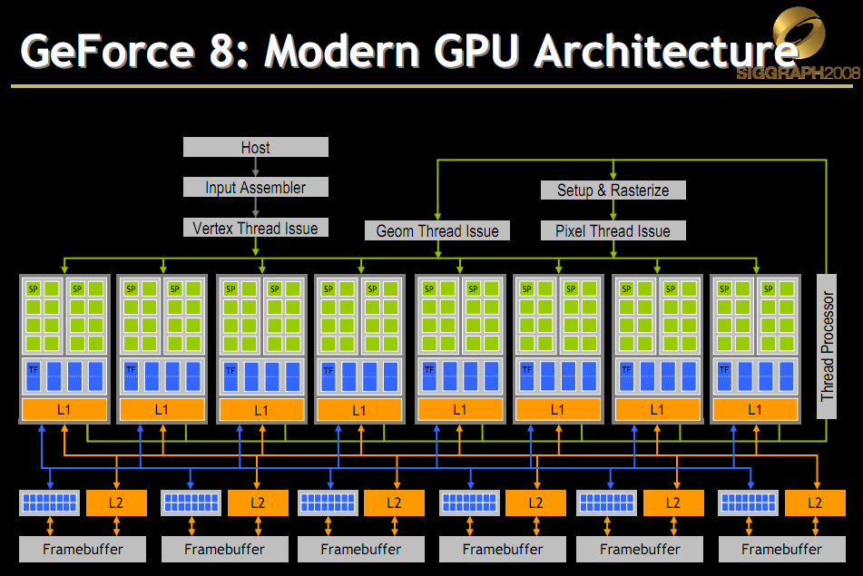
OpenCL and CUDA
Mapping to NVIDIA hardware:
Image from http://s08.idav.ucdavis.edu/luebke-nvidia-gpu-architecture.pdf

Slide 37
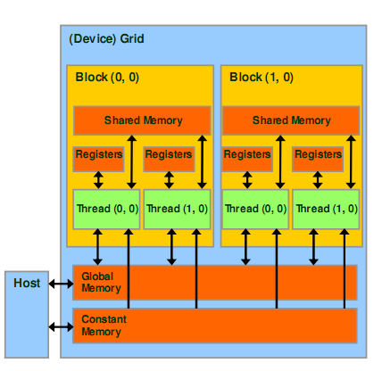
OpenCL and CUDA
Recall the CUDA memory model:
Image from: http://courses.engr.illinois.edu/ece498/al/textbook/Chapter2-CudaProgrammingModel.pdf

Slide 38
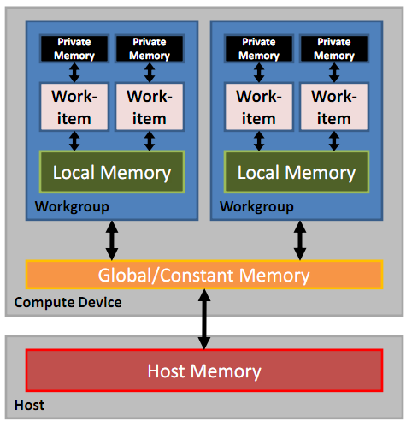
OpenCL and CUDA
In OpenCL:
Image from http://developer.amd.com/zones/OpenCLZone/courses/pages/Introductory-OpenCL-SAAHPC10.aspx

Slide 39
OpenCL and CUDA
CUDA | OpenCL
Global memory | Global memory
Constant memory | Constant memory
Shared memory | Local memory
Local memory | Private memory

Slide 40
OpenCL and CUDA
CUDA | OpenCL
__syncthreads() | __barrier()
Both also have Fences
  In CL
    mem_fence()
    read_mem_fence()
    write_mem_fence()
Notes:
Compiler may reorder memory reads/writes to better exploit local (shared) and global memory

Slide 41
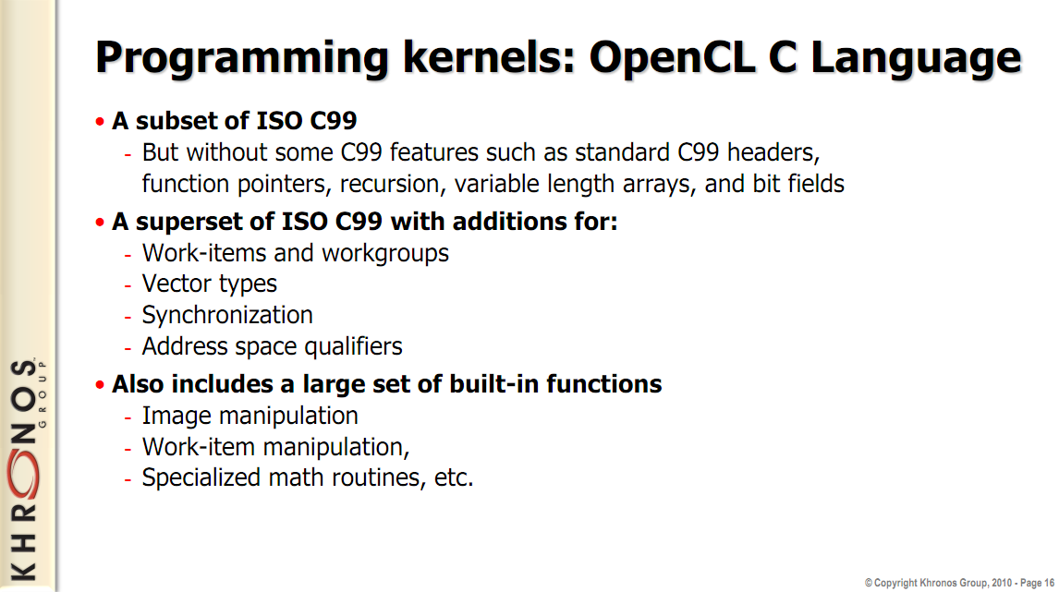
Image from: http://www.khronos.org/developers/library/overview/opencl_overview.pdf

Slide 42
OpenCL and CUDA
In OpenCL:
__kernel void vecAdd(__global const float *a, __global const float *b, __global float *c)
{
int i = get_global_id(0);
c[i] = a[i] + b[i];
}

Slide 43
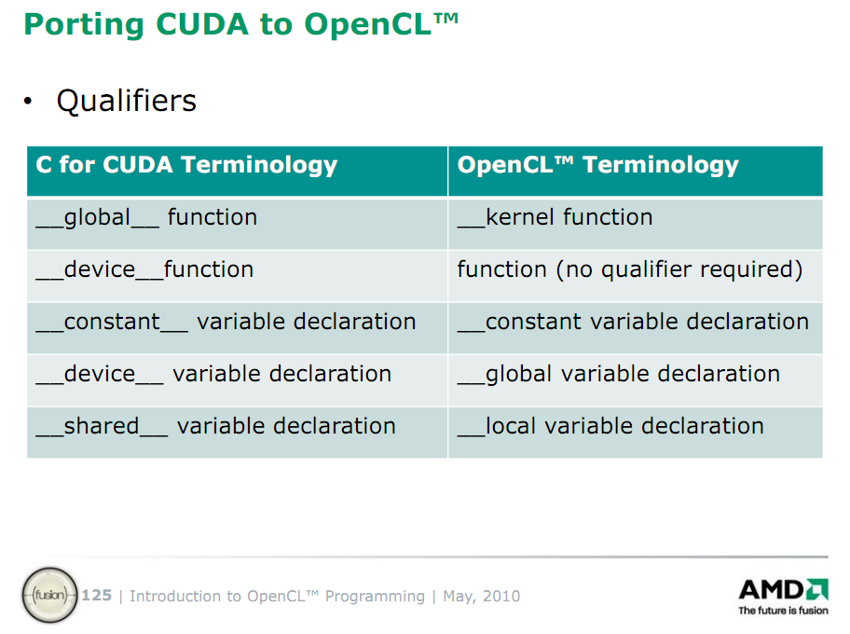
Slide from: http://developer.amd.com/zones/OpenCLZone/courses/pages/Introductory-OpenCL-SAAHPC10.aspx

Slide 44
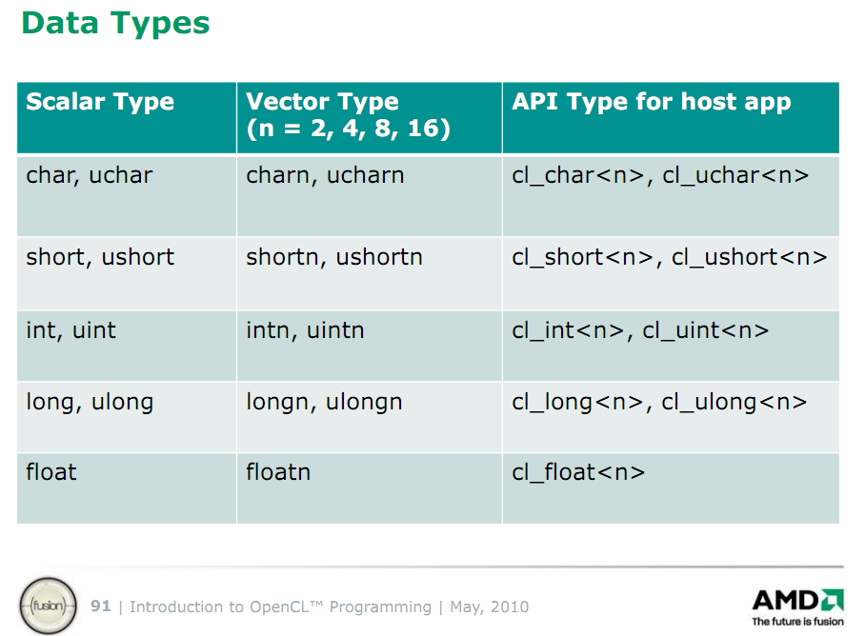
Slide from: http://developer.amd.com/zones/OpenCLZone/courses/pages/Introductory-OpenCL-SAAHPC10.aspx

Slide 45
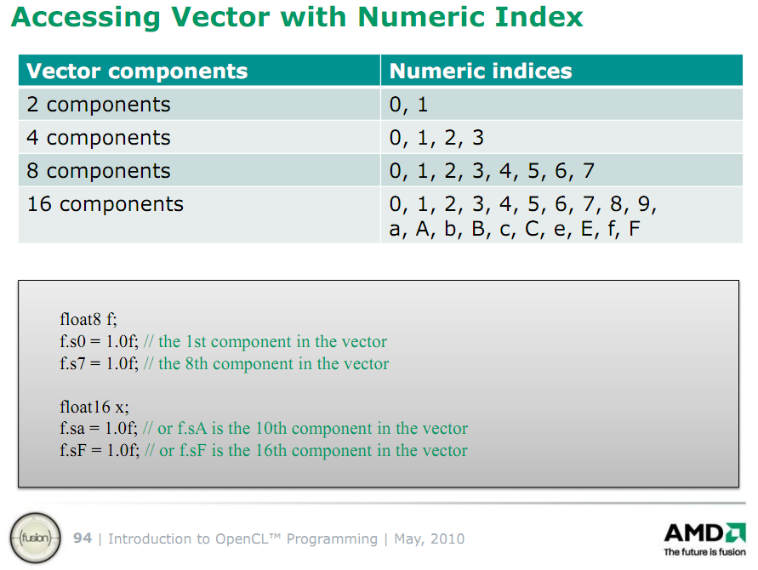
Slide from: http://developer.amd.com/zones/OpenCLZone/courses/pages/Introductory-OpenCL-SAAHPC10.aspx

Slide 46
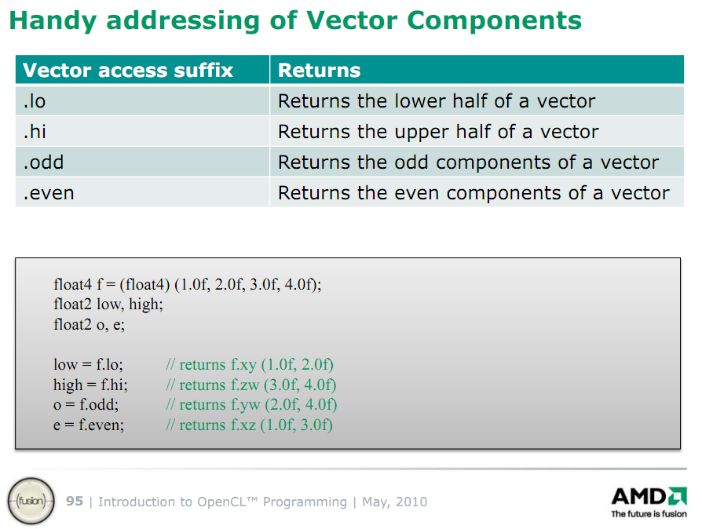
Slide from: http://developer.amd.com/zones/OpenCLZone/courses/pages/Introductory-OpenCL-SAAHPC10.aspx

Slide 47
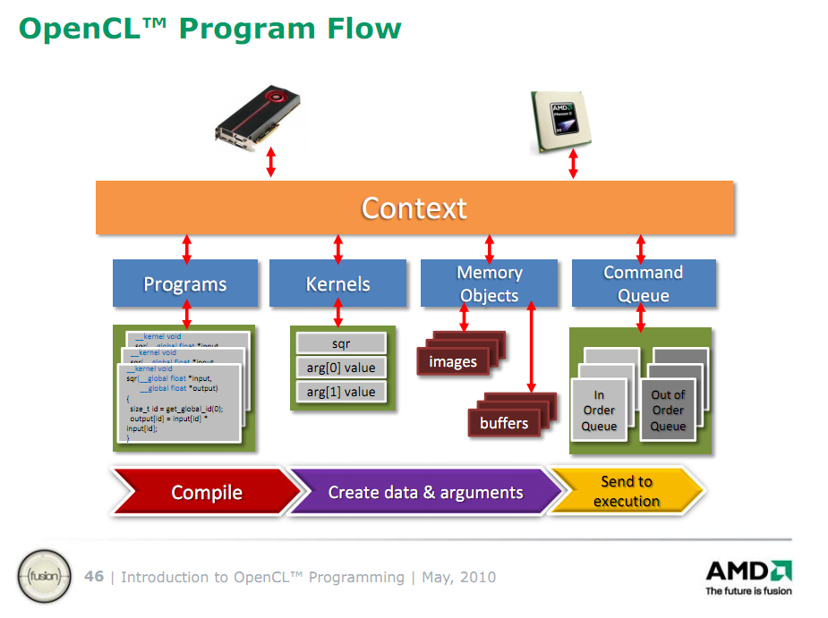
Slide from: http://developer.amd.com/zones/OpenCLZone/courses/pages/Introductory-OpenCL-SAAHPC10.aspx

Slide 48
OpenGL
Shader Programs
OpenGL
Buffers
CUDA
Streams
Slide from: http://developer.amd.com/zones/OpenCLZone/courses/pages/Introductory-OpenCL-SAAHPC10.aspx

Slide 49

Sources
Sutter, Herb. The Free Lunch is Over: A Fundamental Turn Toward Concurrency in Software.March 30, 2005. <http://www.gotw.ca/publications/concurrency-ddj.htm>.
Takizawa, Hiroyuki and Kobayashi, Hiroaki. Hierarchical parallel processing of larg scale data clustering on a PC cluster with GPU co-processing. Soringer science 2006.
Nickson, Christopher. HPC Wire. Apple Planning Snow Leopard Surprise?. Degital Trends - Computing News. Dec 18th, 2008. <http://news.digitaltrends.com/news-article/18693/apple-planning-snow-leopard>.
HPC Wire. OpenCL makes it Official. Dec 9th, 2008. <http://www.hpcwire.com/blogs/OpenCL-Makes-It-Official-35841524.html>.
HPC Wire. OpenCL on the Fast Track. Nov 4th, 2008. <http://www.hpcwire.com/blogs/OpenCL_On_the_Fast_Track_33608199.html>.
West, John. OpenCL: To GPGPU and Beyond. HPC Wire. Dec 11th, 2008. <http://www.hpcwire.com/features/OpenCL-To-GPGPU-and-Beyond-36016144.html>.
Wolfe, Michael. Compilers and More: A GPU and Accelerator Programming Model. HPC Wire. Dec 9th, 2008. <http://www.hpcwire.com/specialfeatures/sc08/features/Compilers_and_More_A_GPU_and_Accelerator_Programming_Model.html?viewAll=y>.
McCool D, Michael and Du Toit, Stefanus. OpenCL Updates. HPC Wire. Nov 21st, 2008. <http://www.hpcwire.com/specialfeatures/sc08/features/OpenCL_Update_34860779.html>.

